Slide 1

Soccer Score Predictor

Slide 2
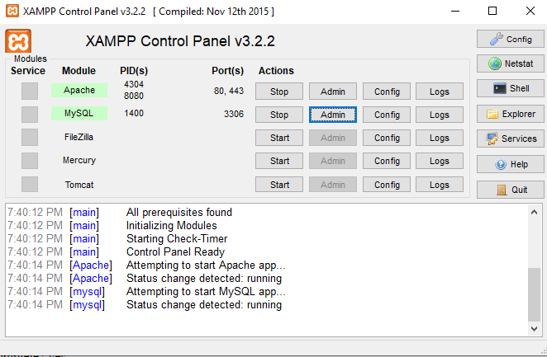
Setup Step #1: Start MySQL + Apache

Slide 3
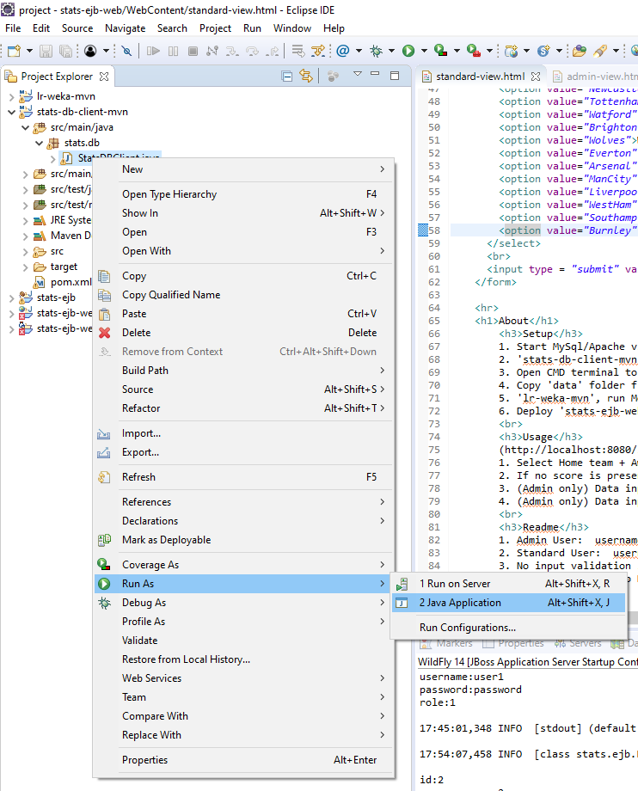
Setup Step #2: Set up MySQL tables + users

Slide 4
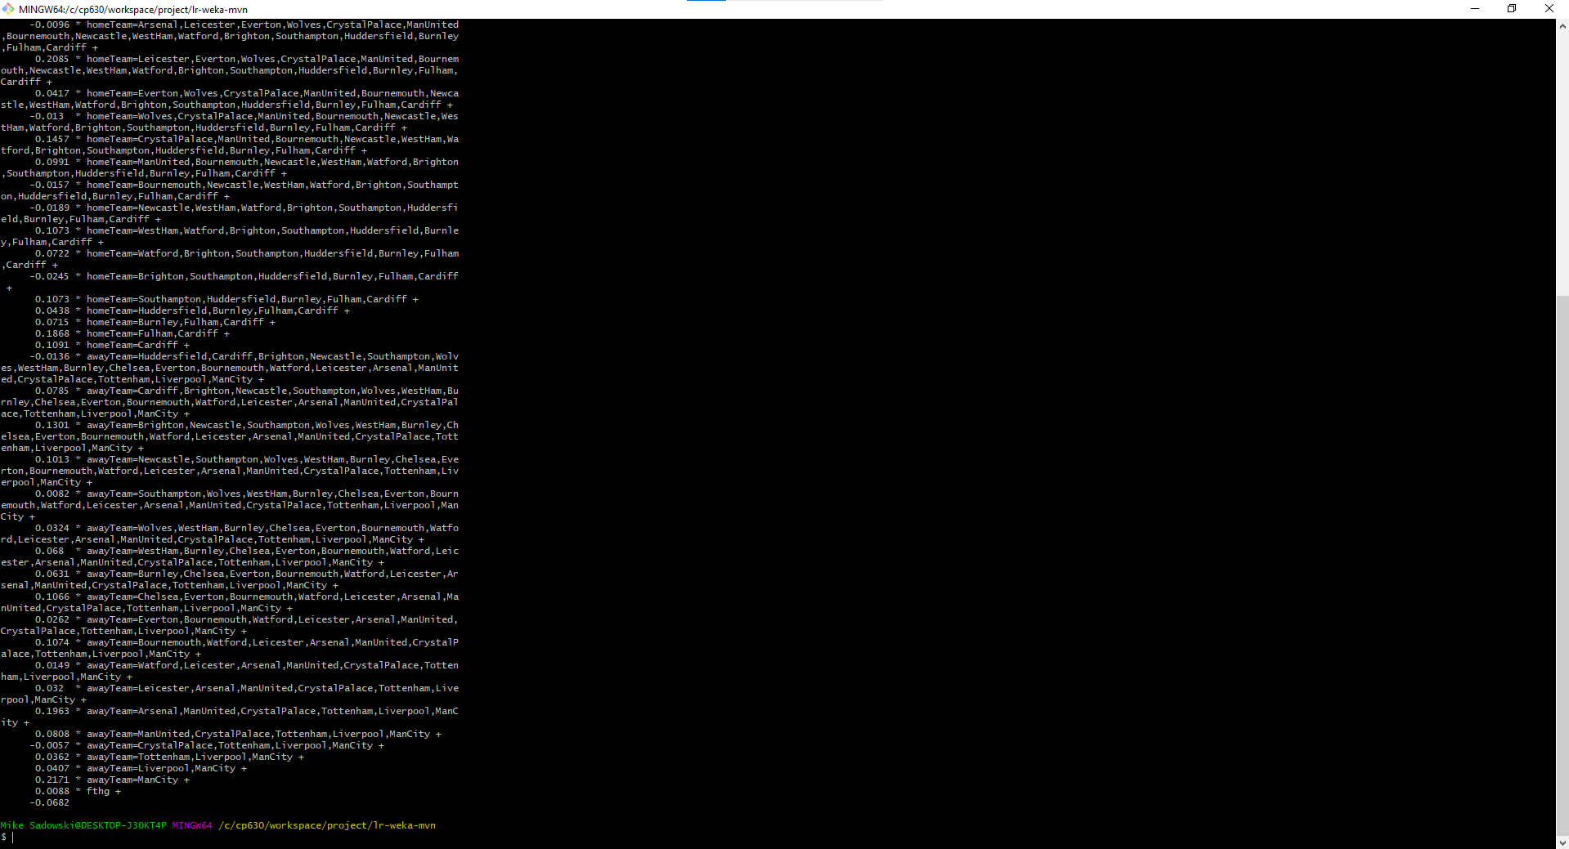
Setup Step #3: Train models via WEKA

Slide 5
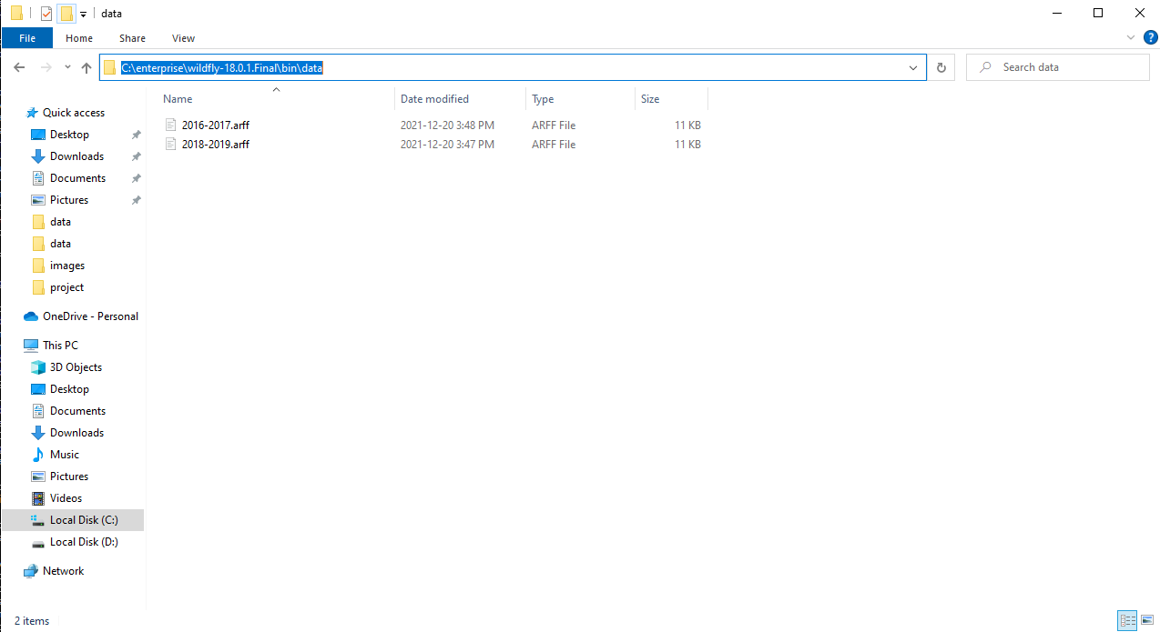
Setup Step #4: Set up data folder

Slide 6
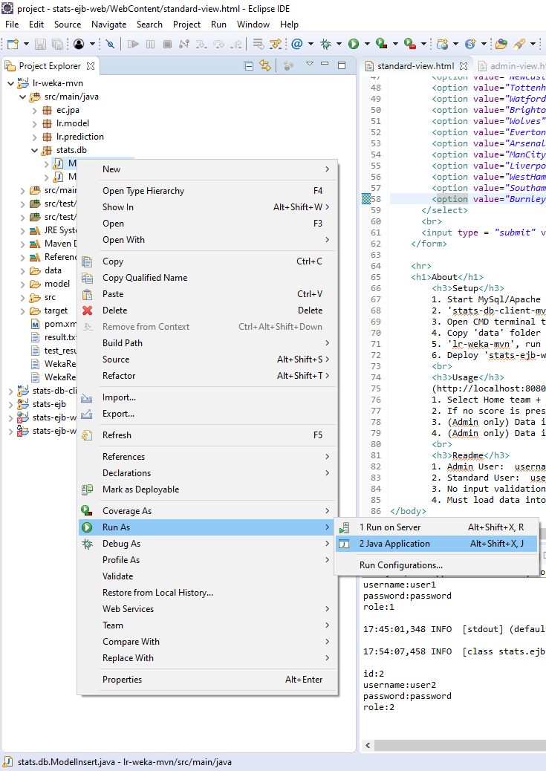
Setup Step #5: Insert model to MySQL

Slide 7
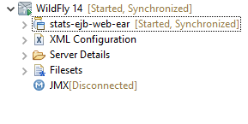
Setup Step #6: Deploy

Slide 8
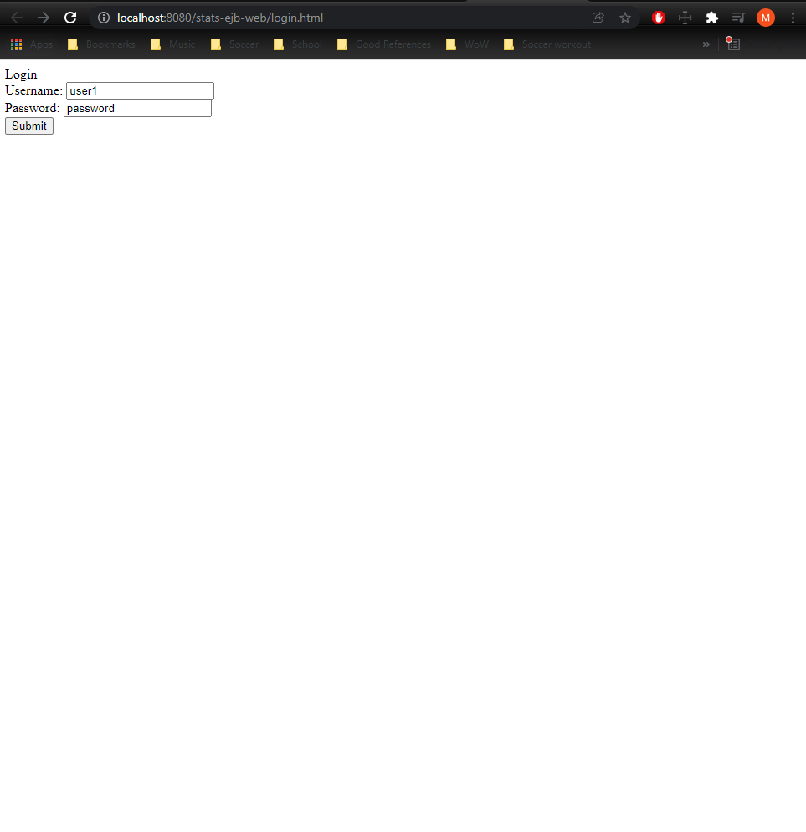
Usage: Login (username=user1 or user2, password=password)

Slide 9
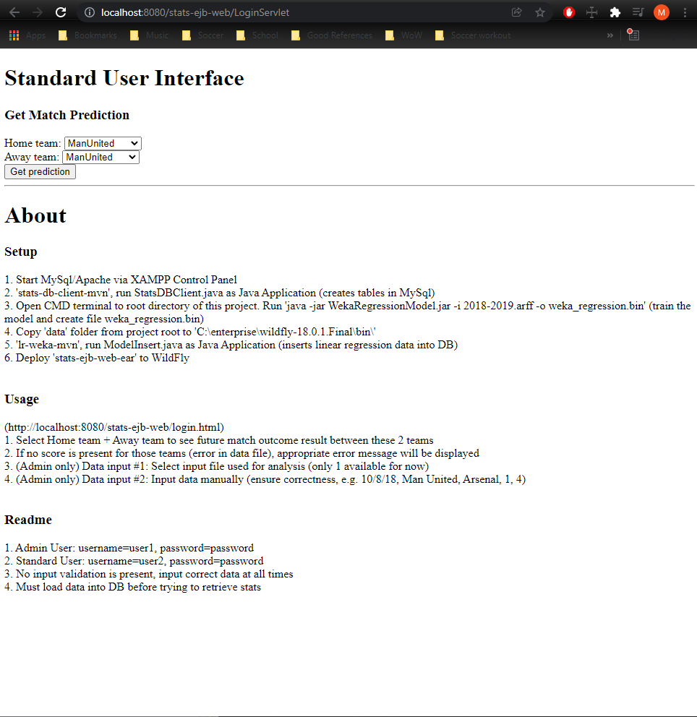
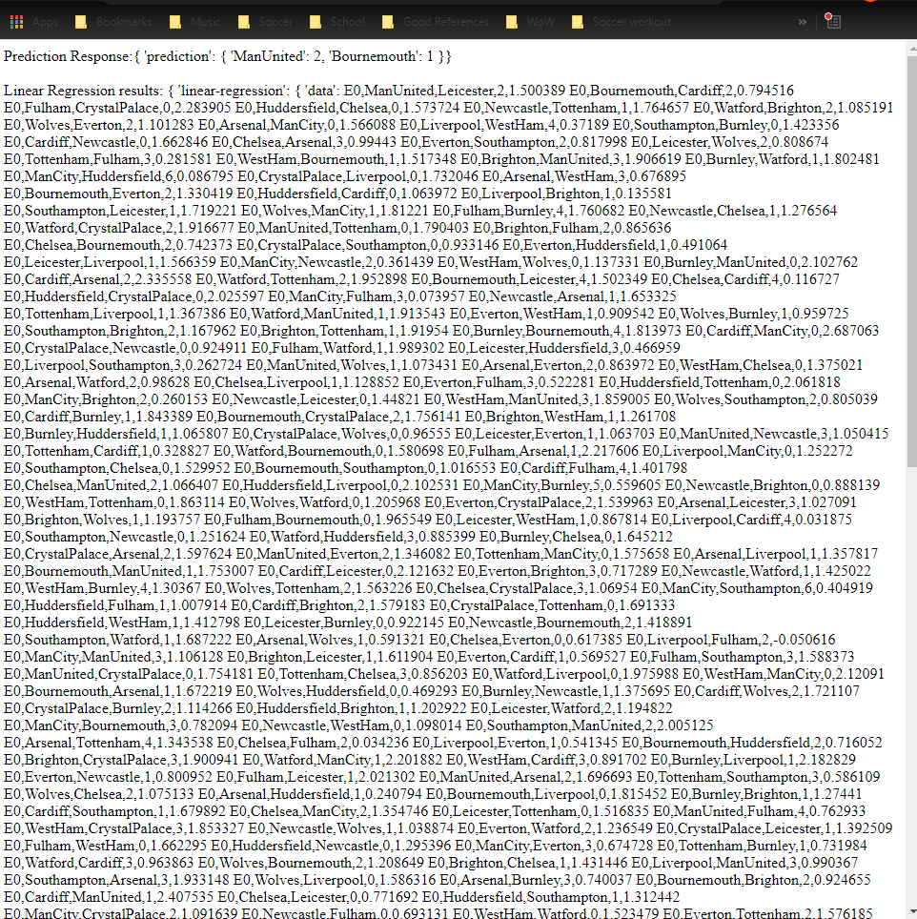
Standard User Interface:
Standard users can input 2 teams to get a future match result prediction
Standard Users can see the about me section

Slide 10
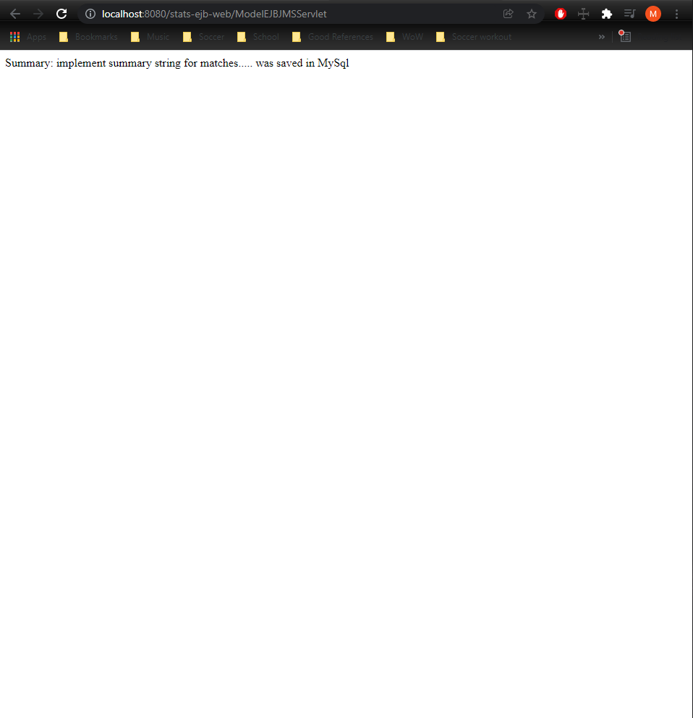
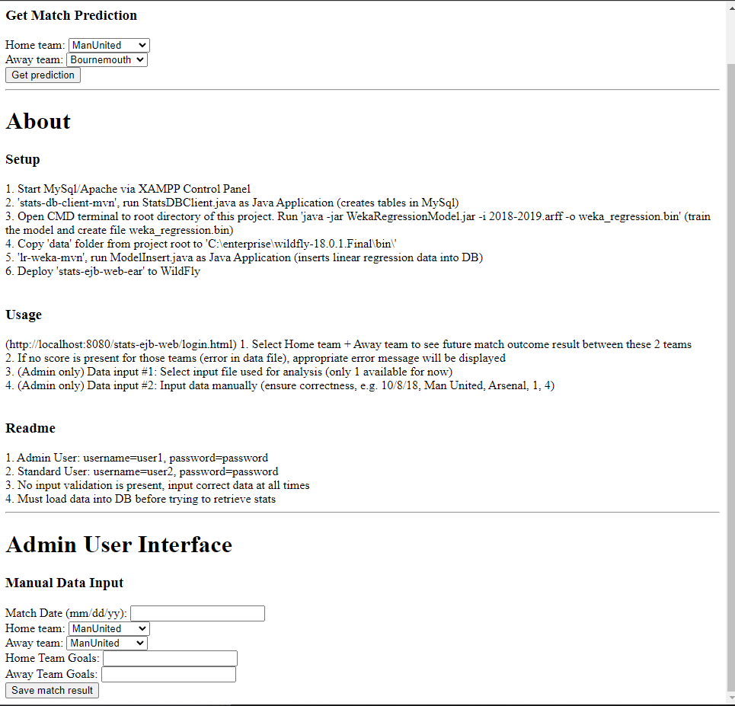
Admin User Interface
Admin users can input 2 teams to get a future match result prediction
AdminUsers can see the about me section
Admin users can manually input scores of games, to be used later in the linear regression/prediction

Slide 11
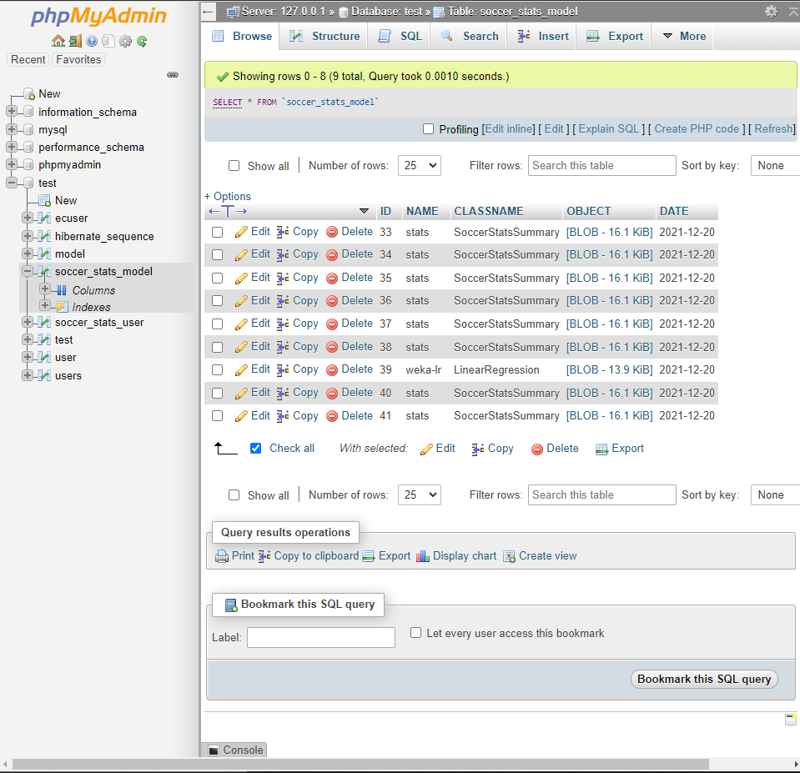
Data persistence
All data is stored in MySQL

Slide 12
README
1. Admin User: username=user1, password=password 2. Standard User: username=user2, password=password 3. No input validation is present, input correct data at all times 4. Must load data into DB before trying to retrieve stats

