Slide 1
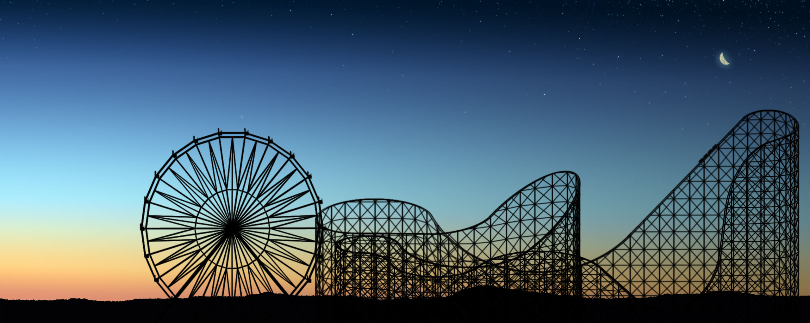
Roller Coaster Creator
Julia Gensheimer and Valerie Richmond

Slide 2
Project Description
Interactive game using Mathematica
Customizable 2D and 3D roller coaster
See cart run along track according to laws of physics
Coin collection and levels
Notes:
General project description—tell what our project is and does.

Slide 3
First, a demonstration…
Please, buckle your seat belts
Lower the safety bar slowly and securely
Keep you hands and feet inside the cart at all times
Notes:
Demo code here. Be sure to show: track restrictions and red flash of lines if you try to click play, message if you don’t get enough coins and lose an attempt, customization factory, other obvious stuff.

Slide 4
How did we do this?
Adjustable track
Moving cart
Buttons to change track
Physics
Level system
Graphics
Notes:
“We knew we needed…” Explain general approach.

Slide 5
Making the Track: Splines
High-degree polynomials are bad!
Needed natural cubic splines for a smooth track
Creates a cubic curve through every two points
Reference: The natural cubic spline
From: Calculus and Mathematica
Authors : Bill Davis, Horacio Porta and Jerry Uhl ©1999

Slide 6
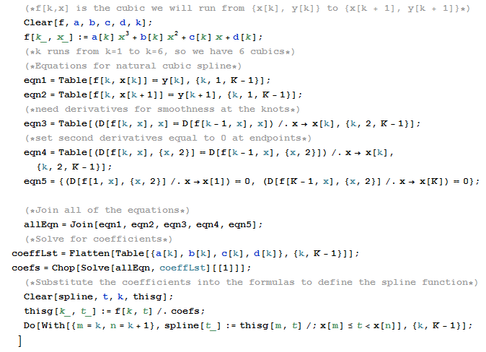
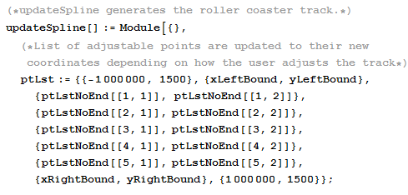
Making the Track: 2D Splines
That’s a lot of math!
SPLINES IN A NUTSHELL:
Differentiate various equations and solve for coefficients to get a piecewise defined function.

Slide 7
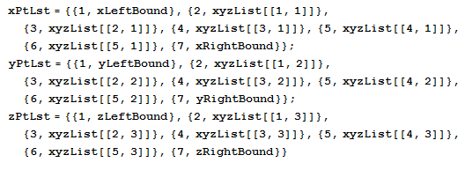
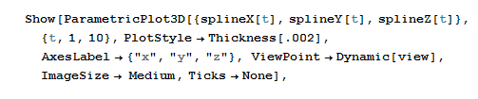
Making the Track: 3D Splines
Given a list of (x, y, z) points to split into three lists
Use Parametric Plot to combine the three functions

Slide 8


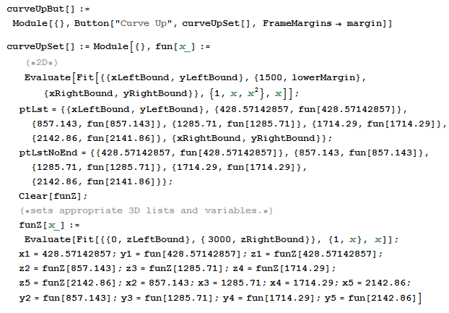
Adjusting the Track
Locators
Dynamically update list of points
Different lists for 2D and 3D—still connected
Track Options Buttons
Have predefined list of points
Sinoid, Curve Up, Curve Down, Line, Random
Can still be adjusted
Notes:
“How do we get the points to give the spline function?” –add code snippets here for track options

Slide 9
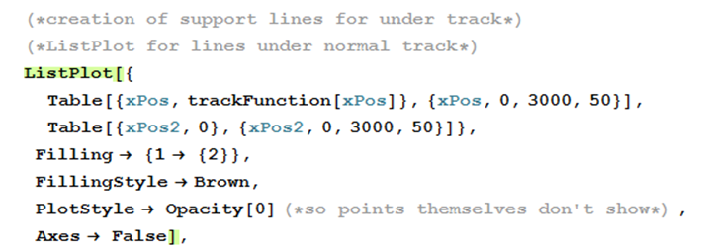
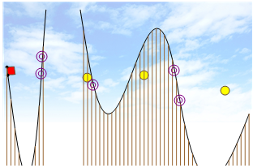
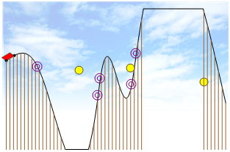
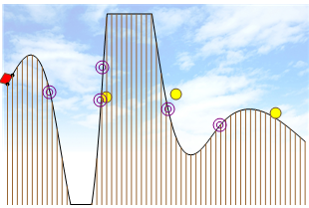
Making the Track: Support Lines and Track Restrictions
No Fill Option ->ListPlot Fill
Loop to find x values of points off of the screen
Algorithm to find the range of points off the screen
Make a list of lines
Add to support line list points on the line

Slide 10
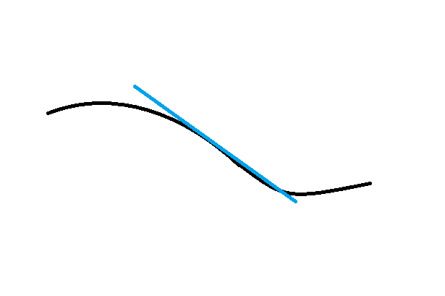
Moving the Cart
3D TRACK
2D TRACK
Same principle
Physics extended to the z dimension
X Position variable dynamically updated
Other three points of the polygon cart are determined based on the slope of the tangent line and triangle trig
Variable is not updated continuously but rather according to its current speed
Notes:
Briefly discuss cart math and how we approached this—both 2D and 3D.
-do example to get the second base point of the cart for negative slope

Slide 11
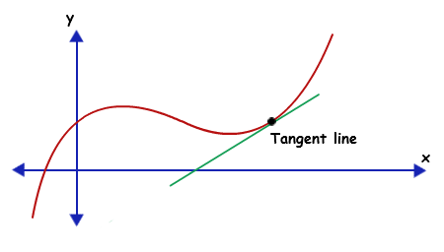
Roller Coaster Physics 101
Newton’s Second Law: F = ma
Free-Body Force diagrams
derive
derive
ACCELERATION
DISTANCE
VELOCITY
integrate
integrate

Slide 12
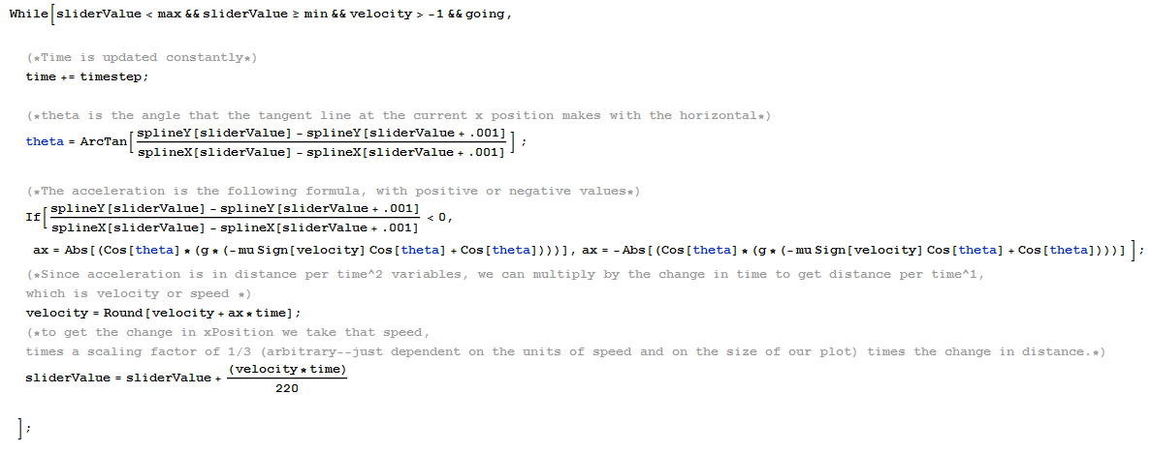
Moving the Cart: Physics
Notes:
Can either have one slide or two for this information—will need to talk a lot about physics

Slide 13
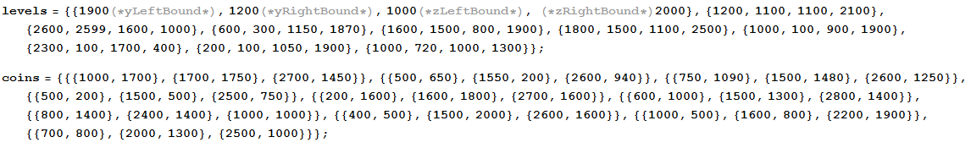
Levels
Hardcoded list of start and endpoints for each level
Endpoint variables, the adjustable point locations, the coins, and the level number display are updated every time a new level is reached
Two chances to pass each level
Advance to Next Level?
Velocity never negative
Track never outside screen
Collected at least the minimum number of coins to advance (changes each level)
Notes:
-hardcoded list of start and endpoints for each of our 10 levels; pictures of code…explain why no x Values, coins3D list also
-resetLevel[] updates: 1) level number display, 2) the endpoint variables so there is a different goal, and 3) the adjustable points so that they are in a line between the new start and end points…and 4) changes coins which we’ll discuss later
-You pass the level if during the run you never had a negative velocity (which would move you away from the endpoint), never made the track move outside the screen (in which case you would lose any points from the partial run and would have to restart the level), and you have collected in the past levels the minimum number of coins needed

Slide 14
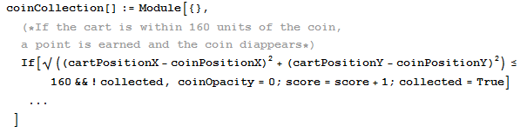


Coin Collection
Disks or Spheres
Reset every Level
Notes:
-here’s what a coin is in the code. Explain…and offset… say is also why cart doesn’t always look perfectly rectangular
-3 per each level
-coin collection only for 2D
-not actual code…actual variables (list name and part specification which would indicate which coin in which level we are testing)
-explain collected variable… are reset
-Code repeated for each of the three coins per level
-

Slide 15
Questions? Comments?

