Slide 1
Existing Model
VanderPal (2015) developed a linear regression model on the impact of R&D Expenses and Corporate Financial Performance (focus on revenue, equity, and assets.).
Dataset: sample of 103 companies which registered high values of R&D, between 1979 and 2013.
Finds positive linkage between R&D spending and revenue growth
Discover impact of R&D investments two times higher on market capitalization compared to investments in tangible assets

Slide 2
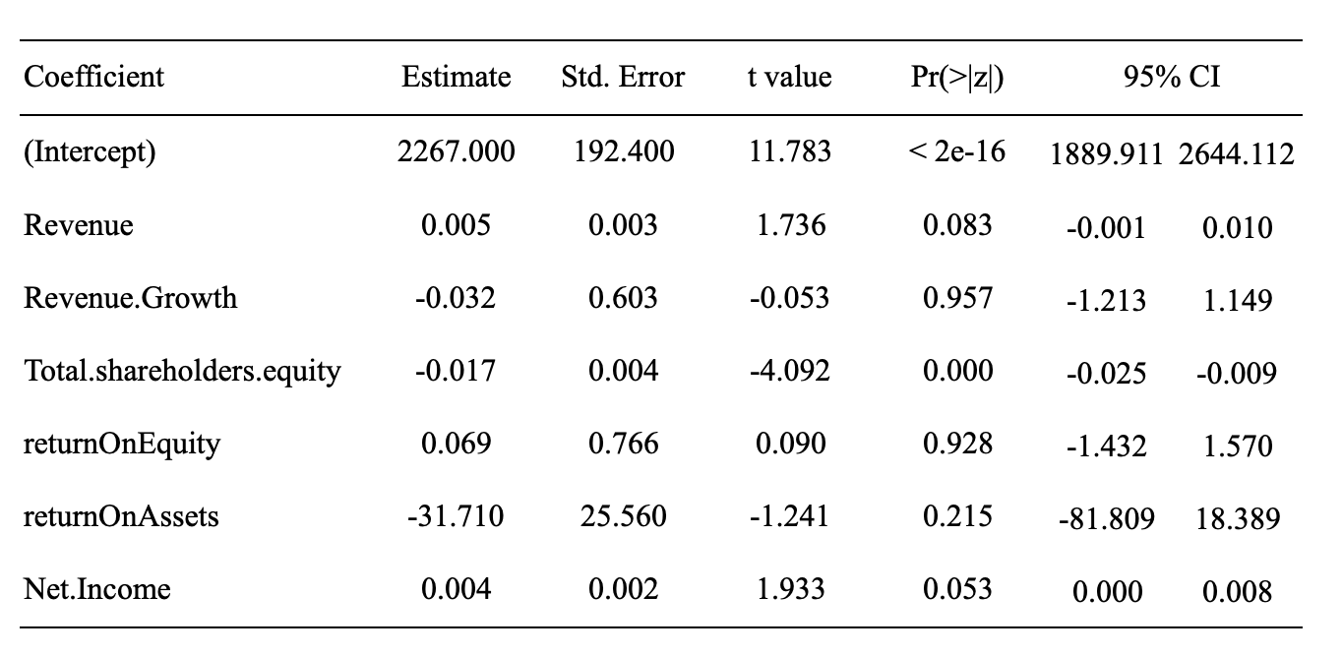
Existing Model on Our Dataset
Significant, but negative coefficient for total equity.
No significant relationship for Revenue Growth
Multiple R-squared: 0.0012, Adjusted R-squared: 0.0009
Not a good model for our dataset.

Slide 3
Developing New Model
Apply machine learning techniques to reduce dimensionality
Principal Component Analysis (PCA)
Least Absolute Shrinkage and Selection Operator (LASSO)
Construct PCs/select variables to put into our regression model with the same dependent variable

Slide 4
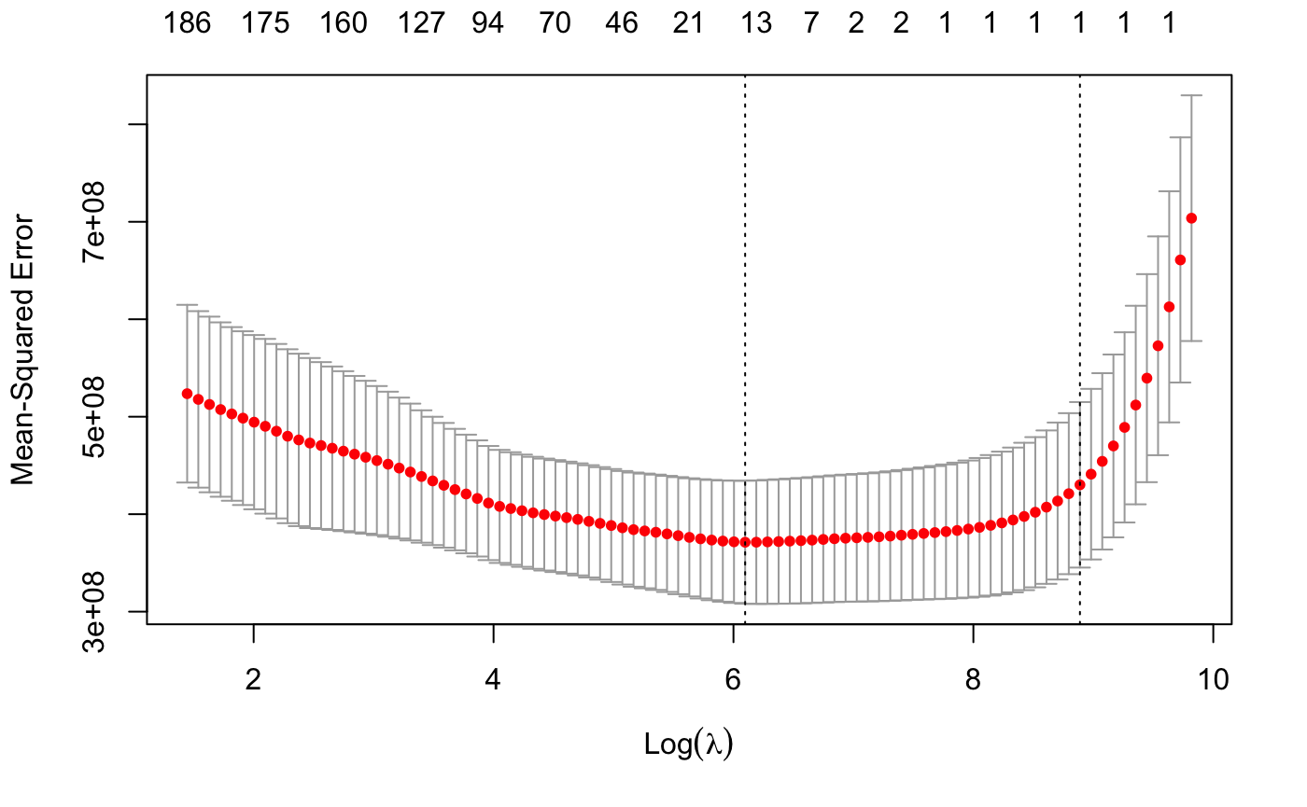
LASSO
Find the best model by minimizing mean squared error.
The results are generated through cross-validation.
Best model contains about 13 variables

Slide 5
LASSO Model Comparisons
Full model vs Reduced model
Full model has 14 variables, reduced model removes insignificant variables out of those 14.
 | Full Model | Reduced Model
Multiple R-squared | 0.03202 | 0.03224
Adjusted R-squared | 0.03133 | 0.03190

Slide 6
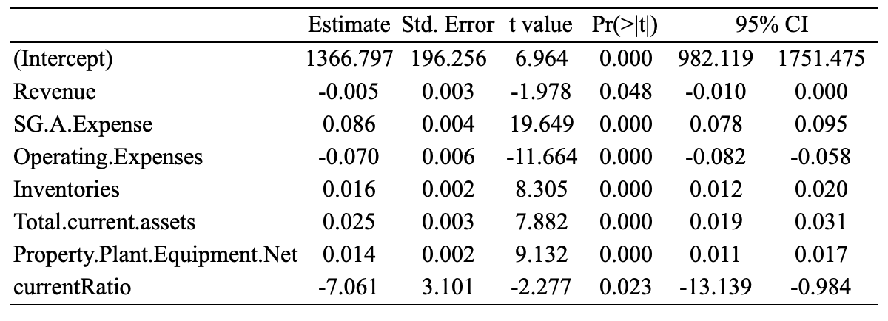
LASSO Suggested Model
This model contains only significant variables
Revenue turns out have a negative relationship with R&D expenses

Slide 7
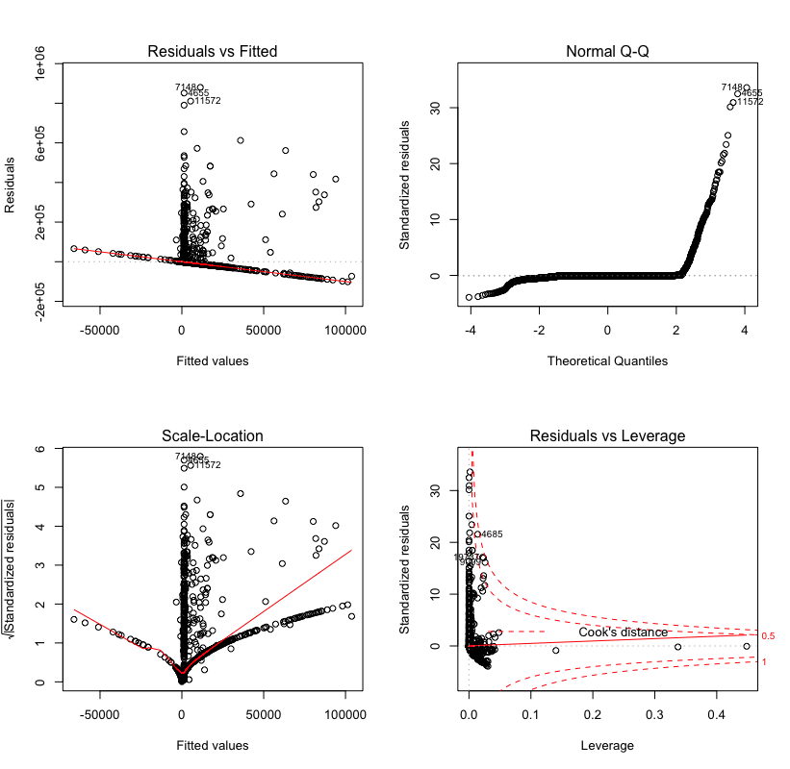
LASSO Suggested Model
The residual plots look very similar to the ones from PCA
This leads us to confirm the existence of outliers which is significantly affecting our model.

