Slide 1
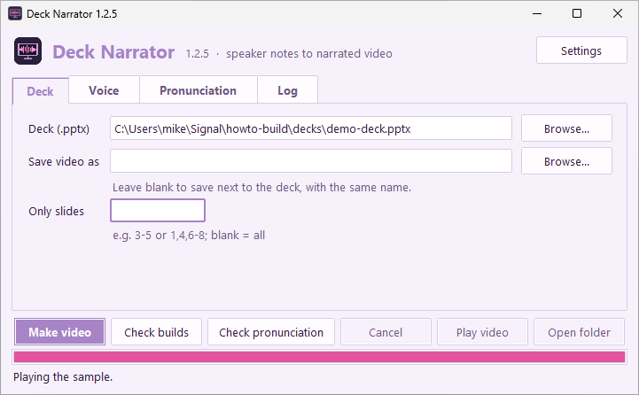
Deck Narrator
Speaker notes in.
Narrated video out.
A tour of version 1.2.5 for Windows
Notes:
Welcome to Deck Narrator. It turns a PowerPoint deck into a narrated video, and the speaker notes are the script. There's no recording, no microphone, and no account, and everything runs on your own computer. By the way, this video was made by Deck Narrator, from this deck, so every voice you hear is the app itself. Let's take the tour.

Slide 2
How it works
1
2
3
Write the script
Pick a voice
Make video
Type what should be said in each slide's speaker notes.
More than two dozen natural voices, at any speed.
Each slide is drawn, its notes are spoken, and it all becomes one MP4.
Notes:
Here's the whole idea, in three steps. [click] First, you write what you want said in each slide's speaker notes. [click] Second, you pick a voice. [click] And third, you press Make video. Deck Narrator draws every slide, speaks its notes, and joins it all into one video file, ready to share.

Slide 3
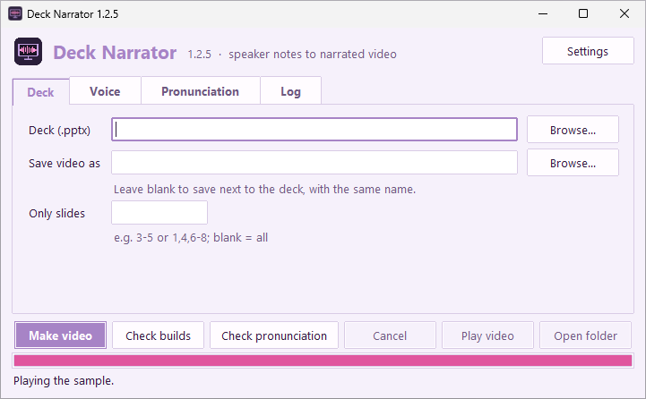
Install and open it
1
Download the installer from the Releases page on GitHub.
2
Run it. The voices are included, so nothing else is downloaded.
3
Open Deck Narrator from the Start menu.
Notes:
To get started, [click] download the installer from the project's Releases page on GitHub. [click] Run it. The voices come included, so there's nothing else to download. [click] Then open Deck Narrator from the Start menu. It opens on the Deck tab.

Slide 4
The Deck tab
Deck: the .pptx to narrate.
Save video as: blank saves it next to the deck.
Only slides: like 3-5, or 1,4,6-8.
Notes:
Every video starts on the Deck tab. Choose your deck with Browse, or paste its path. [click] Here's one chosen: a small demo deck that comes with Deck Narrator. Save video as is optional. Leave it blank, and the video is saved next to the deck, with the same name. Only slides makes a video of just part of the deck, like slides three to five. Hidden slides are always skipped.

Slide 5
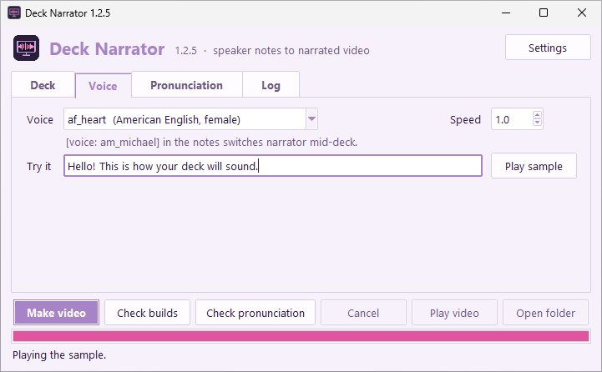
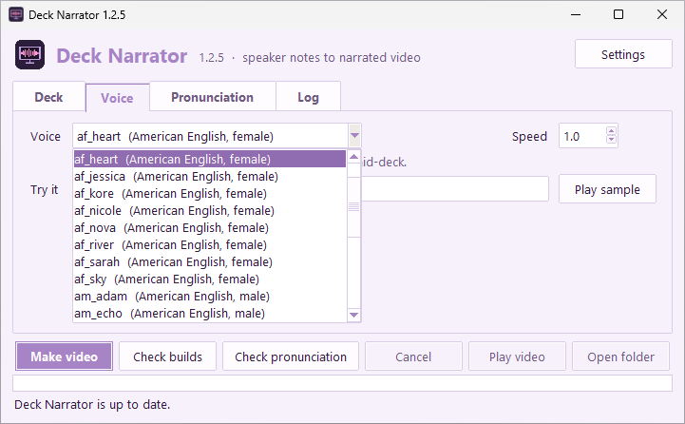
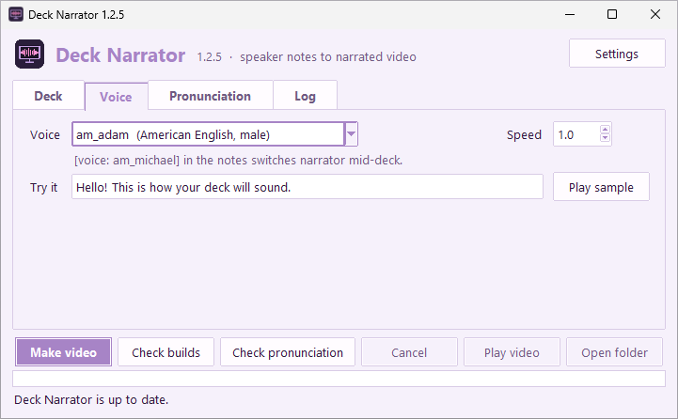
Choose a voice
a = American, b = British; then f or m.
Speed: 1.0 is normal; 1.1 is a little brisker.
Narrators can change mid-deck, too.
Notes:
On the Voice tab, you pick the narrator. [click] Open the list, and there are more than two dozen voices. Each name starts with a for American, or b for British, then f or m. The default is Heart, the voice you're hearing now. [click] Here, I've picked Adam. [voice: am_adam] Hi, I'm Adam, one of the American male voices. [voice: bf_emma] And I'm Emma, one of the British voices. [voice: am_michael] And I'm Michael. We can take turns in one video, as you'll see. [voice: default] Thanks, everyone.

Slide 6
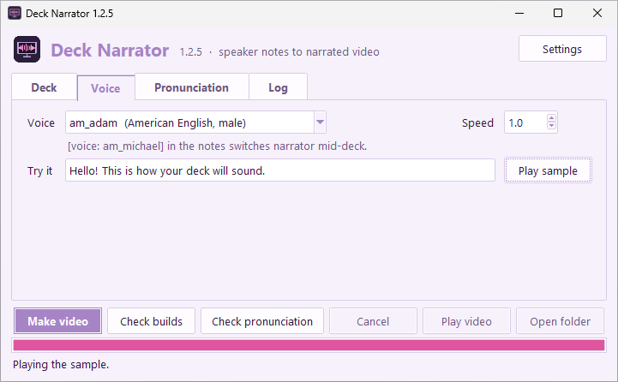
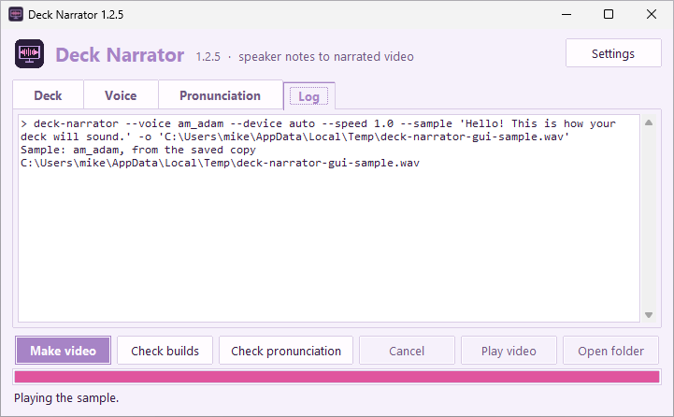
Play sample
Type anything in Try it, then press Play sample.
The built-in sentence is instant, in every voice.
Notes:
To hear a voice before you use it, type anything in Try it, and press Play sample. The built-in sentence, Hello! This is how your deck will sound, plays instantly, in every voice, because the installer comes with those already recorded. [click] The Log tab confirms it, with the words: from the saved copy.

Slide 7
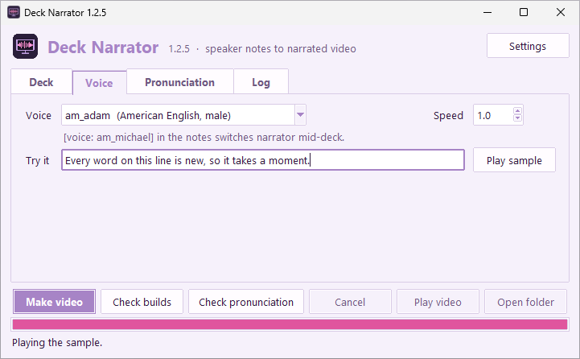
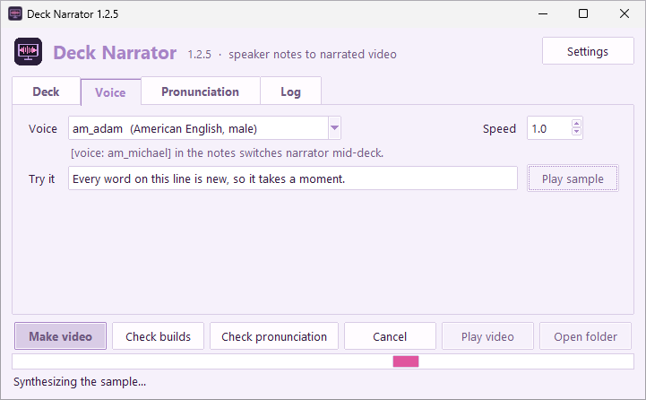
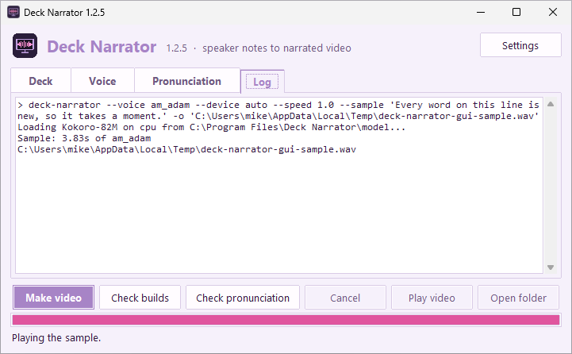
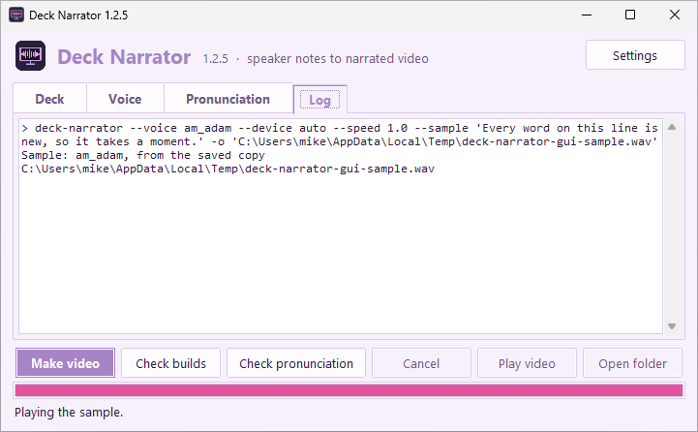
Your own sentence
New text is made the first time: a few seconds.
After that it's saved, so it's instant.
The newest 200 samples are kept.
Notes:
A sentence of your own is new. [click] So the first time, it's synthesized, which takes a few seconds on an ordinary processor. You can see Synthesizing the sample, at the bottom. [click] When it's done, the log says how long the sample is. [click] Press Play sample again, and it's instant: from the saved copy. Deck Narrator keeps the newest two hundred samples.

Slide 8
Writing the script
The speaker notes are read word for word. Punctuation sets the pace.
[click]
reveals the slide's next animation, as the narration reaches it.
[voice: bf_emma]
switches narrator. [voice: default] switches back.
[present](/pɹizˈɛnt/)
sets how one word is said, with phonemes.
Notes:
The speaker notes are the script, word for word, and punctuation sets the pace: a comma is a short pause, and a period a longer one. Three kinds of square brackets do something special. [click] A click marker reveals the slide's next animation, right when the narration gets to it. That's how these boxes are appearing now. [click] A voice marker switches narrator. [voice: bf_emma] Like this. I'll keep talking until someone switches back. [voice: default] [click] And a word in brackets, followed by its phonemes in parentheses, sets how that one word is said. You'll rarely type those yourself: Check pronunciation writes them for you. Any other bracketed note, like pause, or laughs, is simply skipped, so notes you wrote for presenting live still work.

Slide 9
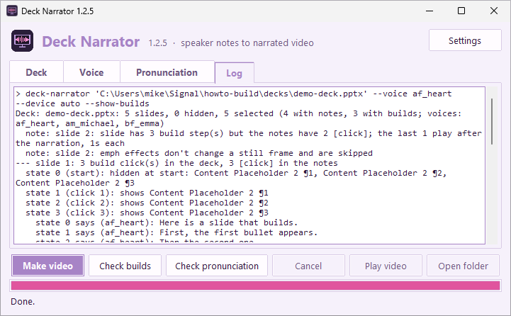
Check builds
Every build state of every slide.
What appears at each click.
Exactly which words are spoken over it.
Notes:
Before you make the video, Check builds shows how your click markers line up with the deck's animations. For every slide, it lists each build state, what appears at each click, and exactly which words are spoken while it's on screen. If the counts don't match, it says what will happen, so there are no surprises.

Slide 10
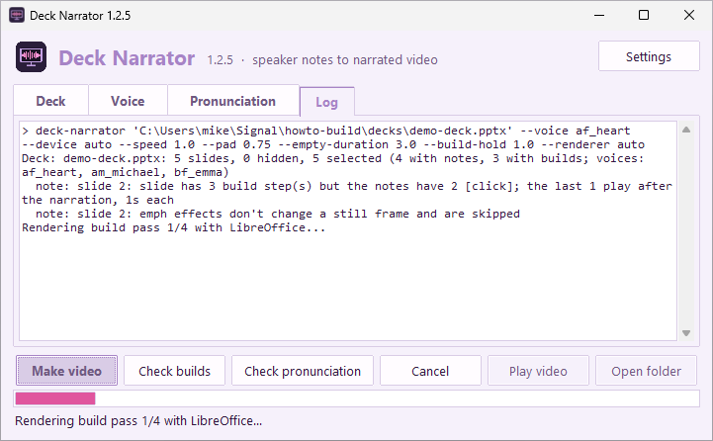
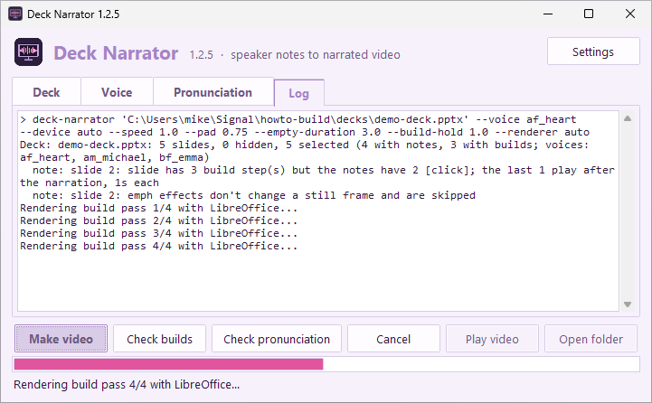
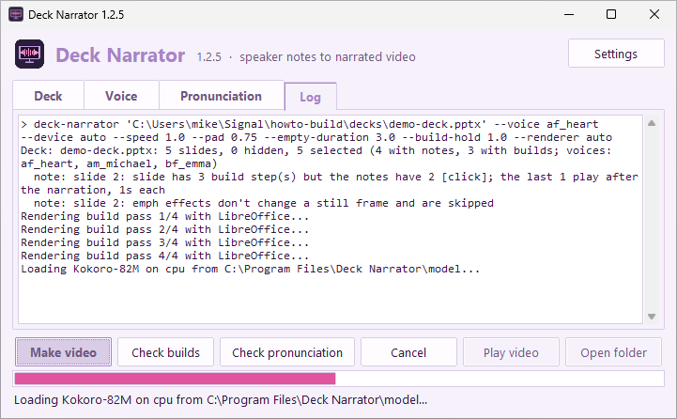
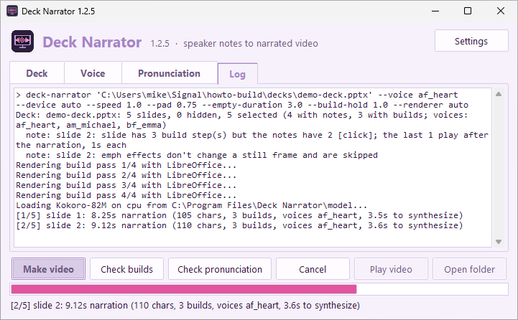
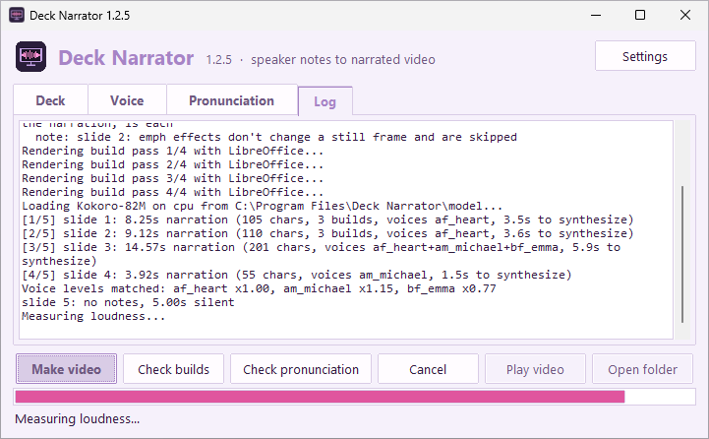
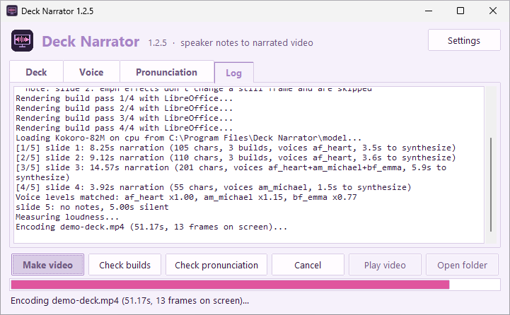
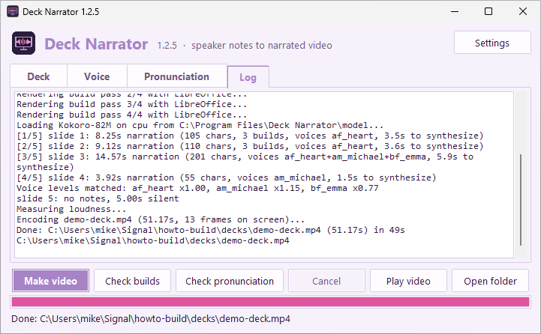
Make video
The Log tab shows every step.
Watch the progress bar and the status line.
Under a minute for this deck, on a 4-core CPU.
Notes:
Press Make video, and the Log tab shows each step. First, the slides are drawn, once for each build state. [click] All four passes done. [click] Next, the voice model loads. [click] Then each slide's narration is spoken, one slide at a time, with the progress bar moving along. [click] The voices' loudness is measured and matched, [click] and the video is encoded. [click] Done. This five slide demo deck took under a minute, with no graphics card at all.

Slide 11
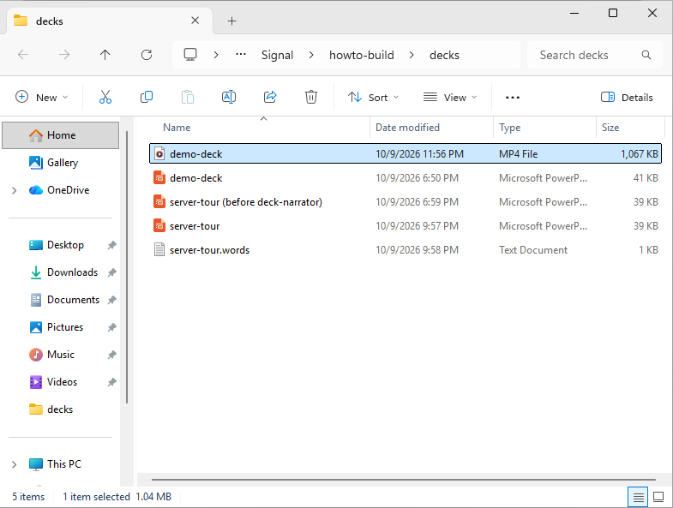
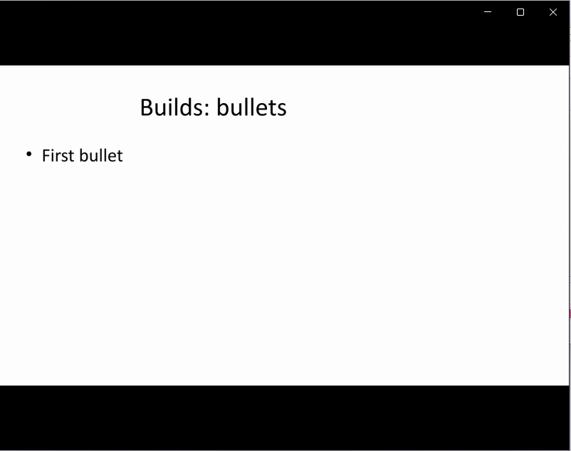
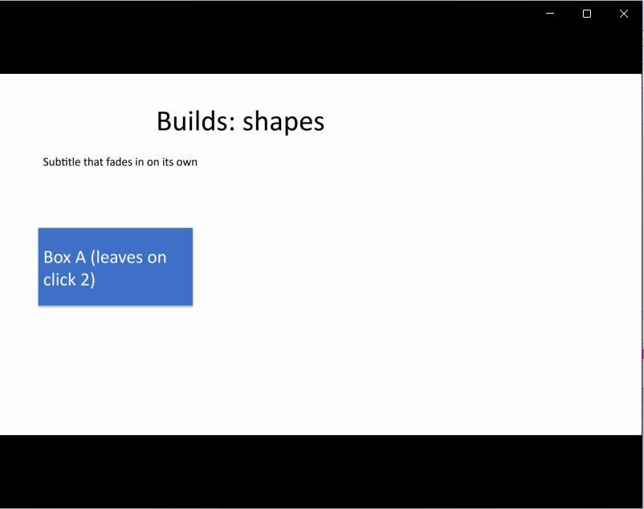
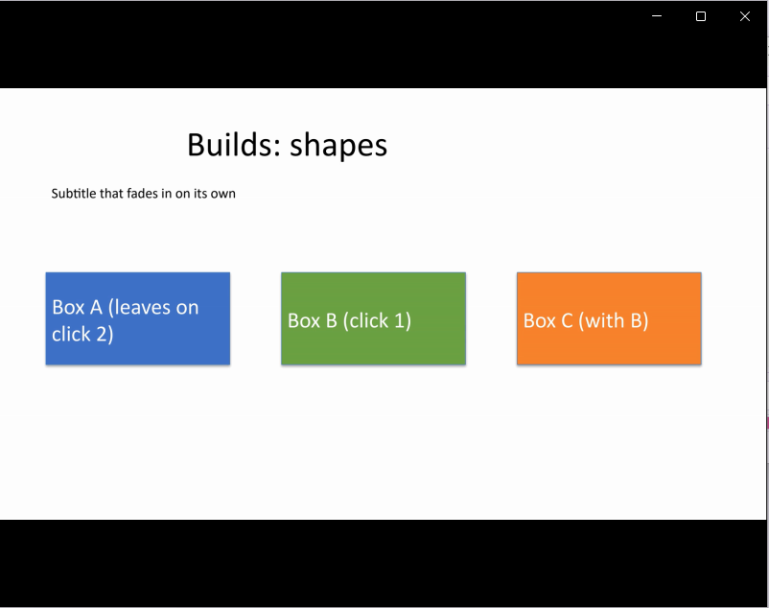
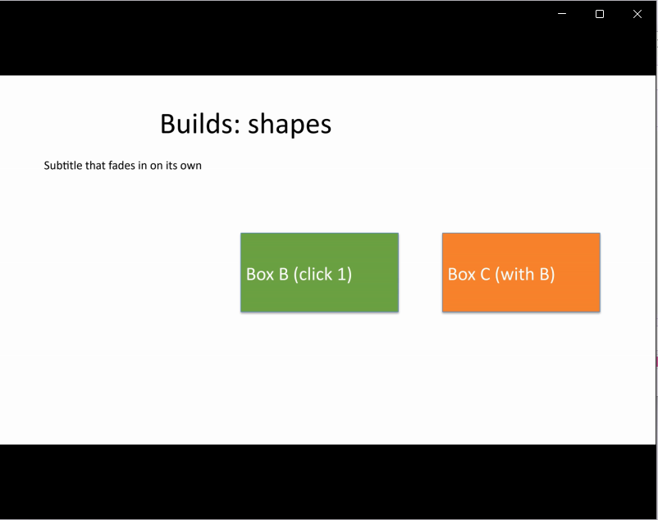
Watch the result
Play video opens it in your video player.
Each [click] became a cut, right on cue.
Open folder shows where it was saved.
Notes:
Play video opens the result. Here's the demo deck playing, its bullets appearing one by one as the narration goes. [click] On the next slide, box A is on screen. [click] At the first click, boxes B and C appear together. [click] At the second, box A leaves. Each animation becomes a cut, right on cue. [click] And Open folder shows you the new video, already selected.

Slide 12
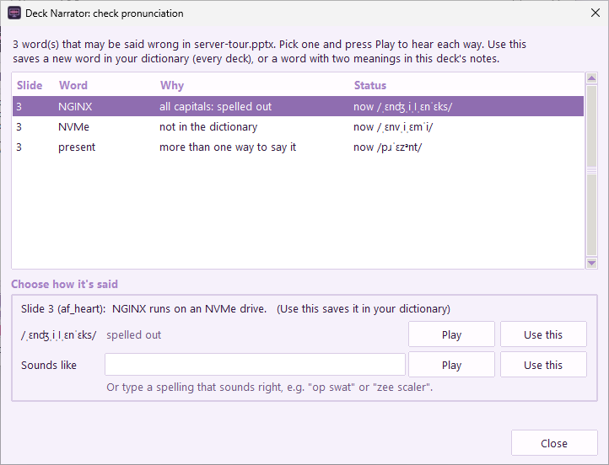
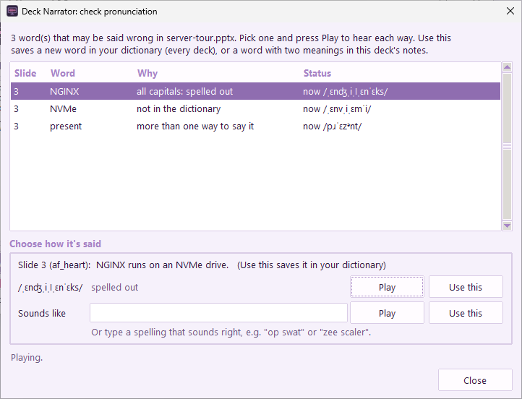
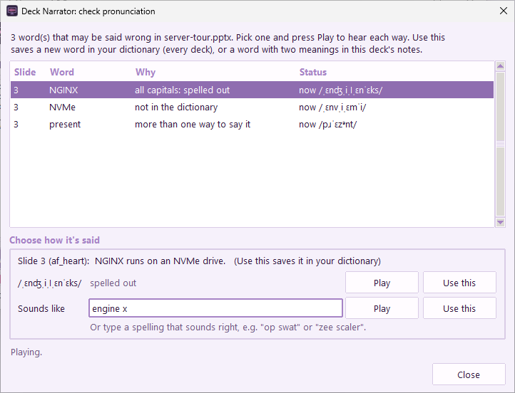
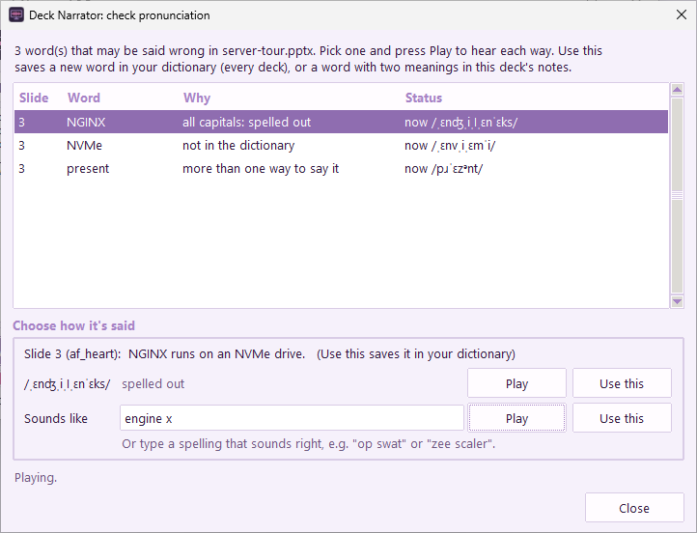
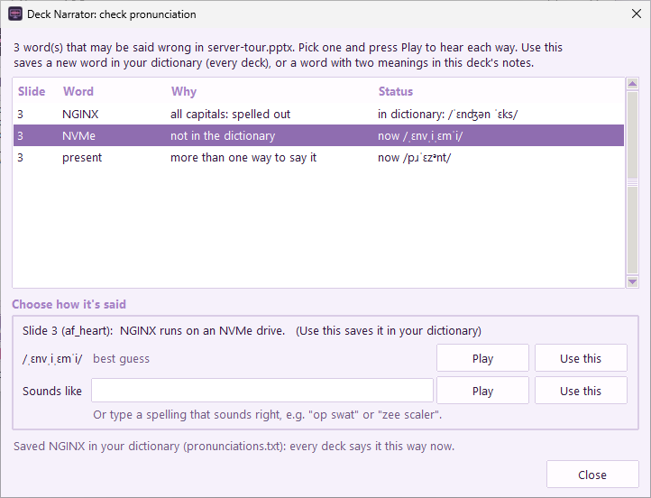
Check pronunciation
Lists only the words that may come out wrong.
Play hears it; Sounds like tries a spelling.
Use this saves a new word in your dictionary.
Notes:
Some words are easy to get wrong. Check pronunciation lists only those: names written in capitals, words the voice doesn't know, and words with two meanings. Each comes with its sentence. First up is a web server whose name is written in capital letters. [click] Press Play, and you hear it spelled out, letter by letter: N, G, I, N, X. [click] That's not how people say it, so type a spelling that sounds right under Sounds like: engine x. [click] Press Play again, and now it says [NGINX](/ˈɛnʤən ˈɛks/). [click] Use this saves it in your own pronunciation dictionary, so every deck says it that way, from now on.

Slide 13
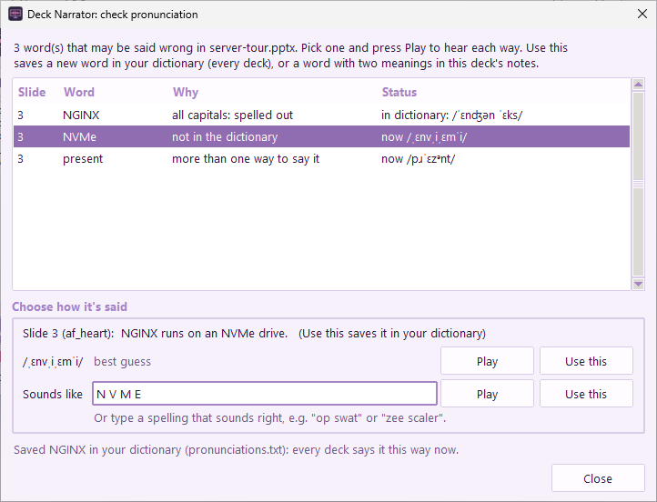
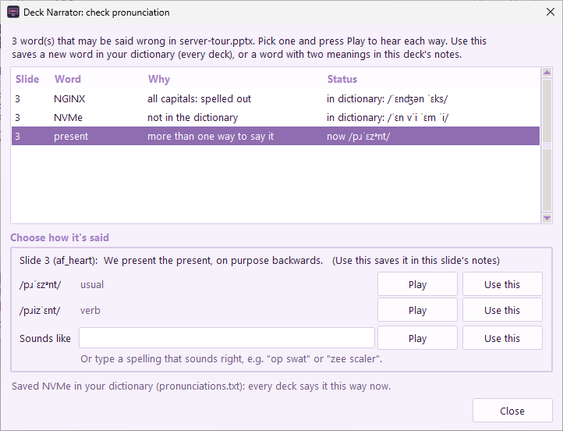
A word the voice doesn't know
Not in the dictionary? The voice guesses.
Spell it how it should sound, then Use this.
Notes:
Next, a word the voice has never seen, so it has to guess: the name of a kind of storage drive, written N, V, M, lowercase e. The guess is close, but to be sure, type the letters, N V M E, under Sounds like. Now it's [NVMe](/ˈɛn vˈi ˈɛm ˈi/), letter by letter. [click] Use this, and it's saved in your dictionary, too.

Slide 14
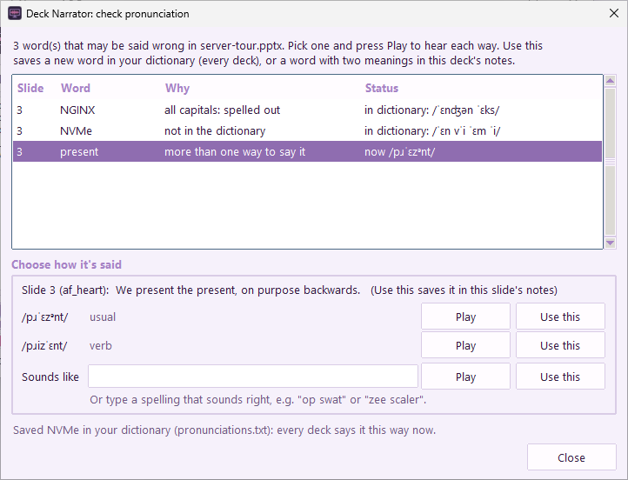
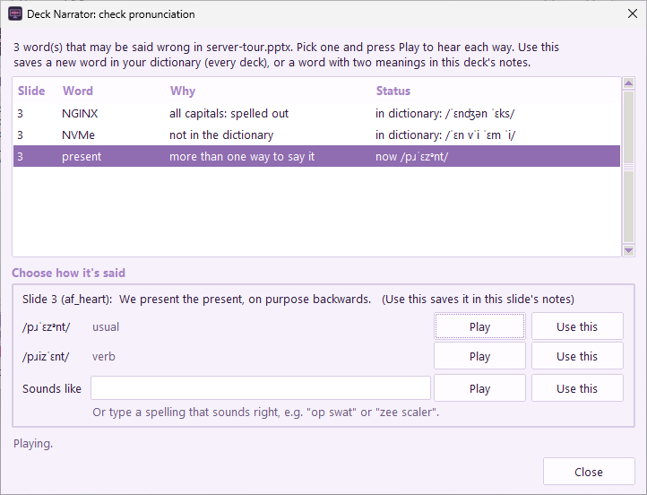
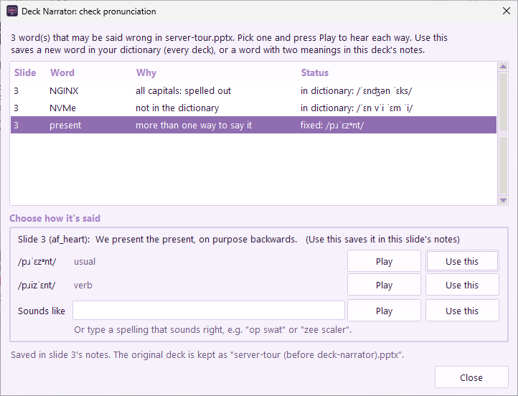
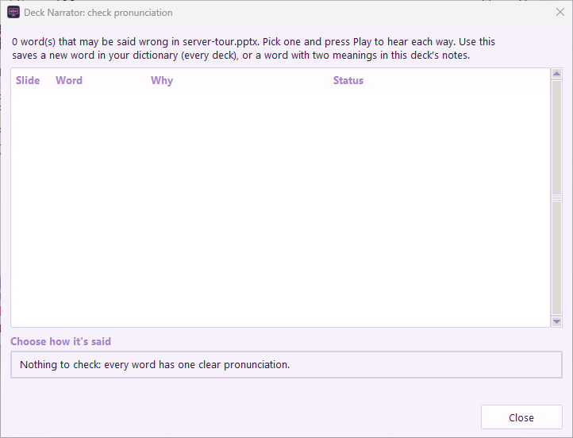
A word with two meanings
Play each reading, then Use this on the right one.
This kind is saved in that slide's notes.
The original deck is kept, the first time.
Notes:
Last, a word with two meanings, said two ways: [present](/pɹˈɛzᵊnt/), like a gift, or the present time. And [present](/pɹizˈɛnt/), as in, to give a presentation. Which one is right depends on the sentence, so this kind of fix goes into that slide's speaker notes, not your dictionary. [click] Play each reading to hear them. [click] Then Use this on the right one. The first time you change a deck, your original is kept as a copy, right next to it. [click] Run the check again, and there's nothing left to fix.

Slide 15
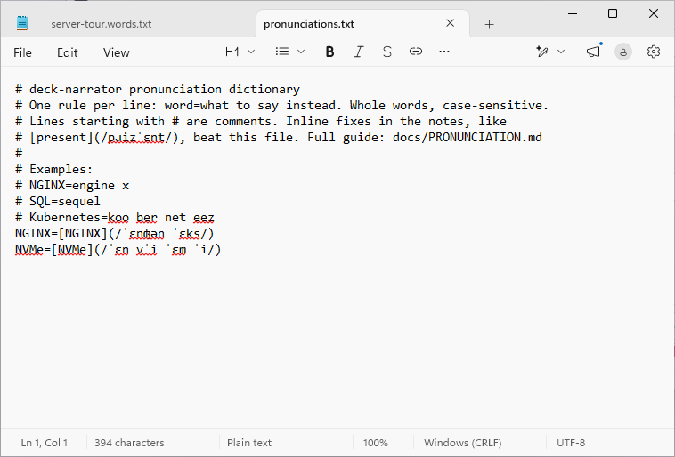
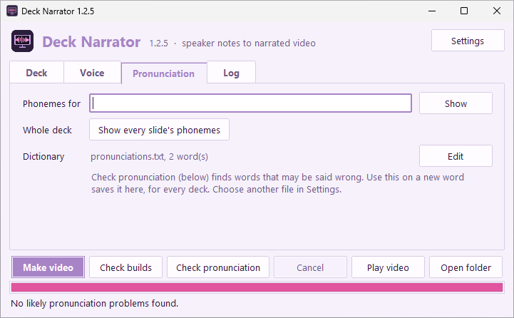
Your pronunciation dictionary
Used for every deck, automatically.
Edit opens it in Notepad.
One rule per line: word=how to say it.
Notes:
The Pronunciation tab shows your dictionary, and how many words it has: two, so far. [click] Edit opens it in Notepad. Each line is a word, an equals sign, and how to say it. You can add words by hand, too, either as a spelling that sounds right, or as phonemes. Deck Narrator uses it for every deck, automatically.

Slide 16
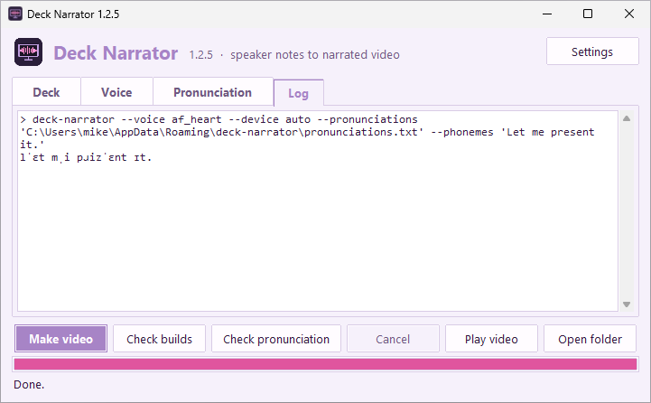
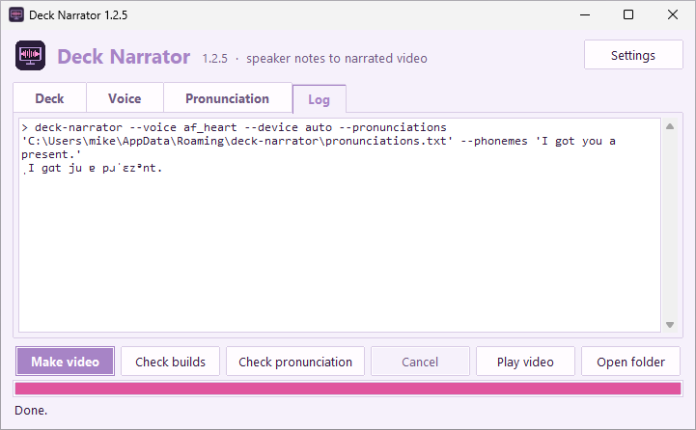
Phonemes for
Shows exactly how any text will be said.
Whole deck: every slide's phonemes at once.
Notes:
Phonemes for shows exactly how any word or sentence will be said. Let me [present](/pɹizˈɛnt/) it, gives the verb, with the stress at the end. [click] And, I got you a [present](/pɹˈɛzᵊnt/), gives the noun, stressed at the start. Show every slide's phonemes does the same for a whole deck.

Slide 17
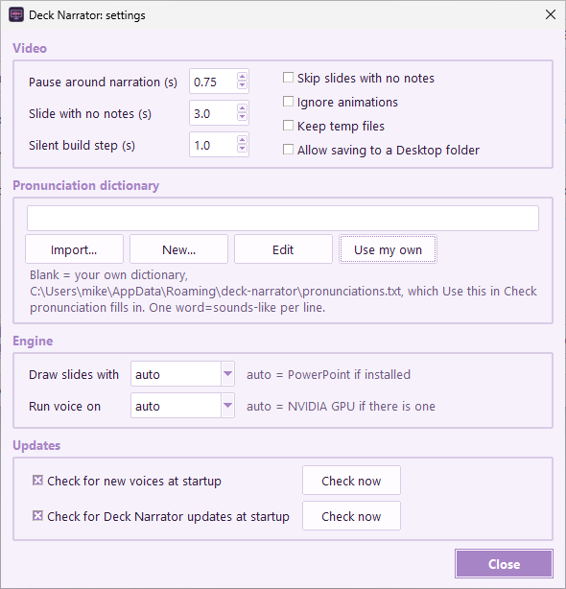
Settings
Pauses, empty slides, animations, temp files.
Which dictionary: blank means your own.
PowerPoint or LibreOffice; CPU or GPU.
Daily checks for new voices and updates.
Notes:
Things that rarely change [live](/lˈɪv/) in Settings, at the top right. The pause around each slide's narration, how long a slide without notes stays up, skipping those slides, or ignoring animations. Which pronunciation dictionary to use, where blank means your own. Whether to draw slides with PowerPoint or with [LibreOffice](/lˈibɹə ˈɔfɪs/), and run the voice on the processor or the graphics card. And the daily checks for new voices, and for a new version of Deck Narrator.

Slide 18
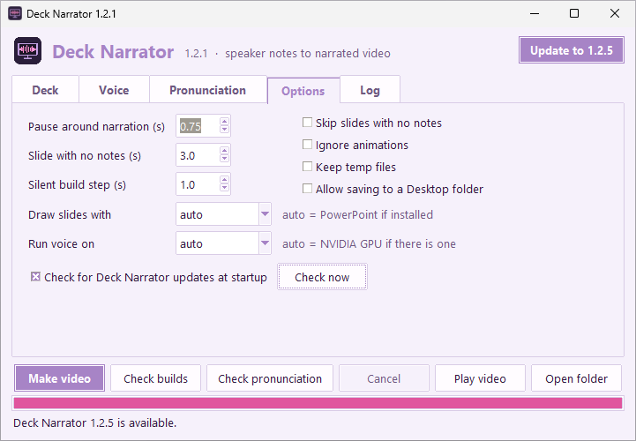
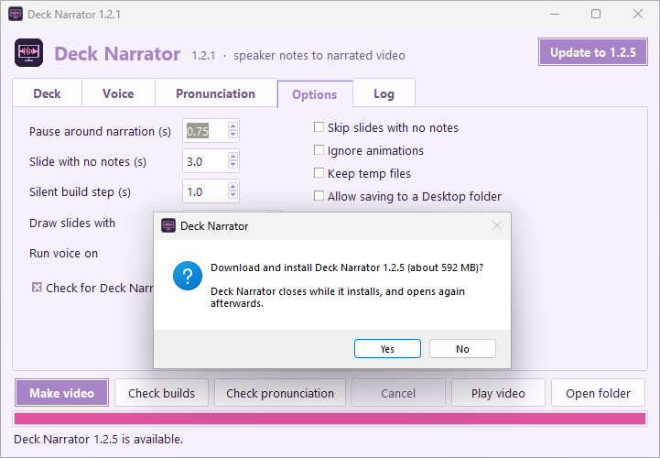
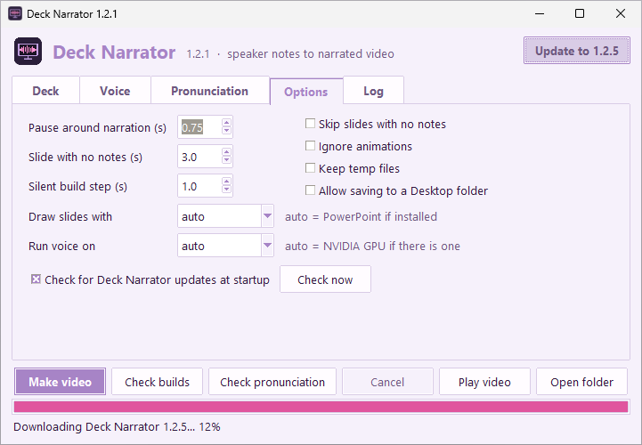
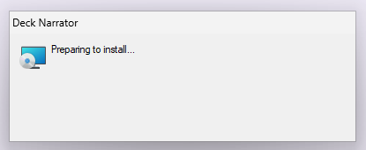
Updates install themselves
An Update button appears when there's a new version.
Checked against GitHub's published checksum.
Settings and your dictionary are kept.
Notes:
Once a day, Deck Narrator checks GitHub for a new version. When there is one, an Update button appears at the top. Here's version one point two point one, finding one point two point five. [click] Press it, and it asks first. [click] The download is checked against the checksum GitHub publishes. [click] Then the installer replaces the old version. Windows may ask for permission. [click] And Deck Narrator opens again, updated, with your settings and your dictionary just as you left them.

Slide 19
That's the tour
Notes → voice → Check builds → Check pronunciation → Make video
github.com/mikesimone/deck-narrator
Free and open source. This video was made with Deck Narrator, from this deck's speaker notes.
Notes:
That's the tour. Write your script in the speaker notes, pick a voice, check your builds and your pronunciation, then make the video. Deck Narrator is free and open source, on GitHub. Thanks for watching.

