Slide 1

Fraser Valley PPC Web Site
Front Four Pages

Slide 2
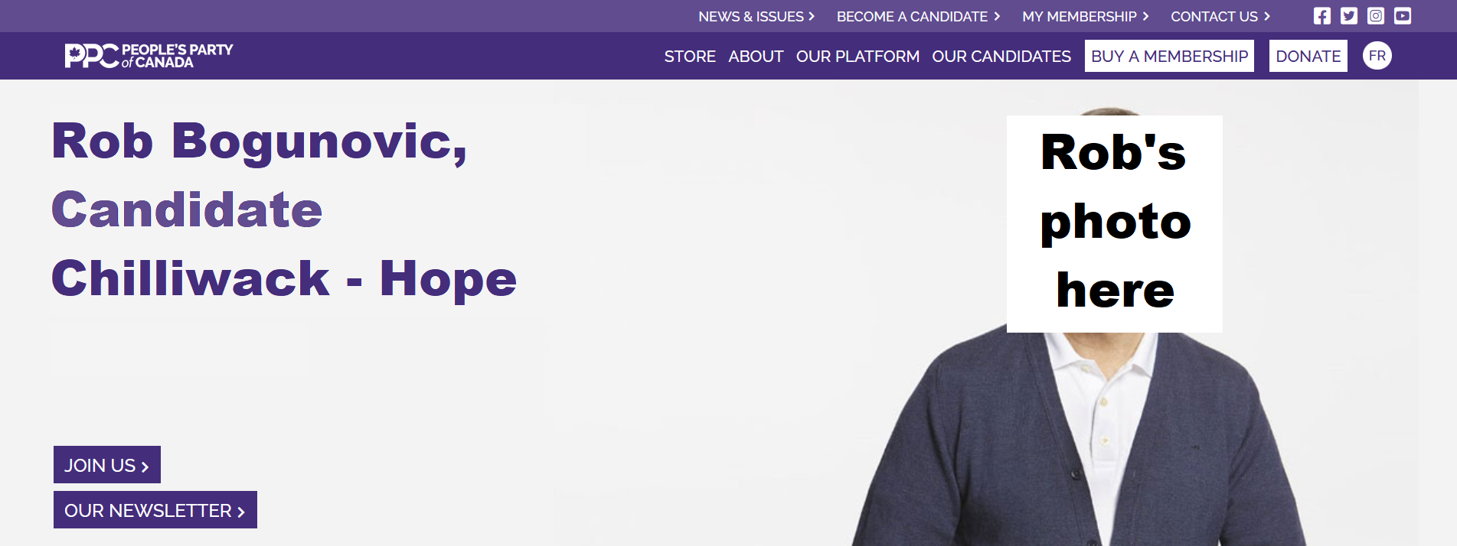
Chilliwack landing page

Slide 3
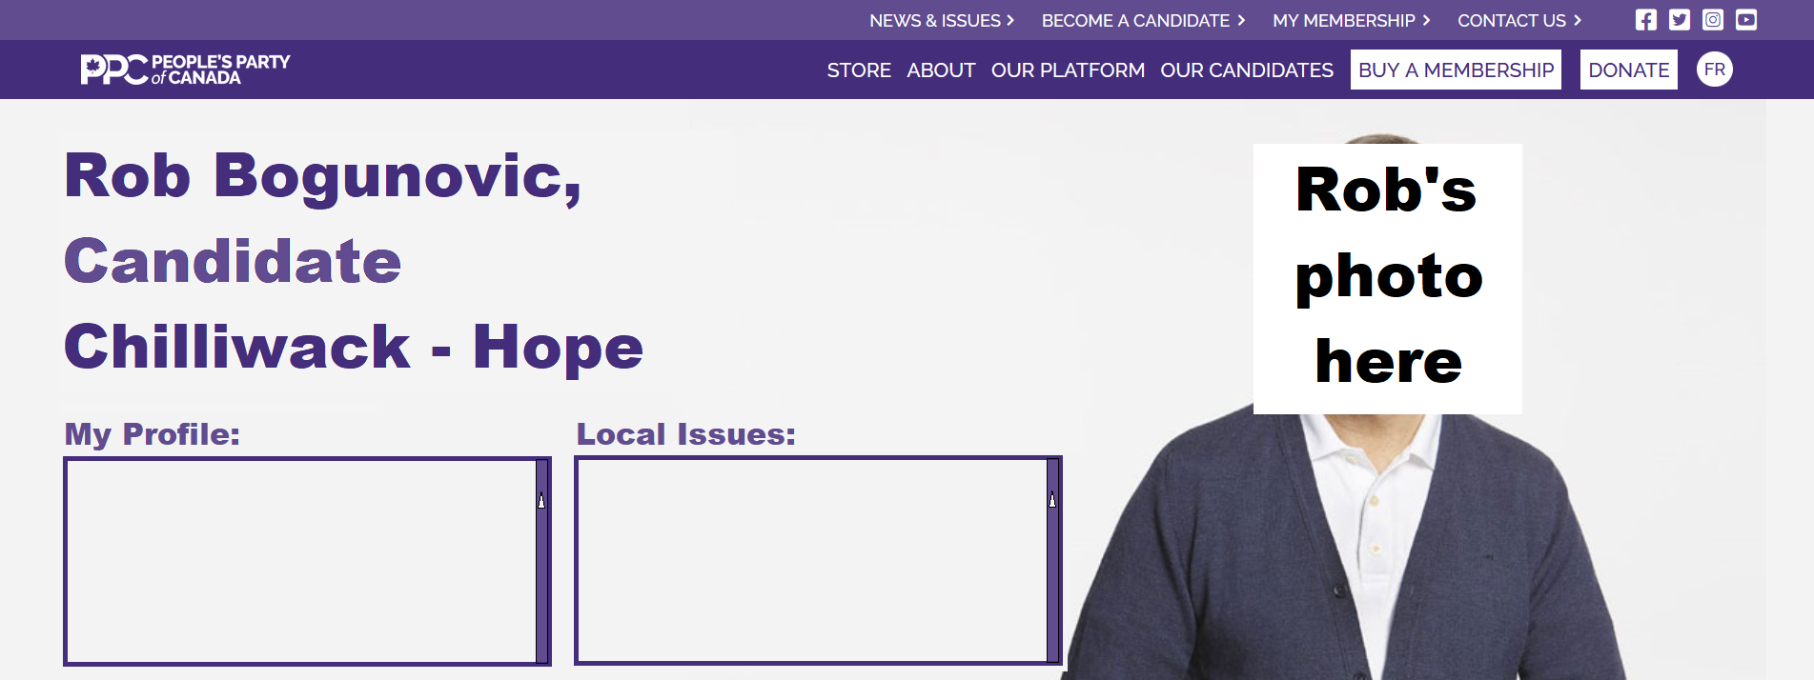
Chilliwack Profile page

Slide 4

Abbotsford landing page

Slide 5
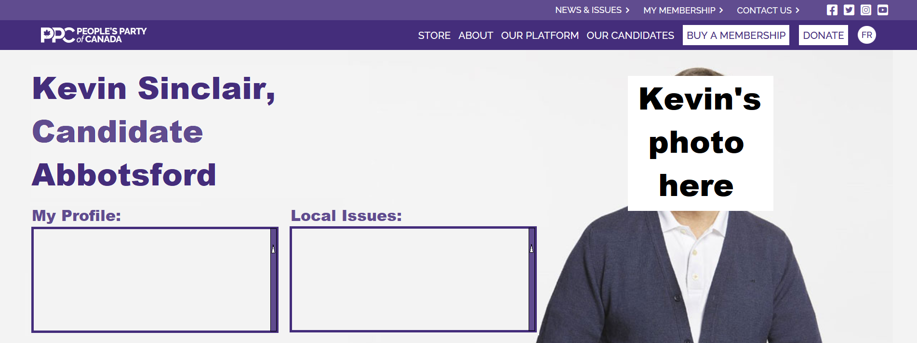
Abbotsford Profile page

Slide 6

Mission landing page

Slide 7
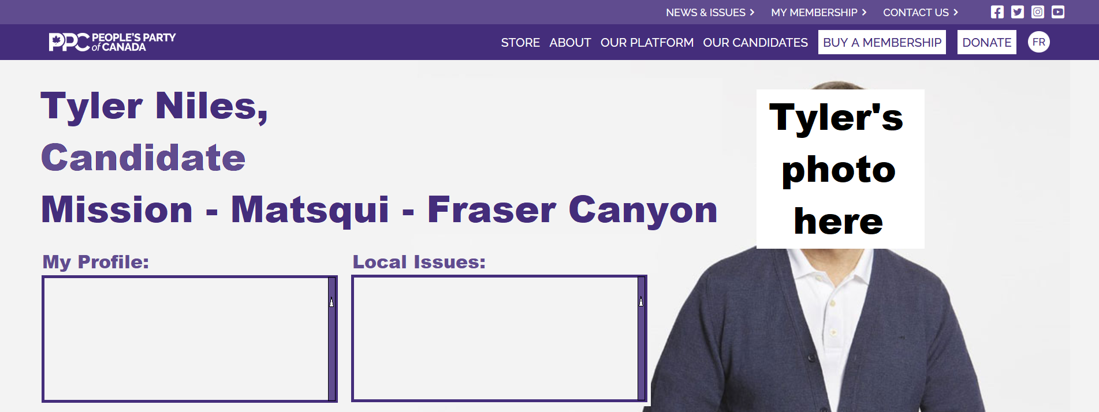
Mission Profile page

