Slide 1

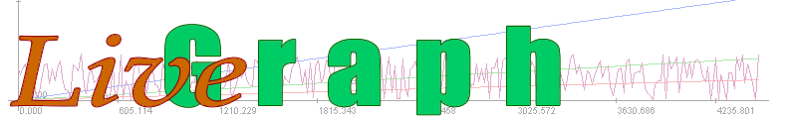
framework for real-time data visualisation, analysis and logging
http://www.live-graph.org
Update graphs in real-time while simulation is running.
Simple user interface to manage several 100s data series at the same time.
Transform data to common stale by a single click.
Runs anywhere (Java).
Integrates with anything (not only Java).
Simple CSV-style files.
Data logging library (only Java).
Free, open-source, well documented, actively developed.

