Slide 1


DDD and FP Can’t Be Friends, Yet
Henning Schwentner
@hschwentner@social.wps.de
Michael Sperber
@sperbsen@discuss.systems

Slide 2
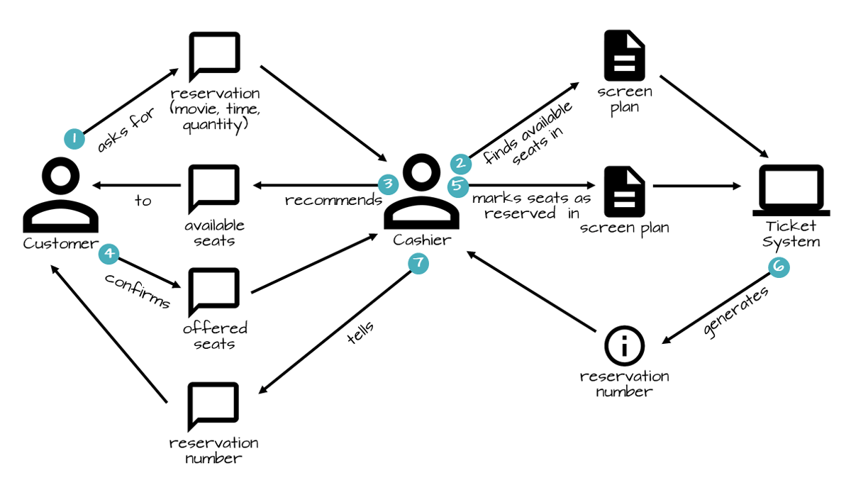


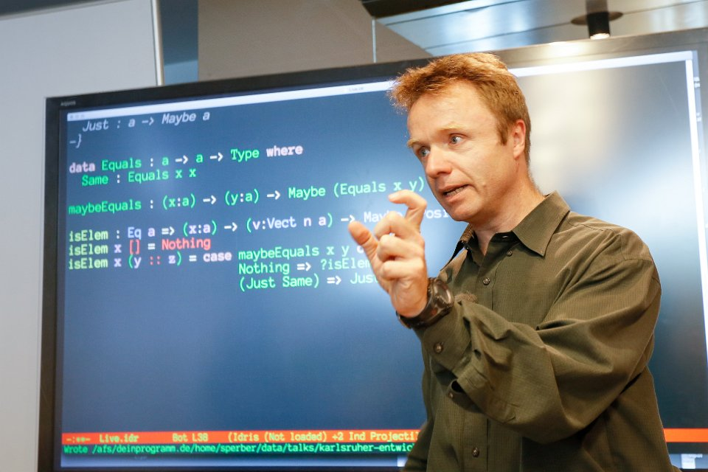




Slide 3
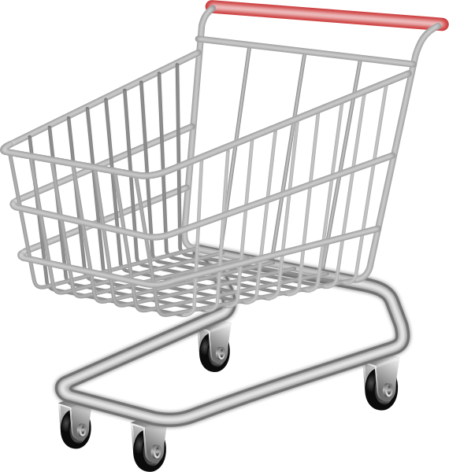

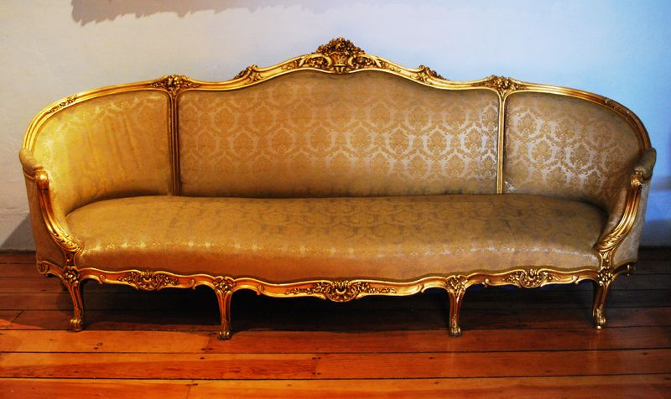
Da Shopping Cart
put articles in cart - always
go to checkout
choose shipping address
no shipping furniture to Packstation
don’t lose input data
Source: Wikimedia (sofa), Wikimedia (candle diffuser)

Slide 4
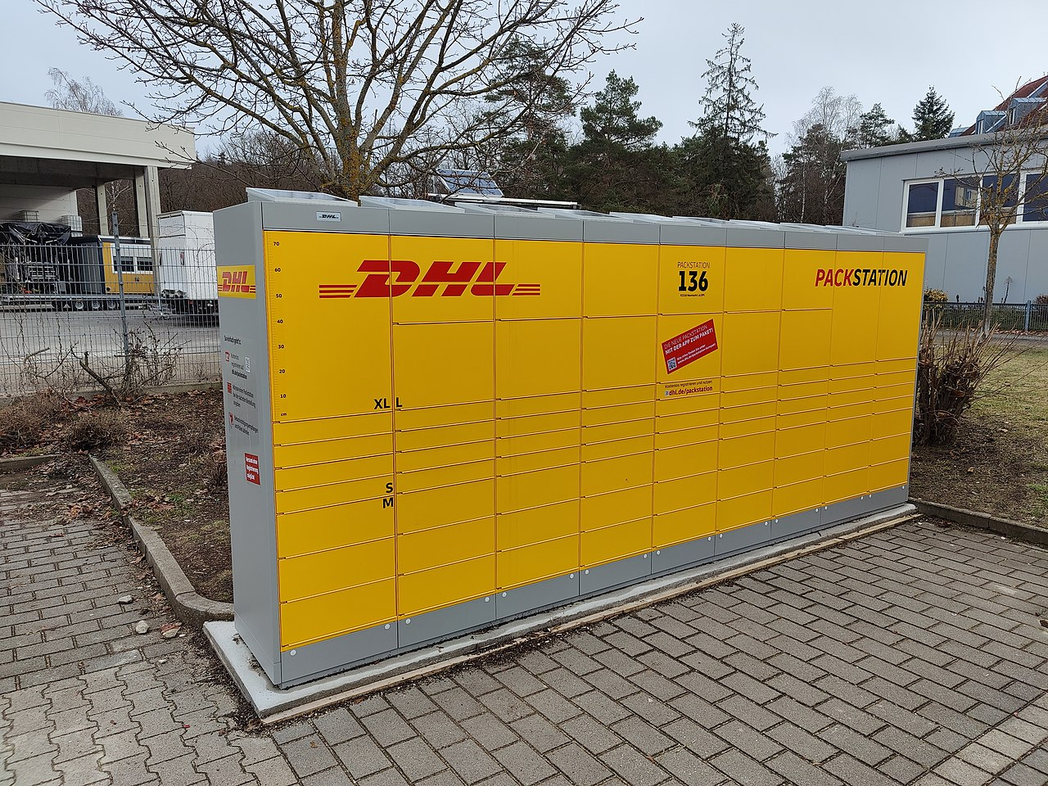
Packstation
Source: Wikipedia

Slide 5
States
Draft Cart
Checkout-Ready Cart
Checked-OutCart

Slide 6
Ubiquitous Language vs. Abstraction

Slide 7
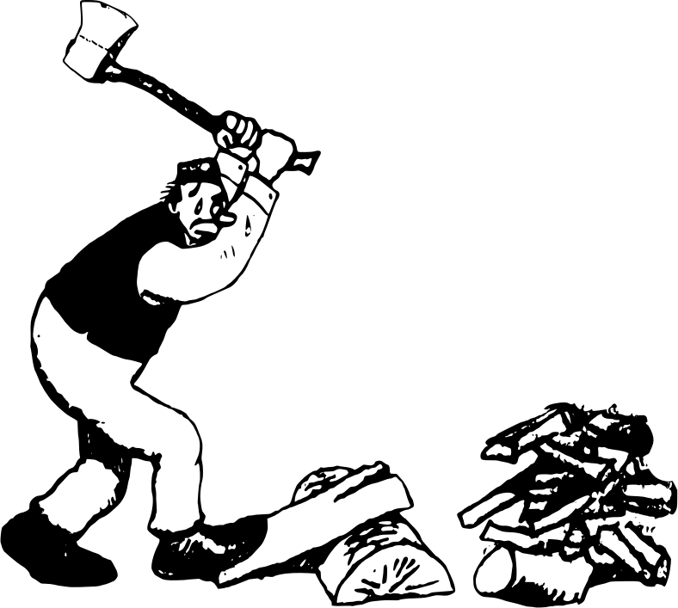
BDD vs. Design Recipes

Slide 8
Entities vs. Value Objects vs. Domain

Slide 9
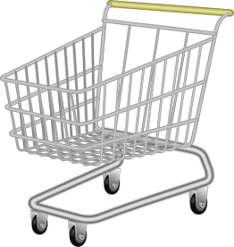
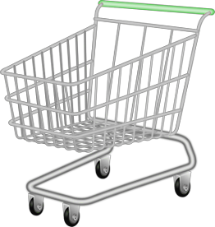
Implementing State Diagrams

Slide 10
What Is It That We’re Modeling?

Slide 11
... and What about Mutability

Slide 12
Not Friends, Yet
DDD Henning
FP Mike
Domain Storytelling Processes
Context Mapping
BDD Operation Signatures
TDD Test Cases & Functions
Design Recipes Data Analysis
Design Recipes Functions
Abstraction Types

Slide 13

software project development
many different fields
functional programming
training, coaching
iSAQB-accredited Functional Software Architecture
www.active-group.de
funktionale-programmierung.de
Notes:
nie in OOP sozialisiert

Slide 14

FIXME

