Slide 1


DDD and FP Can’t Be Friends, Yet
Henning Schwentner
@hschwentner@social.wps.de
Michael Sperber
@sperbsen@discuss.systems

Slide 2
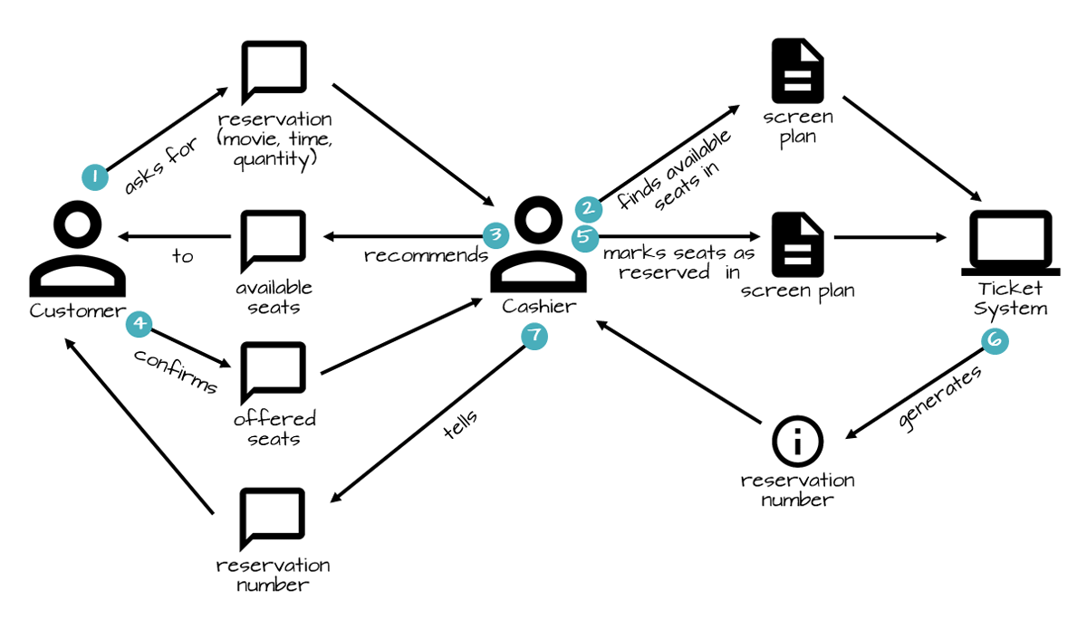


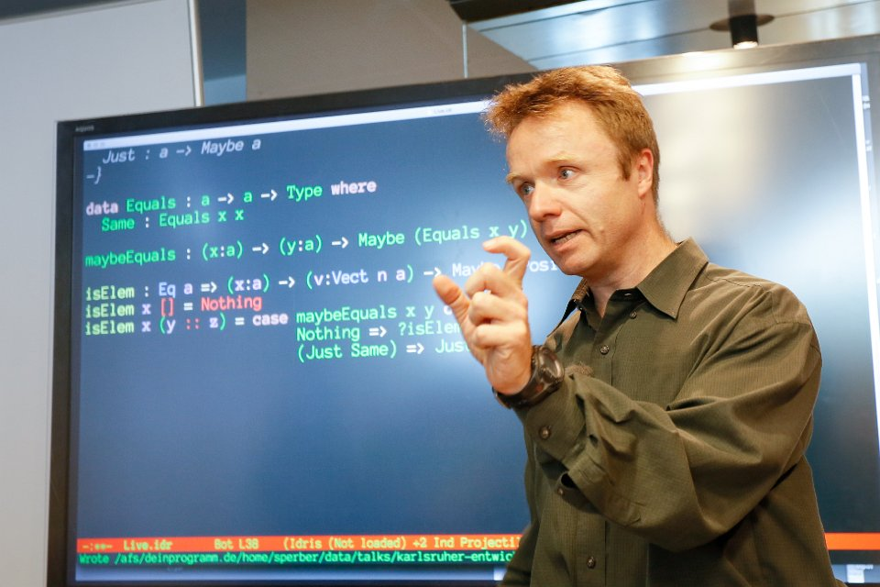




Slide 3
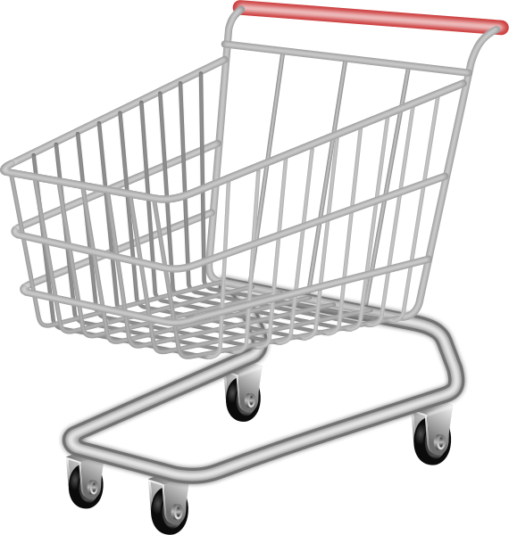

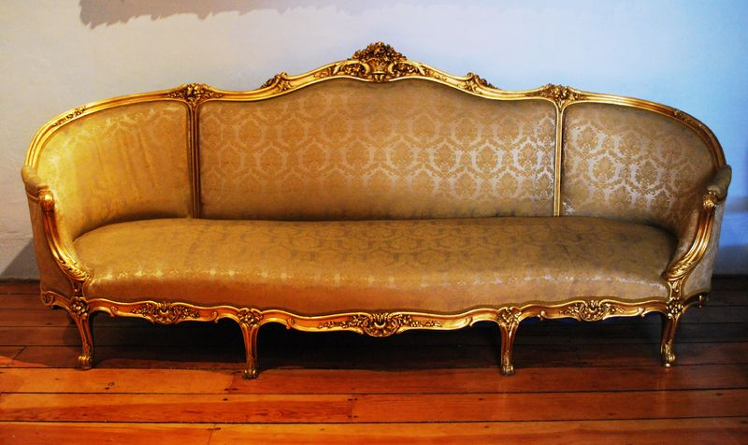
Da Shopping Cart
put articles in cart - always
go to checkout
choose shipping address
no shipping furniture to Packstation
don’t lose input data
Source: Wikimedia (sofa), Wikimedia (candle diffuser)

Slide 4
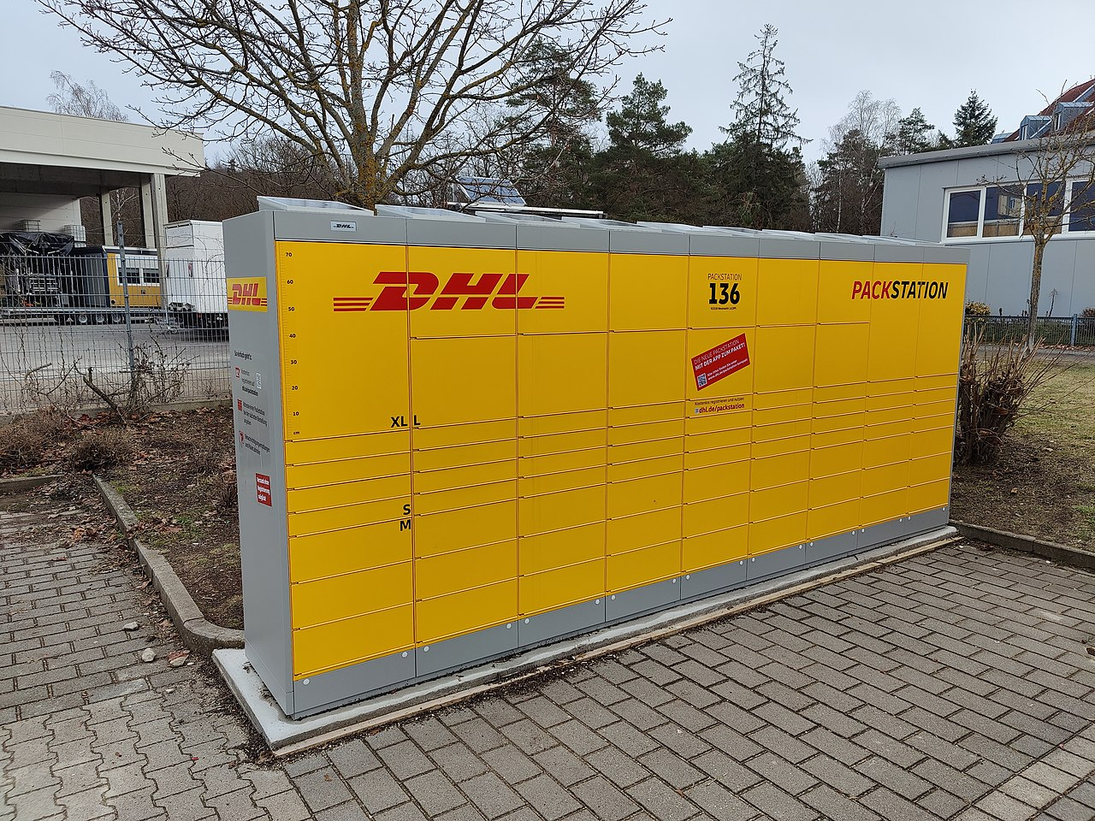
Packstation
Source: Wikipedia

Slide 5
Ubiquitous Language vs. Abstraction

Slide 6
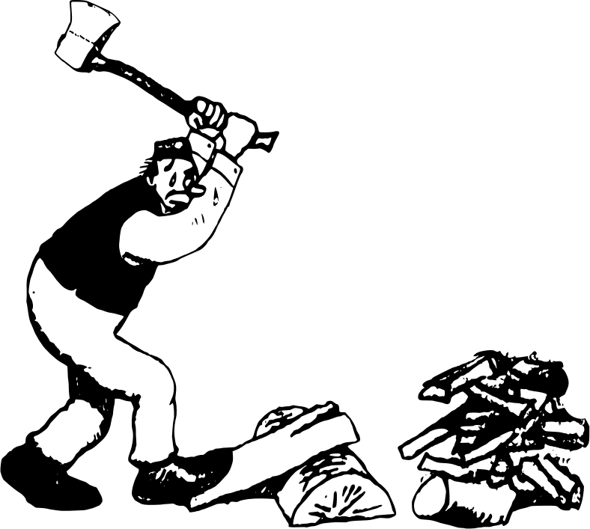
BDD vs. Design Recipes

Slide 7
Entities vs. Value Objects vs. Domain

Slide 8
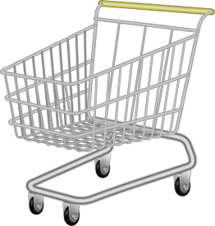
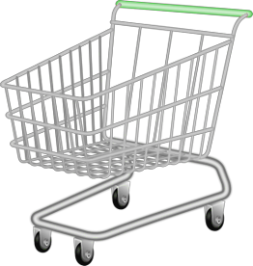
Implementing State Diagrams

Slide 9
What Is It That We’re Modeling?

Slide 10
... and What about Mutability

Slide 11

software project development
many different fields
functional programming
training, coaching
iSAQB-accredited Functional Software Architecture
www.active-group.de
funktionale-programmierung.de
Notes:
nie in OOP sozialisiert

Slide 12

FIXME

