Slide 2

Pivotal CF
The Platform for a New Era of Software Innovation
Alberto Flores
Sr. Field Engineer
Pivotal Federal

Slide 3

Demonstration of Pivotal CF
Operations Manager & Web Console
Ease of Deployment: cf push
Ease of Scalability: cf scale
Service Binding: cf bind-service
High Availability and Self-Recovery
Notes:
For the next few minutes, I’m going to give you a tour of Pivotal CF, the enterprise ready version of CloudFoundry.
This includes 2 web interfaces
- Operations Manager (which is the interface for the operators of the platform) and
- Web Console (which is the interface for the “developers”, those who deploy applications in the cloud).
I will also show the ease of operations in CloudFoundry. In particular, you’ll see how the “cf push” and “cf scale” operations can greatly enhance the agility of application deployment and scalability respectively.
In addition, I’ll demonstrate the flexible “service binding” model that the CloudFoundry platform provides to deployed applications.
As discuss before, CloudFoundry implements 4 different levels of HA (High Availability). I’ll demonstrating one of them as the platform is able to recover a failed applications.
And Lastly, we’ll review a simple DevOps use case to illustrate how the PaaS is a key component of innovation.

Slide 4
Operations Manager
&
Web Console
Notes:
Pivotal CF provides 2 web interfaces to CloudFoundry that makes use of the platform simple.
One is called “Operations Manager”. This is an interface for the operators of CloudFoundry. Here, operators configure resources such as:
VMs,
LDAP integration,
IPs of external resources,
Security pools,
Load balancers,
As well as any other enterprise component needed by your software enterprise.
All of these components and many more are available in a centralized interface so that configuration of the “platform” is transparent to every operator. This means, every change that occurs in the platform is logged and can be subject to your audit requirements. Traditionally, this is another pain point generated by custom and complex scripts that only a few can understand.
The second interface I’d like to show is the developer’s “web console”. This is a simple graphical interface designed to be a source of references for developers and the applications they deploy into the “cloud” managed by the “platform”. In this console, developers can see:
The organization they are assigned and the spaces they have access.
The services available within the platform
All Applications currently deployed within the given workspace
Centralized view relevant to an application lifecycle in the deployed environment. This includes:
Status of the application
Change events
Log entries produced by the application
Services bound
Operation Console to modify resource allocation at runtime.

Slide 5
Ease of Deployment: cf push
Notes:
What we have here is a “java” web based application, using popular frameworks such as Spring and Maven.

Slide 6
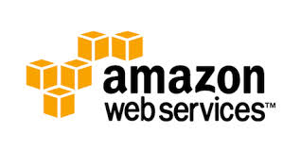
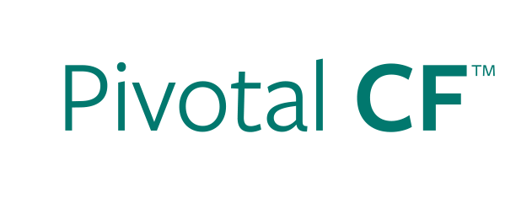
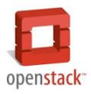


Deploying an Application
IaaS versus PaaS
Provision VM
Install Application Runtime
Deploy Application
cf push
Configure Load Balancer
Configure SSL Termination
Configure Service Connectivity
Configure Firewall
Notes:
As it was mentioned a minute ago, traditional pain points of software innovation include both:
- Complicated Processes and Procedures that slow down innovation.
- Developer Frustration in the lack of tooling to solve problem.
“Platform as a Service” can solve this problem by automating the processes associated with these tasks.

Slide 7
Ease of Scalability: cf scale

Slide 8
Scaling an Application
IaaS versus PaaS
Provision New VM
Install Application Runtime
Deploy Application
cf scale
Configure Load Balancer / Update Route
Configure Service Connectivity
Configure Firewall
Notes:
Highlight that not only are the steps longer in IaaS, but often there are multiple groups involved (ie, Dev, Operations, etc).
Management of configuration information is often manual in IaaS (though not always).
Explain that for non-virtualized customers, the steps are even greater.

Slide 9
Service Binding:
cf bind-service

Slide 10
Sample USPTO App in Cloud Foundry
Cloud Foundry App Space
Cloud Foundry Services Marketplace
USPTO Search Application
Data.gov Crawler
Patent Data Service
Java Spring Worker Code
Patent Search App
Java Spring App Code
Notes:
Logical architecture for USPT

Slide 11
HA and Self-Recovery

Slide 12



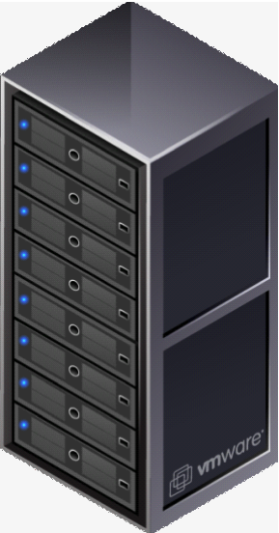

4 Levels of High Availability
PaaS Process Failure
Application Failure
Availability Zone Failure
OS Failure (VM)
Notes:
Application performance and reliability have a direct correlation to HA capability. Pivotal provides 4 level of HA so that you don’t need to invest in people/software to handle common failure situations. If an application fails, we will reboot it in a new container. This automated remediation addresses application bugs that result in outages. If a Pivotal process fails, we will reboot it in a new virtual machine. Our PaaS essentially monitors and remediates itself. If an OS or network failure occurs, our VM monitor will detect this and kill the VM, then reboot it in a new container. This streamlines Linux sysadmin operations. Lastly, if a datacenter rack fails, we will ensure the application stays running because we load application instances in multiple availability zones. No 2 availability zones live on the same datacenter rack. This hardware failure level resilience is very difficult to design using traditional tools provided by HP/CA/IBM.
And, by using Pivotal, you reduce the number of servers that require HP/CA/IBM monitoring tools.

Slide 13
Demonstration of Pivotal CF
Operations Manager & Web Console
Ease of Deployment: cf push
Ease of Scalability: cf scale
Service Binding: cf bind-service
High Availability and Self-Recovery
Notes:
For the next few minutes, I’m going to give you a tour of Pivotal CF, the enterprise ready version of CloudFoundry.
This includes 2 web interfaces
- Operations Manager (which is the interface for the operators of the platform) and
- Web Console (which is the interface for the “developers”, those who deploy applications in the cloud).
I will also show the ease of operations in CloudFoundry. In particular, you’ll see how the “cf push” and “cf scale” operations can greatly enhance the agility of application deployment and scalability respectively.
In addition, I’ll demonstrate the flexible “service binding” model that the CloudFoundry platform provides to deployed applications.
As discuss before, CloudFoundry implements 4 different levels of HA (High Availability). I’ll demonstrating one of them as the platform is able to recover a failed applications.
And Lastly, we’ll review a simple DevOps use case to illustrate how the PaaS is a key component of innovation.

Slide 14
Questions

