Slide 1
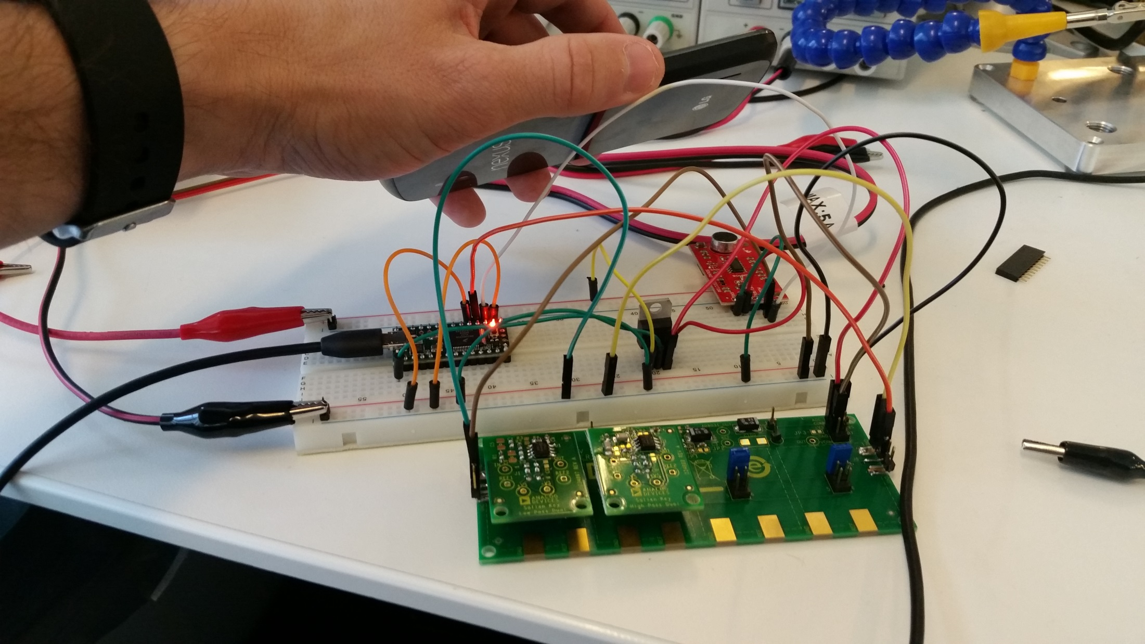

TOTEM SOUND LOCALIZATION ANALOG FILTER TEST
Teensy 3.1 ADCs
Python
Human voice range analog Bandpass filter
(≈ 300Hz < pass-through range < 3000 Hz
Spoken word podcast
Microphone

Slide 2
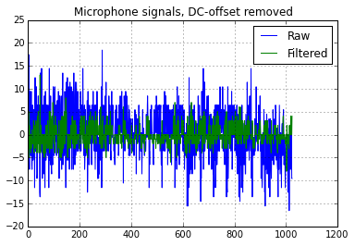

Slide 3
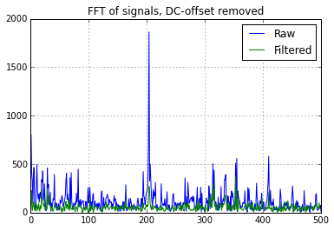
Zoom, next page
Human voice range (300-3000 Hz)

Slide 4
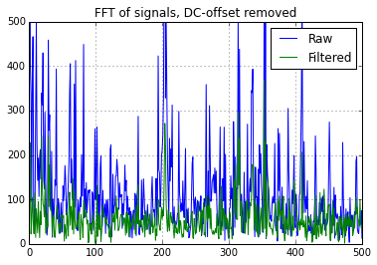
Human voice range (300-3000 Hz)

Slide 5
Test synopsis:
Sampled 1024 points at 50kHz
each FFT bucket is equal to 24.4 Hz
Used a spoken word podcast close to the microphone
Only digital signal processing was the DC-offset removed
Filtered signal and raw had different offsets, meaning active filter is apply some gain (probably result on using resistors/capacitors not perfectly aligned with filter design tool output
Results/Thoughts
Analog filter definitely removes a lot of high-level noise
Hard to tell from simple FFT and spoken word how well human voice passes through filter
Would need to run tests with frequency generator and speaker
FFT peak at ~5000 Hz is interesting
Probably power supply/EMI noise related

