Slide 1

Virtual Assistant
Created and Presented by: Michael Jones, Rajesh Kumar, Rishab Jain, and Jeremy Cantu

Slide 2
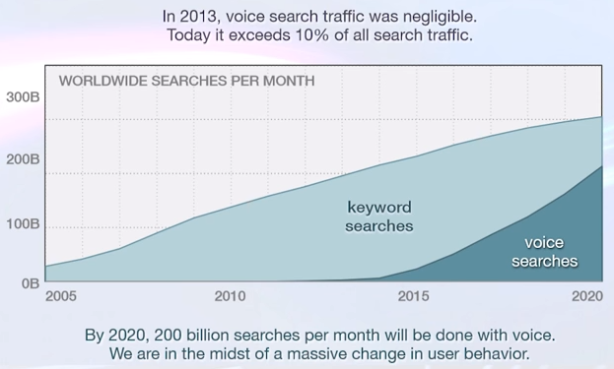
A Paradigm Shift
“According to Google, More than half of teens use voice search and commands daily.
Adults are feeling more comfortable using speech recognition technology: 41% talk to their phones every day and 56% say it makes them “feel tech savvy.”
http://pavel.surmenok.com/2016/02/21/re-work-virtual-assistant-summit-presentation-notes/

Slide 3
Why ConvoSearch?
Reach: Advances in voice and speech-recognition technologies provide a new opportunity to reach out to a variety of audiences to interact with Dell.com via a wide variety of devices.
Speed: Closing the gap in terms of time and clicks between a user and their intended destination via a much more natural method of search.
Personalized Touch: Engaging the user with said natural interaction, as well as the opportunity to learn more about the customer and provide them a much more customized experience.

Slide 4
ConvoSearch - Why guess what the customer wants when they can easily tell us?
Allows the user to browse the Dell site via a spoken and natural conversation between them and their own virtual assistant, “Delly,“ guiding them every step of the way.
Clear and concise results are quickly displayed to the user based on that conversation, granting them the ability to rapidly attain information for their desired search.
In-built normalization of gathered voice data, as well as the ability to gather data for a variety of languages, allows for a large set of customers to be served in such a manner.
The allowance of building personalized experiences on a customer-by-customer basis using extremely detailed information and metrics, as well as the utilization of this data for large-scale trend analysis as a whole.

Slide 5
Demo

Slide 6
Extensibility and Future Work
Integrate recommendations based on business-configurable traits (special promotions, item margins, etc.).
Differentiate Dell in the e-commerce space by integrating with the overall buying experience, allowing users to purchase products and perform and express checkout by use of simplified speech and voice commands.
Integrate machine learning within “Delly,” ensuring that the virtual assistant is capable of providing the customer their intended results.

Slide 7
Q & A ?

