Slide 1
Face Replacement
by Mike Woods and
Michael O'Meara

Slide 2
Our general approach
Initially we used the code published by Zhu and Ramanan based on a paper called ”Face Detection, Pose Estimation and Landmark Localization in the Wild” to perform landmark detection on both the input and target faces. This approach uses a deformable template to find key features in the face.
We thought we’d need to use Thin-Plate Spline warping but, that turned out not to be necessary.
Instead, we do an affine transform to adjust the angle of our face to match the target face(s).
We also snapped points to “edge detected” sides of the face for better results
Lastly, we decided to do two different types of blending to match the surrounding target face. (feathering and poisson)

Slide 3
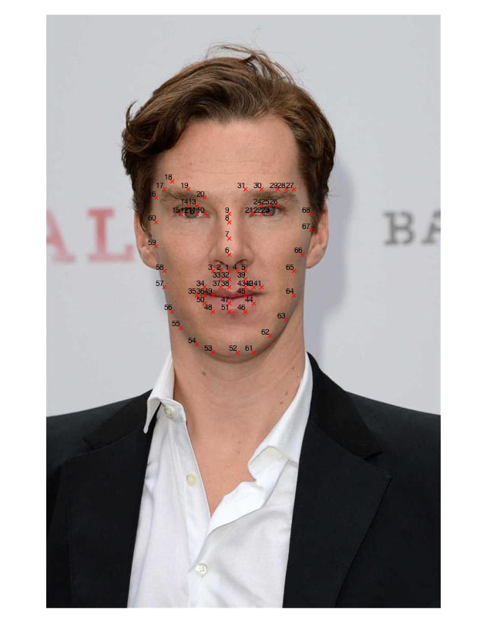
How we use deformable template code?
We used this to find points for the eyes, nose, and mouth.
Using these points, we dilate the centers of those points into circles.
Then, with those circles, we calculate a mask of both the reference images and the target images.
NOTE: Since the points in the template remain roughly in the same positions on each face, this makes our approach fairly stable.

Slide 4

Initially Bad Results

Slide 5
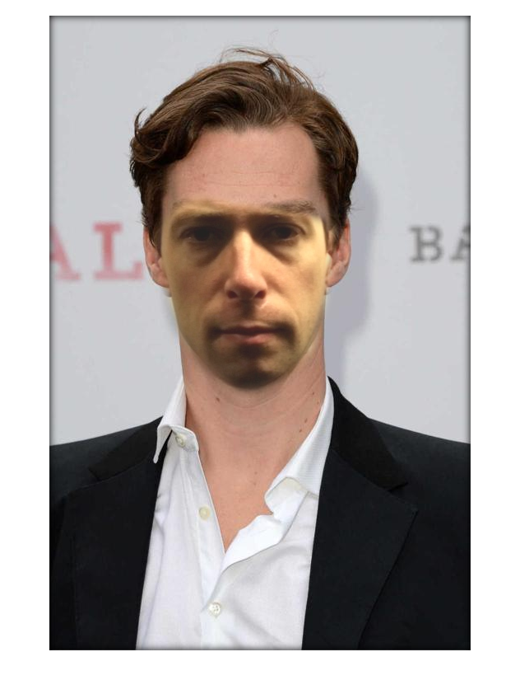
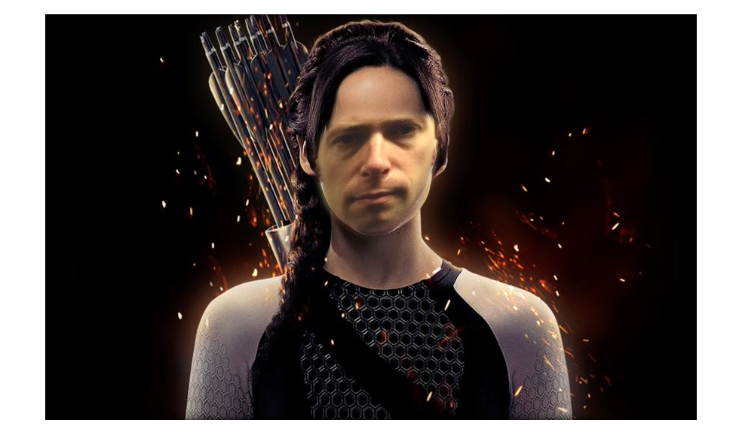
A little better results

Slide 6
Something to write home about?

