Slide 1
Technologia Java Server Pages (JSP)

Slide 2
Agenda
Koncept
JSP servlet life-cycle
JSP syntax
Implicite objects
Dyrektywy
Akcje
Java Bean – co to
JSP Expression Language (EL)
JSP Standard Tag Library (JSTL)

Slide 3
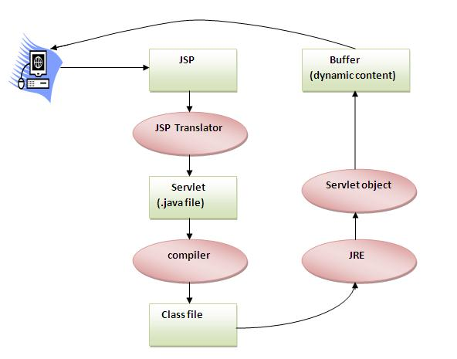
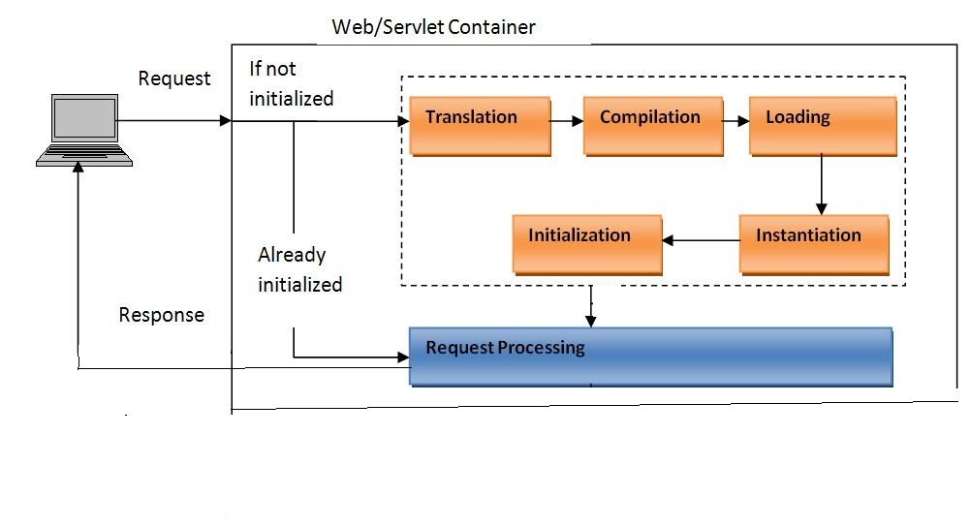
Java Server Pages (JSP) - koncept
Specyfikacja: http://download.oracle.com/otn-pub/jcp/jsp-2_3-mrel2-eval-spec/JSP2.3MR.pdf

Slide 4
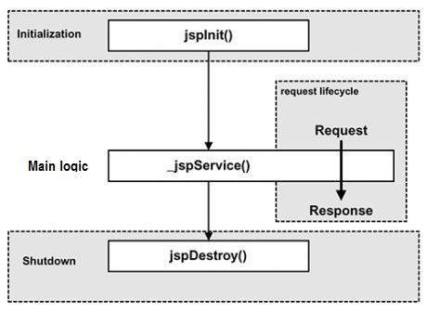
JSP lifecycle (cykl życia) – JSP page jako servlet

Slide 5
Podstawowe elementy składni
Scriptlet:
<% valid java code %>
or
<jsp:scriptlet>
valid java code
</jsp:scriptlet>
Declaration:
<%! variable(s) declaration %>
or
<jsp:declaration>
variable(s) declaration </jsp:declaration>
Expression:
<%= valid output.print parameter %>
or
<jsp:expression>
valid output.print parameter </jsp:expression>
JSP comment:
<%-- ignored by jsp engine --%>
JSP procesor directive:
<%@ directive-name directive-attributes=”…” %>
or
<jsp:directive.directive-name directive-attrib=”…” />
Syntax suport in Eclipse after installation of: http://www.eclipse.org/webtools/

Slide 6
Implicite objects
Jsp page (keep attributes) | Generated Java servlet
request | HttpServletRequest
response | HttpServletResponse
session | HttpSession
application | ServletContext
config | ServletConfig
page | this
pageContext | javax.servlet.jsp.PageContext
out | PrintWriter (implements Writer)
exception | Throwable awailable only in error page Passed by req attribute „javax.servlet.error.exception”

Slide 7
Dyrektywy
<%@ page ... %>
najważniejsze atrybuty:
impot = "<full package class name>"
isErrorPage
errorPage
contentType
pageEncoding
…
<%@ include file="..." %>
<%@ taglib uri="..." prefix="..." %>
e.g. to include Java Standard Tag Library (JSTL)

Slide 8
JSP actions
Page navigation:
jsp:include
jsp:forward
Dynamic XML generation:
jsp:element
jsp:attribute
jsp:body
Java bean management:
jsp:useBean
jsp:setProperty
jsp:getProperty
JSP template (text + EL):
jsp:text
Browser-specific code:
jsp:plugin

Slide 9
Java bean
Java bean = java class which:
Has default constructor
Implements serializable
Implements getters/setters (java naming convetion)

Slide 10
JSP Expression language (currently part of JSP API)
JAVA EE 7: https://docs.oracle.com/javaee/7/api/javax/el/package-summary.html
Spec: http://download.oracle.com/otn-pub/jcp/el-3_0-fr-eval-spec/EL3.0.FR.pdf
Versions: https://en.wikipedia.org/wiki/Java_EE_version_history#Java_EE_7_.28June_12.2C_2013.29
<%@ page isELIgnored ="true|false" %>
Immediate evaluation:
${valid EL expression}
Deferred evaluation (returns Expression object instead result of evaluation):
#{valid EL expression}

Slide 11
EL operacje
Operator | Description
. | Access a bean property or Map entry
[] | Access an array or List element
( ) | Group a subexpression to change the evaluation order
+ | Addition
- | Subtraction or negation of a value
* | Multiplication
/ or div | Division
% or mod | Modulo (remainder)
== or eq | Test for equality
!= or ne | Test for inequality
< or lt | Test for less than
> or gt | Test for greater than
<= or le | Test for less than or equal
>= or ge | Test for greater than or equal
&& or and | Test for logical AND
|| or or | Test for logical OR
! or not | Unary Boolean complement
empty | Test for empty variable values

Slide 12
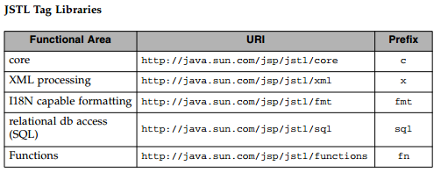
JSP Standard Tag Library (JSTL)
JCP/JSR: https://jcp.org/aboutJava/communityprocess/mrel/jsr052/index2.html
Spec: http://download.oracle.com/otn-pub/jcp/jstl-1.2-mrel2-eval-oth-JSpec/jstl-1_2-mrel2-spec.pdf
Versions: https://en.wikipedia.org/wiki/Java_EE_version_history#Java_EE_7_.28June_12.2C_2013.29
<%@ taglib prefix="c" uri="http://java.sun.com/jsp/jstl/core" %> <%@ taglib prefix="x" uri="http://java.sun.com/jsp/jstl/xml" %> <%@ taglib prefix="fmt" uri="http://java.sun.com/jsp/jstl/fmt" %> <%@ taglib prefix="sql" uri="http://java.sun.com/jsp/jstl/sql" %> <%@ taglib prefix="fn" uri="http://java.sun.com/jsp/jstl/functions" %>

Slide 13
JSTL – maven dependencies
API:
<dependency> <groupId>javax.servlet.jsp.jstl</groupId> <artifactId>javax.servlet.jsp.jstl-api</artifactId> <version>1.2.1</version> </dependency>
IMPL:
<dependency> <groupId>org.glassfish.web</groupId> <artifactId>jstl-impl</artifactId> <version>1.2</version> </dependency>

