Slide 1




Predicting the Impacts of Climate Change on North Carolina’s Agricultural Sector
WORKING DRAFT
2024 AI BOOTCAMP | PROJECT 3
CONTRIBUTORS: Mike Szumski and Jamie Bond

Slide 2
CONTENTS |  | PAGE
Executive Summary |  | 3
Background |  | 4
Approach |  | 5
Modeling and Analysis |  | 5
Findings and Conclusions |  | 13
Additional Questions |  | 14
Reference Content |  | 15
PROJECT OBJECTIVE
In this project, the University of North Carolina Charlotte / Chapel Hill AI Bootcamp project team examined the impacts of weather events, particularly flooding, on North Carolina agriculture and developed predictions about future impacts of climate change driven events on the state’s agricultural sector.

Slide 3
EXECUTIVE SUMMARY
APPROACH
Using Python tools and libraries, the investigating team conducted the following key activities:
Data Transformation – imported, cleaned and joined datasets by location and date attributes or disaster ID
Modeling and Analysis– explored the relationship of the various datasets using
pandas to investigation data correlation and dimensionality
numpy to perform numerical analyses
matplotlib and seaborn to visually explore datasets
KEY FINDINGS
Analyses revealed findings ….
PROJECT OBJECTIVE
To examine the impacts of weather events, particularly flooding, on North Carolina agriculture and develop predictions about future impacts of climate change driven events on the state’s agricultural sector..
DATA SOURCES
Dataset
Dataset
Dataset

Slide 4
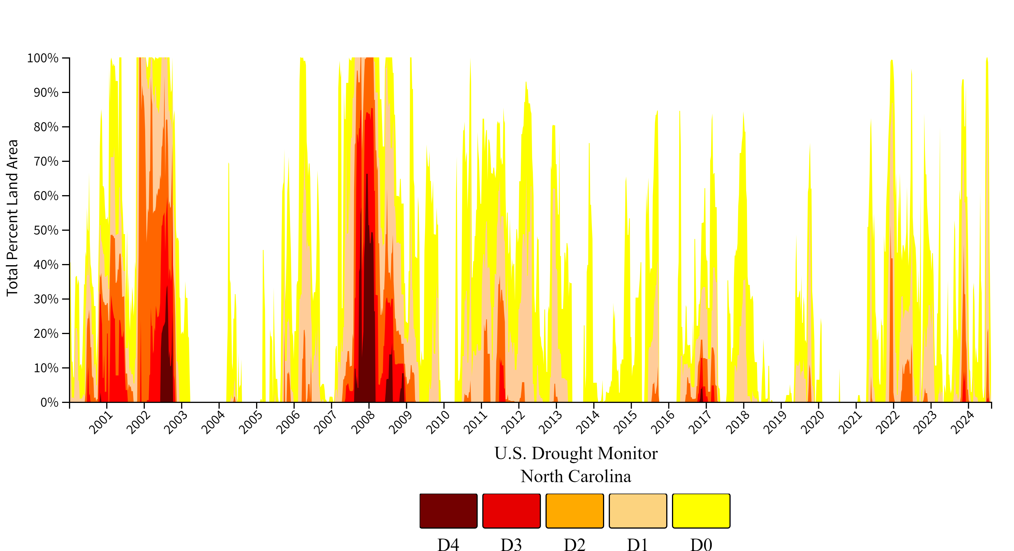
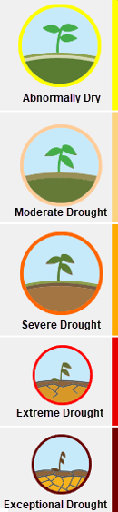
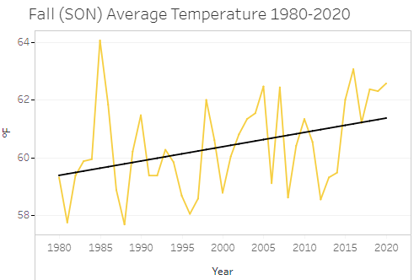
BACKGROUND
[ Warming trends and changes in precipitation patterns across the state …. Importance of agriculture to NC …]
Notes:
Model takes precipitation and temperature
Find relationships plant advisor
Conditions

Slide 5


APPROACH
Seasonal
Weather Data
(Wx)
FEATURES
Temperature
Precipitation
VECTORIZATION
CHAINING
Disaster
Assistance
Program Info
Prompts
Agricultural
Data (Ag)
TARGETS
Corn Yields
[Crop] Yields
[Crop] Yields
ML
Agriculture
Prediction
Model
Insurance
Program Info
Parsers
Harvest Prediction
Model
MODEL TRAINING
LLM
DA
Decisioning & Recommendation Model
Crop
Types
HARVEST
YIELDS
Net Benefit
PROFITABILITY
SEED COSTS
Wx
Forecast
CONFIDENCE LEVELS
COMMODITY PRICING
Financial Prediction
Model
TARGETS
Seed Costs
Commodity Pricing
Farm Protection Plan
Financial
Trends ($)
MODEL TRAINING
Notes:
Model takes precipitation and temperature
Find relationships plant advisor
Conditions

Slide 6
MODELING AND ANALYSIS

Slide 7
RESULTS AND CONCLUSIONS

Slide 8




















ADDITIONAL INVESTIGATION AREAS
MODEL LIMITATIONS
Geospatial Exploration
Location-specific weather and harvest data may reveal information about the impacts of topography (elevation and soil content) on crop yield
Enhanced Weather Data
Additional weather features such as humidity levels, atmospheric pressure and solar irradiance may reveal additional weather influences on yield
Infestations and Disease
Data related to crop-destroying insect populations and disease occurrences as well as pesticide use may reveal new insights on [WHAT?]
Influences of Farming Practices
Individual farming practices are likely to have a material influence on historic harvest data and are not accounted for in the model
Genetic Engineering Techniques
Model does not account for the use of seeds genetically modified for increased drought tolerance or pest resistance

Slide 9
REFERENCE CONTENT
GitHub
Project Repository: github.com/mikeszumski/AgProject3
Contributors
Michael Szumski | @mikeszumski (data wrangling, public health analysis)
Jamie Bond | @JBondAI (dataset identification, storytelling)
Data Providers

Slide 10
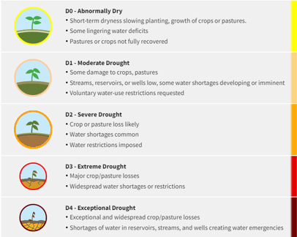
Place holder

Slide 11
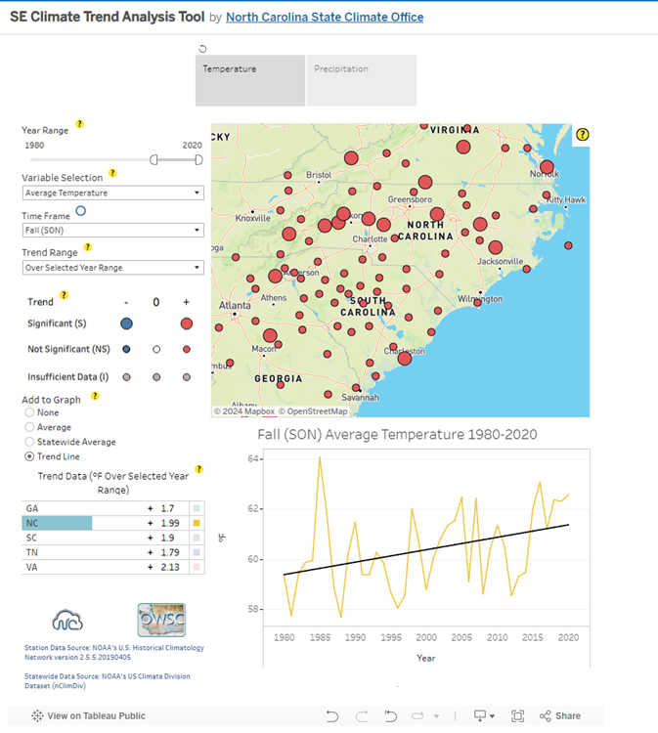
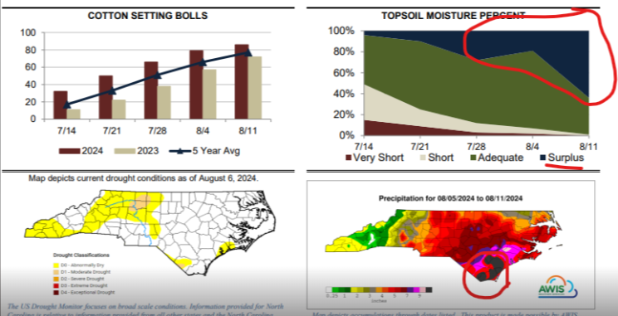
Precipitation and Temperature Data Source
https://public.tableau.com/app/profile/north.carolina.state.climate.office/viz/SEClimateTrendAnalysisTool/TrendAnalysisTool

