Slide 1




Predicting the Impacts of Climate Change on North Carolina’s Agricultural Sector
WORKING DRAFT
2024 AI BOOTCAMP | PROJECT 3
CONTRIBUTORS: Mike Szumski and Jamie Bond

Slide 2
CONTENTS |  | PAGE
Executive Summary |  | 3
Overview |  | 4
Data Exploration |  | 5
Analysis Approach |  | 12
Results and Conclusion |  | 13
Additional Questions |  | 14
Reference Content |  | 15
PROJECT OBJECTIVE
In this project, the University of North Carolina Charlotte / Chapel Hill AI Bootcamp project team examined the impacts of weather events, particularly flooding, on North Carolina agriculture and developed predictions about future impacts of climate change driven events on the state’s agricultural sector.

Slide 3
EXECUTIVE SUMMARY
APPROACH
Using Python tools and libraries, the investigating team conducted the following key activities:
Data Transformation – imported, cleaned and joined datasets by location and date attributes or disaster ID
Modeling and Analysis– explored the relationship of the various datasets using
pandas to investigation data correlation and dimensionality
numpy to perform numerical analyses
matplotlib and seaborn to visually explore datasets
KEY FINDINGS
Analyses revealed findings ….
PROJECT OBJECTIVE
To examine the impacts of weather events, particularly flooding, on North Carolina agriculture and develop predictions about future impacts of climate change driven events on the state’s agricultural sector..
DATA SOURCES
Dataset
Dataset
Dataset

Slide 4
APPROACH
NC Ag Data
ML
ML
ML Analysis
Impact Prediction
NC Wx Data
Guidance
Document
Your
Ag Data
Gen AI
LLM
Coverage
Decision
Q&A Bot
Detailed Instructions
Your
Location
Notes:
PROJECT OBJECTIVE
To examine the impacts of extreme weather and climate events on public health and local economy, with a particular emphasis on extreme heat and impacts to North Carolina
PROJECT OBJECTIVE
In this project, the University of North Carolina Charlotte / Chapel Hill AI Bootcamp project team conducted a data analysis to examine the impacts of extreme weather and climate events on public health and local economy, with a particular emphasis on extreme heat and impacts to North Carolina.

Slide 5
ANALYSIS

Slide 6
ADDITIONAL INVESTIGATION AREAS

Slide 7
REFERENCE CONTENT
GitHub
Project Repository: github.com/mikeszumski/AgProject3
Contributors
Michael Szumski | @mikeszumski (data wrangling, public health analysis)
Jamie Bond | @JBondAI (dataset identification, storytelling)
Data Providers

Slide 8
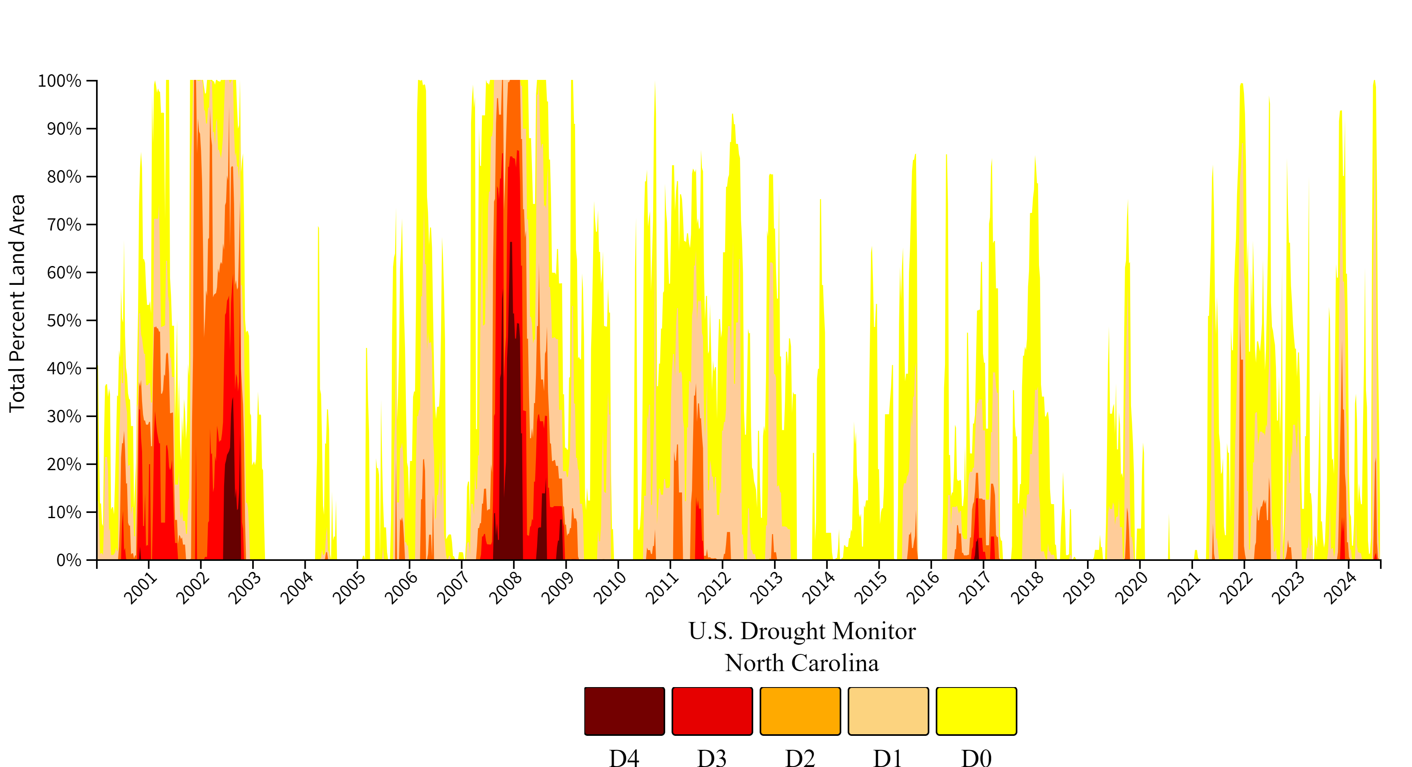
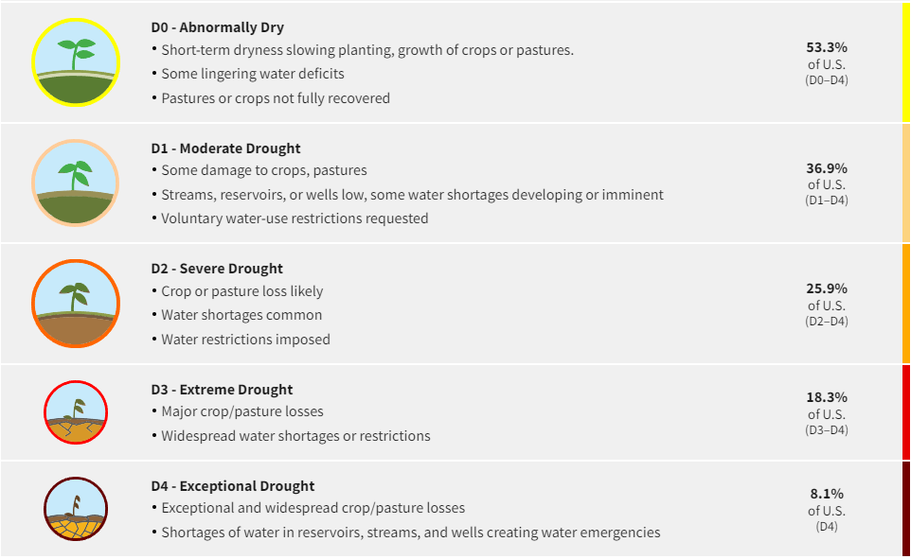
Place holder

