Slide 1
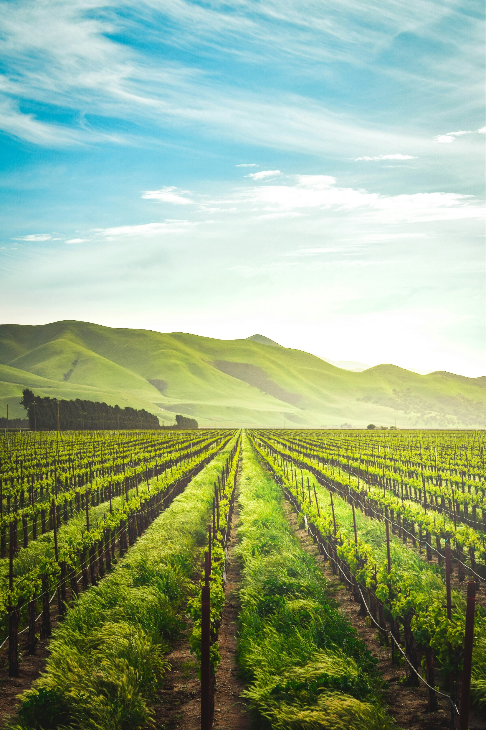
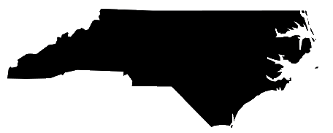


Predicting the Impacts of Climate Change on North Carolina’s Agricultural Sector
WORKING DRAFT
2024 AI BOOTCAMP | PROJECT 3
CONTRIBUTORS: Mike Szumski and Jamie Bond

Slide 2
CONTENTS |  | PAGE
Executive Summary |  | 3
Overview |  | 4
Data Exploration |  | 5
Analysis Approach |  | 12
Results and Conclusion |  | 13
Additional Questions |  | 14
Reference Content |  | 15
PROJECT OBJECTIVE
In this project, the University of North Carolina Charlotte / Chapel Hill AI Bootcamp project team examined the impacts of weather events, particularly flooding, on North Carolina agriculture and developed predictions about future impacts of climate change driven events on the state’s agricultural sector.

Slide 3
EXECUTIVE SUMMARY
APPROACH
Using Python tools and libraries, the investigating team conducted the following key activities:
Data Transformation – imported, cleaned and joined datasets by location and date attributes or disaster ID
Modeling and Analysis– explored the relationship of the various datasets using
pandas to investigation data correlation and dimensionality
numpy to perform numerical analyses
matplotlib and seaborn to visually explore datasets
KEY FINDINGS
Analyses revealed findings ….
PROJECT OBJECTIVE
To examine the impacts of weather events, particularly flooding, on North Carolina agriculture and develop predictions about future impacts of climate change driven events on the state’s agricultural sector..
DATA SOURCES
Dataset
Dataset
Dataset

Slide 4
APPROACH
ML
Threshold for impact
ML
Commodity Trader
NC Ag Data
Good year or
Bad Year
Farmer for planning
NC Wx Data
Trend/probability of future conditions
ML
Guidance
Document
Features: precipitation, temp
Target: yield
Your
Ag Data
Gen AI
LLM
Coverage
Decision
Q&A Bot
Detailed Instructions
Your
Location
Notes:
Model takes precipitation and temperature
Find relationships plant advisor
Conditions

Slide 5
ANALYSIS

Slide 6
ADDITIONAL INVESTIGATION AREAS

Slide 7
REFERENCE CONTENT
GitHub
Project Repository: github.com/mikeszumski/AgProject3
Contributors
Michael Szumski | @mikeszumski (data wrangling, public health analysis)
Jamie Bond | @JBondAI (dataset identification, storytelling)
Data Providers

Slide 8
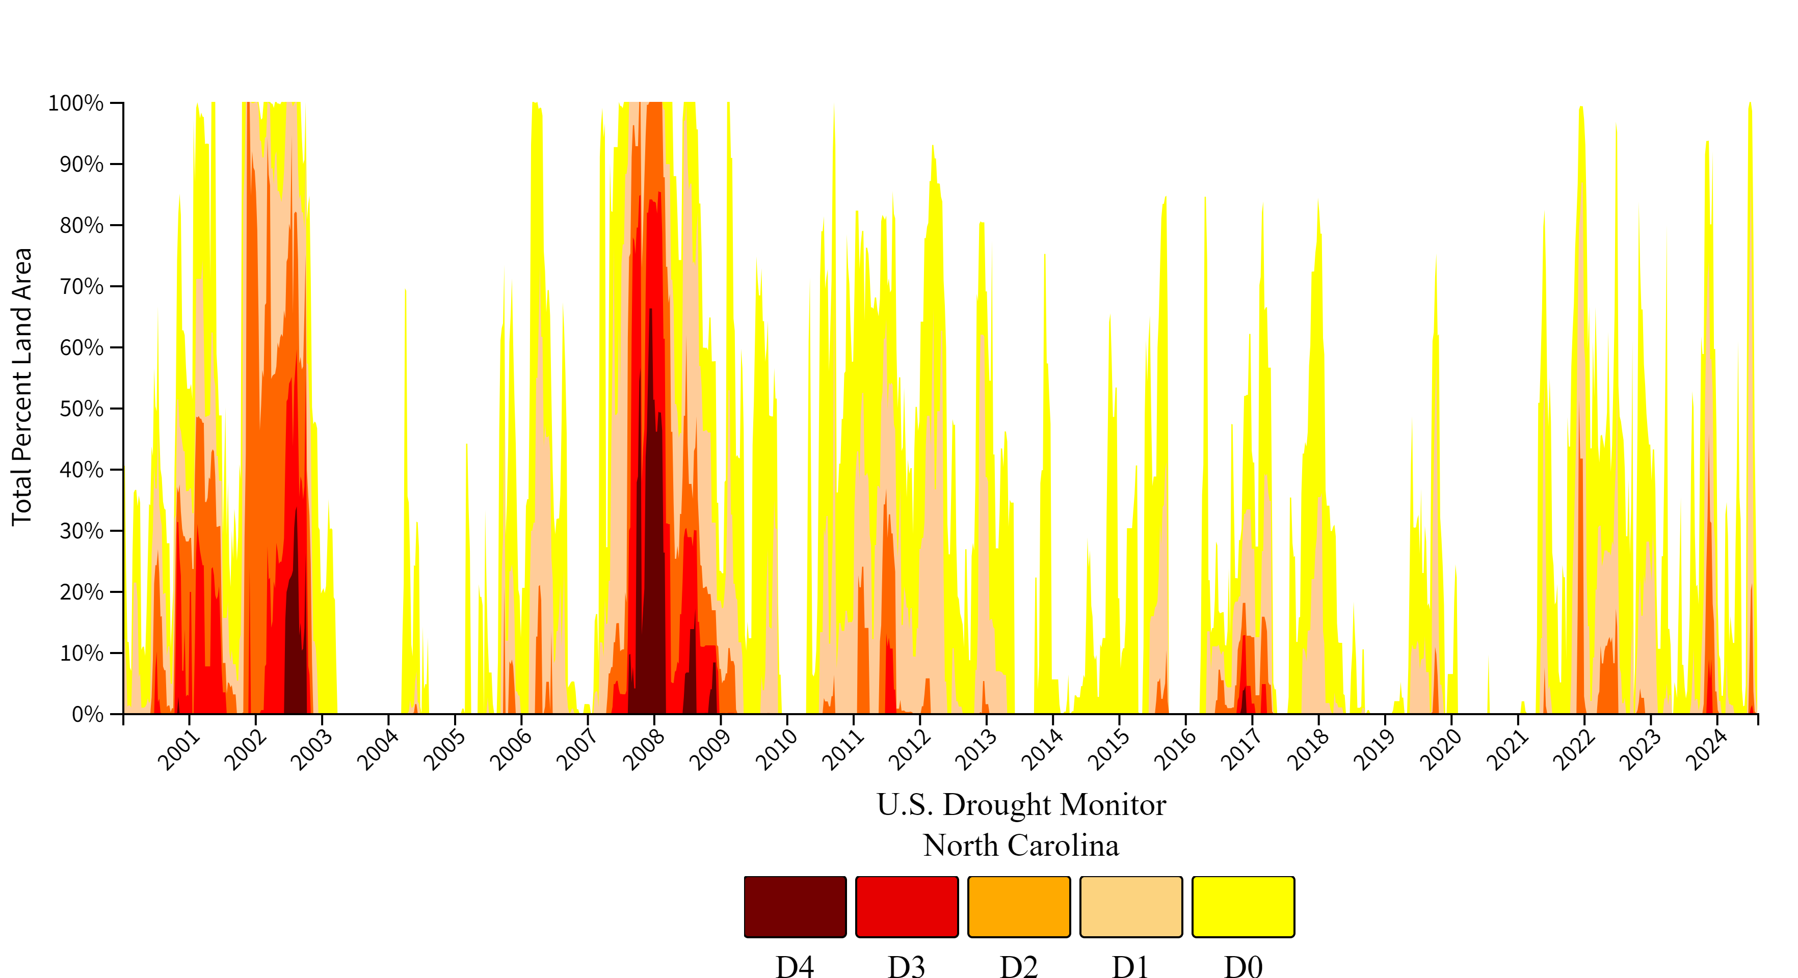
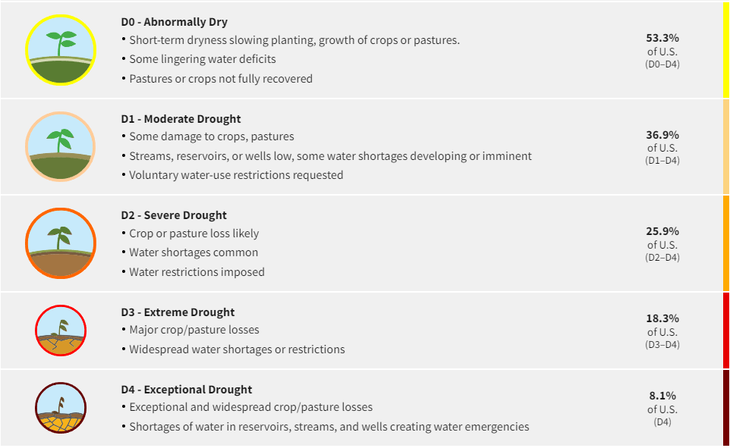
Place holder

Slide 9
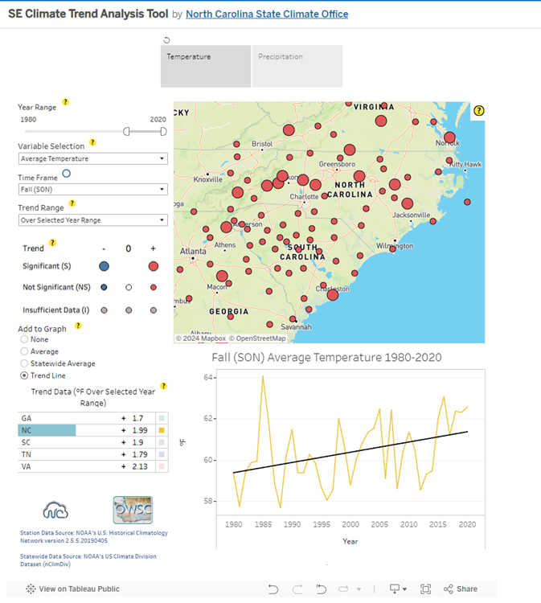
Precipitation and Temperature Data Source
https://public.tableau.com/app/profile/north.carolina.state.climate.office/viz/SEClimateTrendAnalysisTool/TrendAnalysisTool

