Slide 1

MIRJAT
CONSULTANTS

Slide 2
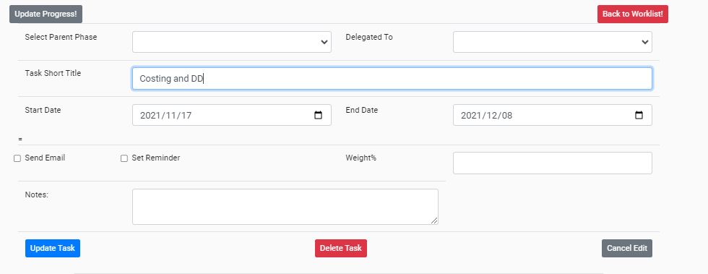

Slide 3
Category
Title
Start Date
End Date (Due Date)
Delegate to PM
Delegate to Other
Instructions
Category
Category

