Slide 1

Moving to Dublin, Ireland
Coursera Python Capstone
October 23, 2020
Michael Culligan

Slide 2
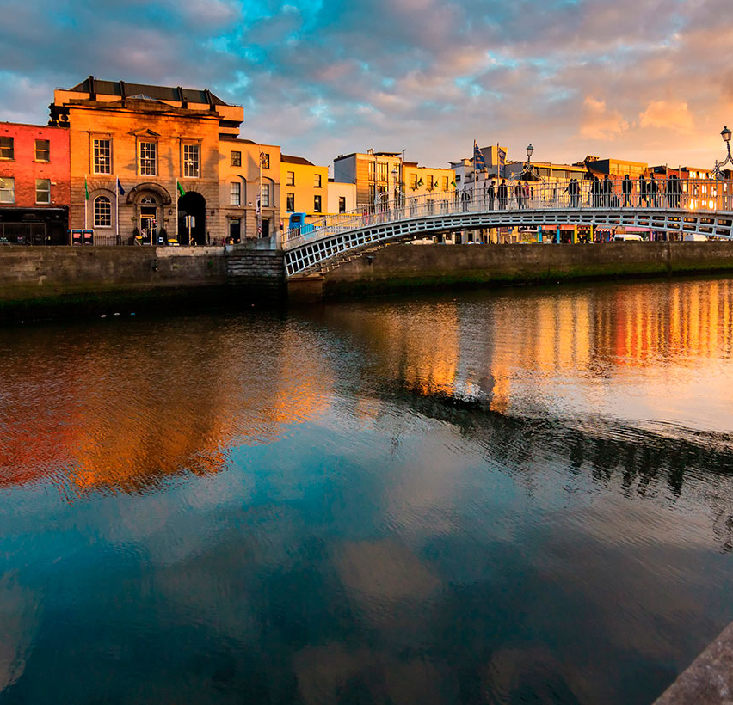
Introduction
Dublin is the capital city of Ireland. Over the past two decades Dublin has emerged as a hub for tech companies, with many jobs available in Data Science.
County Dublin, in which Dublin City is located, is divided into many small neighbourhoods, called Electoral Districts (EDs).
As a Data Analyst, I will be seeking accommodation in Dublin.
In this project I will identify the suitable neighbourhoods in Dublin for me to live in using Foursquare location data.

Slide 3






My Criteria
Café
I like Coffee!
Bar
Id like to have a nice bar or pub in my neighbourhood.
Inside the M50
Dublin City is surrounded by a ring-road to the north, west and south. I wish to live inside this ring-road
Train / Tram Station
Dublin’s buses can be overcrowded and get delayed by rush hour traffic. So I wish to live close to a train or tram station.
Supermarket
I need to be within walking distance of a supermarket.
Italian Restaurant
One of my favourite cuisines.
Gym
I want to live close to a Gym
Indian Restaurant
My other favourite cuisine!
Park
Getting exercise and spending time outdoors is important. So I wish to live close to a park
Cinema / Movie Theatre
I enjoy going to see the latest movies.

Slide 4
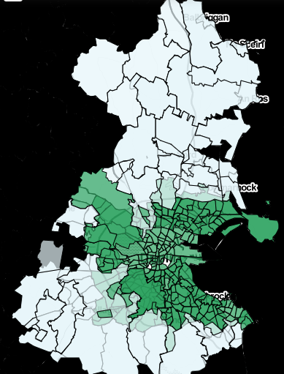
Inside M50
Used Choropleth map from Folium library
Dark Green are neighbourhoods partially or entirely inside M50.
Other neighbourhoods are outside M50 and excluded from rest of analysis.
276 neighbourhoods included.

Slide 5
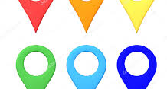
Foursquare Location Data
Attributes used
Joining to spatial data
Name of business / amenity.
Category of that business or amenity e.g. Restaurant. There are 255 distinct categories in Dublin.
Location of that business / amenity, using coordinates
Find all businesses and amenities within 1km of the centre of each neighbourhood. Overall, there are 9187 amenities and businesses.
Identify the neighbourhoods which best match my requirements.
Cluster the remaining neighbourhoods using k-means clustering, an unsupervised machine learning algorithm.

Slide 6
Sample of Data
Neighbourhood | Latitude | Longitude | Venue | Venue Latitude | Venue Longitude | Venue Category
Tallaght-Kingswood | 53.296763 | -6.365558 | Homestore & More | 53.293334 | -6.370574 | Furniture / Home Store
Tallaght-Kingswood | 53.296763 | -6.365558 | Dunnes Stores | 53.298851 | -6.359697 | Supermarket
Tallaght-Kingswood | 53.296763 | -6.365558 | Burger King | 53.293286 | -6.369308 | Fast Food Restaurant
Tallaght-Kingswood | 53.296763 | -6.365558 | Costa Coffee | 53.294775 | -6.355743 | Coffee Shop
Tallaght-Kingswood | 53.296763 | -6.365558 | The Cycle Superstore | 53.293976 | -6.362918 | Sporting Goods Shop

Slide 7
Findings
23 neighbourhoods satisfied at least 8 of the 9 criteria listed.
There are 1666 amenities in these 23 neighbourhoods.
19 of the 23 neighbourhoods are located to the south of the city centre.
9 neighbourhoods satisfied all 9 criteria. Two of these, Rathmines West B and Rathmines East D, also had sports facilities and a waterfront, the two optional extra amenities.
The most common venues across the city are pubs, followed by cafés, coffee shops, supermarkets and restaurants.

Slide 8
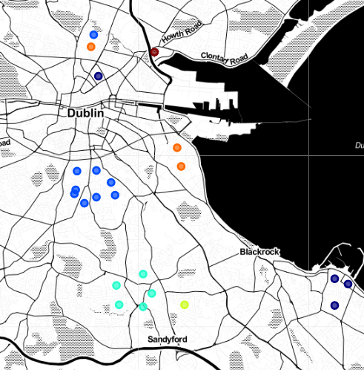
6 Clusters
Neighbourhoods located beside each other usually fall into the same cluster.
4 neighbourhoods to the north of the city centre are in 4 different clusters.
Dark Blue: Dún Laoghaire (and Rotunda)
Blue: Rathmines (and Botanic B)
Teal: Dundrum
Yellow: Stillorgan
Orange: Pembroke (and Botanic C)
Maroon: West Clontarf

Slide 9
Cluster Analysis
Cluster 1
Cluster 2
Cluster 3
Cluster 4
Cluster 5
Cluster 6
Dun Laoghaire-East Central
Dun Laoghaire-Glenageary
Dun Laoghaire-West Central
Rotunda A
Cafes
Coffee Shops
Rathmines East D
Rathmines West A
Rathmines West B
Rathmines West C
Rathmines West D
Rathmines West F
Rathmines and Rathgar East
Rathmines and Rathgar West
Pubs
Restaurants
Cafes
Dundrum
Dundrum-Kilmacud
Dundrum-Sweetmount
Dundrum-Taney
Clothing Stores
Coffee Shops
Cafes
Stillorgan-Kilmacud
Bars
Convenience Stores
Supermarkets
.
Pembroke East
Pembroke East B
Botanic C
Pubs
Hotels
Cafes
Clontarf West D
Cafes
Convenience Stores
Pubs

Slide 10
Top 10 Neighbourhoods by Criteria
Neighbourhood | Water | Sports | Sum Criteria
Rathmines West A | 0 | 1 | 58
Rathmines West C | 0 | 0 | 52
Rathmines East D | 1 | 2 | 46
Rathmines and Rathgar West | 0 | 0 | 45
Rathmines and Rathgar East | 0 | 0 | 45
Rathmines West B | 1 | 1 | 45
Rathmines West F | 0 | 0 | 43
Rotunda A | 0 | 0 | 40
Botanic C | 0 | 0 | 39
Rathmines East D satisfies all 9 criteria, with 46 venues from these categories. It also offers a canal walk and sports facilities.
It is the winning neighbourhood.
With 8 of the top ten neighbourhoods, Rathmines is the winning cluster.

Slide 11

“The villagelike suburb of Rathmines centres on a cluster of upscale gastropubs, global bistros, and coffee shops. Redbrick Victorian houses line the leafy streets.”
Description of Rathmines East D, the winning neighbourhood

