Slide 1
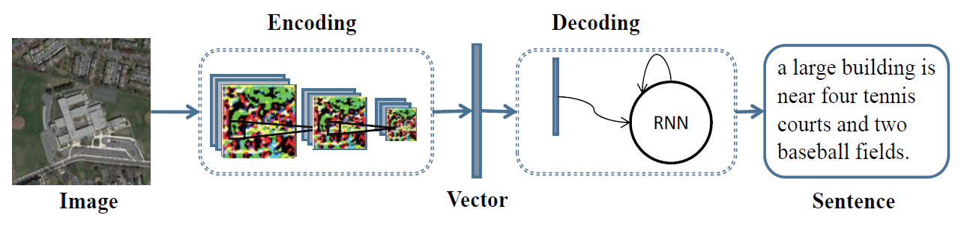
Baseline Model Structure (RNN + LSTM)

Slide 2
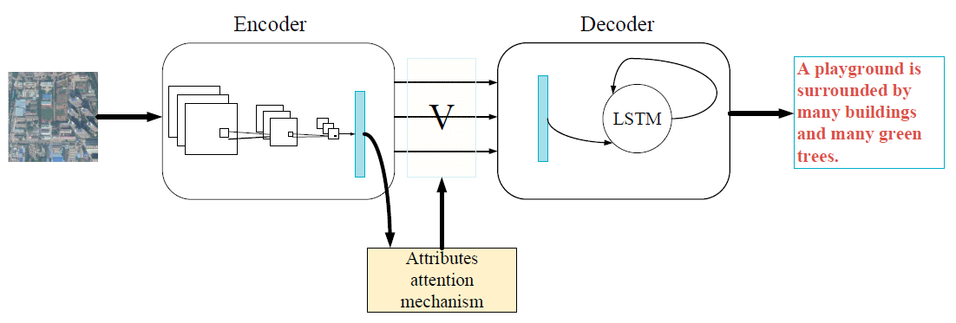
Attention Model Structure (RNN + Attention + LSTM)

Slide 3
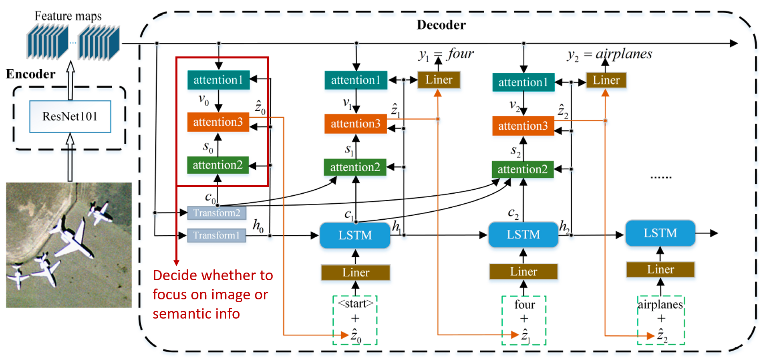
Multi Attention Model Structure (RNN + Multi-Attention+ LSTM)

Slide 4
Transfer Learning
Pre-trained CNN:
InceptionV3
Vgg16
…
Pre-trained embeddings weights:
GloVe (200d)
Wikipedia2Vec (500d)

Slide 5
Transfer Learning
Pre-trained CNN:
InceptionV3
Vgg16
…
Pre-trained embeddings weights :
GloVe (200d)
Wikipedia2Vec (500d)
Pros:
Good performance
Simple to incorporate
Reduces training time
…
Cons:
Performance depends on task similarity
…

Slide 6
Transfer Learning vs. Learning from scratch
Pre-trained CNN model performed better than CNN model learned from scratch
Pre-trained embeddings weights performed better than embeddings weights learned from scratch
We decided to use pre-trained CNN model and embeddings weights

Slide 7
Evaluation scores from the best model of each structure
Test data and train data are from the same datasets
 | n-gram Comparison Evaluation |  |  |  |  |  |  | Semantic Evaluation
MODEL | Bleu 1 | Bleu 2 | Bleu 3 | Bleu 4 | METEOR | ROUGE L | CIDEr | SPICE | USC Similarity
Baseline | 0.648 | 0.523 | 0.440 | 0.381 | 0.300 | 0.553 | 2.125 | 0.400 | 0.612
Attention | 0.572 | 0.435 | 0.351 | 0.294 | 0.256 | 0.473 | 1.540 | 0.324 | 0.550
Multi-Attention | 0.593 | 0.463 | 0.340 | 0.321 | 0.271 | 0.498 | 1.738 | 0.345 | 0.583
Notes:
baseline (slow dataloader, glove embed, vgg16) 9.1.3
attention v3 (fast dataloader, glove embed) 16
multi attention (fast dataloader, wiki2vec embed) 19

Slide 8
Evaluation scores from the best model of each structure
Testing Model Generalization
Test data and train data are from different datasets
 | n-gram Comparison Evaluation |  |  |  |  |  |  | Semantic Evaluation
MODEL | Bleu 1 | Bleu 2 | Bleu 3 | Bleu 4 | METEOR | ROUGE L | CIDEr | SPICE | USC Similarity
Baseline | 0.453 | 0.220 | 0.117 | 0.0717 | 0.145 | 0.290 | 0.210 | 0.119 | 0.458
Attention | 0.431 | 0.209 | 0.108 | 0.0687 | 0.140 | 0.280 | 0.146 | 0.114 | 0.449
Multi-Attention | 0.431 | 0.194 | 0.0778 | 0.0343 | 0.133 | 0.270 | 0.144 | 0.0965 | 0.450
Notes:
baseline (slow dataloader, glove embed, vgg16) 9.1.3
attention v3 (fast dataloader, glove embed) 16
multi attention (fast dataloader, wiki2vec embed) 19

Slide 9
Future Improvements
Optimizing hyperparameters
Finetuning the pre-trained CNN
Extracting features from different convolutional layers
Improving attention structures

