Slide 3
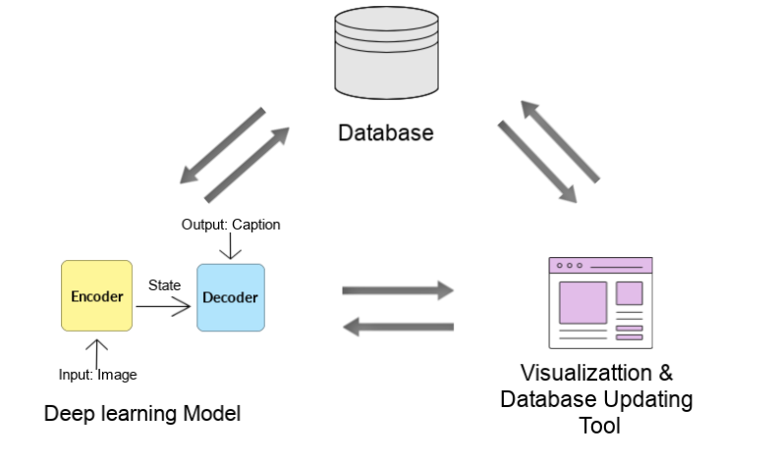
Final Data Product
Complete image captioning pipeline
3 independent modules

Slide 4
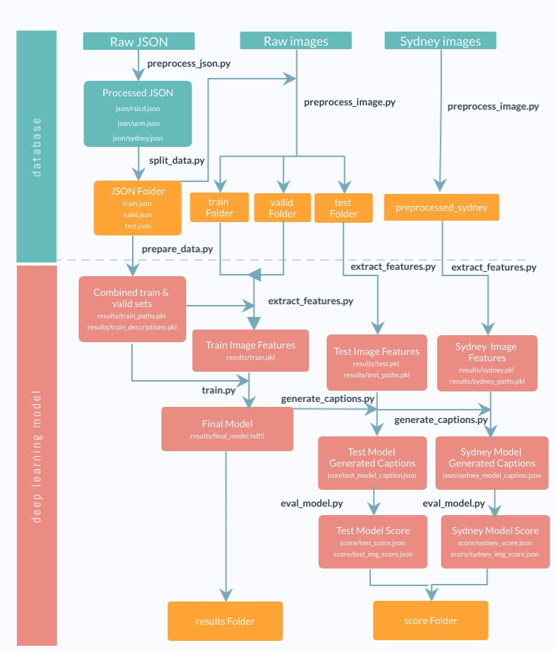
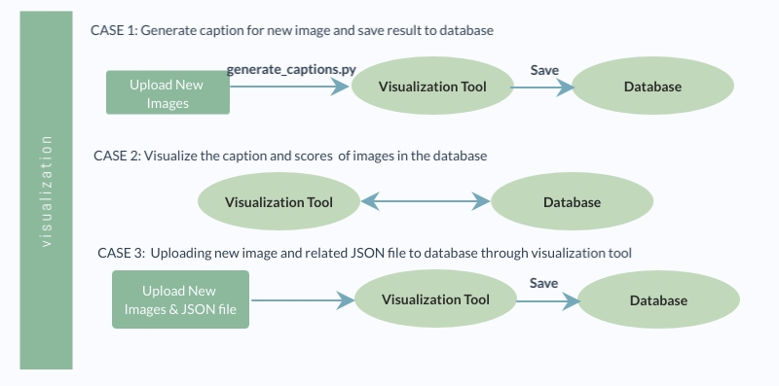
Product Pipeline
Database & Model: GNU Make
Visualization tool: Django

Slide 5
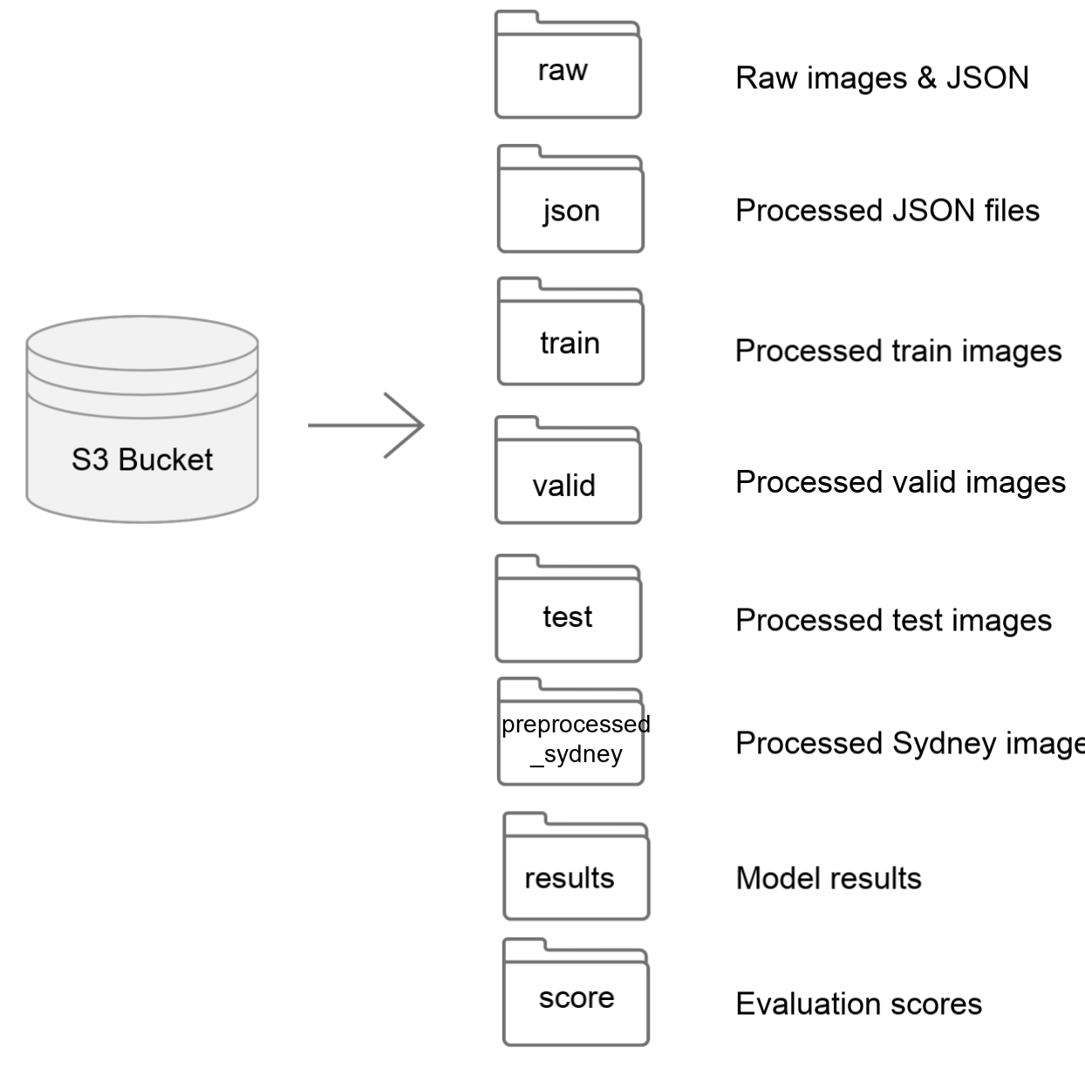
Database
AWS S3 bucket
Advantages:
- Integrate with AWS GPU
- Scalability
- Easy to use
Future improvements

Slide 6
Deep Learning Model: Evaluation Metrics
Total 9 evaluation metrics
N-gram based metrics: Used in research papers
Bleu 1-4
Rouge L
Meteror
CIDEr

Slide 7
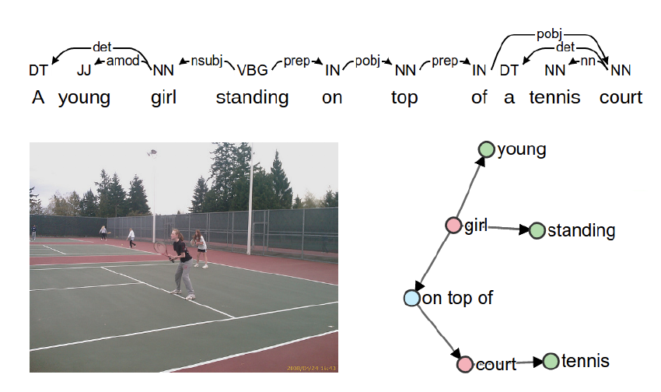
Deep Learning Model: Evaluation Metrics
Semantic-based metrics:
SPICE: scene graph
Universal Sentence Encoder Similarity

Slide 8
Deep Learning Model
Final model: Baseline model with VGG 16 & Glove Embedding
Train
Generate Caption
Evaluate
Save trained model, model results and score back to database
Future Improvements

Slide 9
Visualization Tool
Updates the Database with new images and/or human-annotated captions
Visualizes the model generated caption and score of existing images

Slide 10
Visualization Tool
Demo for showcasing

