Slide 1
Image Captioning of Earth Observation Imagery
MDS-MDA Joint Capstone Project
Dora Qian, Fanli Zhou, James Huang, Mike Chen

Slide 2
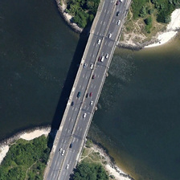
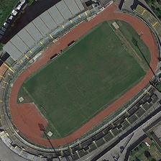
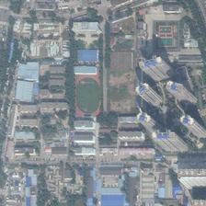
MDA
A Canadian aerospace company
Developed Canadarm and Canadarm2
Access to a vast database of satellite images
These images are uncaptioned

Slide 3
Motivation and Goals
Associating an image with a caption makes it accessible
Sort images based on content
Return queries
Evaluate similarity
Develop a pipeline
Generates a model from raw data
Create a visualization tool
Aim to help users interact with model and data

Slide 4
Objectives
Data Processing
Transform and store data in a well defined and reproducible structure
Creating the Model
Extract features from image
Generate sentence from features
Evaluating the Model
Semantic sentence similarity
N-gram similarity
Visualization Tool
Caption and upload new images to database
View previously generated image/caption pairs and evaluation scores

Slide 5
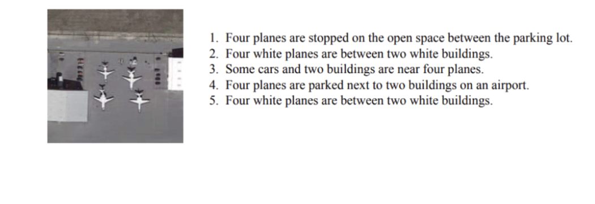
The Data
UCM_Captions
RSICD (Remote Sensing Imaging Captioning Dataset)
Sydney_Dataset
Training on UCM and RSICD, testing on Sydney

Slide 6
CUTOFF
ALL PREVIOUS SLIDES ARE INTRODUCTION
ALL FUTURE SLIDES ARE CONCLUSION

Slide 7
Conclusion
We have been successful in creating a functional data pipeline and visualization tool
Our goals were met and all the features we aimed to create are available
Performance of the model is fair
We hope that MDA can iterate and improve upon our work

Slide 8
Limitations
Relatively small dataset
Poor performance of CNN feature extraction models trained from scratch
Using pre-trained model trained on ImageNet type images
Attention model did not perform as expected
The captions were not significantly improved and was at times worse
Short project time
Lacked time to add or fine tune more layers

Slide 9
Recommendations
Explore training a CNN feature extraction model from scratch
Use much larger captioned satellite image datasets found online
Fix or refine attention model
A well implemented attention model should yield better results
Add or fine tune model layers
More comprehensive cross-dataset performance evaluation

