Slide 3
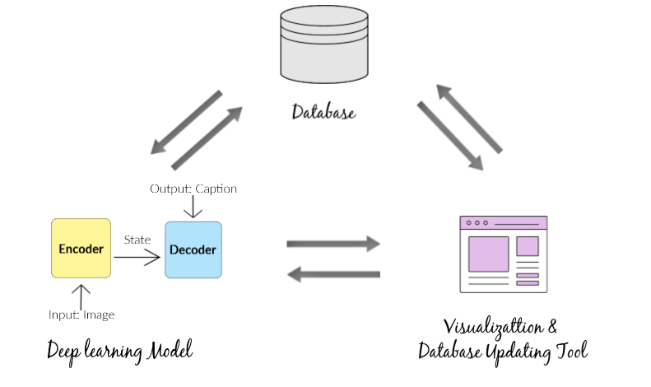
Final Data Product
Complete image captioning pipeline
3 independent modules

Slide 4
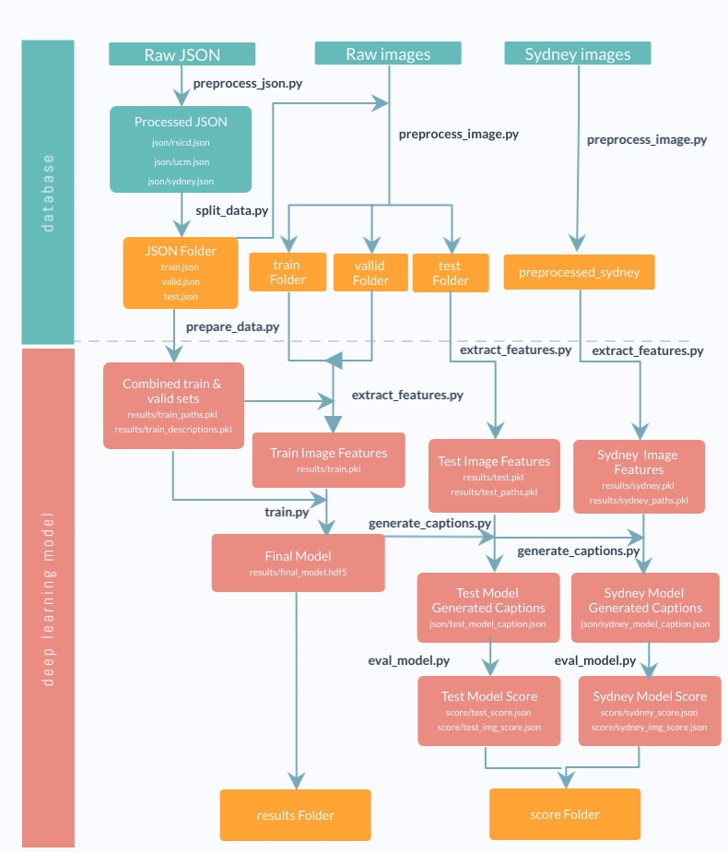
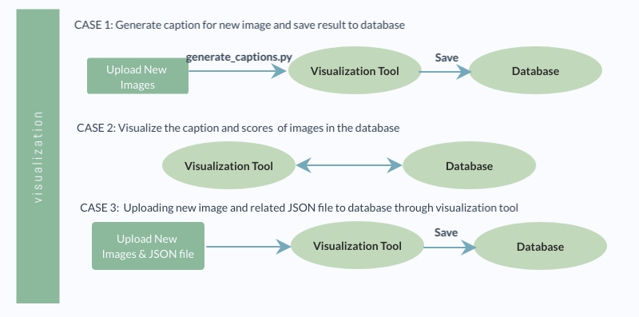
Product Pipeline
Database & Model: GNU Make
Visualization tool: Django

Slide 5
Database
AWS S3 bucket
Advantages:
- Integrate with AWS GPU
- Scalability
- Easy to use
Future improvements

Slide 6
Deep Learning Model: Evaluation Metrics
Total 9 metrics
N-gram based metrics
Bleu 1-4, Rouge L, Meteror, CIDEr
Used in research papers
Semantic-based metrics:
SPICE, Universal Sentence Encoder Similarity

Slide 7
Deep Learning Model
Final model: Baseline model with VGG 16 & Glove Embedding
Future Improvements

Slide 8
Visualization Tool
Updates the Database with new images and/or human-annotated captions
Visualizes the model generated caption and score of existing images

Slide 9
Visualization Tool
Demo for showcasing

