Slide 1
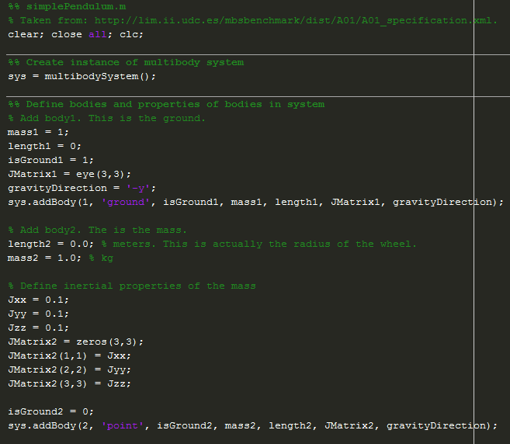
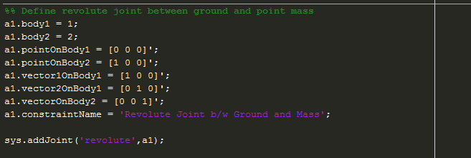

Slide 2
Y
y_{block}
X
x_{block}
g = 9.81 m/s²
45°

