Slide 1
Development and Validation of MATLAB-Based 3D Multibody Kinematics and Dynamics Simulation Engine
Michael Vignos
ME 751
December 16th, 2016

Slide 2
Problem Statement

Slide 3
Object Oriented Programming

Slide 4
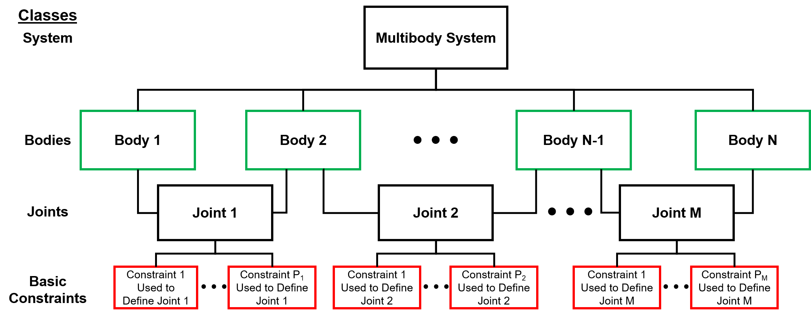
simEngine3D Structure

Slide 5
simEngine3D Structure
External forces and torques applied at the body level.

Slide 6
Validated Constraints and Joints

Slide 7
Force and Torque Options

Slide 8
Analysis of Mechanisms
Only really spend time on the assembly analysis and the computing of initial velocities because everything else we discussed directly in class

Slide 9
simEngine3D Validation

