Slide 1
Development and Validation of MATLAB-Based 3D Multibody Kinematics and Dynamics Simulation Engine
Michael Vignos
ME 751
December 16th, 2016

Slide 2
Problem Statement
To development and validate a 3D multibody kinematics and dynamics simulation engine within MATLAB
Key Features:
Straight-forward to use
Ability to define a multibody system consisting of bodies, constraints (i.e. joints), and externally applied forces and torques
Ability to perform kinematics, inverse dynamics, and dynamics analyses

Slide 3
Key Feature #1:
Straight-forward to use

Slide 4
Object Oriented Programming

Slide 5
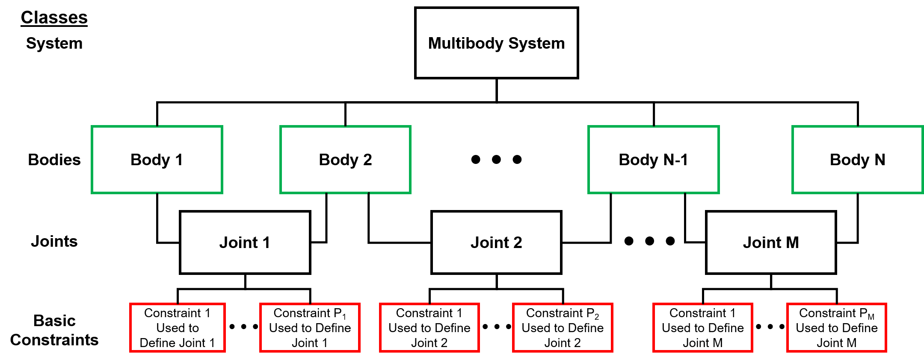
simEngine3D Structure

Slide 6
simEngine3D Structure
External forces and torques applied at the body level.

Slide 7
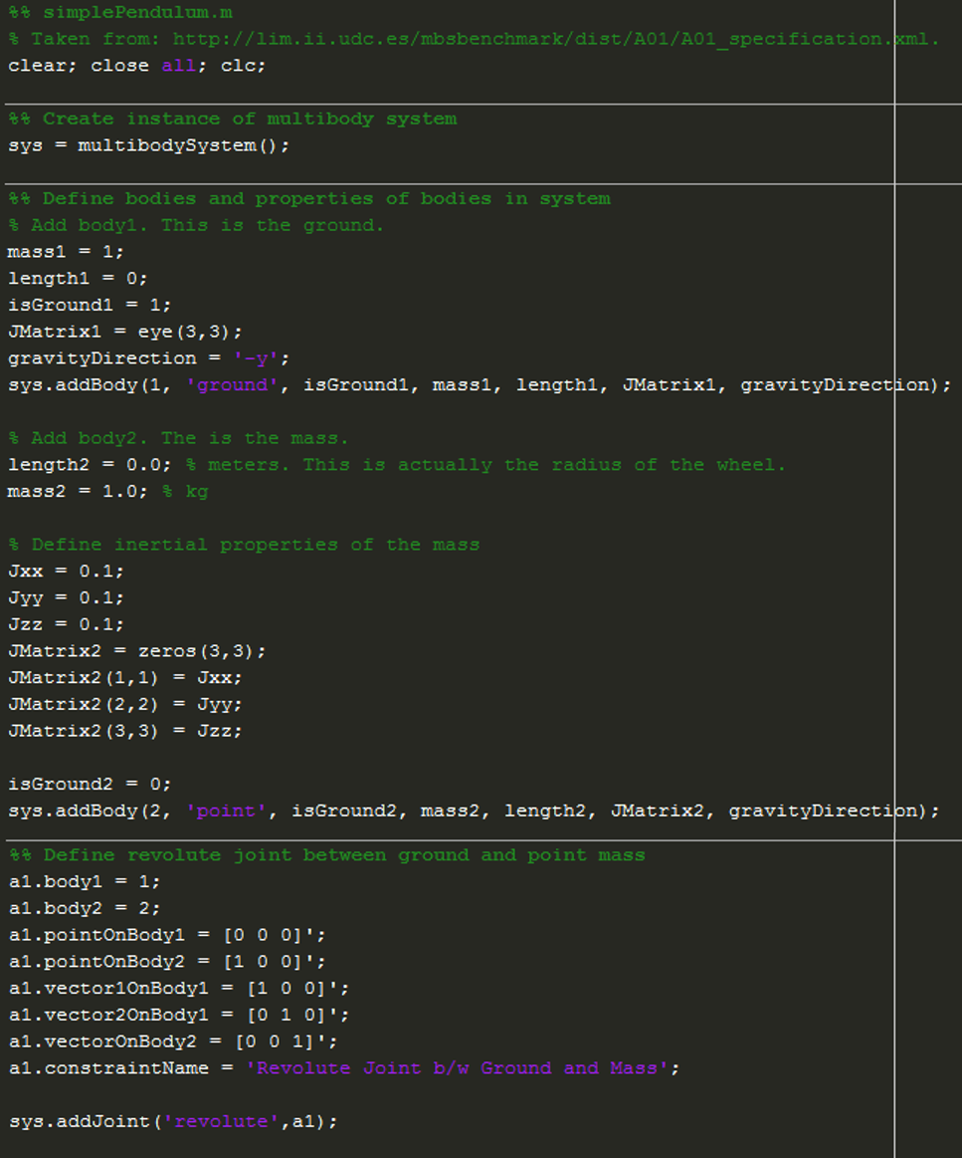
Example Model Definition
Create an instance of the multibody system class
Add a body to the system
Add a joint to the system

Slide 8
Key Feature #2:
Ability to define bodies, constraints (i.e. joints), and externally applied forces and torques

Slide 9
Validated Constraints and Joints
Basic Constraints
Dot Product 1 constraint
Dot Product 2 constraint
Distance constraint
Coordinate difference constraint
Intermediate Constraints
Parallel 1 constraint
Parallel 2 constraints
Joints

Slide 10
Adding Joints to System

Slide 11
Force and Torque Options

Slide 12
Variable Torque

Slide 13
TSDA

Slide 14
Analysis of Mechanisms
Only really spend time on the assembly analysis and the computing of initial velocities because everything else we discussed directly in class

Slide 15
simEngine3D Validation
Simple pendulum with revolute joint

