Slide 1
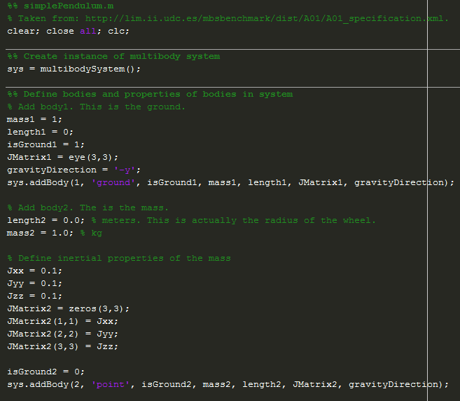
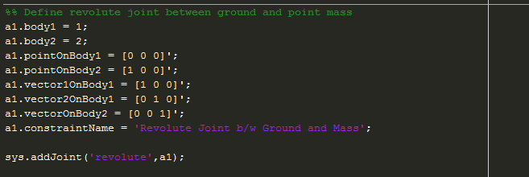

Slide 2
Y
y_{block}
X
x_{block}
g = 9.81 m/s²
45°

Slide 3
Classes
Multibody System
System
Body 1
Body 2
• • •
Body N-1
Body N
Bodies
Joints
Joint 1
Joint 2
• • •
Joint M
Basic
Constraints
Constraint 1 Used to Define Joint 1
• • •
Constraint P₁ Used to Define Joint 1
Constraint 1 Used to Define Joint 2
• • •
Constraint P₂ Used to Define Joint 2
Constraint 1 Used to Define Joint M
• • •
Constraint P_{M} Used to Define Joint M

Slide 4
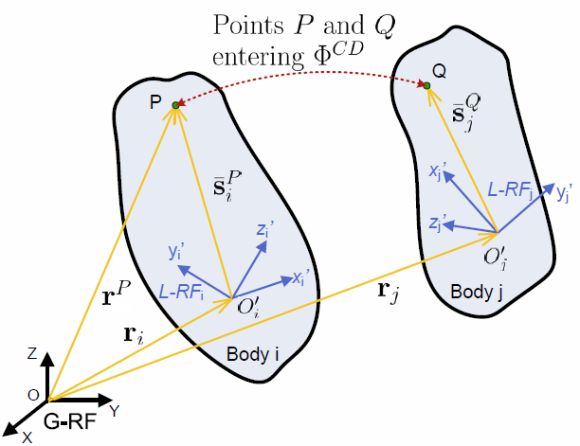
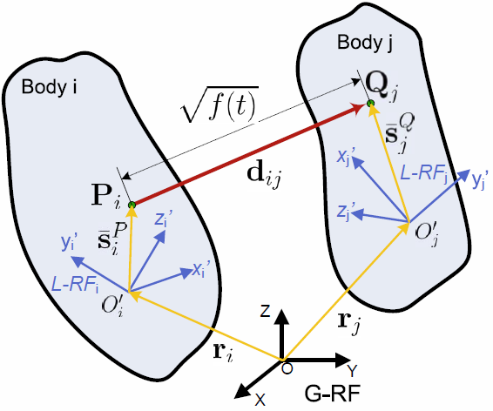
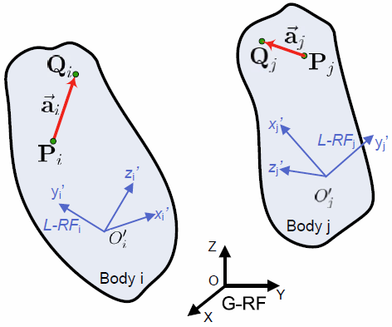
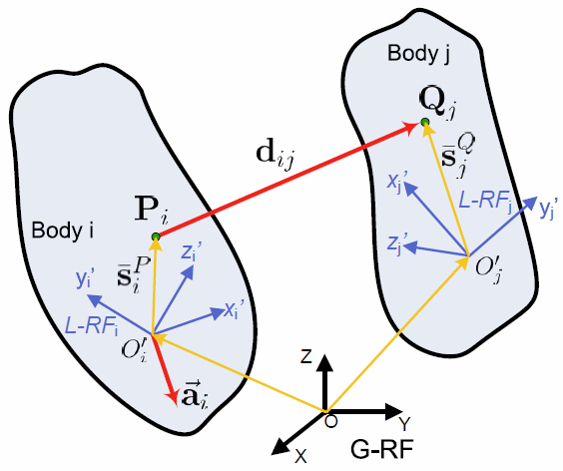
A
CD Constraint
B
D Constraint
C
DP1 Constraint
D
DP2 Constraint

Slide 5
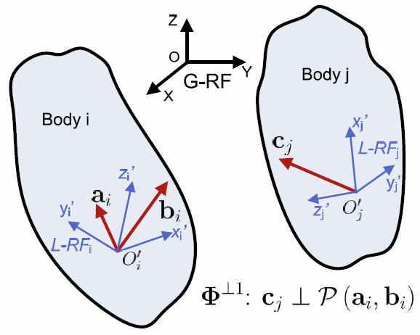
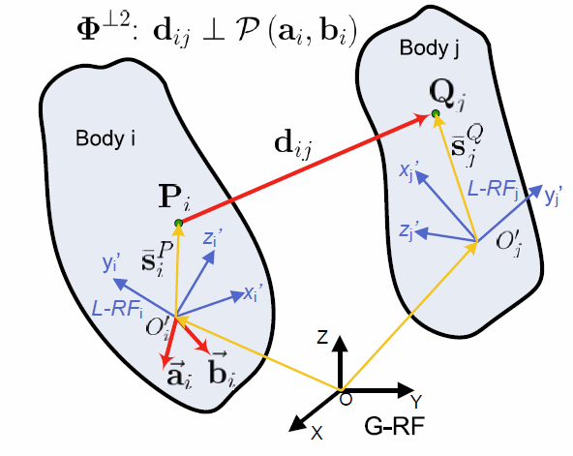
A
B1 Constraint
B
B2 Constraint

Slide 6
