Slide 1
Inference Engine

Slide 2
Apply Von Mises PDF Process to graph theory to create strategy space for possible enemy strategies
Use observations to strengthen leaves in tree with multiplicative effect
A new leaf in a branch normalizes the old leaf node to be like every other inner node
Over time, strategy leaf nodes will emerge as obvious enemy choice
While strategies are still being formed, Nova can act based on what region/quadrant has the largest average height

Slide 3
Edge weight increase with each unit spotted
Learned?

Slide 4
Vulture Rush
Marine Rush
Compiled observations about enemy base, when normalized, is compared to strategy trees using graph similarity metrics

Slide 5
Option A: Distance metric
Compare state graph to strategies graph and select the one with the lowest graph distance (if all above threshold, stick with default strategy)

Slide 6
Option B: Strategy Space
Lay out all strategies into a single supergraph and let the PDF additive process downselect to strategy leaf nodes for “localizing” on approach

Slide 7
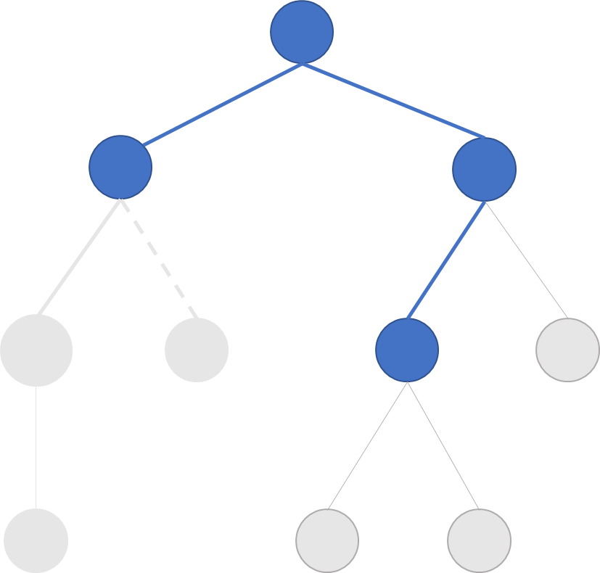
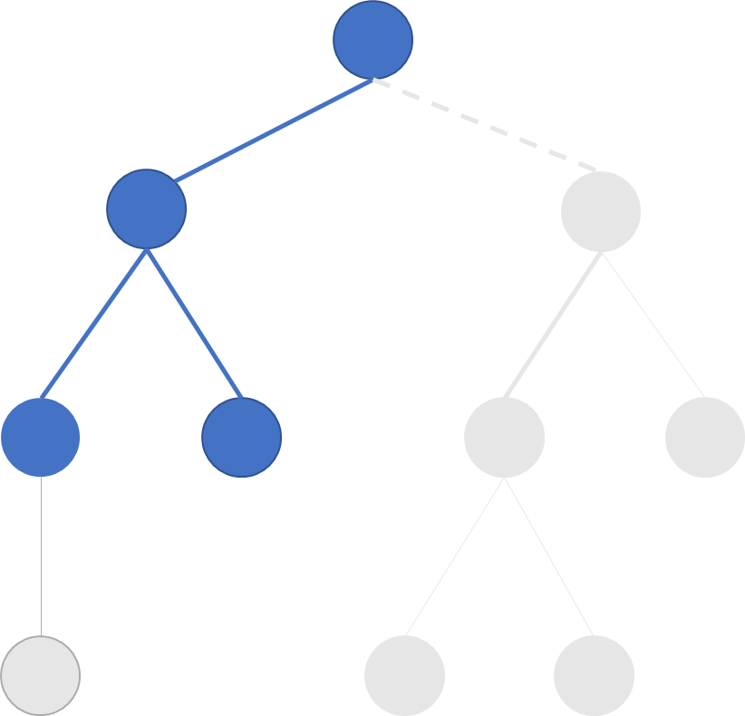
Ground Strategies
Aggressive Strategies
Defensive Strategies
Air Strategies

Slide 8
Ground Strategies
Aggressive Strategies
Defensive Strategies
Air Strategies

Slide 9
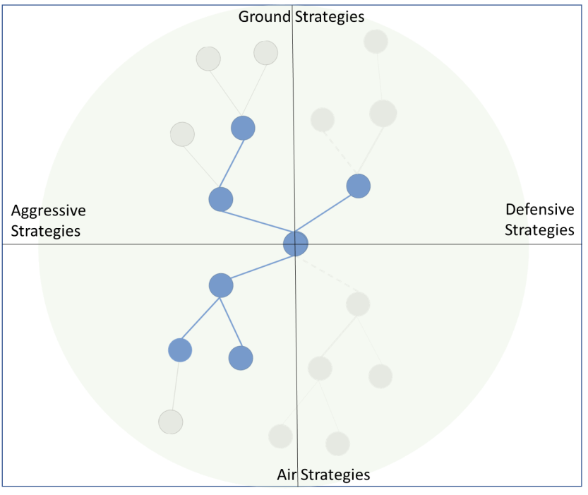
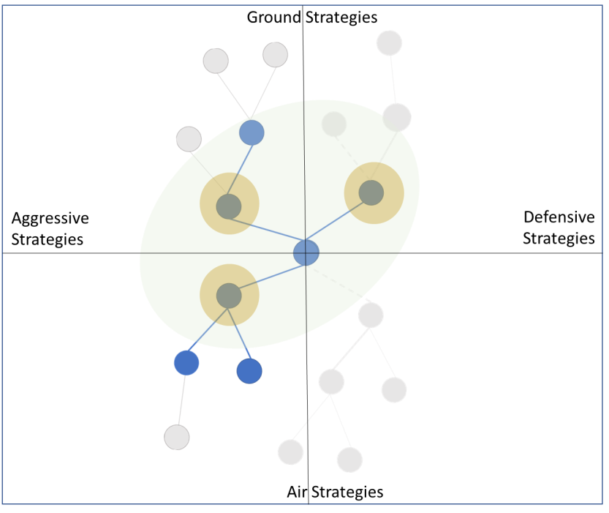
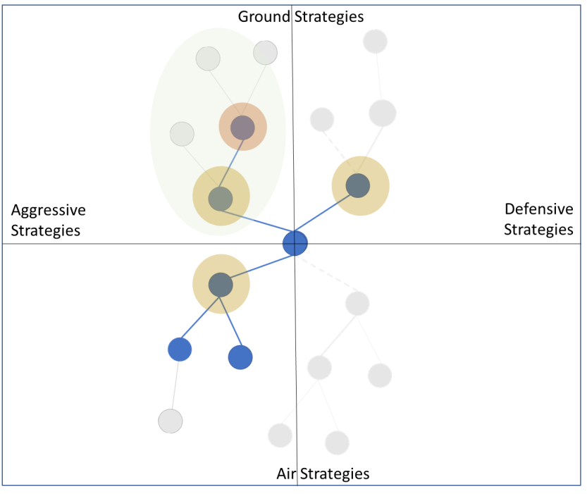

Slide 12

Architecture
StarCraft
BWAPI
NOVA
Intent Recognition Engine (IRE)
ID Enemy Strategy
Strategies
Propose Counter-Strategy
Evaluator
Read and Write Strategies

Slide 13
Architecture
PDDL File
Nova AI Module
Strategy Reader
Game Interface
(BWAPI)
Strategy Manager
Strategy Space
Strategies
UnitType
Status
Update Template Weights
Test Driver
Tech Tree Manager
Information Manager
Tech Tree Manager
Tech Tree Manager

Slide 14
Strategy Reader
PDDL File
Test Driver
Strategy Space
Strategies
Game Interface
(BWAPI)
Nova AI Module
Tech Tree Manager
Tech Tree Manager
(I) Tech Tree Manager

Slide 15
NOVA Mapping
IRE Function | NOVA Class | NOVA Function | Notes
Initialize | NovaAIModule.cpp | onStart (31)
Process observed enemy unit | NovaAIModule.cpp SquadManager.cpp | onUnitShow (533) newEnemy (639)
Process observed enemy building | ? | ? | Is enemySeen both buildings and units?
Load strategies | StrategyManager.cpp | Constructor (84)
Identify Strategy | StrategyManager.cpp | onFrame (239)
Recommend Results | StrategyManager.cpp | onFrame (240)
Produce Units | StrategyManager.cpp | onFrame | informationManager->_percentList informationManager->_turretList informationManager->buildRequest

Slide 16
Schedule
 | T1 1 2 3 4 5 6 7 8 9 10 11 12 | T2 13 14 15 16 17 18 19 20 21 22 23 24
Design
Develop
Test
Document
Design Done
Toy Demo
Software Done
Testing Done
Thesis Submission
Req
Arch
Toy Problem
Final Product
V&V for Thesis
Writing Thesis
Thesis Outline
Thesis Rev1

Slide 17
Strategies - Terran
Name | A vs AA | G vs AG | Atk vs Def
Bio (marines/medics) | -0.25 | 0.75 | 1
Rax_fe (second base) | 0 | 0 | -1
Two_facto(tanks) | 0 | 1 | 0.5
Vultures | 0 | 1 | 0.75
Air(wraiths) | 0.75 | -0.5 | 0.25
drop | 0.25 | 0.25 | -0.25

Slide 18
Strategies - Protoss
Name | A vs AA | G vs AG | Aggressive vs Def
Two_gates (zealots) | 0 | 1 | 1
fast_dt (dark templars) | -0.25 | 0 | 0
Templar | -0.5 | 0 | 0.5
Speedzeal (zealots+upgrades) | 0 | 1 | 0.75
Corsair | -1 | 0 | -0.75
Nony (dragoons) | 0 | 0 | 0.5
Reaver_drop | 0.25 | 0 | -0.25

Slide 19
Strategies - Zerg
Name | A vs AA | G vs AG | Atk vs Def
Speedlings (zerlings) | 0 | 1 | 1
Fast_mutas (mutalisks) | 1 | -1 | 0.25
Mutas (expand+mutas) | 0.75 | -0.75 | -0.25
Lurkers | 0 | 0 | -0.25
Hydras | -0.25 | 1 | 0.75

