Slide 1

Deep Unsupervised Learning Using Nonequilibrium Thermodynamics
Lightning-Chat
Joshua Bowen & Racquel Bowen

Slide 2
Chat Focus: The math
If you read the paper and understood all of it perfectly…

Slide 3
Chat Focus: The math
If you read the paper and understood all of it perfectly….this presentation won’t be very interesting for you…

Slide 4
Chat Focus: The math
If you read the paper and understood all of it perfectly….this presentation won’t be very interesting for you…
For anyone who might have gotten a little lost or confused…

Slide 5
Chat Focus: The math
If you read the paper and understood all of it perfectly….this presentation won’t be very interesting for you…
For anyone who might have gotten a little lost or confused… we thought it would be helpful to look at some of the equations from the paper to see what’s happening and what tricks the authors used.

Slide 6
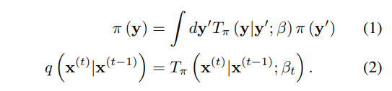


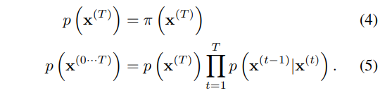
Model Setup
Equation (1)
This equation defines how we move from state y’ to state y.

Slide 7
Model Setup
Equation (1)
This equation defines how we move from state y’ to state y.
On the LEFT we have “π(y)” – this means the distribution of the data at state y.

Slide 8
Model Setup
Equation (1)
This equation defines how we move from state y’ to state y.
On the LEFT we have “π(y)” – this means the distribution of the data at state y.
On the RIGHT we have an integral with respect to dy’. We integrate with respect to dy’ because we are summing over the continuous space of all possible states that y’ could be.

Slide 9
Model Setup
Equation (1)
This equation defines how we move from state y’ to state y.
On the LEFT we have “π(y)” – this means the distribution of the data at state y.
On the RIGHT we have an integral with respect to dy’. We integrate with respect to dy’ because we are summing over the continuous space of all possible states that y’ could be.
The T_{π} (y|y’; β) is what the paper calls the Markov diffusion kernel – it is like the transition probability matrix P but for continuous variables -- it provides the probability density – how likely we are to go from y’ to y in 1 time-step (β).

Slide 10
Model Setup
Equation (1)
This equation defines how we move from state y’ to state y.
On the LEFT we have “π(y)” – this means the distribution of the data at state y.
On the RIGHT we have an integral with respect to dy’. We integrate with respect to dy’ because we are summing over the continuous space of all possible states that y’ could be.
The T_{π} (y|y’; β) is what the paper calls the Markov diffusion kernel – it is like the transition probability matrix P but for continuous variables -- it provides the probability density – how likely we are to go from y’ to y in 1 time-step (β).
Finally, we multiple by π(y’) – to represent the probability of getting to state y’ in the first place.

Slide 11
Model Setup
Equation (1)
This equation defines how we move from state y’ to state y.
On the LEFT we have “π(y)” – this means the distribution of the data at state y.
On the RIGHT we have an integral with respect to dy’. We integrate with respect to dy’ because we are summing over the continuous space of what all possible states that y’ could be.
The T_{π} (y|y’; β) is what the paper calls the Markov diffusion kernel – it is like the transition probability matrix P but for continuous variables -- it provides the probability density – how likely we are to go from y’ to y in 1 time-step (β).
Finally, we multiple by π(y’) – to represent the probability of getting to state y’ in the first place.
BIG IDEA

Slide 12
Model Setup
Equation (1)
This equation defines how we move from state y’ to state y.
On the LEFT we have “π(y)” – this means the distribution of the data at state y.
On the RIGHT we have an integral with respect to dy’. We integrate with respect to dy’ because we are summing over the continuous space of what all possible states that y’ could be.
The T_{π} (y|y’; β) is what the paper calls the Markov diffusion kernel – it is like the transition probability matrix P but for continuous variables -- it provides the probability density – how likely we are to go from y’ to y in 1 time-step (β)
Finally, we multiple by π(y’) – to represent the probability of getting to state y’ in the first place.
BIG IDEA
Equation (1): Defines how to get from the distribution at state y’ to the one at state y in 1 time-step

Slide 13
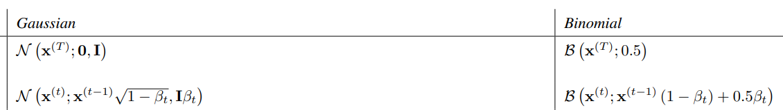
Model Setup
Equation (2)
This is where the authors define the Markov Chain based on what we just talk about –

Slide 14
Model Setup
Equation (2)
This is where the authors define the Markov Chain based on what we just talk about – they say the probability of getting from state x^{(t-1)} to x^{(t)} is just the probability density assigned by the kernel in the time-step specific to t which is β_{t}.

Slide 15
Model Setup
Equation (2)
This is where the authors define the Markov Chain based on what we just talk about – they say the probability of getting from state x^{(t-1)} to x^{(t)} is just the probability density assigned by the kernel in the time-step specific to t which is β_{t}.
The diffusion kernel provides transition probabilities.

Slide 16
Model Setup
Equation (2)
This is where the authors define the Markov Chain based on what we just talk about – they say the probability of getting from state x^{(t-1)} to x^{(t)} is just the probability density assigned by the kernel in the time-step specific to t which is β_{t}.
The diffusion kernel provides transition probabilities.
The specific kernels the authors use – in the appendix – are responsible for adding the Gaussian noise in the images.

Slide 17
Model Setup
Equation (2)
This is where the authors define the Markov Chain based on what we just talk about – they say the probability of getting from state x^{(t-1)} to x^{(t)} is just the probability density assigned by the kernel in the time-step specific to t which is β_{t}.
The diffusion kernel provides transition probabilities.
The specific kernels the authors use – in the appendix – are responsible for adding the Gaussian noise in the images.
The previous state x^{(t-1)} (you can think of it as the signal or structure from the data) is made smaller by multiplying by √ of 1-β_{t}.

Slide 18
Model Setup
Equation (2)
This is where the authors define the Markov Chain based on what we just talk about – they say the probability of getting from state x^{(t-1)} to x^{(t)} is just the probability density assigned by the kernel in the time-step specific to t which is β_{t}.
The diffusion kernel provides transition probabilities.
The specific kernels the authors use – in the appendix – are responsible for adding the Gaussian noise in the images.
The previous state x^{(t-1)} (you can think of it as the signal or structure from the data) is made smaller by multiplying by √ of 1-β_{t}.
And we add β_{t} of covariance which is Gaussian noise.

Slide 19
Model Setup
Equation (2)
This is where the authors define the Markov Chain based on what we just talk about – they say the probability of getting from state x^{(t-1)} to x^{(t)} is just the probability density assigned by the kernel in the time-step specific to t which is β_{t}.
The diffusion kernel provides transition probabilities.
The specific kernels the authors use – in the appendix – are responsible for adding the Gaussian noise in the images.
The previous state x^{(t-1)} (you can think of it as the signal or structure from the data) is made smaller by multiplying by √ of 1-β_{t}.
And we add β_{t} of covariance which is Gaussian noise.
For Binomial it’s almost easier to see what is happening –

Slide 20
Model Setup
Equation (2)
This is where the authors define the Markov Chain based on what we just talk about – they say the probability of getting from state x^{(t-1)} to x^{(t)} is just the probability density assigned by the kernel in the time-step specific to t which is β_{t}.
The diffusion kernel provides transition probabilities.
The specific kernels the authors use – in the appendix – are responsible for adding the Gaussian noise in the images.
The previous state x^{(t-1)} (you can think of it as the signal or structure from the data) is made smaller by multiplying by √ of 1-β_{t}.
And we add β_{t} of covariance which is Gaussian noise.
For Binomial it’s almost easier to see what is happening – it’s just a weighted sum between the previous state and the default value of ½ .

Slide 21
Model Setup
Equation (2)
This is where the authors define the Markov Chain based on what we just talk about – they say the probability of getting from state x^{(t-1)} to x^{(t)} is just the probability density assigned by the kernel in the time-step specific to t which is β_{t}.
The diffusion kernel provides transition probabilities.
The specific kernels the authors use – in the appendix – are responsible for adding the Gaussian noise in the images.
The previous state x^{(t-1)} (you can think of it as the signal or structure from the data) is made smaller by multiplying by √ of 1-β_{t}.
And we add β_{t} of covariance which is Gaussian noise.
For Binomial it’s almost easier to see what is happening – it’s just a weighted sum between the previous state and the default value of ½ .
BIG IDEA
Equation (2): says that every link in the Markov chain is defined by the diffusion kernel

Slide 22
Model Setup
Equation (3)
Now that we have our chain defined in Eq (2)… we can notice a useful property by combining the definition of the chain and the Markov property.

Slide 23
Model Setup
Equation (3)
Now that we have our chain defined in Eq (2)… we can notice a useful property by combining the definition of the chain and the Markov property.
If we want to know the distribution of our data after doing T steps of diffusion (or T applications of our noise-adding kernels).

Slide 24
Model Setup
Equation (3)
Now that we have our chain defined in Eq (2)… we can notice a useful property by combining the definition of the chain and the Markov property.
If we want to know the distribution of our data after doing T steps of diffusion (or T applications of our noise-adding kernels).
Start with the probability of state x⁽⁰⁾.

Slide 25
Model Setup
Equation (3)
Now that we have our chain defined in Eq (2)… we can notice a useful property by combining the definition of the chain and the Markov property.
If we want to know the distribution of our data after doing T steps of diffusion (or T applications of our noise-adding kernels).
Start with the probability of state x⁽⁰⁾.
Then multiply the conditional probabilities of the next state based on the previous state.

Slide 26
Model Setup
Equation (4)
At this point we have covered the 3 equations that define the forward diffusion process that takes us from data to Gaussian noise.

Slide 27
Model Setup
Equation (4)
At this point we have covered the 3 equations that define the forward diffusion process that takes us from data to Gaussian noise.
Eq (4) & (5) are describing the reverse process and remember this must be learned step by step.

Slide 28
Model Setup
Equation (4)
At this point we have covered the 3 equations that define the forward diffusion process that takes us from data to Gaussian noise.
Eq (4) & (5) are describing the reverse process and remember this must be learned step by step.
BIG IDEA

Slide 29
Model Setup
Equation (4)
At this point we have covered the 3 equations that define the forward diffusion process that takes us from data to Gaussian noise.
Eq (4) & (5) are describing the reverse process and remember this must be learned step by step.
BIG IDEA
Equation (4): Is just notation saying something we already know… the reverse chain at step T is just the well-behaved tractable distribution we forced it to be… this is just defining the starting point of the reverse distribution

Slide 30
Model Setup
Equation (4)
At this point we have covered the 3 equations that define the forward diffusion process that takes us from data to Gaussian noise.
Eq (4) & (5) are describing the reverse process and remember this must be learned step by step.
BIG IDEA
Equation (4): Is just notation saying something we already know… the reverse chain at step T is just the well-behaved tractable distribution we forced it to be… this is just defining the starting point of the reverse distribution

Slide 31
Model Setup
Equation (4)
At this point we have covered the 3 equations that define the forward diffusion process that takes us from data to Gaussian noise.
Eq (4) & (5) are describing the reverse process and remember this must be learned step by step.
BIG IDEA
Equation (4): Is just notation saying something we already know… the reverse chain at step T is just the well-behaved tractable distribution we forced it to be… this is just defining the starting point of the reverse distribution.

Slide 32
Model Setup
Equation (5)
Equation (4): Is just notation saying something we already know… the reverse chain at step T is just the well-behaved tractable distribution we forced it to be… remember the reverse chain starts at step T and moves to step 0… so this is just defining the starting point of the reverse distribution

Slide 33
Model Setup
Equation (5)
ESSENTIALLY
Equation (5): Is just the same equation from Eq (3) but for the reverse chain – which is why we move from x^{(t)} to x^{(t-1)}

Slide 34

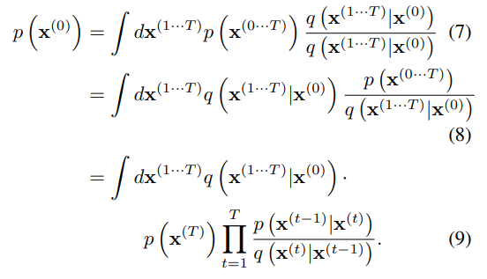
Model Probability Pt I
Equation (6)
Now that we have our models we want to know what the model says about x⁽⁰⁾ …

Slide 35
Model Probability Pt I
Equation (6)
Now that we have our models we want to know what the model says about x⁽⁰⁾ …why do we care?...

Slide 36
Model Probability Pt I
Equation (6)
Now that we have our models we want to know what the model says about x⁽⁰⁾ …why do we care?... Remember we need p(x⁽⁰⁾) to do inference –

Slide 37
Model Probability Pt I
Equation (6)
Now that we have our models we want to know what the model says about x⁽⁰⁾ …why do we care?... Remember we need p(x⁽⁰⁾) to do inference – but we cannot compute it directly, so the authors do some rearranging.

Slide 38
Model Probability pt I
Equation (6)
You might be wondering why is p(x⁽⁰⁾) = ∫ of the joint probability of x^{(0…T)} and dx^{(1…T)}…

Slide 39
Model Probability pt I
Equation (6)
You might be wondering why is p(x⁽⁰⁾) = ∫ of the joint probability of x^{(0…T)} and dx^{(1…T)}… well remember if we have the joint distribution p(x^{(0…T)})

Slide 40
Model Probability pt I
Equation (6)
You might be wondering why is p(x⁽⁰⁾) = ∫ of the joint probability of x^{(0…T)} and dx^{(1…T)}… well remember if we have the joint distribution p(x^{(0…T)}) then we can find the marginal p(x⁽⁰⁾) by integrating over all the possible values of the other variables in the joint distribution.

Slide 41
Model Probability pt I
Equation (7)
This is just Eq (6) × 1

Slide 42
Model Probability Pt I
Equation (8)
All we did here are is SWAP the terms…

Slide 43
Model Probability Pt I
Equation (8)
All we did here are is SWAP the terms…we swap where the terms are… but it is still the same equation.

Slide 44
Model Probability Pt I
Equation (8)
All we did here are is SWAP the terms…we swap where the terms are… but it is still the same equation.
We do this because it turns out that the ratio of ^{p}/_{q} is actually a lot easier to work with than an ∫ of just p.

Slide 45
Model Probability Pt I
Equation (8)
All we did here are is SWAP the terms…we swap where the terms are… but it is still the same equation.
We do this because it turns out that the ratio of ^{p}/_{q} is actually a lot easier to work with than an ∫ of just p.
We can sample from or simulate q cheaply.

Slide 46
Model Probability pt I
Equation (9)
Here the authors just substitute in the definitions of p(x^{(0…T)}) and q(x^{(1…T)}| x⁽⁰⁾).

Slide 47
Model Probability pt I
Equation (9)
Here the authors just substitute in the definitions of p(x^{(0…T)}) and q(x^{(1…T)}| x⁽⁰⁾).
Notice now that this ∫ fits the form of an expectation: 𝔼_{q}[^{p}/_{q}]

Slide 48
Model Probability pt I
Equation (9)
Here the authors just substitute in the definitions of p(x^{(0…T)}) and q(x^{(1…T)}| x⁽⁰⁾)
Notice now that this ∫ fits the form of an expectation: 𝔼_{q}[^{p}/_{q}]
BIG IDEA
Instead of doing a massive ∫ for p(x⁽⁰⁾) we can sample forward diffusion paths (q) and calculate the ratio of the corresponding reverse diffusion paths and average over these (take the expectation) with respect to q.

Slide 49
Model Probability pt I
Equation (9)
Here the authors just substitute in the definitions of p(x^{(0…T)}) and q(x^{(1…T)}| x⁽⁰⁾)
Notice now that this ∫ fits the form of an expectation: 𝔼_{q}[^{p}/_{q}]
BIG IDEA
Instead of doing a massive ∫ for p(x⁽⁰⁾) we can sample forward diffusion paths (q) and calculate the ratio of the corresponding reverse diffusion paths and average over these (take the expectation) with respect to q.
Instead of doing a massive ∫ for p(x⁽⁰⁾) we can sample forward diffusion paths (q) and calculate the ratio of the corresponding reverse diffusion paths and average over these (take the expectation) with respect to q.

Slide 50
Model Probability pt i
Equation (9)
Here the authors just substitute in the definitions of p(x^{(0…T)}) and q(x^{(1…T)}| x⁽⁰⁾)
Notice now that this ∫ fits the form of an expectation: 𝔼_{q}[^{p}/_{q}]
Why does any of this matter?
The authors use Eq (9) in their next equation for deriving the ELBO for their process

Slide 51
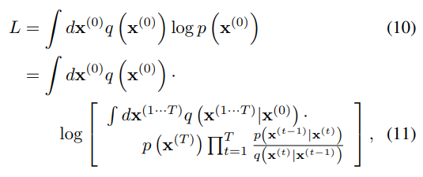
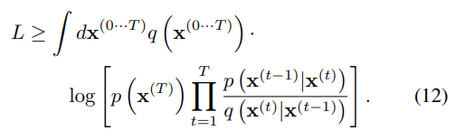
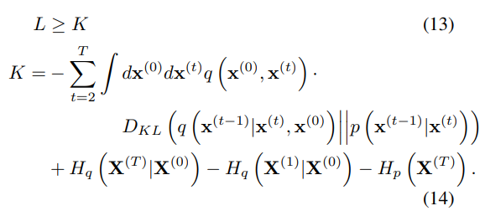

Model Probability PT II
Equation (10)
The ∫ here is again an 𝔼.

Slide 52
Model Probability PT II
Equation (10)
The ∫ here is again an 𝔼.
L = 𝔼_{q}[log(p(x⁽⁰⁾))] the expected log likelihood of the model.

Slide 53
Model Probability PT II
Equation (10)
The ∫ here is again an 𝔼.
L = 𝔼_{q}[log(p(x⁽⁰⁾))] the expected log likelihood of the model.
It is asking how likely the actual data set is in the model’s eyes.

Slide 54
Model Probability PT II
Equation (10)
The ∫ here is again an 𝔼.
L = 𝔼_{q}[log(p(x⁽⁰⁾))] the expected log likelihood of the model.
It is asking how likely the actual data set is in the model’s eyes.
Ideally the data we are modeling is highly probable in our model otherwise our model isn’t very good.

Slide 55
Model Probability PT II
Equation (10)
The ∫ here is again an 𝔼.
L = 𝔼_{q}[log(p(x⁽⁰⁾))] the expected log likelihood of the model.
It is asking how likely the actual data set is in the model’s eyes.
Ideally the data we are modeling is highly probable in our model otherwise our model isn’t very good.
So we want to maximize L, but we can’t calculate p(x⁽⁰⁾) directly.

Slide 56
Model Probability PT II
Equation (11)
We substitute our work-around from Eq (9).

Slide 57
Model Probability PT II
Equation (12)
This one jumps a few steps.

Slide 58
Model Probability PT II
Equation (12)
This one jumps a few steps.
First thing we do is move the log into the ∫ to get a lesser value (Jensen's inequality).

Slide 59
Model Probability PT II
Equation (12)
This one jumps a few steps.
First thing we do is move the log into the ∫ to get a lesser value (Jensen's inequality).
Then use log rules to separate the ∫ into 2 ∫.

Slide 60
Model Probability PT II
Equation (12)
This one jumps a few steps.
First thing we do is move the log into the ∫ to get a lesser value (Jensen's inequality).
Then use log rules to separate the ∫ into 2 ∫.
That 1st ∫ collapses to a constant and the 2nd can be merged with the outer ∫ to go from dx⁽⁰⁾ and dx^{(1…T)} to dx^{(0…T)} and the same applies for q(x).

Slide 61
Model Probability PT II
Equation (12)
This one jumps a few steps.
First thing we do is move the log into the ∫ to get a lesser value (Jensen's inequality).
Then use log rules to separate the ∫ into 2 ∫.
That 1st ∫ collapses to a constant and the 2nd can be merged with the outer ∫ to go from dx⁽⁰⁾ and dx^{(1…T)} to dx^{(0…T)} and the same applies for q(x).
Believe it or not… there is actually a lot more math (in the appendix) to get us to Eq (13)… the math in the appendix isn’t all that fascinating or thrilling.

Slide 62
Model Probability PT II
Equation (12)
This one jumps a few steps.
First thing we do is move the log into the ∫ to get a lesser value (Jensen's inequality).
Then use log rules to separate the ∫ into 2 ∫.
That 1st ∫ collapses to a constant and the 2nd can be merged with the outer ∫ to go from dx⁽⁰⁾ and dx^{(1…T)} to dx^{(0…T)} and the same applies for q(x).
Believe it or not… there is actually a lot more math (in the appendix) to get us to Eq (13)… the math in the appendix isn’t all that fascinating or thrilling.
BIG IDEA

Slide 63
Model Probability PT II
Equation (12)
This one jumps a few steps.
First thing we do is move the log into the ∫ to get a lesser value (Jensen's inequality).
Then use log rules to separate the ∫ into 2 ∫.
That 1st ∫ collapses to a constant and the 2nd can be merged with the outer ∫ to go from dx⁽⁰⁾ and dx^{(1…T)} to dx^{(0…T)} and the same applies for q(x).
Believe it or not… there is actually a lot more math (in the appendix) to get us to Eq (13)… the math in the appendix isn’t all that fascinating or thrilling.
BIG IDEA
Equation (12): Merge the inner and outer integrals (with lots of math)

Slide 64
Model Probability PT II
Equation (13)
This is just restating that K is a lower bound.

Slide 65
Model Probability PT II
Equation (14)
This is the final form of their “ELBO” derivation because it can be analytically calculated.

Slide 66
Model Probability PT II
Equation (14)
This is the final form of their “ELBO” derivation because it can be analytically calculated.
We are not going to cover all the appendix math… but they used a few tricks that are specific to the way they organized their diffusion that let some terms cancel and simplify nicely.

Slide 67
Model Probability PT II
Equation (14)
This is the final form of their “ELBO” derivation because it can be analytically calculated.
We are not going to cover all the appendix math… but they used a few tricks that are specific to the way they organized their diffusion that let some terms cancel and simplify nicely.
One thing to note – the lower bound is related to a negative mixture of KL divergences between each step.

Slide 68
Model Probability PT II
Equation (14)
This is the final form of their “ELBO” derivation because it can be analytically calculated.
We are not going to cover all the appendix math… but they used a few tricks that are specific to the way they organized their diffusion that let some terms cancel and simplify nicely.
One thing to note – the lower bound is related to a negative mixture of KL divergences between each step.
Similar to the ELBO and KL divergence we saw in the Variational Inference paper.

Slide 69
Model Probability PT II
Equation (14)
This is the final form of their “ELBO” derivation because it can be analytically calculated.
We are not going to cover all the appendix math… but they used a few tricks that are specific to the way they organized their diffusion that let some terms cancel and simplify nicely.
One thing to note – the lower bound is related to a negative mixture of KL divergences between each step.
Similar to the ELBO and KL divergence we saw in the Variational Inference paper.
BIG IDEA
Equation (14): Final form that is analytically tractable – similar to ELBO from VI paper

Slide 70
Model Probability PT II
Equation (15)
So if all this was about how to train the model…

Slide 71
Model Probability PT II
Equation (15)
So if all this was about how to train the model… we are going to pick the link in the chain from t to t-1 that maximizes the lower bound…

Slide 72
Model Probability PT II
Equation (15)
So if all this was about how to train the model… we are going to pick the link in the chain from t to t-1 that maximizes the lower bound… which is the same thing as minimizing the divergence from the reverse-of-the-forward diffusion process.

Slide 73
Model Probability PT II
Equation (15)
So if all this was about how to train the model… we are going to pick the link in the chain from t to t-1 that maximizes the lower bound… which is the same thing as minimizing the divergence from the reverse-of-the-forward diffusion process.
The nice thing is that you are maximizing each individual link.

Slide 74
Model Probability PT II
Equation (15)
So if all this was about how to train the model… we are going to pick the link in the chain from t to t-1 that maximizes the lower bound… which is the same thing as minimizing the divergence from the reverse-of-the-forward diffusion process.
The nice thing is that you are maximizing each individual link.
To wrap this all up… the authors have a nice quote:

Slide 75
Model Probability PT II
Equation (15)
So if all this was about how to train the model… we are going to pick the link in the chain from t to t-1 that maximizes the lower bound… which is the same thing as minimizing the divergence from the reverse-of-the-forward diffusion process.
The nice thing is that you are maximizing each individual link.
To wrap this all up… the authors have a nice quote:
“Thus, the task of estimating [p(x⁽⁰⁾)] has been reduced to the task of performing regression on the functions which set the mean and covariance of a sequence of Gaussians”

Slide 76
Model Probability PT II
Equation (15)
So if all this was about how to train the model… we are going to pick the link in the chain from t to t-1 that maximizes the lower bound… which is the same thing as minimizing the divergence from the reverse-of-the-forward diffusion process
The nice thing is that you are maximizing each individual link
To wrap this all up… the authors have a nice quote:
“Thus, the task of estimating p(x(0)) has been reduces to the task of performing regression on the functions which set the mean and covariance of a sequence of Gaussians”
In other words:

Slide 77
Model Probability PT II
Equation (15)
So if all this was about how to train the model… we are going to pick the link in the chain from t to t-1 that maximizes the lower bound… which is the same thing as minimizing the divergence from the reverse-of-the-forward diffusion process
The nice thing is that you are maximizing each individual link
To wrap this all up… the authors have a nice quote:
“Thus, the task of estimating p(x(0)) has been reduces to the task of performing regression on the functions which set the mean and covariance of a sequence of Gaussians”
In other words:
We went from intractable to lots of small totally do-able steps!

Slide 78

End of Lightning-chat

