Slide 1

GOFLOW – a workflow engine for django
svn co https://opensvn.csie.org/goflow/trunk/goflow goflow
cd goflow/testgoflow
python manage.py syncdb –pythonpath=../..
python manage.py runserver –pythonpath=../..
http://localhost:8000/admin
http://code.djangoproject.com/wiki/GoFlow
Page <number>

Slide 2
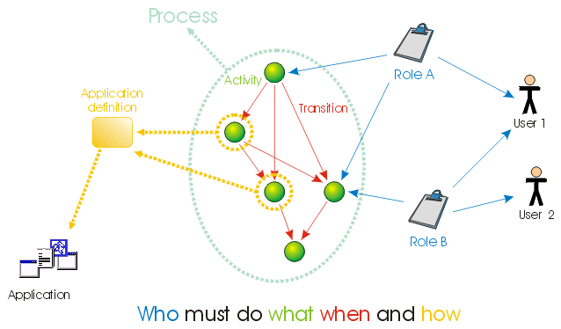
GOFLOW – a workflow engine for django
Design inspired by OpenFlow
http://www.openflow.it/Documentation/documentation/OpenFlowIntroduction
http://code.djangoproject.com/wiki/GoFlow
Page <number>

Slide 3
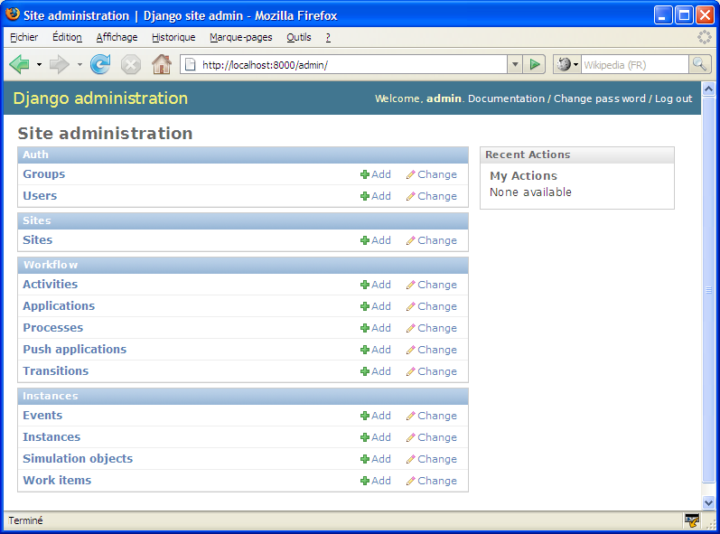
GOFLOW – a workflow engine for django
go here
Process design
Process runtime
http://code.djangoproject.com/wiki/GoFlow
Page <number>

Slide 4
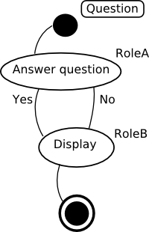
GOFLOW – a workflow engine for django
Process: question_process
A question is asked (user must have question_process role)
User with role A answers yes or no
The result is sent to user with rôle B
http://code.djangoproject.com/wiki/GoFlow
Page <number>

Slide 5
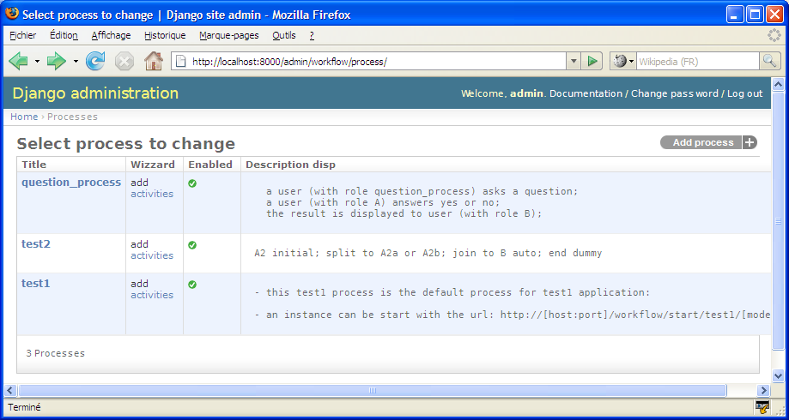
GOFLOW – a workflow engine for django
question_process edition
http://code.djangoproject.com/wiki/GoFlow
Page <number>

Slide 6
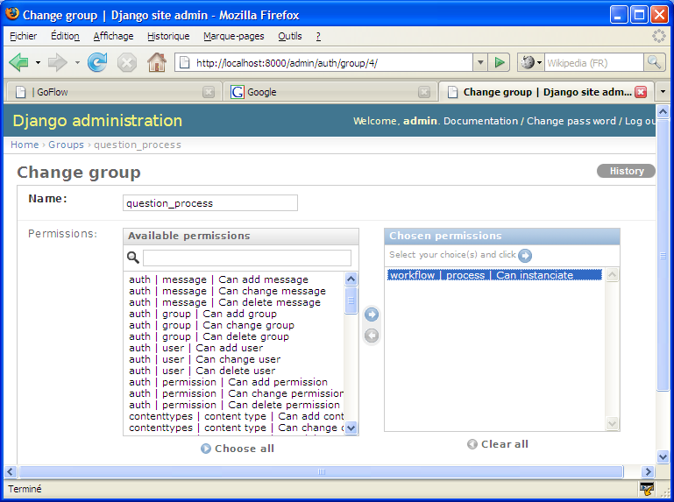
GOFLOW – a workflow engine for django
Role=group
this group as the same name as a process ...
... an with this permission, the user can start an instance in the process
http://code.djangoproject.com/wiki/GoFlow
Page <number>

Slide 7
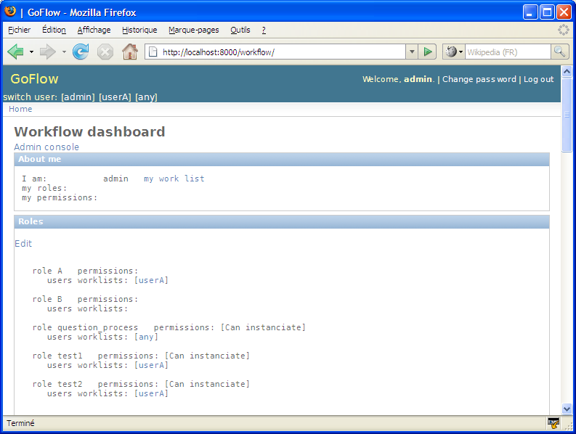
GOFLOW – a workflow engine for django
Go to the workflow dashboard
Fast user switching
Info about:
.current user
roles
processes
instances history
process execution simulation
http://code.djangoproject.com/wiki/GoFlow
Page <number>

Slide 8
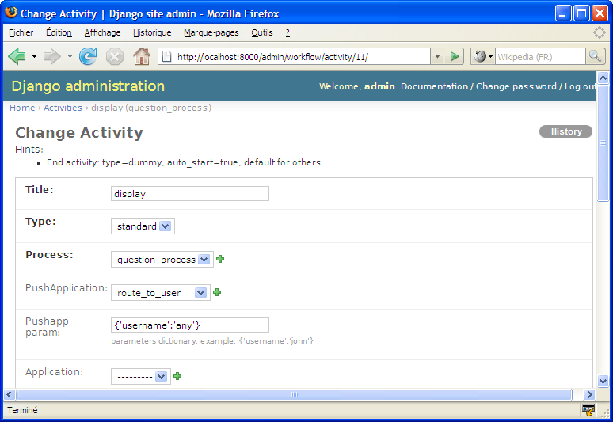
GOFLOW – a workflow engine for django
Process execution simulation:
leave the application field blank
no manual code needed
http://code.djangoproject.com/wiki/GoFlow
Page <number>

