Slide 1
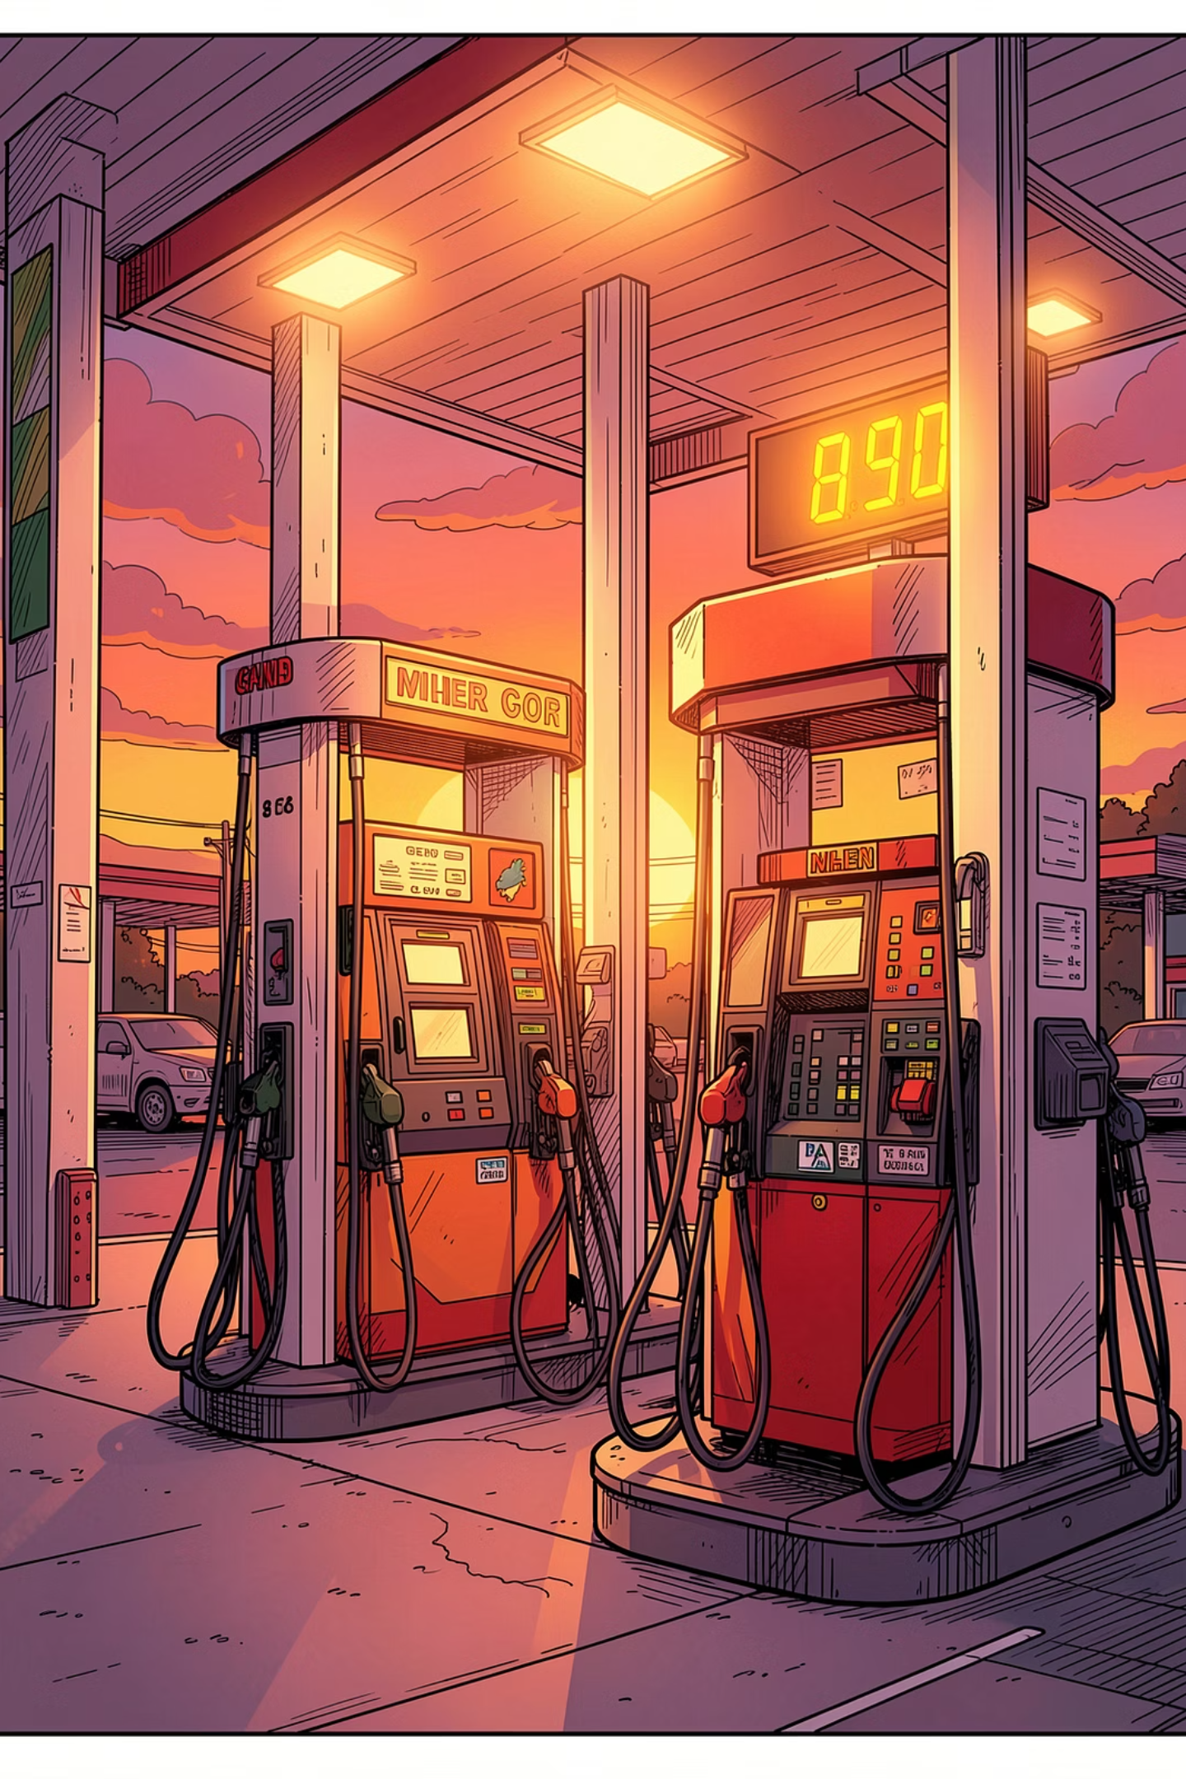
STAT 418 · FINAL PROJECT · JUNE 2026
U.S. Retail Gasoline Price Forecast
A deployed data science application that collects weekly EIA gasoline prices, trains two forecasting models, serves predictions through Flask, and presents them in an interactive Streamlit dashboard.
1,729
2
Weekly Observations
Models Served
1993–2026 EIA data
XGBoost & SARIMA
2
Live Services
Flask API + Streamlit UI
Mike Wu
Streamlit app: https://fuel-price-streamlit-oluqiqxkmq-uw.a.run.app
Flask API: https://fuel-price-api-oluqiqxkmq-uw.a.run.app
Notes:
Hi everyone, my project is called "U.S. Retail Gasoline Price Forecast."
The goal is to build a full stack data science application, not just a model in a notebook. The app collects weekly U.S. gasoline price data from the EIA, turns that time series into model features, trains two forecasting models, and then serves predictions through a Flask API. A separate Streamlit dashboard calls that API so users can choose the forecasting method and forecast horizon interactively.
The current dataset has 1,729 weekly observations from 1993 through May 18, 2026. I serve two models, XGBoost and SARIMA, and the final project is deployed as two live services: one Cloud Run service for the Flask model API and another Cloud Run service for the Streamlit interface.
The important idea on this slide is that the project follows the production-style requirement from class: the app and the model API are hosted separately, and the user interface communicates with the model through an API call.

Slide 2
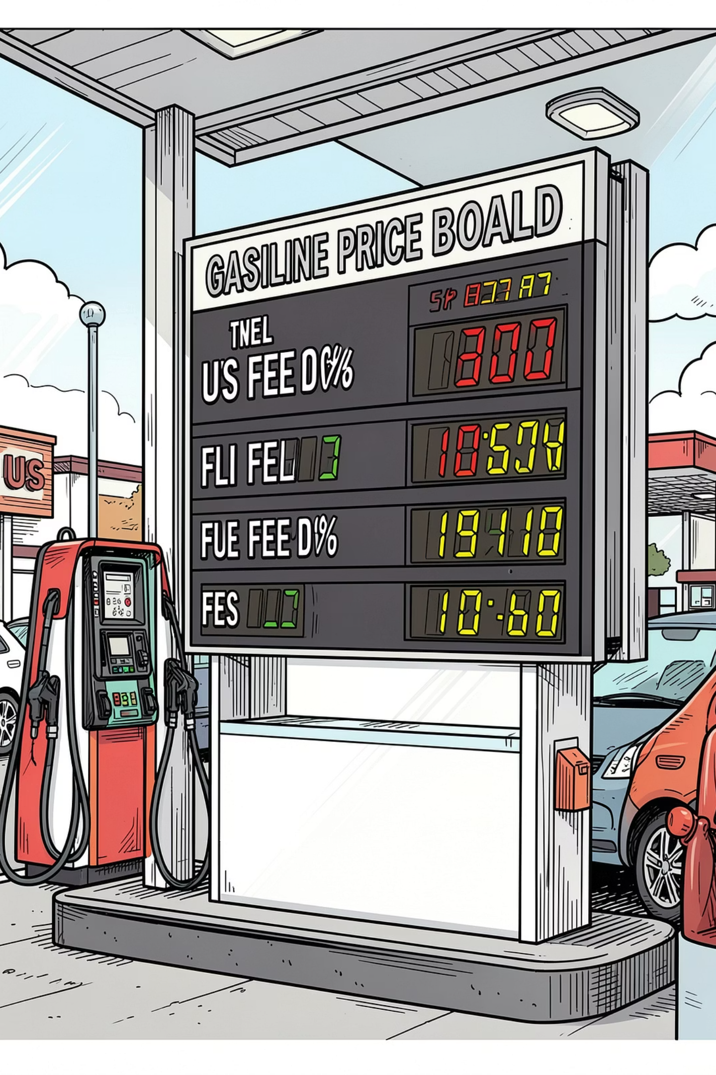
MOTIVATION
Fuel Prices Are Volatile Enough to Make Short-Term Forecasting Useful
$0.949
$5.107
Lowest Historical
Highest Historical
per gallon
per gallon
$4.621
Latest Observation
May 18, 2026
User Problem
Price movement is hard to reason about from raw weekly tables. A useful class demo needs both an interface and a deployed model endpoint.
Project Objective
Make model choice and forecast horizon interactive. Deploy the API and app separately so the architecture matches production patterns.
Notes:
The motivation is that gasoline prices are familiar, visible, and volatile. Most people understand the impact of gas prices, but it is hard to look at a raw weekly table and get an intuitive sense of where prices may move in the short term.
In this dataset, the lowest historical national weekly price is about 94.9 cents per gallon, while the highest is about 5.107 dollars per gallon. The latest observation in my snapshot is 4.621 dollars per gallon for May 18, 2026. That range shows why this is a useful forecasting problem: the target variable can move a lot over time, and even short-term changes matter for planning.
The user problem I wanted to solve is not just "can we train a model?" It is "can someone interact with the model easily?" So the app lets a user select XGBoost or SARIMA, choose a forecast horizon, and get a chart and table back from the deployed model API.
My project objectives were three things: first, collect and process real public data; second, compare more than one forecasting approach; and third, deploy the app and API separately so the architecture looks like a real data product rather than a local script.

Slide 3
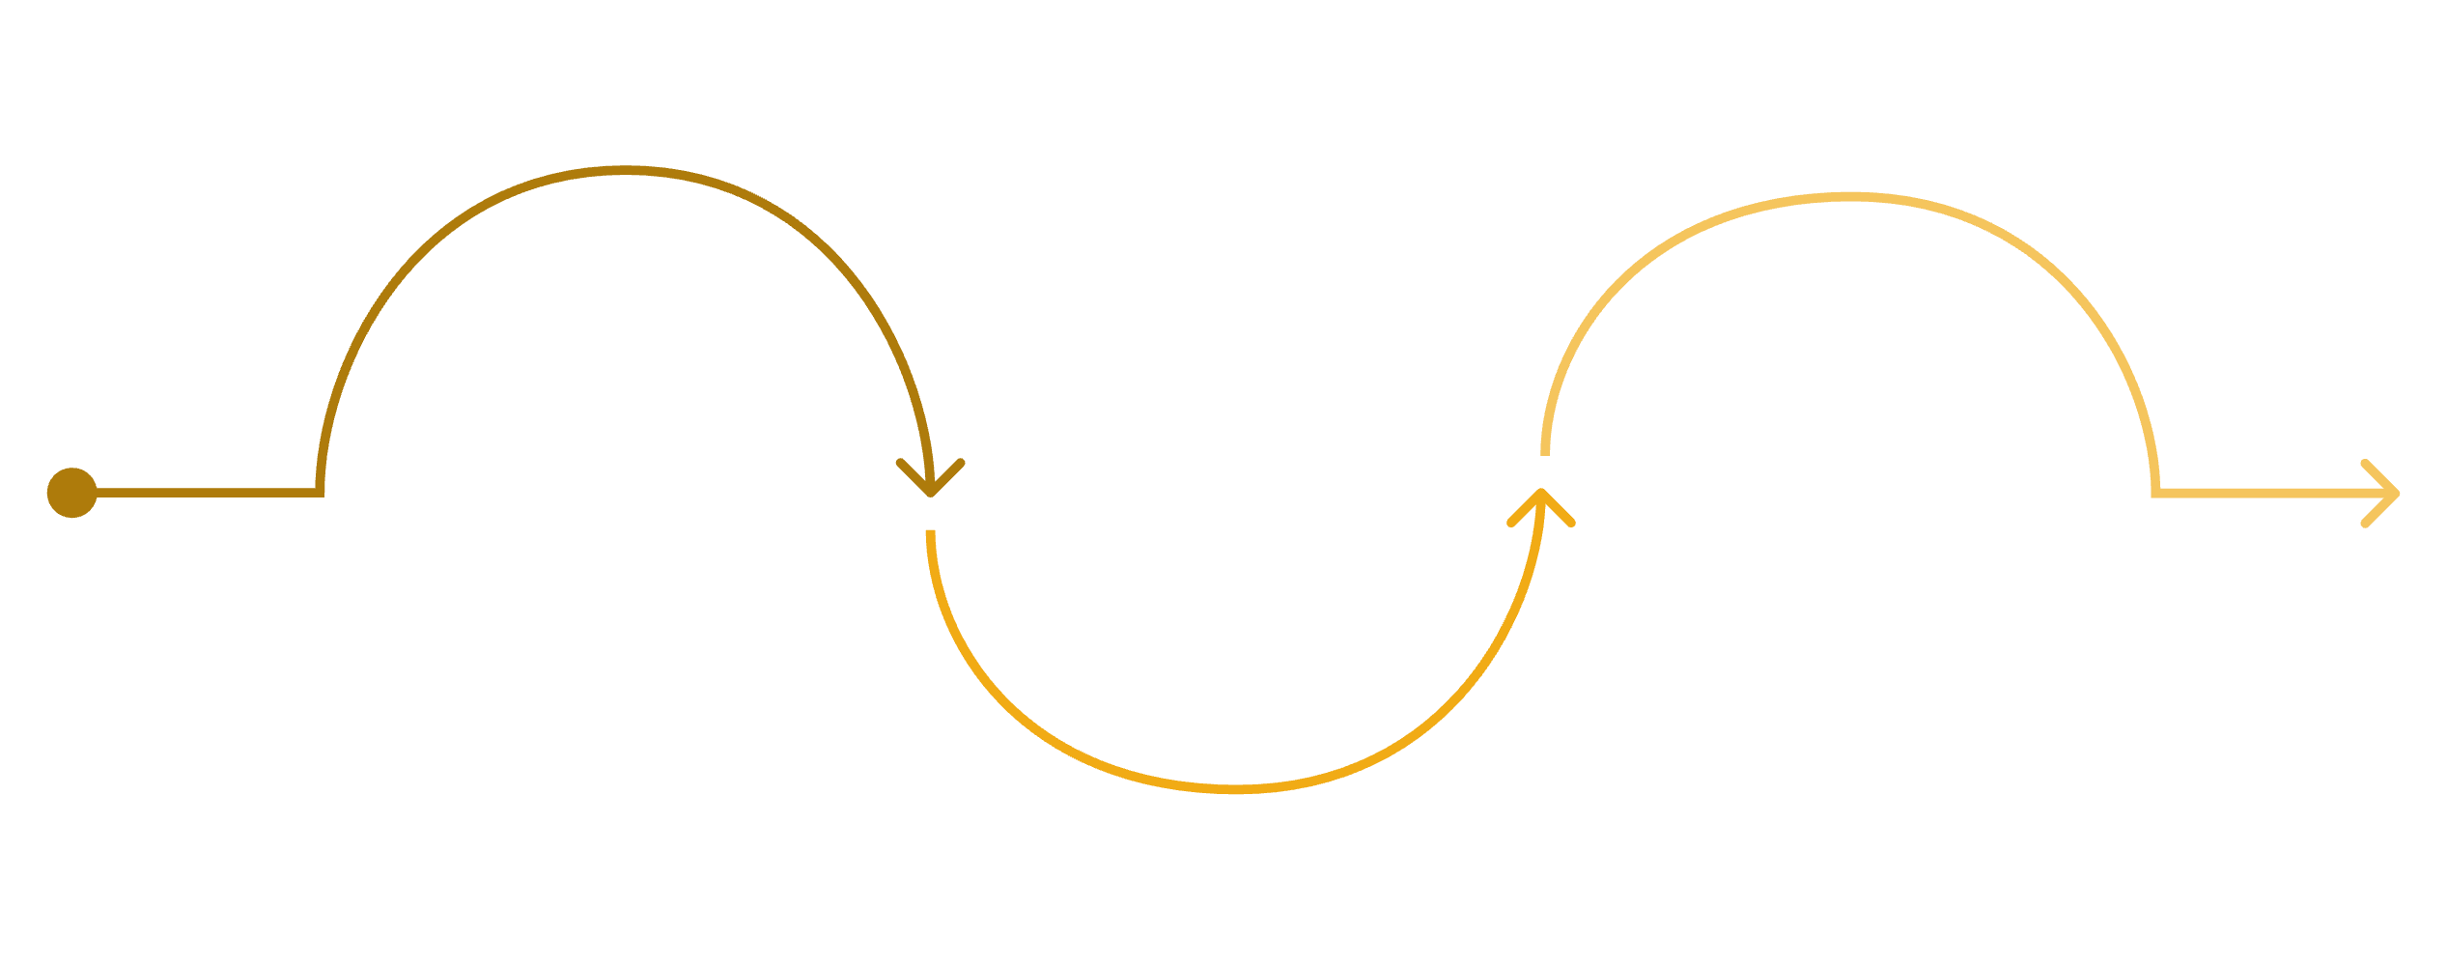

DATA PIPELINE
EIA Weekly Gasoline Prices Become Model-Ready Lag Features
Collect
Model Frame
EIA Open Data API; synthetic fallback for CI/local
Clean
Create lags 1/2/4/8/52, month and ISO week
Sort by period, coerce price, dedupe weeks, save raw CSV
Explainable features: recent lags capture price level and momentum; calendar fields capture weekly seasonality.
Feature Engineering
Lags 1, 2, 4, 8, 52: recent level, momentum, annual seasonality
Month + ISO week: calendar structure
1,729 rows: Apr 5, 1993 to May 18, 2026
Notes:
This slide shows the data pipeline.
The data source is the EIA Open Data API, specifically weekly U.S. retail gasoline prices. The project also has a synthetic fallback for testing or local runs without an API key, but the final data snapshot uses the real EIA series.
After collection, the raw data is cleaned into a simple weekly table. The pipeline sorts by date, converts price values to numeric format, removes duplicate weeks, and saves a raw CSV snapshot. Keeping that raw snapshot is useful because the deployed API can serve forecasts from the same data version that the models were trained on.
For feature engineering, I keep the model frame intentionally explainable. The XGBoost model uses lag features at 1, 2, 4, 8, and 52 weeks. Those lags represent recent level, short-term momentum, and yearly seasonality. I also include month and ISO week features to represent calendar patterns.
This matters because gasoline prices have both short-term movement and seasonal structure. Rather than adding many hard-to-explain variables, I wanted a compact feature set that I could explain clearly during the presentation.
The final dataset contains 1,729 rows spanning April 5, 1993 through May 18, 2026.

Slide 4
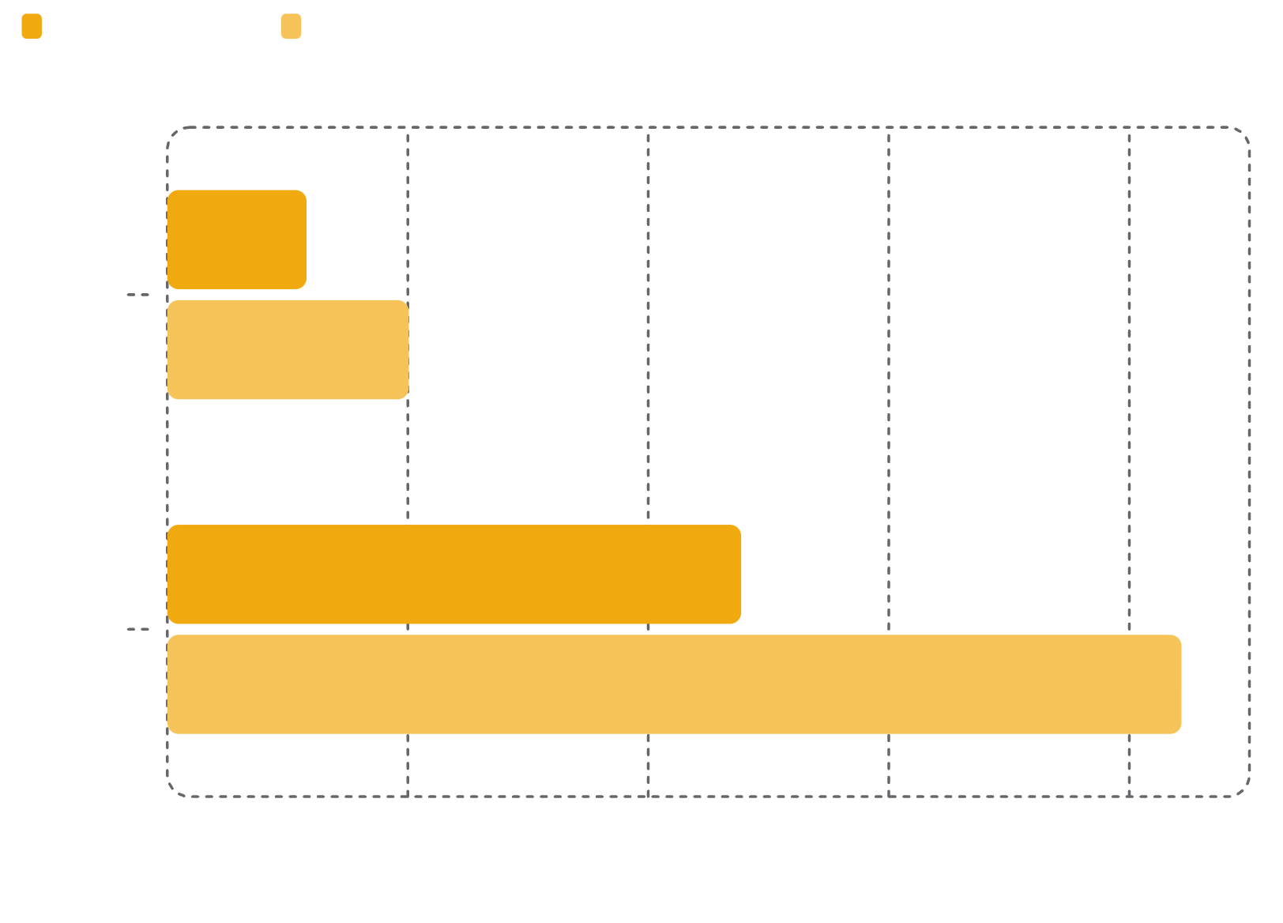
MODEL EVALUATION
XGBoost Won the 52-Week Holdout Comparison
XGBoost — Default Model
Recursive multi-step forecast from lag features plus month and week-of-year. Recent lags explain more of the short-term signal than a univariate seasonal structure alone.
SARIMA — Baseline
Seasonal weekly time-series baseline: SARIMA(1,1,1)(1,1,1,52). Both models are available in the app, but XGBoost's lower holdout error makes it the default.
Notes:
I trained and evaluated two forecasting approaches: XGBoost and SARIMA.
XGBoost is the default model in the app. It uses the lag and calendar features from the previous slide, and it forecasts recursively. That means for a multi-week forecast, the model predicts the next week, feeds that prediction back into the lag features, and continues forward for the selected horizon.
SARIMA is my baseline time-series model. It is a univariate seasonal model using the specification SARIMA(1,1,1)(1,1,1,52). The seasonal period of 52 is chosen because the data is weekly and gasoline prices often show annual seasonality.
For evaluation, I used a 52-week holdout window. XGBoost performed better on this holdout. Its MAE is about 0.0579 dollars per gallon and RMSE is about 0.1004. SARIMA's MAE is about 0.2386 and RMSE is about 0.4217.
The main interpretation is that recent lagged prices carry a strong short-term signal. SARIMA gives a useful time-series baseline, but in this project the lag-based XGBoost model captured the short-term structure better. That is why XGBoost is the default option in the deployed app, while SARIMA remains available for comparison.

Slide 5
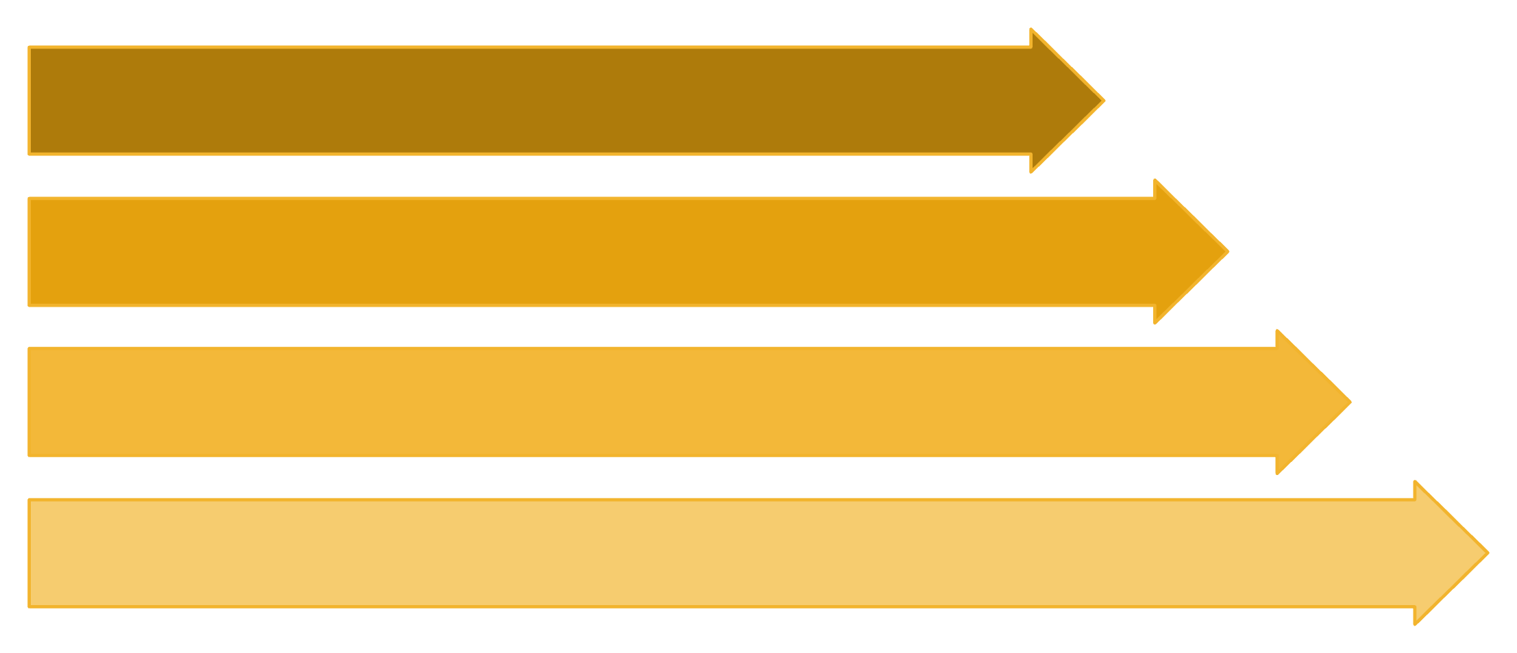
ARCHITECTURE
The App and Model API Are Deployed as Separate Cloud Run Services
EIA API
Raw CSV
Model Files
Cloud Run Services
EIA data flows through a raw CSV snapshot into trained model artifacts, served by a Flask API and consumed by a separate Streamlit UI — both running on Cloud Run.
Why Separate Services?
Endpoints
UI and API deploy independently
API testable with curl/Postman
Artifact Registry stores images
API memory: 1 Gi for SARIMA
/health
/metadata
Liveness check
Model info
/predict
Forecast JSON
Notes:
This slide shows the deployed architecture.
The data starts at the EIA API and is saved as a raw CSV snapshot. Then the training pipeline creates the model artifacts, including the XGBoost model and a compact SARIMA representation. Those files are packaged into the API container.
At runtime, the Flask API exposes endpoints such as /health, /metadata, and /predict. The Streamlit app is a separate Cloud Run service. It does not load the model directly. Instead, it sends a POST request to the Flask API and receives forecast JSON back.
I deployed the two services separately on Google Cloud Run. This was important for the course requirement, but it is also a better architecture. The UI can change without rebuilding the model API, and the API can be tested directly with tools like curl or Postman.
One challenge here was that SARIMA initially produced a very large model artifact. That made deployment slow and impractical, so I changed the storage approach to keep compact parameters instead of saving a huge fitted object. I also set the API memory to 1 GiB on Cloud Run so SARIMA forecasts would not cause the instance to terminate.

Slide 6
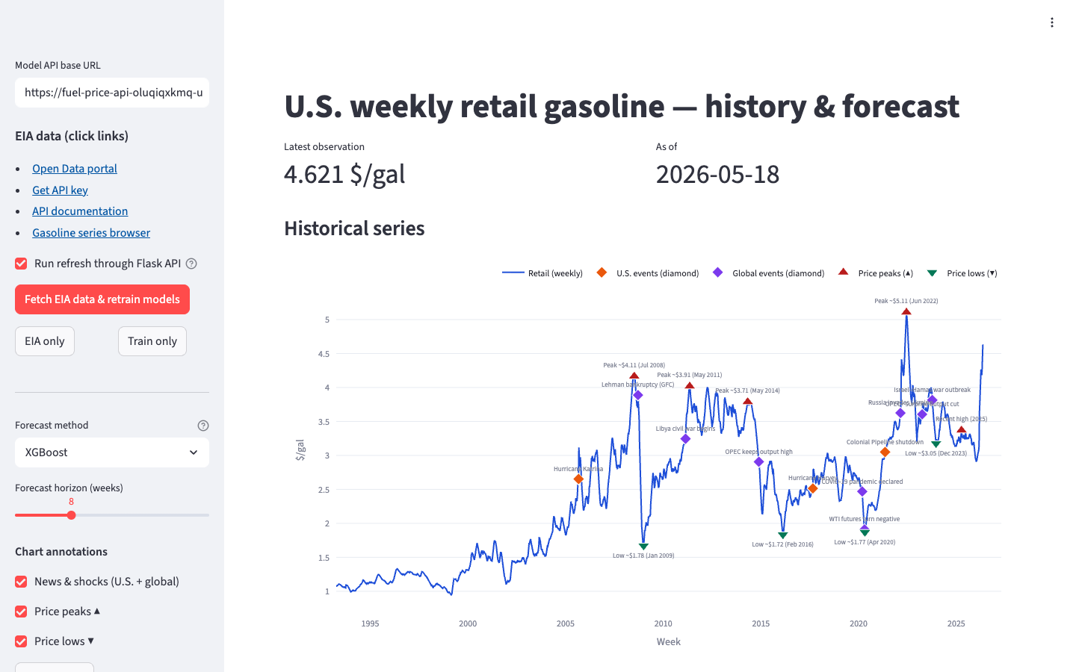
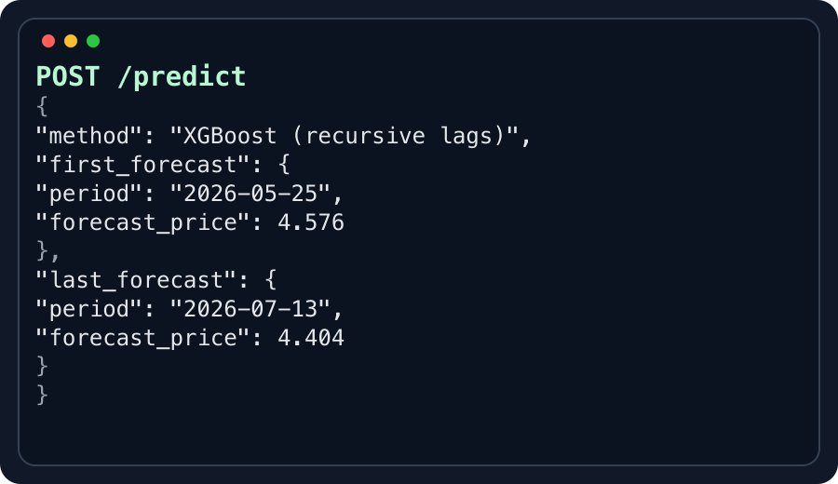

LIVE APP SCREENSHOTS
Click to reveal: Streamlit UI, then Flask API JSON
LIVE DEMO
The Demo Shows Streamlit Calling Flask in Real Time
01
Choose Method
Select XGBoost or SARIMA, then set the forecast horizon.
02
Submit Forecast
Streamlit sends horizon + method to Flask /predict.
1 Streamlit dashboard on Cloud Run
03
API Forecast
Flask loads the trained model and returns weekly JSON forecasts.
04
View Results
The app displays the forecast chart/table while the raw API call proves the backend works independently.
Live demo links: Streamlit app + POST https://fuel-price-api-oluqiqxkmq-uw.a.run.app/predict
2 Flask API returns the forecast payload
Notes:
This is the live demo slide.
The user workflow has four steps. First, the user chooses the model method in the sidebar, either XGBoost or SARIMA. Second, the user sets the forecast horizon from 1 to 26 weeks. Third, Streamlit sends the request to the Flask API. Fourth, the app displays the forecast as both a chart and a table.
For the demo, I would first open the Streamlit app:
https://fuel-price-streamlit-oluqiqxkmq-uw.a.run.app
Then I would choose XGBoost, set the horizon to 8 weeks, and click "Get forecast." I would point out that the chart is not just computed inside Streamlit. Streamlit is calling the deployed API service.
To show the API directly, I can open the health endpoint:
https://fuel-price-api-oluqiqxkmq-uw.a.run.app/health
That returns JSON showing the API is alive and lists the supported methods.
Then I can show a prediction request with this command:
curl -X POST https://fuel-price-api-oluqiqxkmq-uw.a.run.app/predict \
-H "Content-Type: application/json" \
-d '{"horizon":8,"method":"xgboost"}'
The response includes the method, horizon, last historical period, validation metrics, and a list of forecasted dates and prices. This demonstrates the core app/API interaction required by the final project.
If the live demo is slow, I would still explain the flow clearly: the dashboard is the front end, Flask is the model service, and /predict is the contract between them.

Slide 7

REFLECTION
The Main Work Was Turning a Model Into a Reliable Deployed System
Challenges Solved
AI Assistant Role
Cloud Run needed separate API/UI services and correct MODEL_API_URL wiring
SARIMA artifact was too large; compact parameter storage fixed deployment
SARIMA needed 1 Gi Cloud Run memory to avoid instance termination
Scaffolded Flask/Streamlit integration and Docker commands
Generated draft code that I checked against course requirements
Lesson: pair AI help with tests, logs, and explicit verification
Future Work: scheduled EIA refresh, confidence intervals, SHAP feature importance, and leaner dependency files for faster rebuilds.
Notes:
The biggest lesson from this project was that turning a model into a reliable deployed system takes more work than training the model itself.
Some challenges were deployment-related. Cloud Run required the API and UI to be configured as separate services, and Streamlit needed the correct MODEL_API_URL environment variable so it could call the public API endpoint. SARIMA also required extra care because the original artifact was too large and the API needed enough memory.
AI assistance was useful for scaffolding and troubleshooting. It helped with the Flask and Streamlit structure, Docker commands, deployment checks, and debugging. But I still had to manually verify the code, simplify generated pieces, check logs, run tests, and make sure the final project matched the course requirements.
For future work, I would add a scheduled EIA refresh so the deployed model can update automatically, add confidence intervals, include a feature importance or SHAP view, and continue reducing dependencies so Cloud Run rebuilds are faster.
Overall, this project gave me practice across the full data science workflow: data collection, preprocessing, model comparison, API design, frontend interaction, deployment, and presentation of results.

