Slide 1
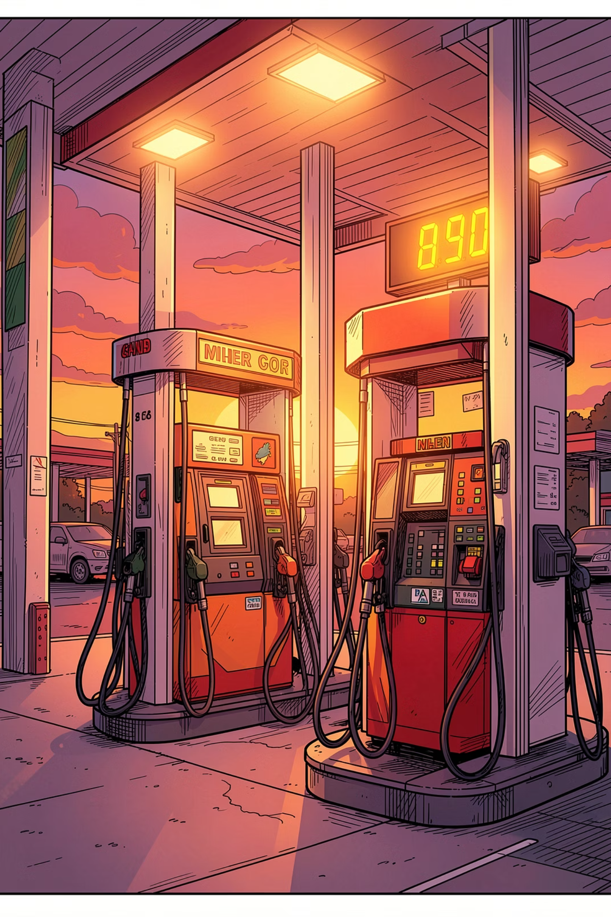
STAT 418 · FINAL PROJECT · JUNE 2026
U.S. Retail Gasoline Price Forecast
A deployed data science application that collects weekly EIA gasoline prices, trains two forecasting models, serves predictions through Flask, and presents them in an interactive Streamlit dashboard.
1,729
2
Weekly Observations
Models Served
1993–2026 EIA data
XGBoost & SARIMA
2
Live Services
Flask API + Streamlit UI
Mike Wu
Streamlit app: https://fuel-price-streamlit-oluqiqxkmq-uw.a.run.app
Flask API: https://fuel-price-api-oluqiqxkmq-uw.a.run.app

Slide 2
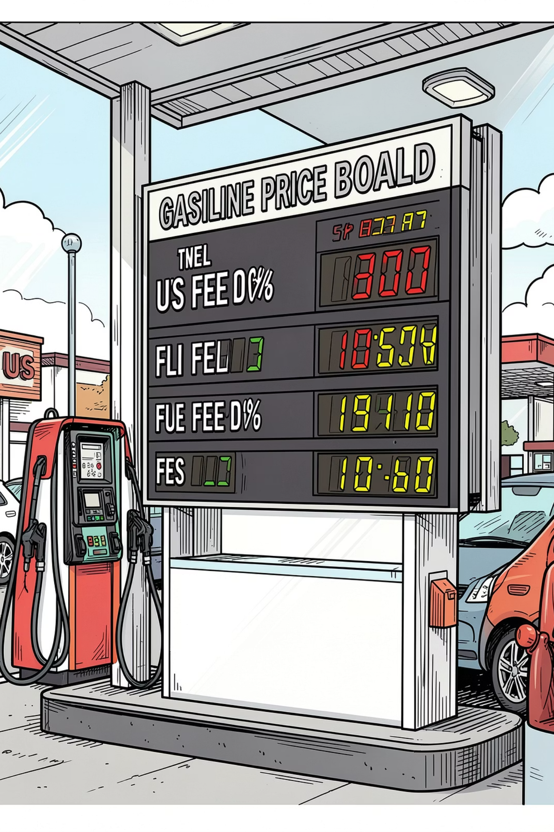
MOTIVATION
Fuel Prices Are Volatile Enough to Make Short-Term Forecasting Useful
$0.949
$5.107
Lowest Historical
Highest Historical
per gallon
per gallon
$4.621
Latest Observation
May 18, 2026
User Problem
Price movement is hard to reason about from raw weekly tables. A useful class demo needs both an interface and a deployed model endpoint.
Project Objective
Make model choice and forecast horizon interactive. Deploy the API and app separately so the architecture matches production patterns.

Slide 3
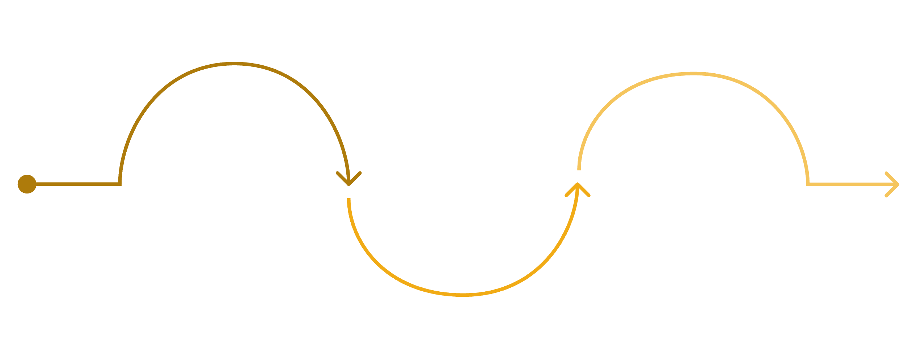

DATA PIPELINE
EIA Weekly Gasoline Prices Become Model-Ready Lag Features
Collect
Model Frame
EIA Open Data API; synthetic fallback for CI/local
Clean
Create lags 1/2/4/8/52, month and ISO week
Sort by period, coerce price, dedupe weeks, save raw CSV
The model intentionally keeps the feature set explainable: lagged prices carry recent level and momentum; calendar variables capture seasonal weekly structure.
Feature Engineering
Lags 1, 2, 4, 8, 52 — recent level, momentum, and yearly seasonality
Month and ISO week — calendar-based seasonal structure
1,729 rows spanning April 5, 1993 to May 18, 2026

Slide 4
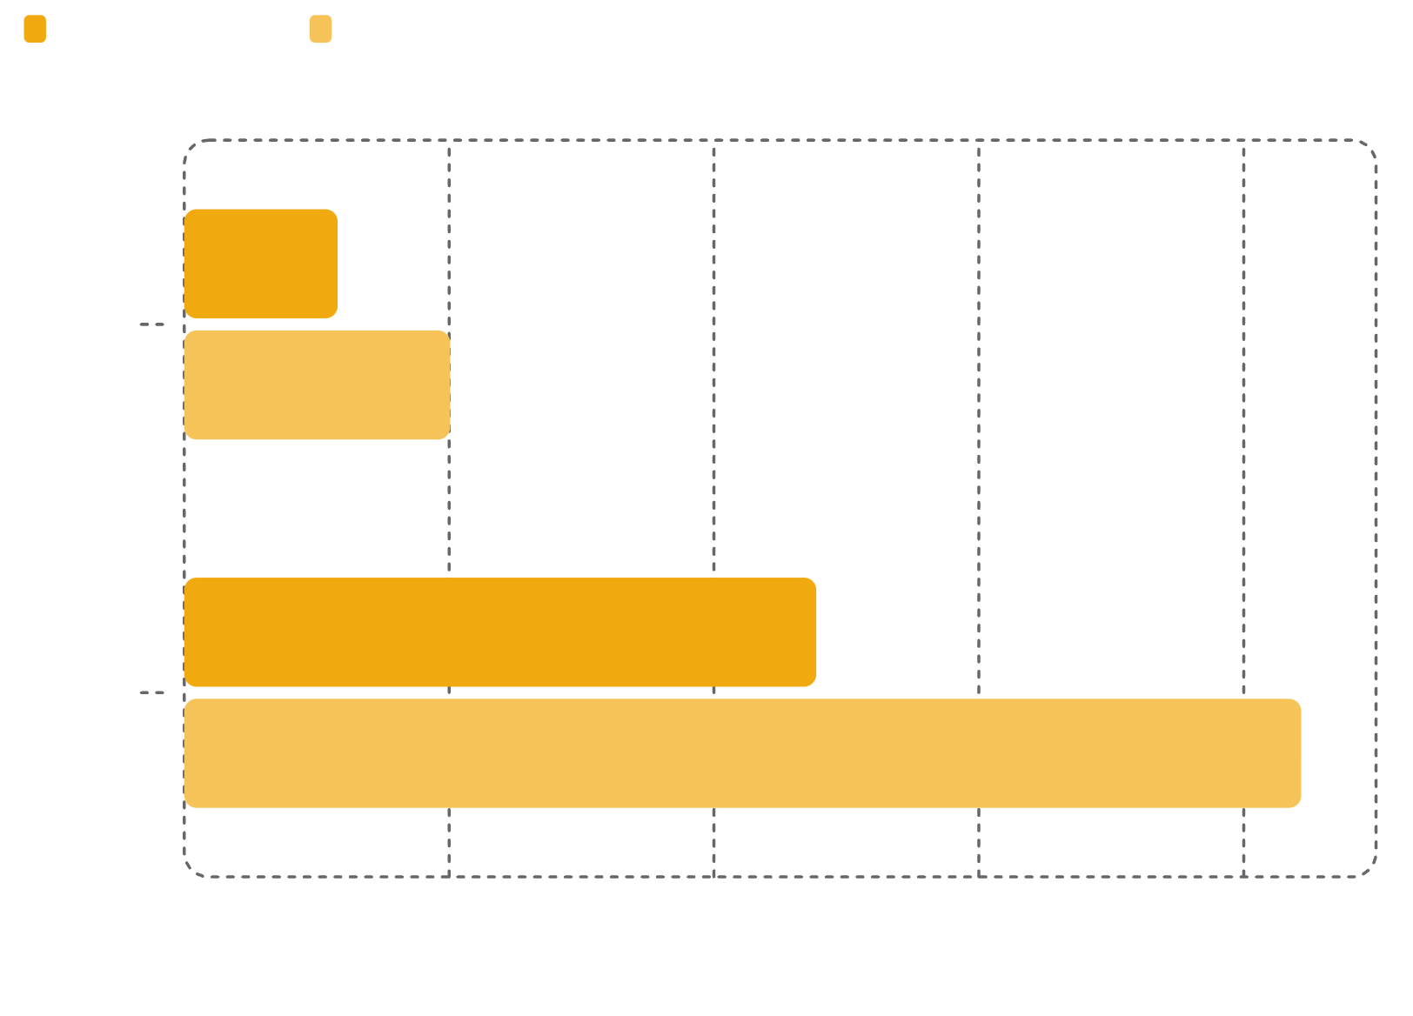
MODEL EVALUATION
XGBoost Won the 52-Week Holdout Comparison
XGBoost — Default Model
Recursive multi-step forecast from lag features plus month and week-of-year. Recent lags explain more of the short-term signal than a univariate seasonal structure alone.
SARIMA — Baseline
Seasonal weekly time-series baseline: SARIMA(1,1,1)(1,1,1,52). Both models are available in the app, but XGBoost's lower holdout error makes it the default.

Slide 5

ARCHITECTURE
The App and Model API Are Deployed as Separate Cloud Run Services
EIA API
Raw CSV
Model Files
Cloud Run Services
EIA data flows through a raw CSV snapshot into trained model artifacts, served by a Flask API and consumed by a separate Streamlit UI — both running on Cloud Run.
Why Separate Services?
Endpoints
UI can change independently from the model API
API testable directly with curl or Postman
Artifact Registry stores container images
API memory set to 1 Gi for SARIMA
/health
/metadata
Liveness check
Model info
/predict
Forecast JSON

Slide 6


LIVE DEMO
The Demo Proves the UI and API Are Communicating Live
01
Choose Method
Select XGBoost or SARIMA in the sidebar.
02
Set Horizon
Adjust the Streamlit slider from 1 to 26 weeks.
03
API Forecast
POST /predict returns JSON forecasts.
04
View Results
Streamlit renders a chart and forecast table; API demo shows raw JSON.
Try it yourself: curl -X POST /predict -d '{ "horizon": 8, "method": "xgboost" }' · Open Streamlit App →

Slide 7

REFLECTION
The Main Work Was Turning a Model Into a Reliable Deployed System
Challenges Solved
AI Assistant Role
Cloud Run required separate API/UI services with correct MODEL_API_URL wiring
SARIMA artifact was initially too large — compact parameter storage made deployment practical
SARIMA needed 1 Gi Cloud Run memory to avoid instance termination
Scaffolded Flask/Streamlit integration, Docker commands, and troubleshooting
Generated draft code, then manually checked and aligned to course requirements
Key lesson: AI is strongest when paired with tests, logs, and explicit verification
Future Work: Scheduled EIA refresh, broader feature engineering, confidence intervals, SHAP feature importance view, and leaner dependency files for faster rebuilds.

