Slide 1

Deep Learning Methods to Identify Glaucoma in Optical Coherence Tomography (OCT)
By: Mikey Joyce
Dept. of Electrical Engineering and Computer Science, University of Missouri,
Columbia, MO 65211, USA
CS/ECE 8690 Computer Vision Final Project
1

Slide 2
Outline
Motivation, Scope, and Description
Data and Computational Resources
Computer Vision Processing Modules and Pipeline
Approach: Algorithms and Module Implementation Details
Model Testing
Summary and Future Work
References
2

Slide 3
Motivation, Scope, and Description
Glaucoma is a complex disease, assisting ophthalmologists with computers to identify glaucoma could increase the rate of care for said disease
Typically, a smaller thickness of various parts of the retina are associated with glaucoma
Various deep learning methods have shown promise in assisting ophthalmologists with glaucoma diagnosis
Test various deep learning frameworks on this task
Decided to only develop glaucoma classification models instead of the progression models due to time constraints, the difficulty of the dataset in general, and since progression is more of a temporal concept it is hard to analyze based on only one measurement in time
3

Slide 4
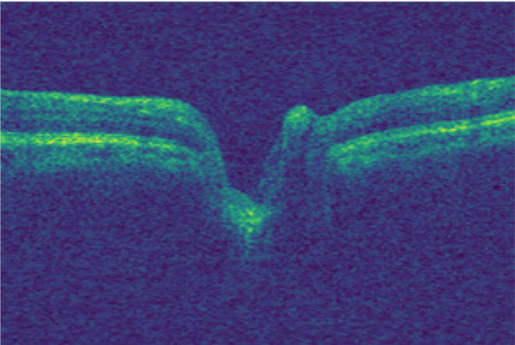
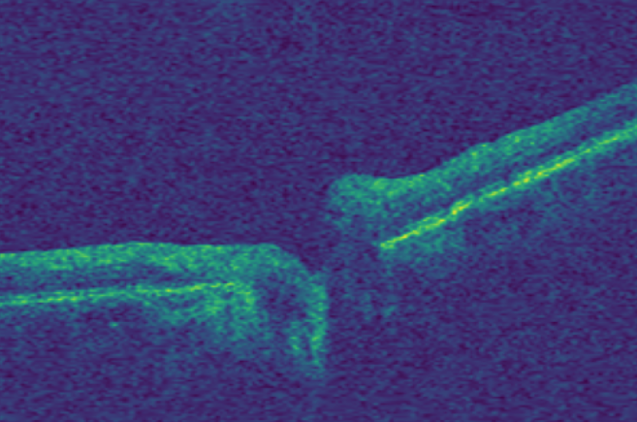
Data and Computational Resources
Utilized the Harvard Glaucoma Detection and Progression (Harvard-GDP) dataset
Dataset contains data for 1,000 patients with labels for glaucoma and various types of glaucoma progression
Each patient has an OCT scan that contains 200 grayscale images of resolution (200, 300)
i.e. 200k images in the dataset
Utilized a Google Colab environment: A100 GPU with 40 GB of GPU RAM and 85 GB of system RAM
4

Slide 5
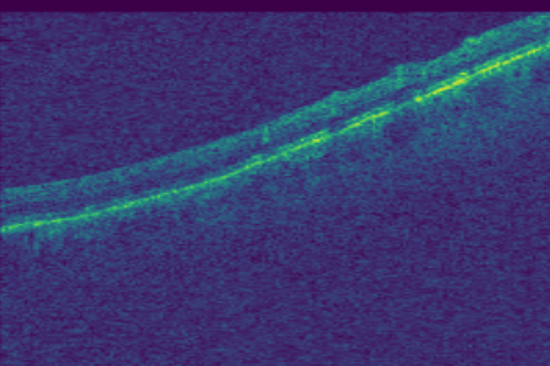
Data and Computational Resources
The data is complex
Significant amount of salt and pepper noise
Lots of variance within each scan, pictures on the right are both from the same glaucoma positive eye
Because of this it is hard to develop a method using classical computer vision
5

Slide 6
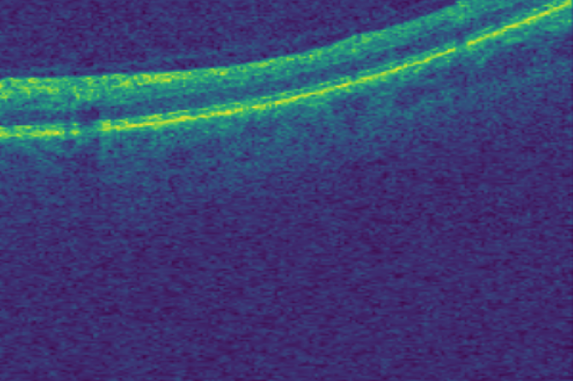
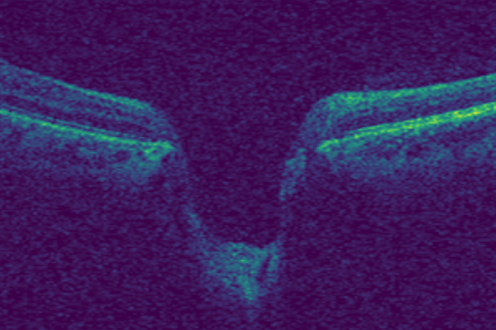
Data and Computational Resources
Lots of variance between scans as well
Specifically, variance with respect to rotations and brightness
6

Slide 7
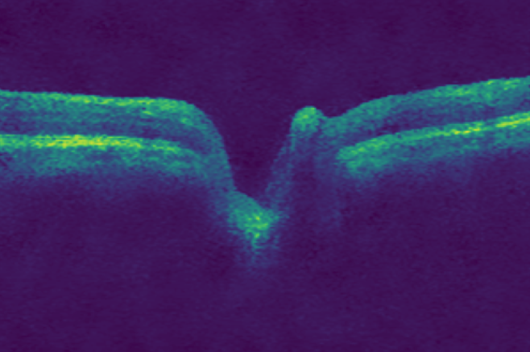
Computer Vision Modules and Pipeline
Input Image
Bilateral Filter
Glaucoma Predictions
Deep Neural Network
7

Slide 8
Approach: Algorithms and Module Implementation Details
Utilized Keras and Tensorflow to implement various deep learning methods. Chose Keras over PyTorch because it is a Google product so meshes with Colab better.
Other libraries: Pandas, NumPy, Google.colab, os, OpenCV, Matplotlib, Sklearn (for testing metrics).
Decided to test out 5 different deep learning architectures and provide a performance analysis
Infrastructures:
EfficientNetB0
ResNet50
U-Net with naïve head
U-Net with a ResNet-50 head
VGG16
Contributions:
Significant computation time & resources
Analysis of the state-of-the-art CNNs for glaucoma classification
Simple preprocessing image manipulation
Input & output modules to hook up to the deep nets
8

Slide 9
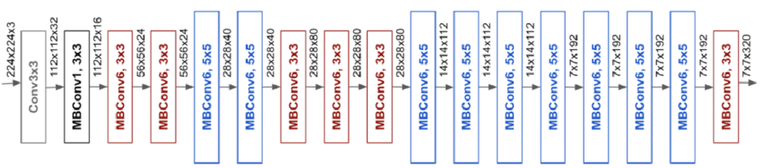
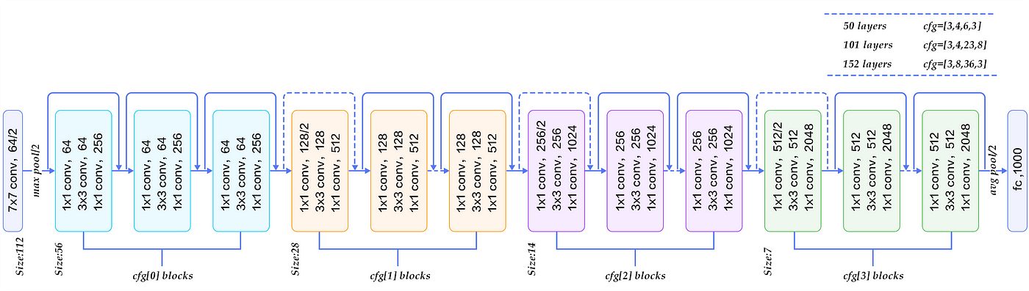
Approach: Algorithms and Module Implementation Details
EfficientNetB0: 4,008,835 trainable parameters
ResNet-50: 23,536,647 trainable parameters
9

Slide 10
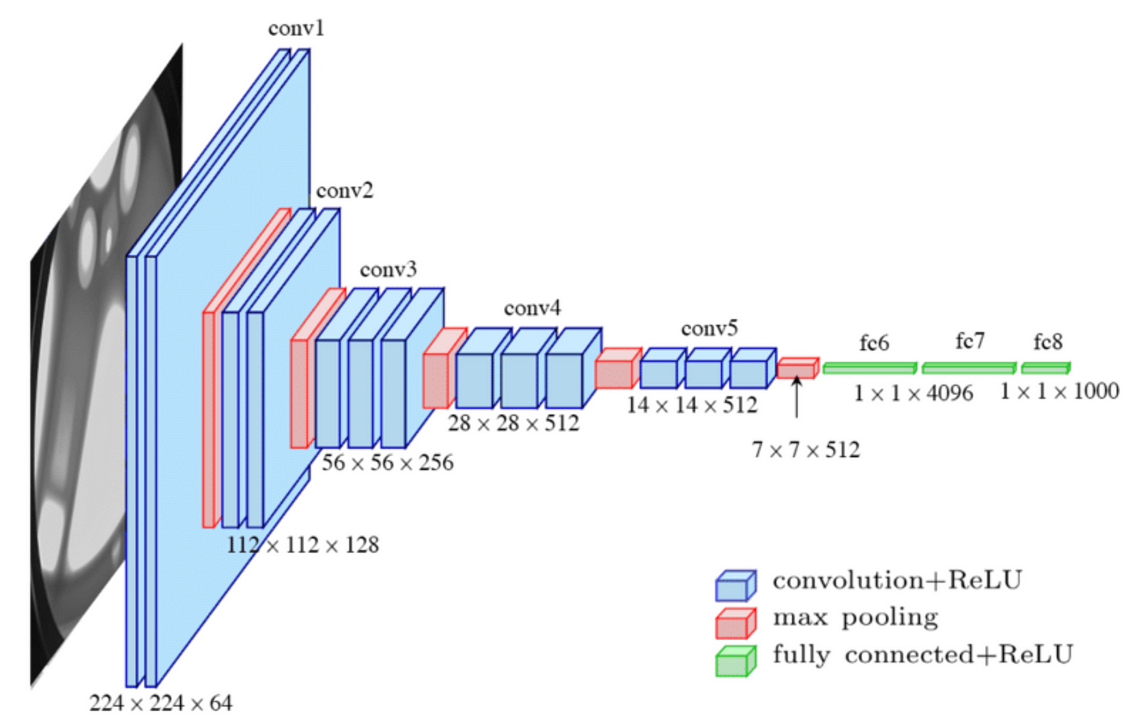
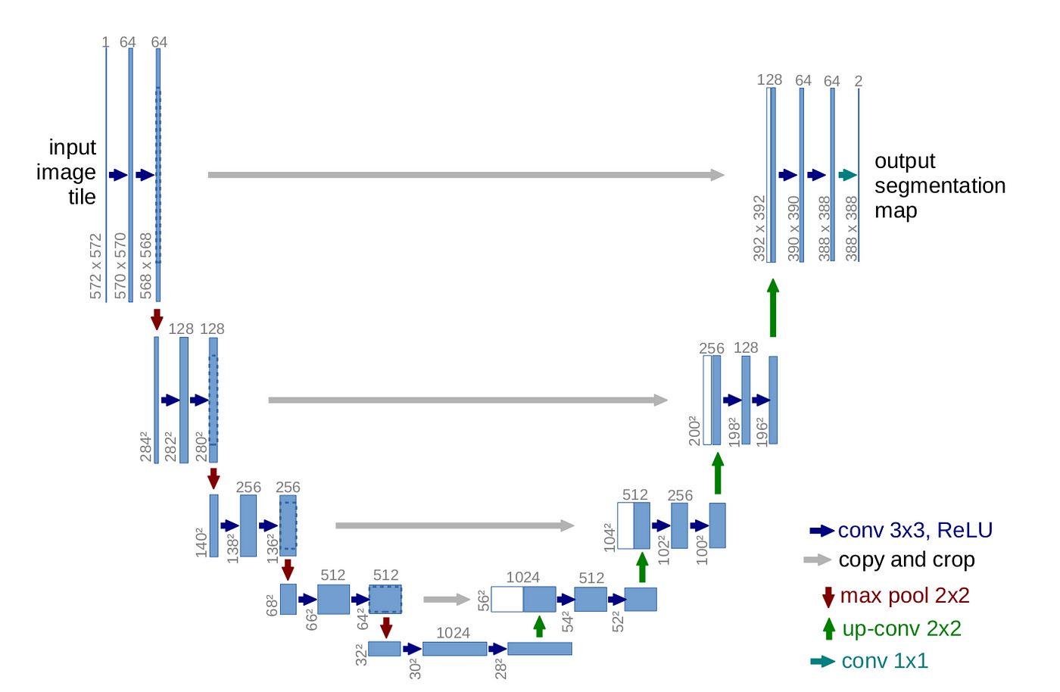
Approach: Algorithms and Module Implementation Details
U-Net: 1,940,817 trainable parameters
VGG16: 14,715,207 trainable parameters
10

Slide 11


Approach: Algorithms and Module Implementation Details
Each model required 3 channel input, so the following transformation was injected before using the deep infrastructure:
Each model's output was then interpreted with the following transformation:
11

Slide 12
Training
Each model was trained in the same manner:
42% of data for train, 18% for validation, 40% for testing
Main reason was because didn’t have enough compute to use more in the training set
Initialized weights with the weights trained on imagenet
Allowed for all weights in the network to be updated during training
Adam Optimizer with lr=0.001
Binary Cross Entropy Loss
Batch size of 32
Epochs 10
Monitor accuracy, precision, recall, AUC, validation accuracy
12

Slide 13
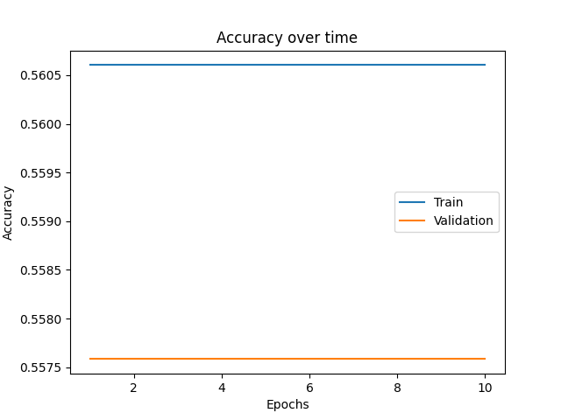
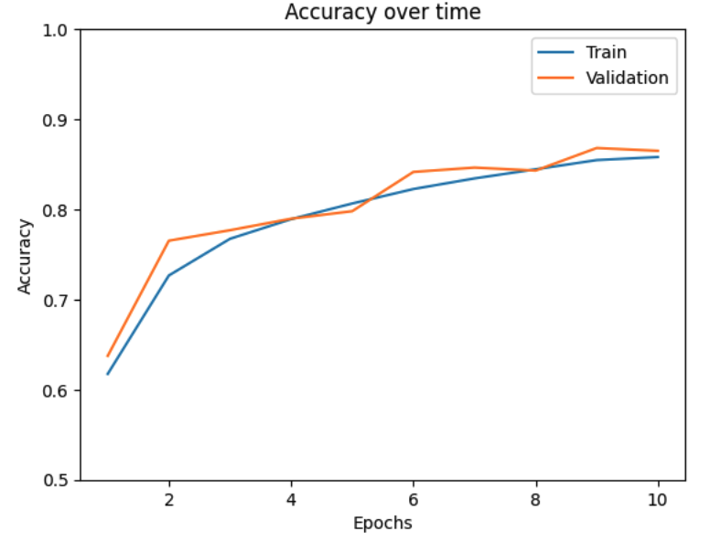
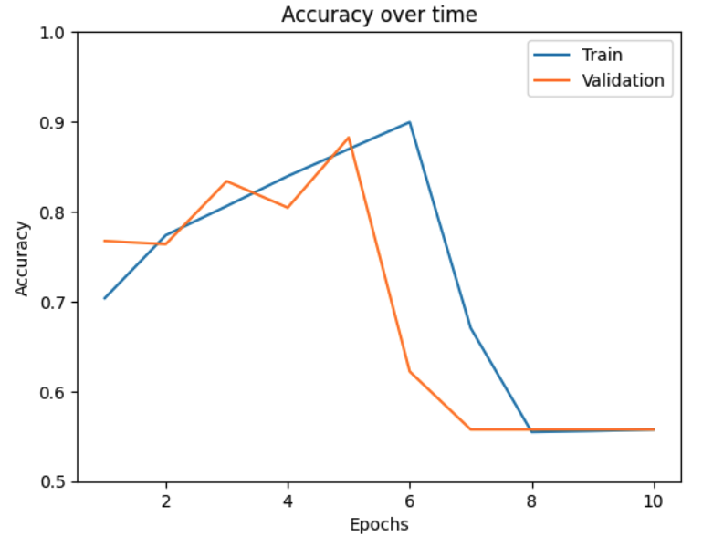
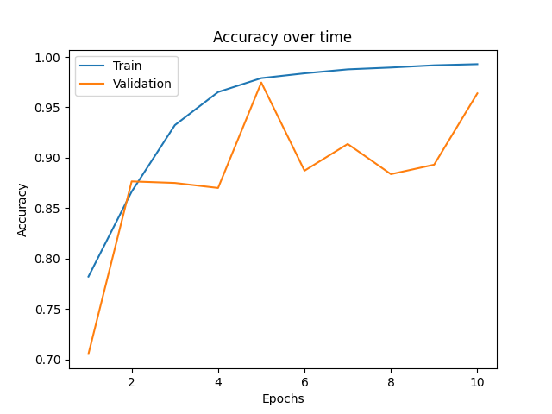
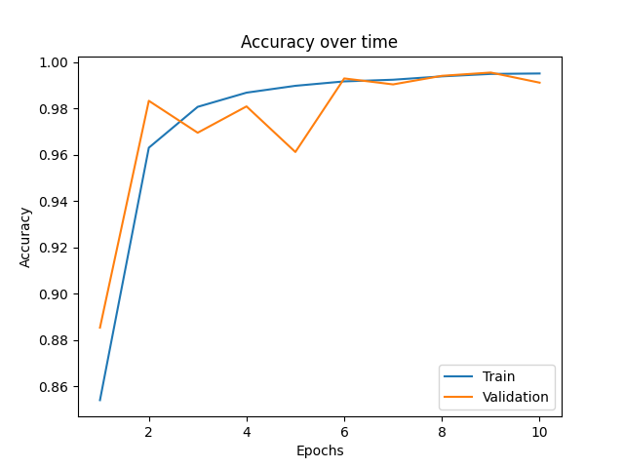
Model Selection
Review training metrics to pick best for testing:
VGG16
U-Net Base
U-Net + ResNet50
ResNet50
EfficientNetB0
13

Slide 14
Models for Testing
Based on the metrics the following models were selected:
VGG16: Epoch 1 → didn’t really matter since this model didn’t learn for some reason
U-Net Base: Epoch 9 → had best validation metrics on this epoch
U-Net + ResNet50: Epoch 5 → best validation here
ResNet50: Epoch 5 → best validation
EfficientNetB0: Epoch 9
Models | Accuracy | Precision | Recall | F1
VGG16 | 55.25% | 0% | 0% | 0%
U-Net Base | 72.83% | 71.20% | 65.95% | 68.48%
U-Net + ResNet50 | 74.82% | 73.93% | 67.54% | 70.60%
ResNet50 | 72.09% | 71.94% | 61.67% | 66.40%
EfficientNetB0 | 81.48% | 80.06% | 76.86% | 78.43%
14

Slide 15
Summary & Future Work
I set out to perform image classification to identify OCT images that had glaucoma in them.
Most of the models had poor results besides the EfficientNetB0, which did okay
Ran into problems of not having enough compute to manipulate the data during preprocessing, which resulted in having too much to ask from the deep networks, 85GB of RAM was not enough for a serious CV pipeline on this dataset
Major Issue #1: could not normalize data because converting from int32 to float32 caused issues with running out of memory
Major Issue #2 : could not apply data augmentations because kept running out of memory in the process
Major Issue #3 : preprocessing using the BilateralFilter took hours of time due to the size of the dataset, if I wanted to preprocess the data more, I likely would have run out of time. Training networks also took a long time.
Future: get a better machine and apply more preprocessing, normalization, and augmentations to assist the deep networks
15

Slide 16
References
S. Jiang, Y. Peng, Y. Zhu, B. Caicedo, N. Rabinowitz, J. Kong, and L. Peng, "Harvard Glaucoma Detection and Progression: A Multimodal Multitask Dataset and Generalization-Reinforced Semi-Supervised Learning," in IEEE Transactions on Medical Imaging, vol. 39, no. 4, pp. 1121-1131, Apr. 2020.
O. Ronneberger, P. Fischer, and T. Brox, "U-Net: Convolutional Networks for Biomedical Image Segmentation," in Proceedings of the International Conference on Medical Image Computing and Computer-Assisted Intervention (MICCAI), 2015, pp. 234-241.
K. Simonyan and A. Zisserman, "Very Deep Convolutional Networks for Large-Scale Image Recognition," in Proceedings of the International Conference on Learning Representations (ICLR), 2015.
K. He, X. Zhang, S. Ren, and J. Sun, "Deep Residual Learning for Image Recognition," in Proceedings of the IEEE Conference on Computer Vision and Pattern Recognition (CVPR), 2016, pp. 770-778.
M. Tan and Q. V. Le, "EfficientNet: Rethinking Model Scaling for Convolutional Neural Networks," in Proceedings of the IEEE Conference on Computer Vision and Pattern Recognition (CVPR), 2019, pp. 610-619.
16

