Slide 1

Breast Cancer Nuclei Segmentation on the SNOW Dataset
1
Mikey Joyce
Graduate
Dept. of Electrical Engineering and Computer Science, University of Missouri,
Columbia, MO 65211, USA
CS 4650/7650, ECE 4655/7655 Digital Image Processing Final Project

Slide 2
Outline
2
Motivation, Scope, and Description
Data and Computational Resources
Image Processing Modules and Pipeline
U-net Setup & Training
Training Metrics
Approach: Algorithms and Module Implementation Details
Results: Demo and Evaluation
Summary and Future Work
References

Slide 3
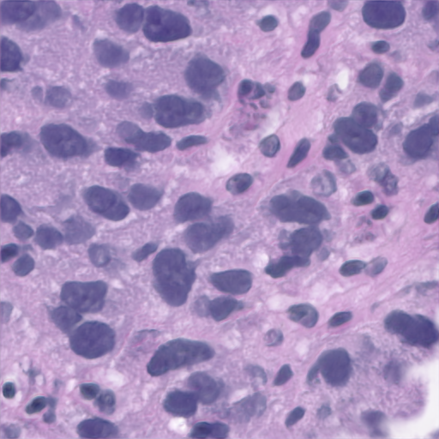
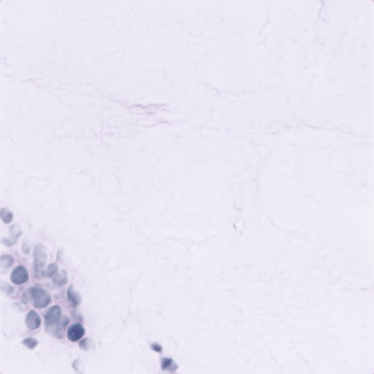
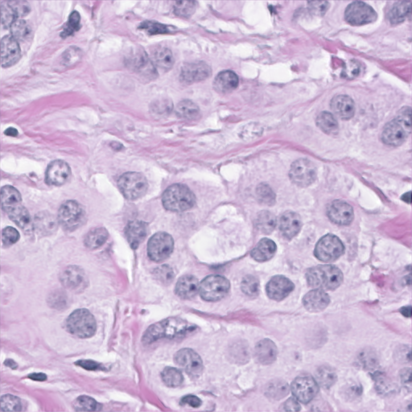
Motivation, Scope, and Description
3
Cell segmentation in microscopy scans of biopsy samples is hard to generalize for a large number of images with classical CV approaches
Inconsistencies that are hard to generalize: Difference in cell size/shape and stain techniques
U-net deep learning infrastructure was designed to deal with this exact problem in the 2015 paper
Using U-net, an image processing pipeline will be developed to segment thousands of images

Slide 4
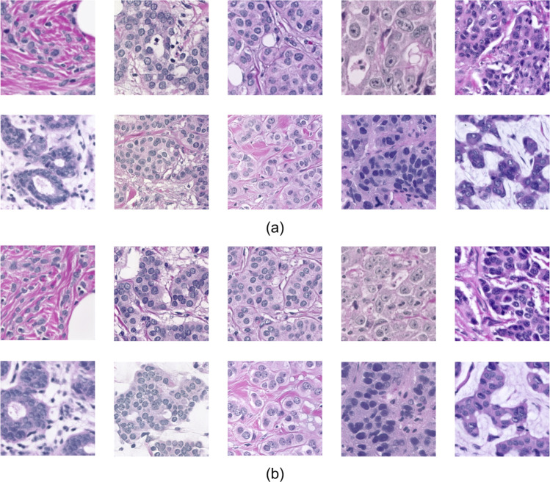
Data and Computational Resources
4
Utilized the Synthetic Nuclei and Annotation Wizard (SNOW) data set: a) real images (BreCaHAD dataset) b) synthetic (SNOW dataset)
Each image is synthetic, did not test on real microscopy scans
Dataset had 20k images and 20k masks, masks stored as matlab files :/ (made masks 5x larger in storage than they needed to be)
Loading 5k images and 5k masks into memory + all other memory usage took ~30GB of RAM
Computational constraints of 50 GB RAM and NVIDIA Tesla T4 GPU 15 GB
Didn’t make logistical sense to use more than 5k images
Image taken from: [1] K. Ding, M. Zhou, H. Wang, O. Gevaert, D. Metaxas, and S. Zhang, "A Large-scale Synthetic Pathological Dataset for Deep Learning-enabled Segmentation of Breast Cancer," Scientific Data, vol. 10, no. 1, p. 231, 2023. [Online]. Available: https://doi.org/10.1038/s41597-023-02125-y

Slide 5


Data and Computational Resources Cont
5
Formatting the data took lots of time!
Dataset unzipped was 146.8 GB had to upload images to Google drive as well because I utilized Colab
File names were weird and utilized a tool within Mac’s Finder to rename filenames with the following convention:
000000.png or 000000.mat
I would not recommend renaming 40k files at once, nearly crashed my computer
Uploading 5k images at once to Google nearly crashes computer
Since masks are 5x larger (5k masks is 32 GB of matlab files) I decided to have a local script on my device that extracted the masks from the matlab files and saved them as PNGs
Finally, could upload these masks to Google drive, took about 2 hours for 10k file upload

Slide 6
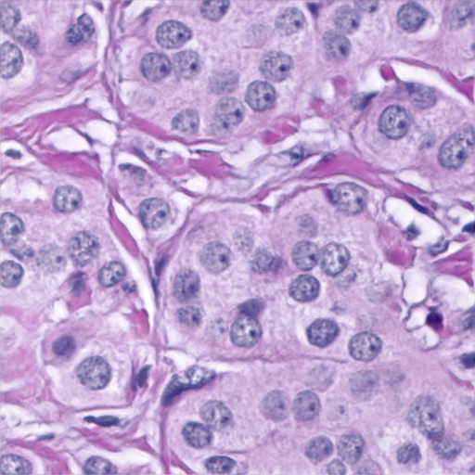
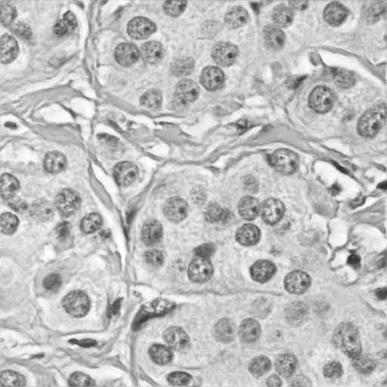
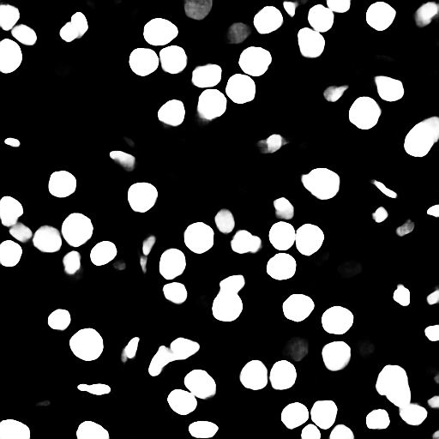

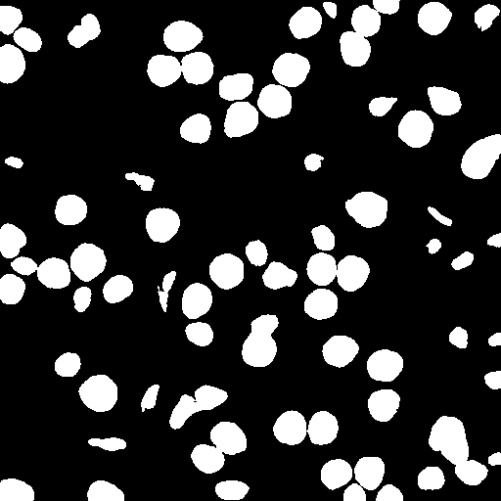

Image Processing Pipeline
6
Input Image
Extract Red Channel
U-net output
U-net
Original Mask Extracted From Matlab File
Mask After Binary Threshold (Pixel values > 0 are the mask)
Output after Otsu

Slide 7
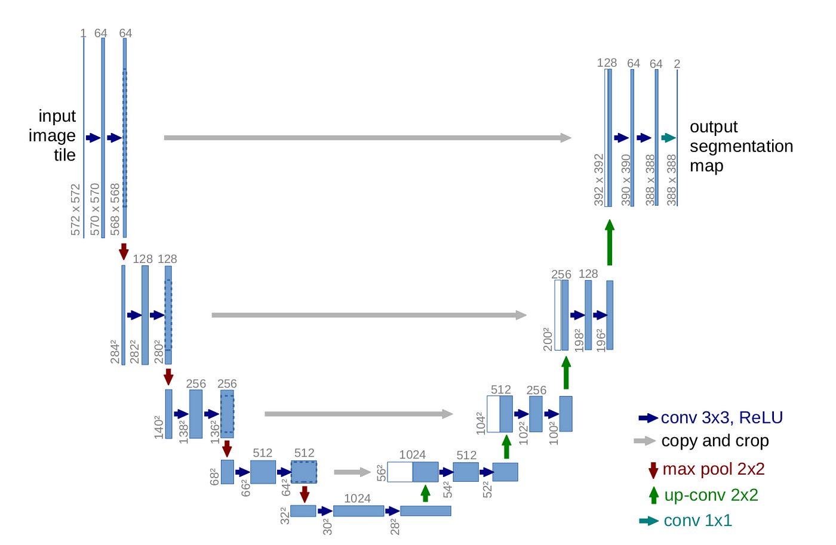
U-net Setup & Training
7
Pipeline revolves around U-net
The original U-net has number of filters as 64>128>256>512>1024
My U-net has less filters: 16>32>64>128>256
Training time is much faster because the number of parameters went from 7+million to less than 2 million
Added dropout layers as well to combat possible overfitting
Decided to use 3,600 train images, 400 validation images, and 1,000 test images
Training time ~3 hours for 50 epochs, I saved the model on each epoch
Sigmoid Activation
Adam Optimizer
Loss function: BCE

Slide 8
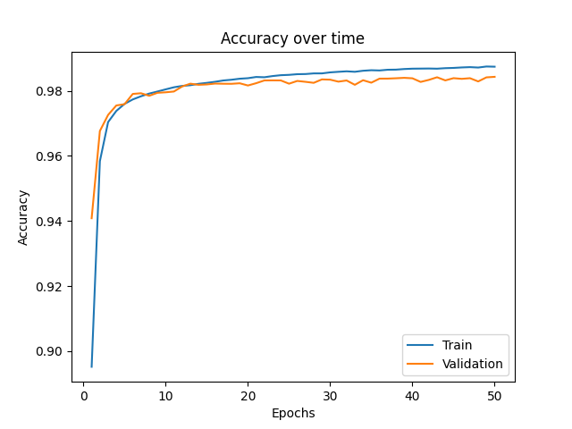
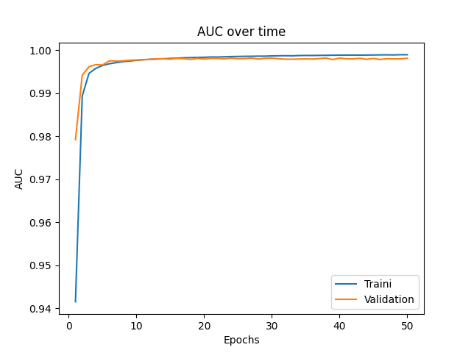
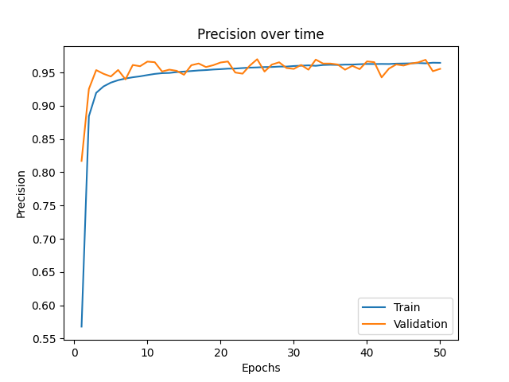
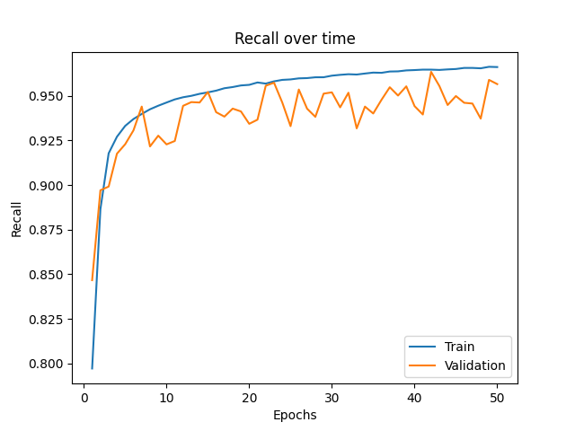
Training Metrics
8
Network seemed to learn well and fast
Maybe could have used more epochs or was 50 overkill ?
Minute test differences between models from epochs 20-50

Slide 9





Approach: Algorithms and Module Implementation Details
9
Libraries Utilized:
Scipy.io → used to extract the masks from matlab without a matlab license ☺
Os → used to iterate over my filesystem locally and on Google drive
Google.colab → used to link my Google drive to Colab
Matplotlib → used to visualize images and plot metrics
OpenCV → used to read/write images in, split the images channels, and for Otsu
Numpy → used simply to convert datatypes into something tensorflow accepts
Tensorflow and Keras → Used to implement the U-net
560 × 560800 × 985

Slide 10
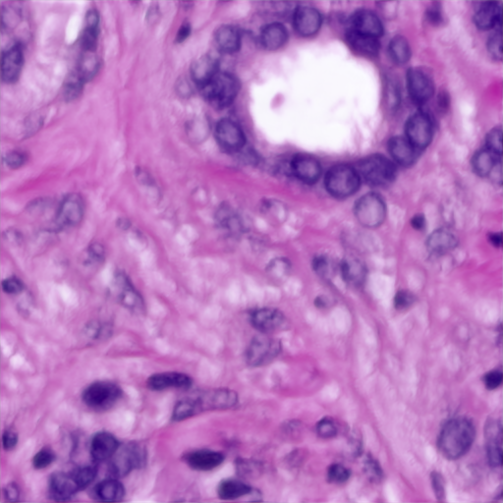
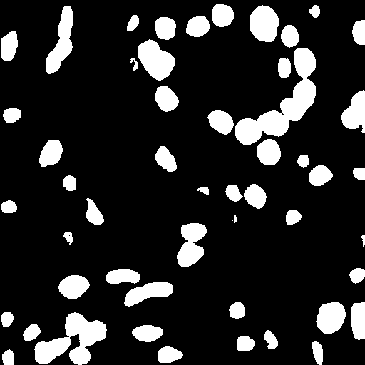
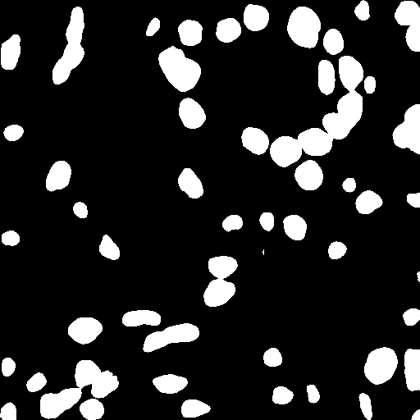

Results: Demo & Evaluation
10
Test Image
Expected Mask
Predicted Mask
Predicted mask looks similar to the expected mask
Some differences, but pretty good overall

Slide 11
Summary & Future Work
11
I wanted to accomplish nuclei segmentation and believe I accomplished it well
Some problems that were encountered:
Initially went down a rabbit hole on the UBC Ovarian Cancer dataset on Kaggle
Data formatting caused my machine some headaches
Needed a stronger machine to do deep learning, at times even colab was throwing graph execution errors because I maxed out the resources
Future work
Possibly test whether my trained model can segment real images
If that is successful test whether the model can segment other cancers/cells right out the gate? My guess is no

Slide 12
References
12
[1] K. Ding, M. Zhou, H. Wang, O. Gevaert, D. Metaxas, and S. Zhang, "A Large-scale Synthetic Pathological Dataset for Deep Learning-enabled Segmentation of Breast Cancer," Scientific Data, vol. 10, no. 1, p. 231, 2023. [Online]. Available: https://doi.org/10.1038/s41597-023-02125-y
[2] O. Ronneberger, P. Fischer, and T. Brox, "U-Net: Convolutional Networks for Biomedical Image Segmentation," arXiv preprint arXiv:1505.04597, 2015. [Online]. Available: https://arxiv.org/abs/1505.04597

