Slide 1

Neural Networks for IGPS
Mikey Joyce

Slide 2
Experiment Setup
Built a Radial Basis Function (RBF) Neural Network
Gaussian as the RBF kernel. Designed it to have three different modes for covariance (one value, one value per node, full covariance matrix).
Initialize centers of RBF utilizing the centers found in the first IGPS visit
Trying to predict the next time steps “ProgressionStructure1” feature
Current RBF setup has 3 RBF nodes, reason being we had 3 clusters for IGPS
Covariance initialization is at 0.5 with one value per RBF node, allowed for the updating of the covariance values using SGD
Learning rate: 0.01 (here for the future)

Slide 3
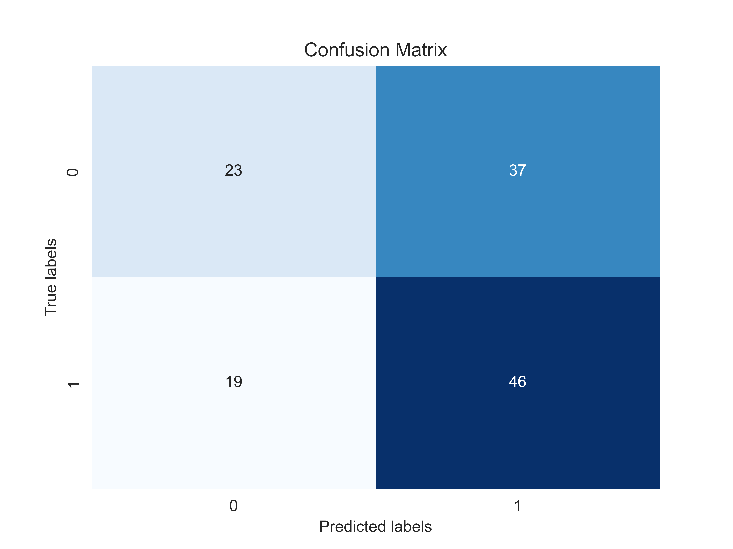
Experiments Cont.
With original 12-dimensional feature set, weak results:
Accuracy Score: 0.552
Precision Score: 0.5542168674698795
Recall Score: 0.7076923076923077

Slide 4
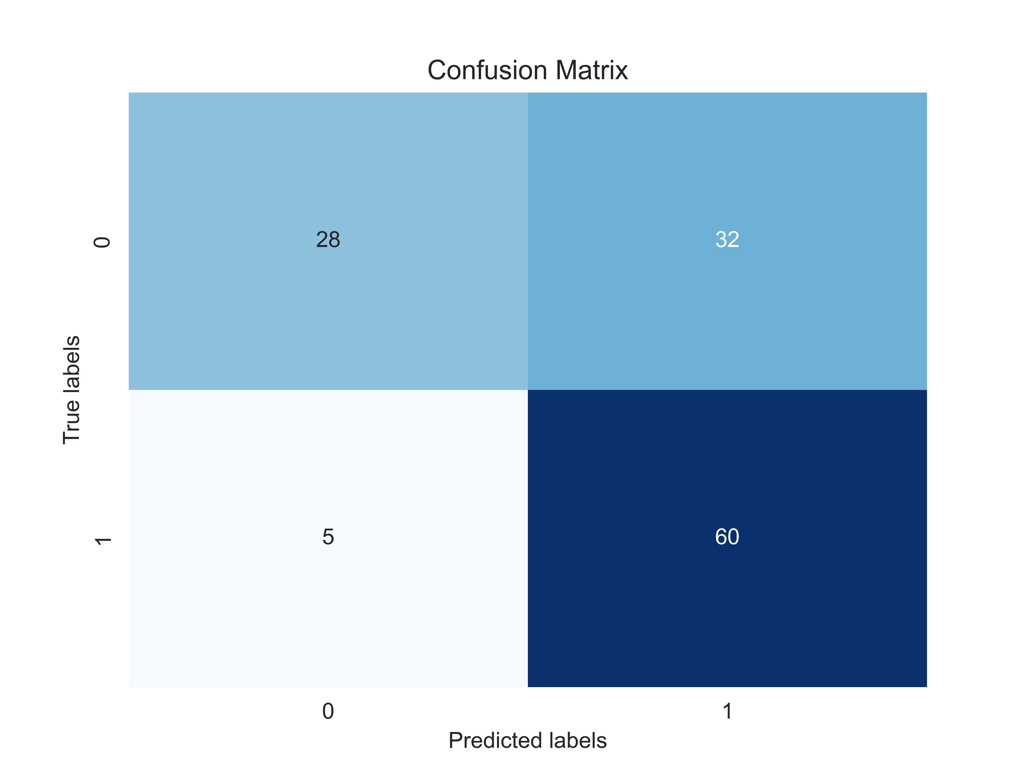
Experiment Cont.
Modifying the feature set to have the current time steps “ProgressionStructure” and “ProgressionStructure1” variable gave better results, but it is kind of cheating, won’t transfer to other data sets
Accuracy Score: 0.704
Precision Score: 0.6521739130434783
Recall Score: 0.9230769230769231

Slide 5
Experiment Cont.
Interesting finding as well, can get the same results as the last slide by removing most features from the feature vector.
Only keep:
'IOP', 'P1', 'P5', 'R4', 'ProgressionStructure', 'ProgressionStructure1’
Results:
Accuracy Score: 0.704
Precision Score: 0.6521739130434783
Recall Score: 0.9230769230769231

Slide 6
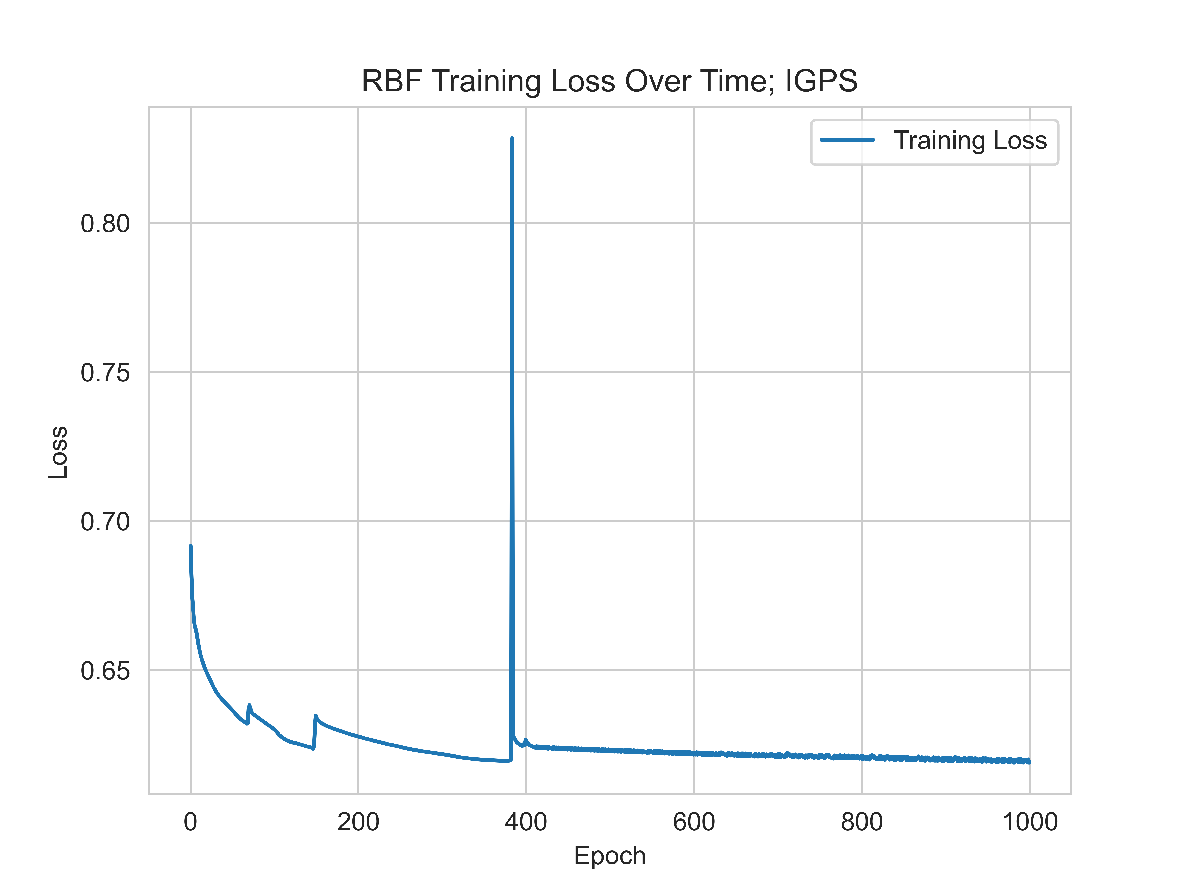
Experiment Cont.
Full covariance matrix in RBF gives strange loss over time
Overfitting?
Error in code?
With this, the test set has unstable results, as they change from run to run even with the same parameters (using the other covariance modes gives more stable results)
(Increased epochs to demonstrate the behavior)

