Slide 1

Neural Networks for IGPS
Mikey Joyce

Slide 2
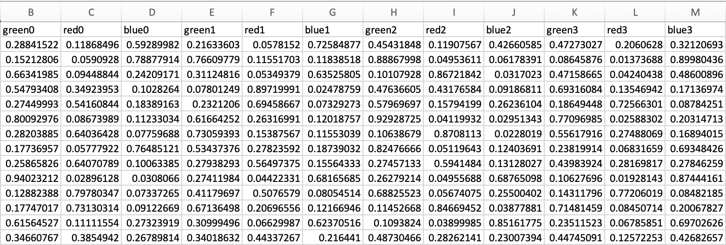
Experiment Setup
IGPS data was split up by visits
12 visits total, but only 11 with enough data (last visit has only 5 entries)
Clustered each visit independently utilizing FCM (may not be the best, since after the first visit the clusters haven’t been verified)
Extract the memberships from each patient at each time step (feature vector sample below)
Since this is time series, I utilized a Dynamic Time Warping (DTW) algorithm to construct an affinity matrix (No jargon: I am encoding the relationship/similarity between each trajectory)

Slide 3
Experiment Setup Cont.
Fed the DTW affinity matrix to a spectral clustering algorithm
Peak silhouette score was at 15 clusters
Any other cluster validity measures I should try ?
Next, I use spectral clustering with k=15 to group the trajectories

