Slide 1
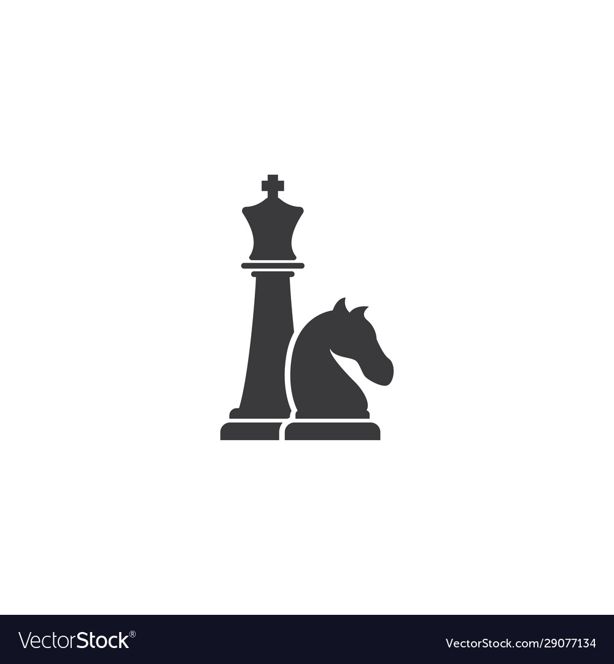
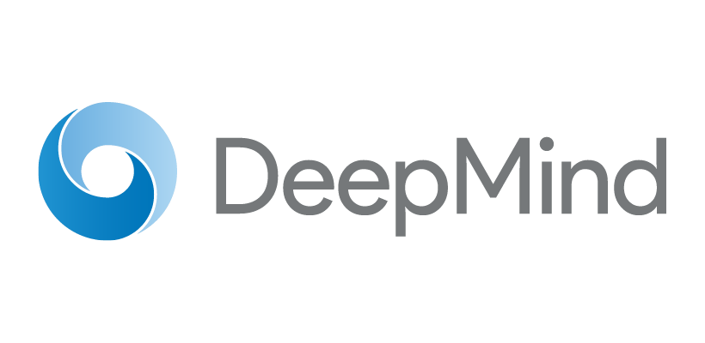
Understanding DeepMind’s Mastering Chess and Shogi by Self-Play with a General Reinforcement Learning Algorithm
Presented by Mikey Joyce

Slide 2
Overview
The paper I am covering discusses a “general” reinforcement learning algorithm, Alpha Zero, that attained superhuman performance in the turn-based board games Go, Shogi, and Chess.
This is an important advancement due to the nature of generalization being the ultimate goal of artificial intelligence, and it achieved a certain degree of generalization.
Novelty: past algorithms that have mastered various turn-based board games required hand crafted features and knowledge from game experts, Alpha Zero learns the knowledge required to become an expert utilizing deep networks
Ex: Stockfish, one of the worlds best chess engines, utilizes a hand crafted evaluation function to assess any given position and determines the player that has the advantage by outputting a scalar heuristic
Alpha Zero learned the evaluation function

Slide 3



Methods pt. 1
Eq. 1: State Evaluation
State Evaluation:
A deep neural network, f, with parameters, θ, is trained to evaluate the position, s, by outputting a vector of move ”probabilities” defined as:
Where, a, denotes a move. The network also outputs a scalar, v, that estimates the outcome from the given position.
Simulating Games:
Games are simulated utilizing the Monte-Carlo tree search (MCTS) algorithm. Each simulation consists of a series of games traversing a tree from root to leaf. The search returns a vector, π, which is a probability distribution of moves
In the simulation, at each state a move with a low number of past occurrences and a high move probability p & value v obtained from the current neural network. The MCTS ensures the network is exploring new moves while also exploiting known good moves.
Eq. 2: Next move evaluation
Eq. 3: Positional evaluation

Slide 4
Methods pt. 2
Training the evaluation function:
To train the parameters, θ, of the evaluator the following method is applied:
Initialize θ randomly
Play game utilizing MCTS
At the end of the game compute the game outcome z = {-1: loss, 0: draw, 1: win}
Update parameters θ given the following loss function:
Repeat steps 2-4 until desired parameters are reached
c, is a hyperparameter that controls the amount of regularization that is factored into the weights of the neural network.
The loss function is trying to minimize the error between the predicted outcome of the game, v, and the ground truth outcome, z, while also maximizing the similarity between the probabilities found in search, π, and the estimated policy vector, p.

Slide 5
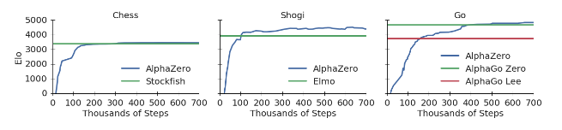
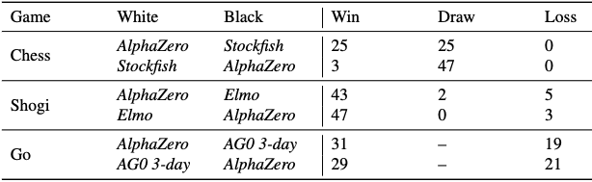
Experiments and Results pt. 1
For the three separate games, a different instance of AlphaZero was trained for 700,000 epochs and a mini-batch size of 4,096.
After ~300,000 epochs AlphaZero surpassed the best Chess engine in Elo rating. For Shogi it took ~110,000 epochs to beat the best engine. And for Go it took ~165,000 epochs.
Interesting to note that the Elo ratings in Chess and Go did not surpass the best engines by a large margin during the training cycle.
At the end of training the AlphaZero models for each game were paired against the best engine in the respective board game to see the results of actual play. The W/D/L rates are shown in the table →

Slide 6
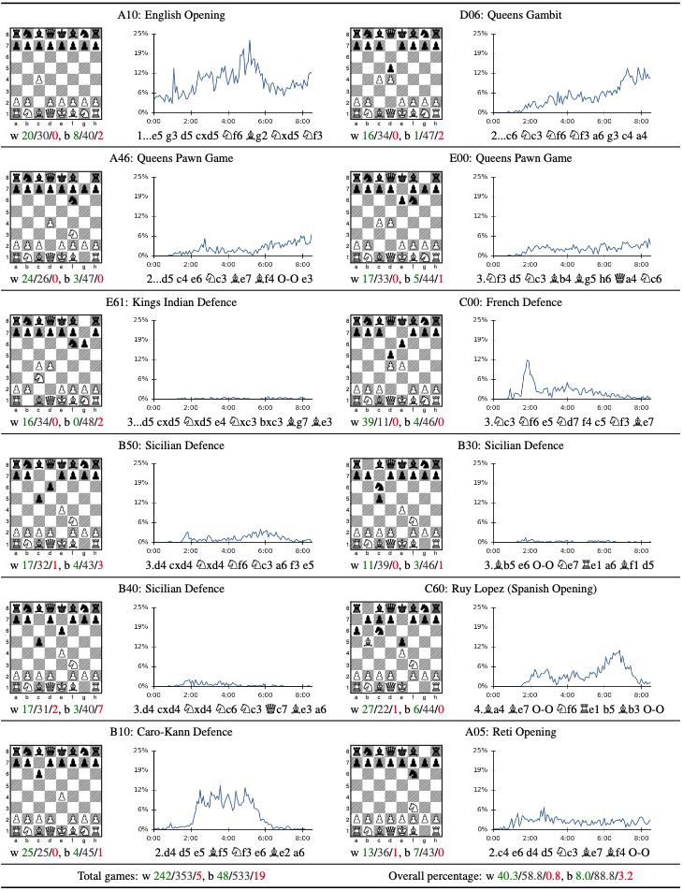
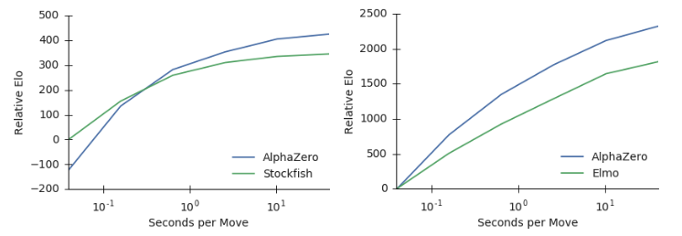
Experiments and Results pt. 2
Analyzing the position search rate of AlphaZero’s MCTS v.s. state of the art game engines it was found AlphaZero only searches 80,000 positions/second in chess while Stockfish search 70,000,000 positions/second. For Shogi, AlphaZero searches 40,000 positions/second while the top Shogi engine, Elmo, searches 35,000,000 positions/second.
The table on the right shows popular chess openings that AlphaZero discovered during training and the proportion of training games where AlphaZero played said opening over training time.
After training AlphaZero played 100 games against Stockfish using each opening. The W/D/L rates are reported as well, AlphaZero typically forced wins as white and draws as black.

Slide 7
Reflection and Future Work
Overall, this work was solid by introducing a generalized algorithm to complex turn based board games, where in the past game expert's domain knowledge were required to achieve the same goal.
It was also able to surpass current methodologies while searching a much smaller space. This was possible due to the encoded intuition that the state evaluation deep neural network provided to MCTS.
To me what was lacking was a in depth explanation of how MCTS is obtaining π. This is crucial in getting correct as it is an aspect of how the deep net is gaining intuition as it is acting as a truth label to correct the network. However, they never actually explained how MCTS specifically was calculating π, which hurts reproducibility.
Along these lines, it would have been nice to see a specific network structure outlined. Instead, they left that open to interpretation, probably because the network itself that was utilized could work with various types of networks.
I also think that the claim that it is a general algorithm needs to be revised as it is clear this is only a general algorithm with respect to turn-based board games. This is due to the method that the network learns knowledge about the world is represented through a MCTS simulation, which works on discrete domains. How would this operate on a continuous domain?
In the future work, a reinforcement learning algorithm that is generalized upon continuous domains rather than a discrete one should be investigated (i.e. a RL agent that can play DOTA and Call of Duty). If this is (or already has been accomplished) then creating a generalized RL algorithm that can work on both discrete and continuous domains should be investigated.

