Slide 1

Clustering Techniques to determine origins of wine
Mikey Joyce

Slide 2
Goal
Analyze wine dataset utilizing clustering techniques to determine which wines should be grouped together
Create a tool that could be utilized by a sommelier or aspiring sommelier to improve their technique for identifying wines

Slide 3
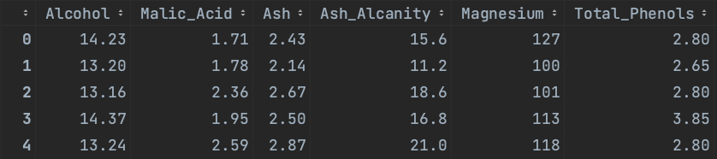
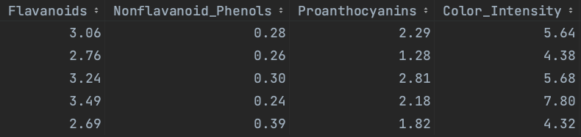
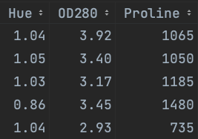
The Data
13 features contained within the dataset
Will drop Proline because it is the only categorical feature and feels out of place

Slide 4
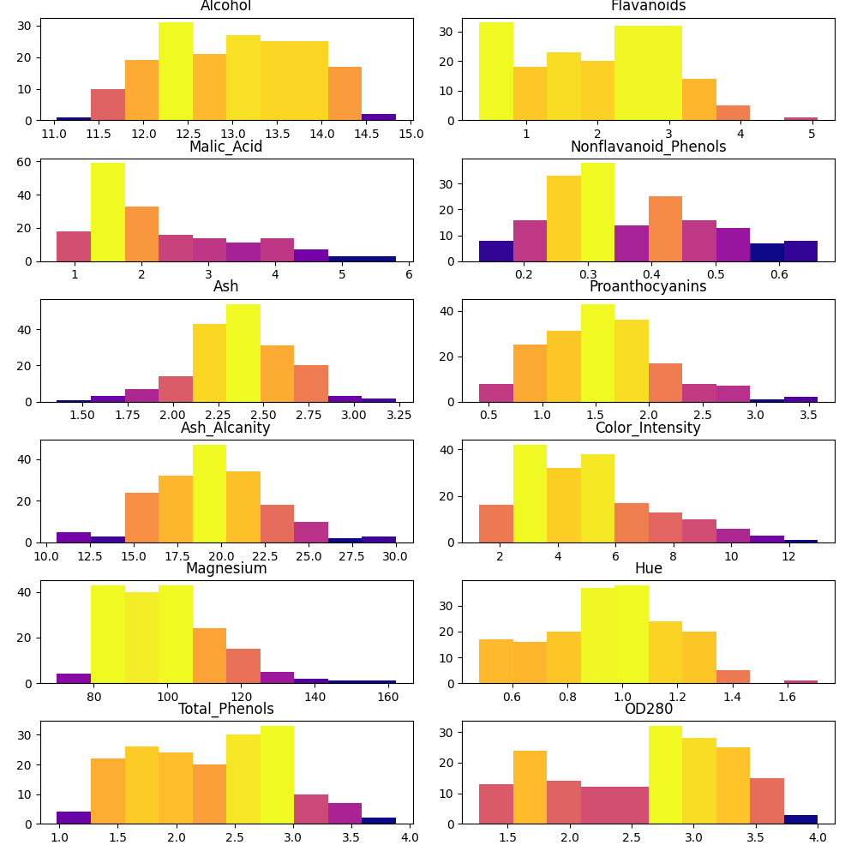
Resulting Feature Vector
Alcohol ←→ Falvanoids
Malic_Acid ←→ Nonflavanoid_Phenols
Ash ←→ Proanthocyanins
Ash_Alcanity ←→ Color_Intensity
Magnesium ←→ Hue
Total_Phenols ←→ OD280
12 features within the vector

Slide 5
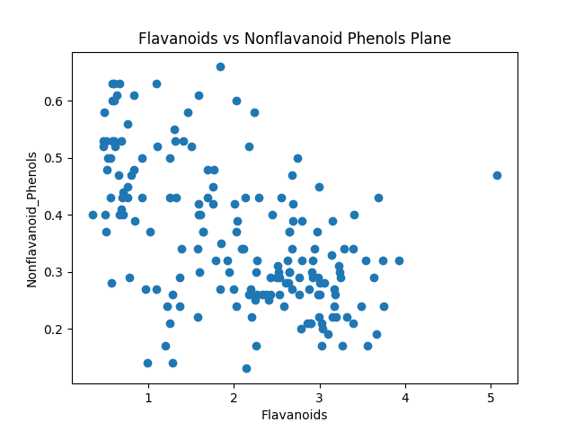
Are Clusters Obvious?
Clusters are not obvious to the eye on any of the plots

Slide 6
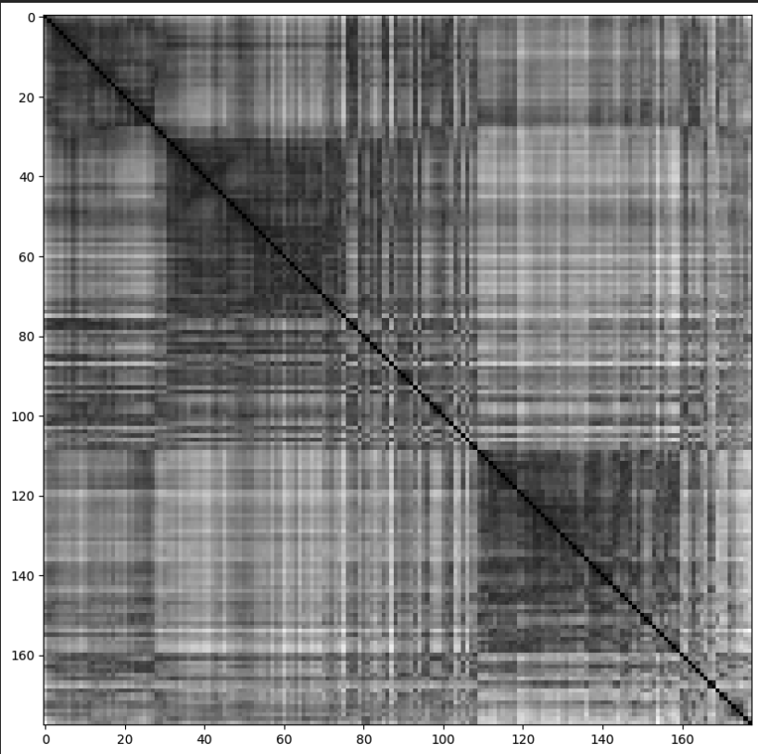
Determining Number of clusters
Decided to run the vat and ivat algorithm to visualize if there is a cluster structure within the data
There seems to be a structure with 2 main clusters and the larger cluster may have 2 sub clusters within

Slide 7
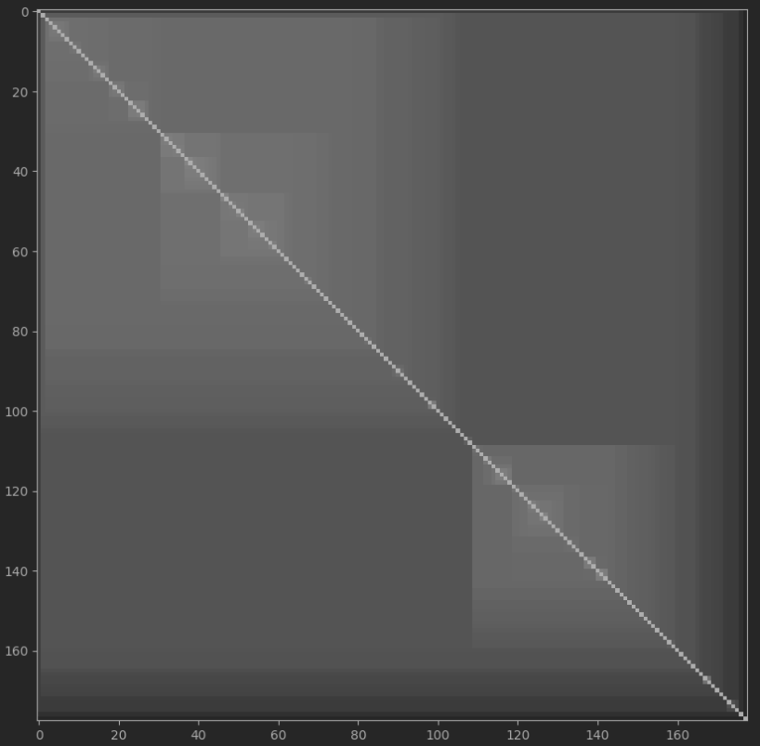
Determining Number of clusters
It is more clear in the ivat that there are two main clusters and the larger cluster has two sub clusters
This observation will influence my approach. I will not try to cluster using 3 clusters as num clusters. Instead I will try and find two main clusters and then with the larger cluster I will try and find the sub clusters.

Slide 8
Clustering Plan
Dimensionality reduction round #1
Reduce the 12-feature set with t-SNE into a 2D map to aid in clustering
Clustering round #1
Utilize the map given from dimensionality reduction to identify two clusters with spectral clustering
Dimensionality reduction round #2
Remove the data points from the smaller cluster from the dataset and then reduce the 12-feature set into a 2D map with t-SNE for clustering
Clustering round #2
With the final map apply fuzzy c–means clustering over it to obtain two subclusters. Harden the memberships and calculate the final clusters

Slide 9
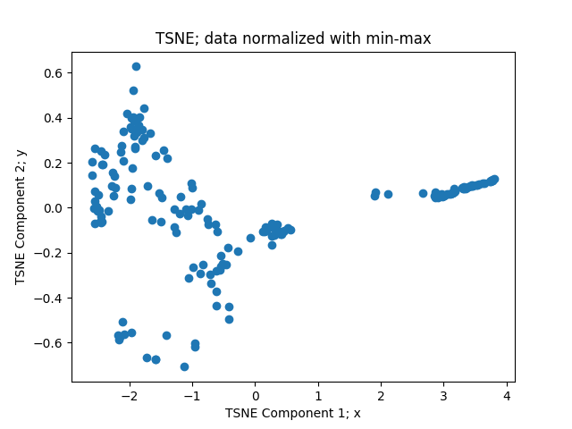
Dimensionality Reduction Round 1: t-SNE
PCA didn’t give ideal results
Applied t-SNE on the data and there appears to be more separability between the data
This t-SNE implementation allows for the saving of embeddings as well, so new data can be mapped to this exact embedding

Slide 10
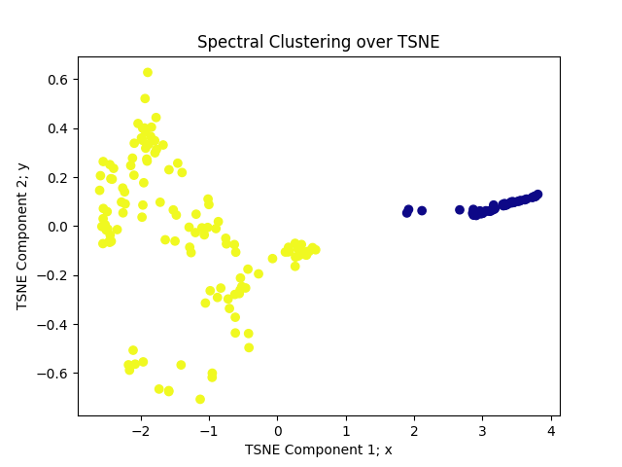
Clustering round 1: Spectral
Since we know one cluster is likely larger than the other cluster, I decided to opt for spectral clustering to deal with the imbalance of cluster sizes
Spectral clustering also seemed like a good fit because the clusters each have structured shapes that are not the same
Was able to obtain two clear and concise clusters

Slide 11
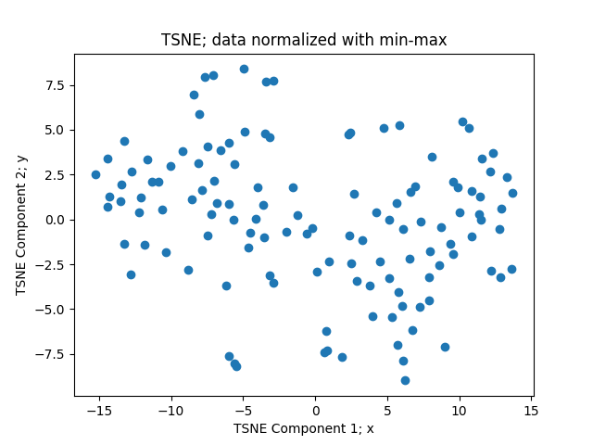
Dimensionality Reduction Round #2: t-sne
Now to start this round, I deleted the data points from the smaller cluster from the input vector
Applied t-SNE on the larger cluster to get a smaller feature set

Slide 12
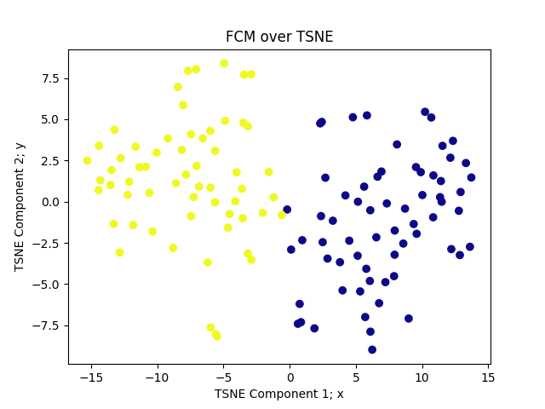
Clustering round 2: Fuzzy c-means
The t-SNE plot obtained from the larger cluster did not seem to have as crisp of clusters as the first t-SNE plot.
Because of this I decided to employ the Fuzzy C-Means clustering algorithm to account for uncertainty within the clusters

Slide 13
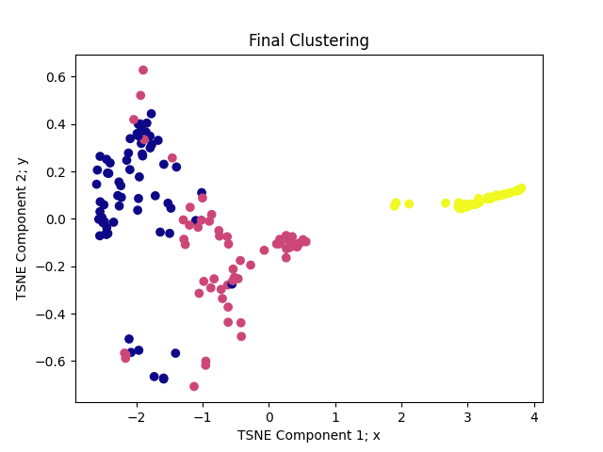
Final clustering result
The results are visualized on the first t-SNE embedding that was produced
My dataset that I found online had a counterpart with the same data for supervised learning, so I was able to obtain the labels, my method performs at 93% accuracy when applied against the labels as a benchmark

Slide 14
Citations
Andrew Y. Ng, Michael I. Jordan, and Yair Weiss. 2001. On spectral clustering: analysis and an algorithm. In Proceedings of the 14th International Conference on Neural Information Processing Systems: Natural and Synthetic (NIPS'01). MIT Press, Cambridge, MA, USA, 849–856.
Bezdek, James C., et al. “FCM: The fuzzy C-means clustering algorithm.” Computers &amp; Geosciences, vol. 10, no. 2–3, 1984, pp. 191–203, https://doi.org/10.1016/0098-3004(84)90020-7.
Havens, Timothy & Bezdek, James. (2012). An Efficient Formulation of the Improved Visual Assessment of Cluster Tendency (iVAT) Algorithm. Knowledge and Data Engineering, IEEE Transactions on. 24. 1 - 1. 10.1109/TKDE.2011.33.
Maaten, Laurens van der and Geoffrey E. Hinton. “Visualizing Data using t-SNE.” Journal of Machine Learning Research 9 (2008): 2579-2605.
Wang, Harry. “Wine Dataset for Clustering.” Kaggle, 29 Apr. 2020, www.kaggle.com/datasets/harrywang/wine-dataset-for-clustering.

