Slide 1

Example of Cluster Validity Measures w/ FCM
Mikey Joyce

Slide 2
Overview
This presentation follows a Google Colab notebook:
https://colab.research.google.com/drive/1edI7dI37UaoyrpntZzKASLZY72Gw0Mpj?usp=sharing
I will show some cluster validity examples on the Iris dataset
I also show this example utilizing the FCM algorithm that Dr. Keller mentioned in the email

Slide 3
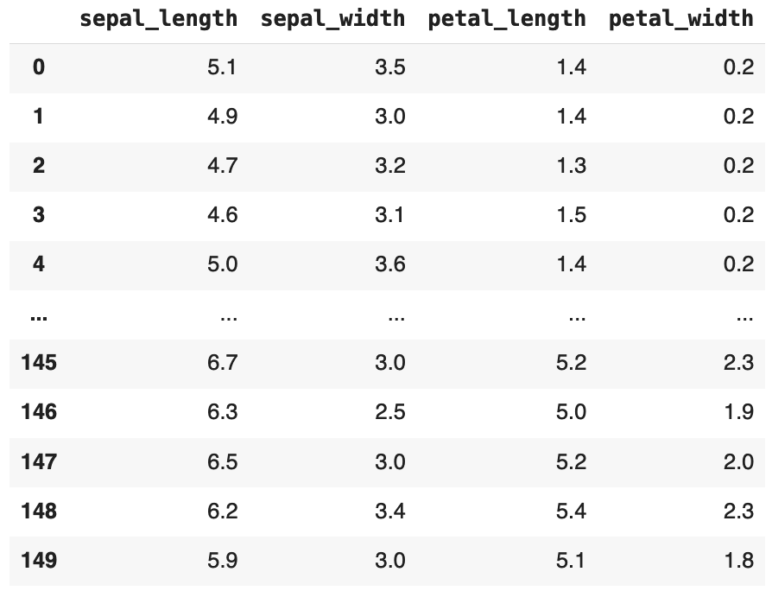
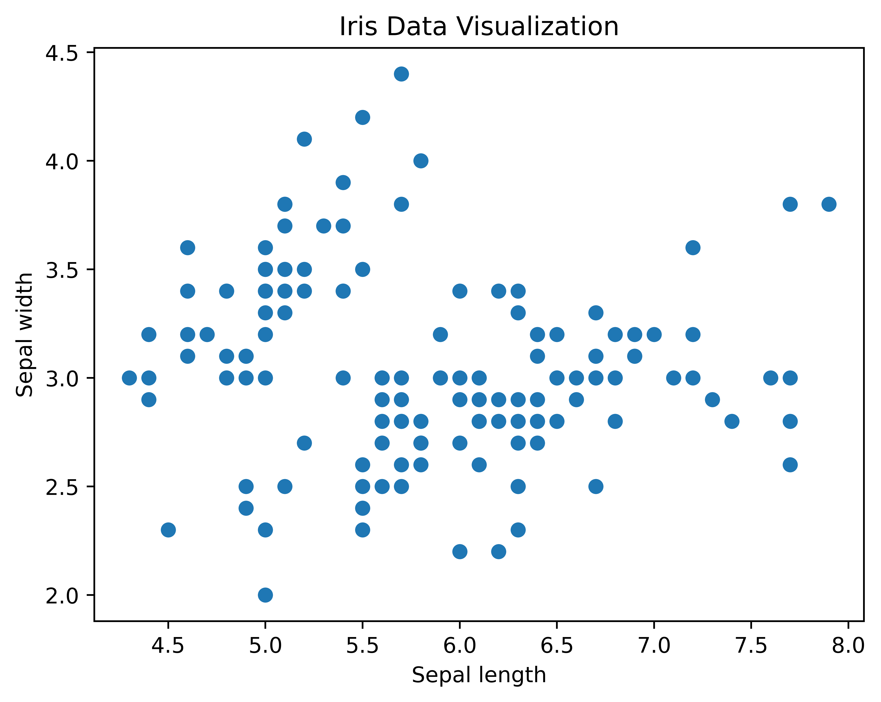
Iris Dataset
The iris dataset is a basic dataset with 4 features on metrics that iris flowers have. It is a popular benchmark/warm up dataset for testing pattern recognition algorithms.
I normalized this data with the MinMaxScaler() normalization method found in scikit-learn

Slide 4
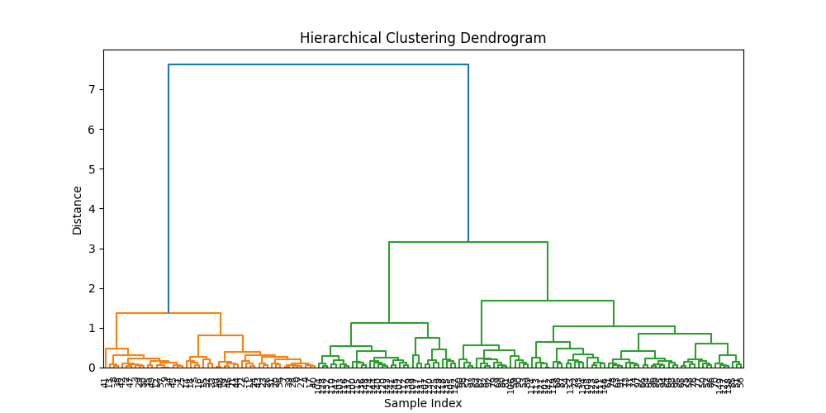
Hierarchical Clustering
Here I am utilizing the Ward algorithm.
It produces a dendrogram and clusters.
Shows how the data may be naturally grouped
k = number of colors in image, in this case k=2.

Slide 5
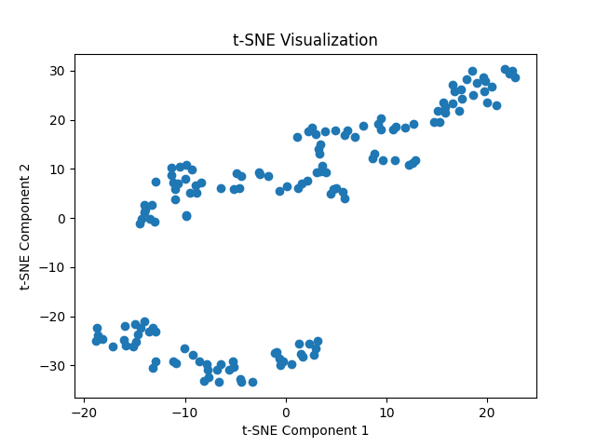
t-SNE
t-SNE is a feature reduction algorithm with the main goal of providing us with visualizations of high dimensional data in a dimensionality humans can digest
This visualization can be good post clustering, if you visually want to understand if your clusters have some separability in high dimensions
Here we see two clear groups

Slide 6
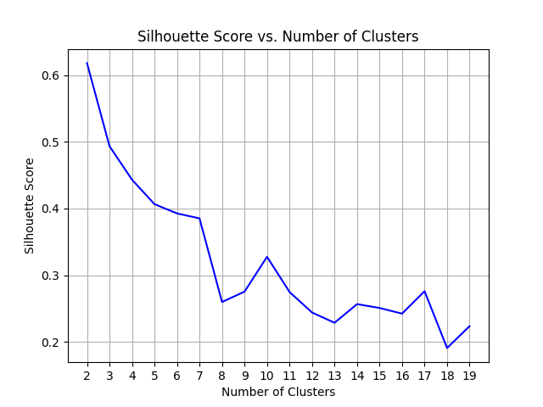
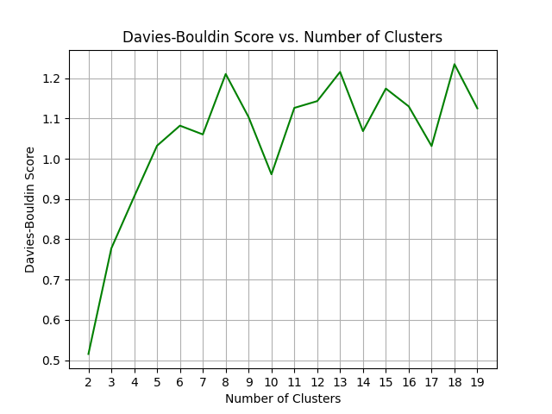
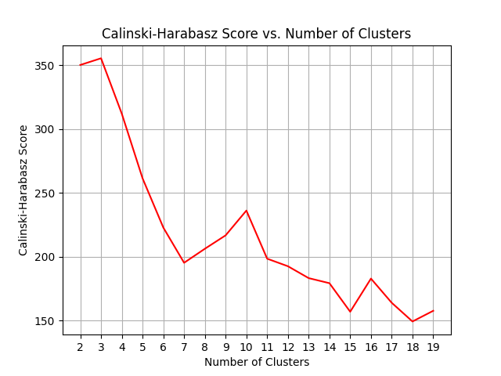
Other Validity Metrics
I provided an example of three metrics that can be used to help analyze validity of clusters
Silhouette Score is quite popular: A score of 1 means clusters are highly separated, while a score of -1 means there is not high separability
Calinski-Harabasz Score: high-values = more separability
Davies-Bouldin Score: low-values = more separability

Slide 7
Other Validity Metrics cont.
Silhouette-score the best score was k=2
Calinski-Harabasz the best score was k=3
Davies-Bouldin the best score was k=2
They don’t agree, but for Calinski-Harabasz the score for k=2 was only slightly worse, and so far everything we looked at is showing k=2
Pitfall with these measures:
Even for complex/real data you will find the charts look similar, with k=2 showing the best scores. If this is something you experience it could still be worth it to look at the local minima/maxima.
Ex: if you look at k=10 on the three charts on slide 6, there is a local maxima for Silhouette & calinski and a local minima on davies. This could potentially be a clustering to explore further.

Slide 8
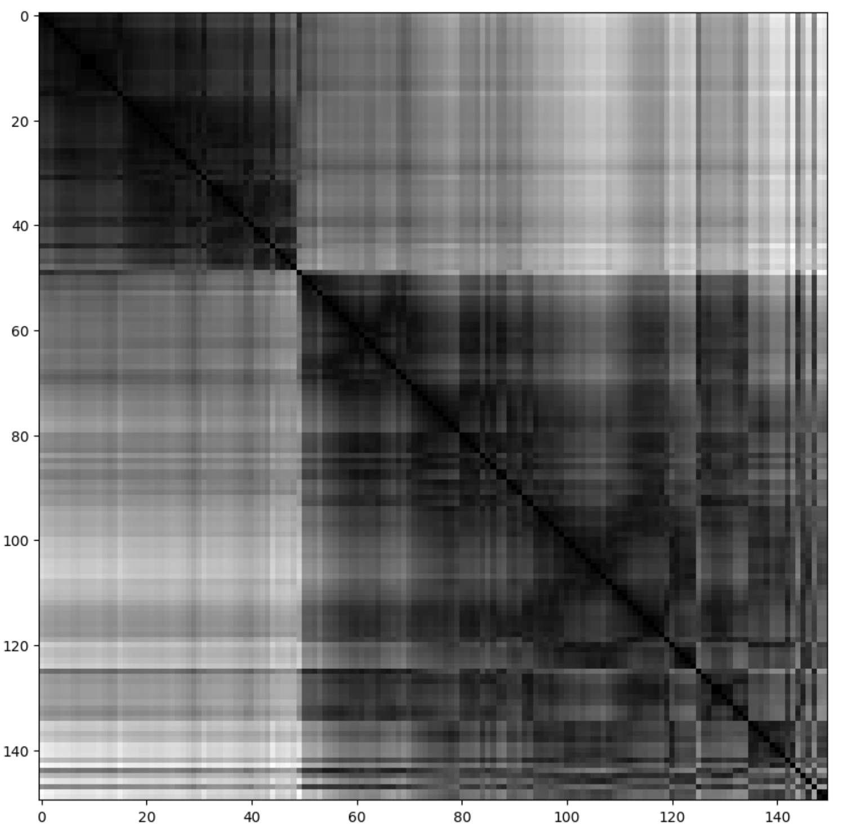
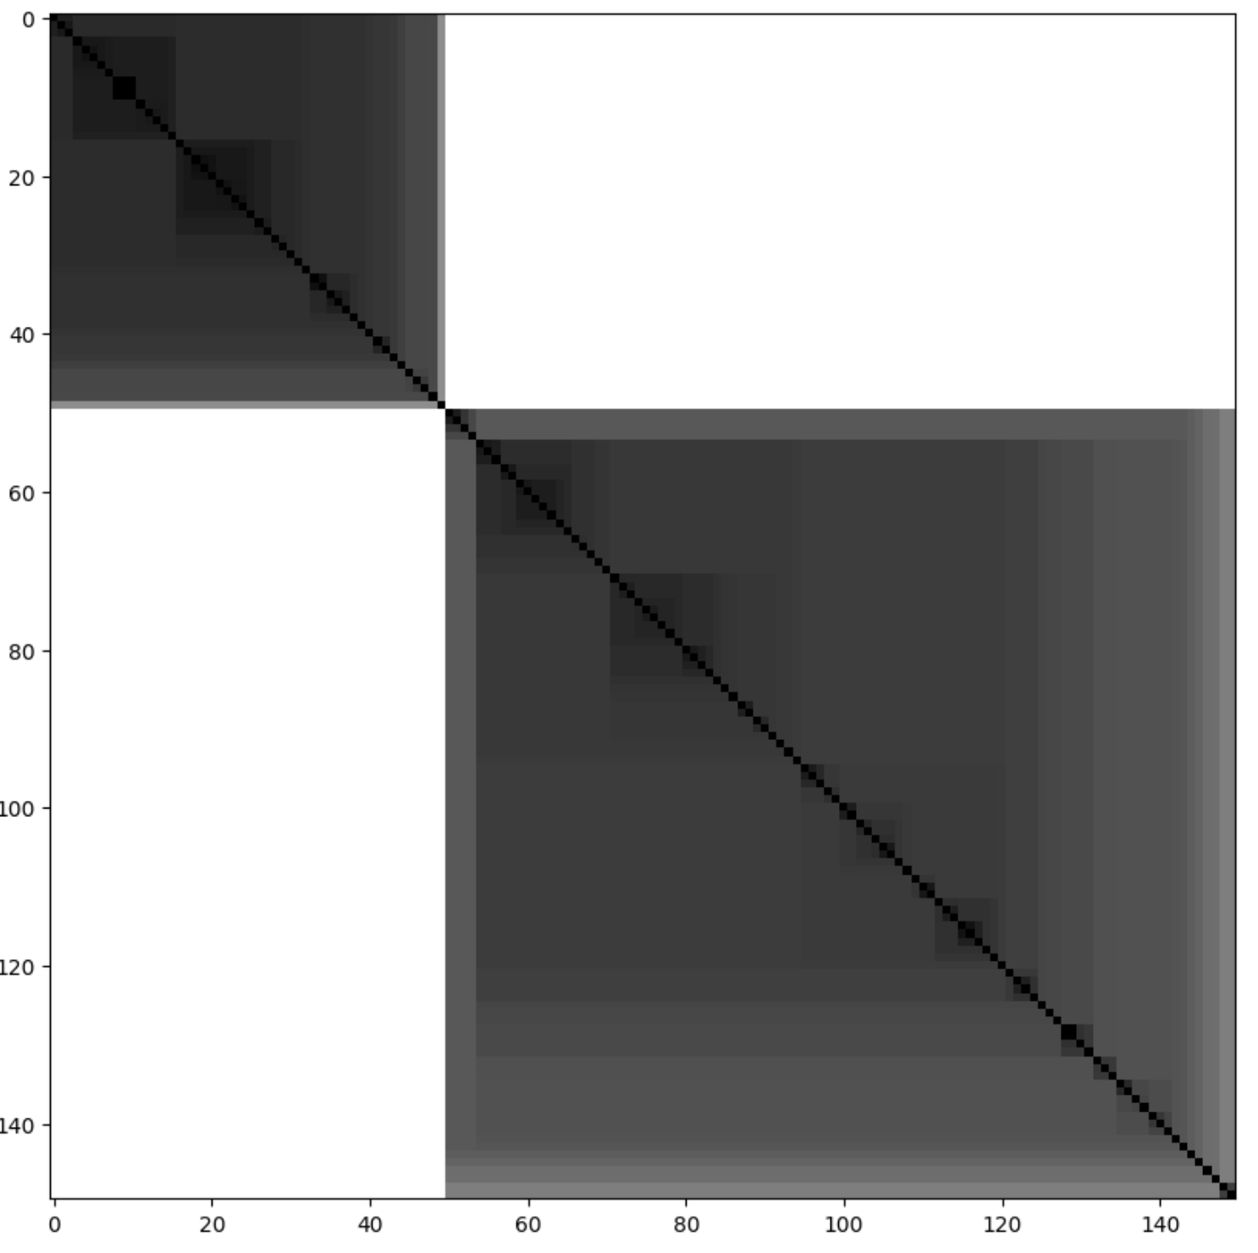
Visual Assessment of Tendency Algorithm
New notebook for this one (requires a specific version of pandas ☹):
https://colab.research.google.com/drive/1blBKOzSD-P6wenIzXEOkBcHI344GyAPB?usp=sharing
These visualizations are trying to visualize the natural groupings of the clusters
VAT (top) is the original, iVAT (bottom) is an improvement on VAT
These visuals can sometimes also help to find sub clusters within clusters

Slide 9
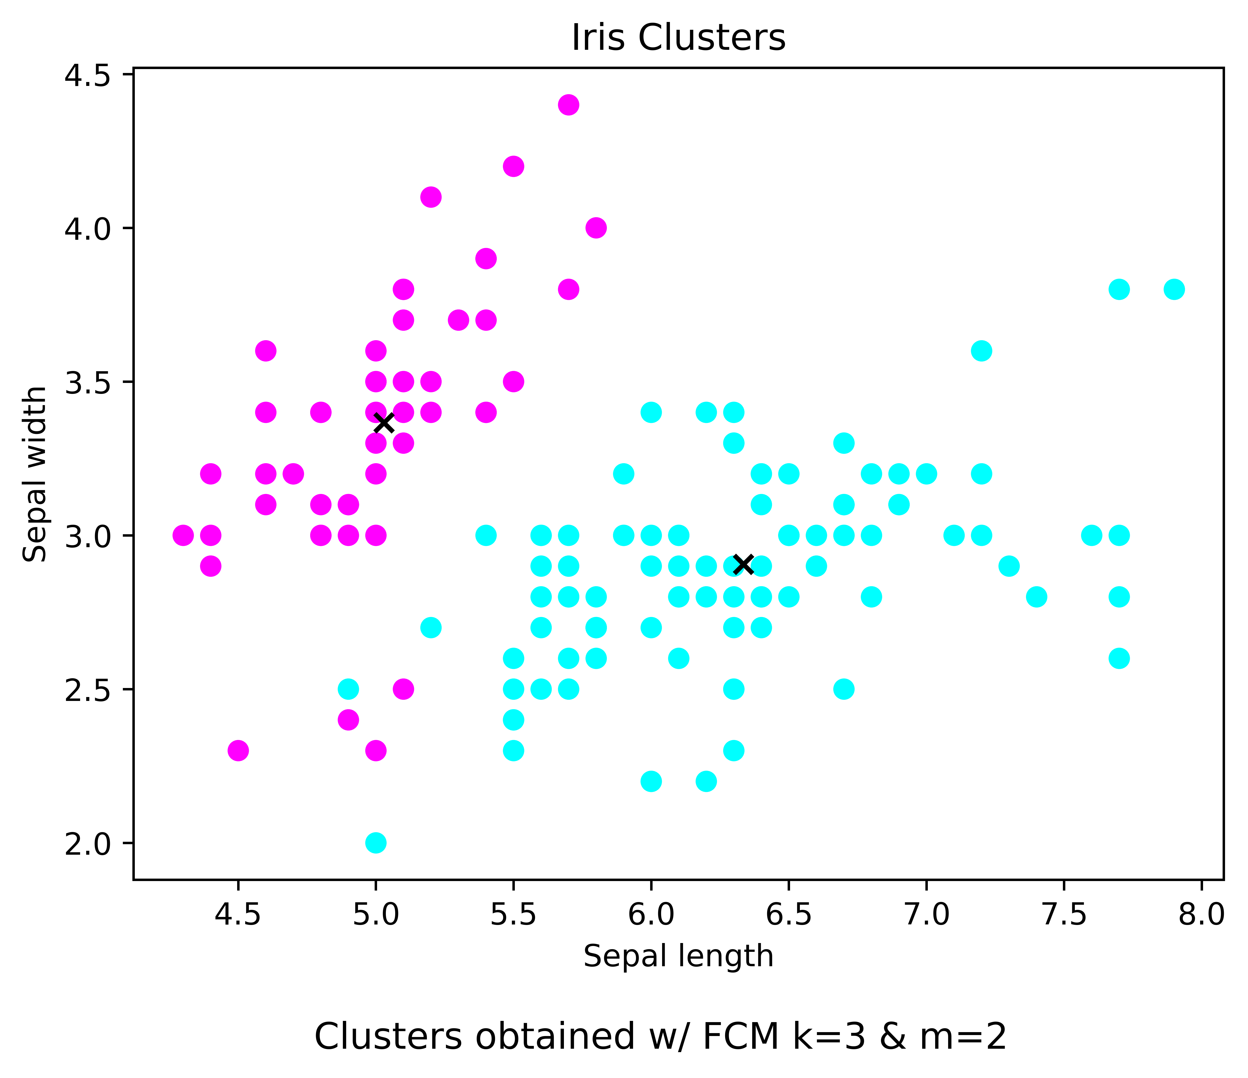
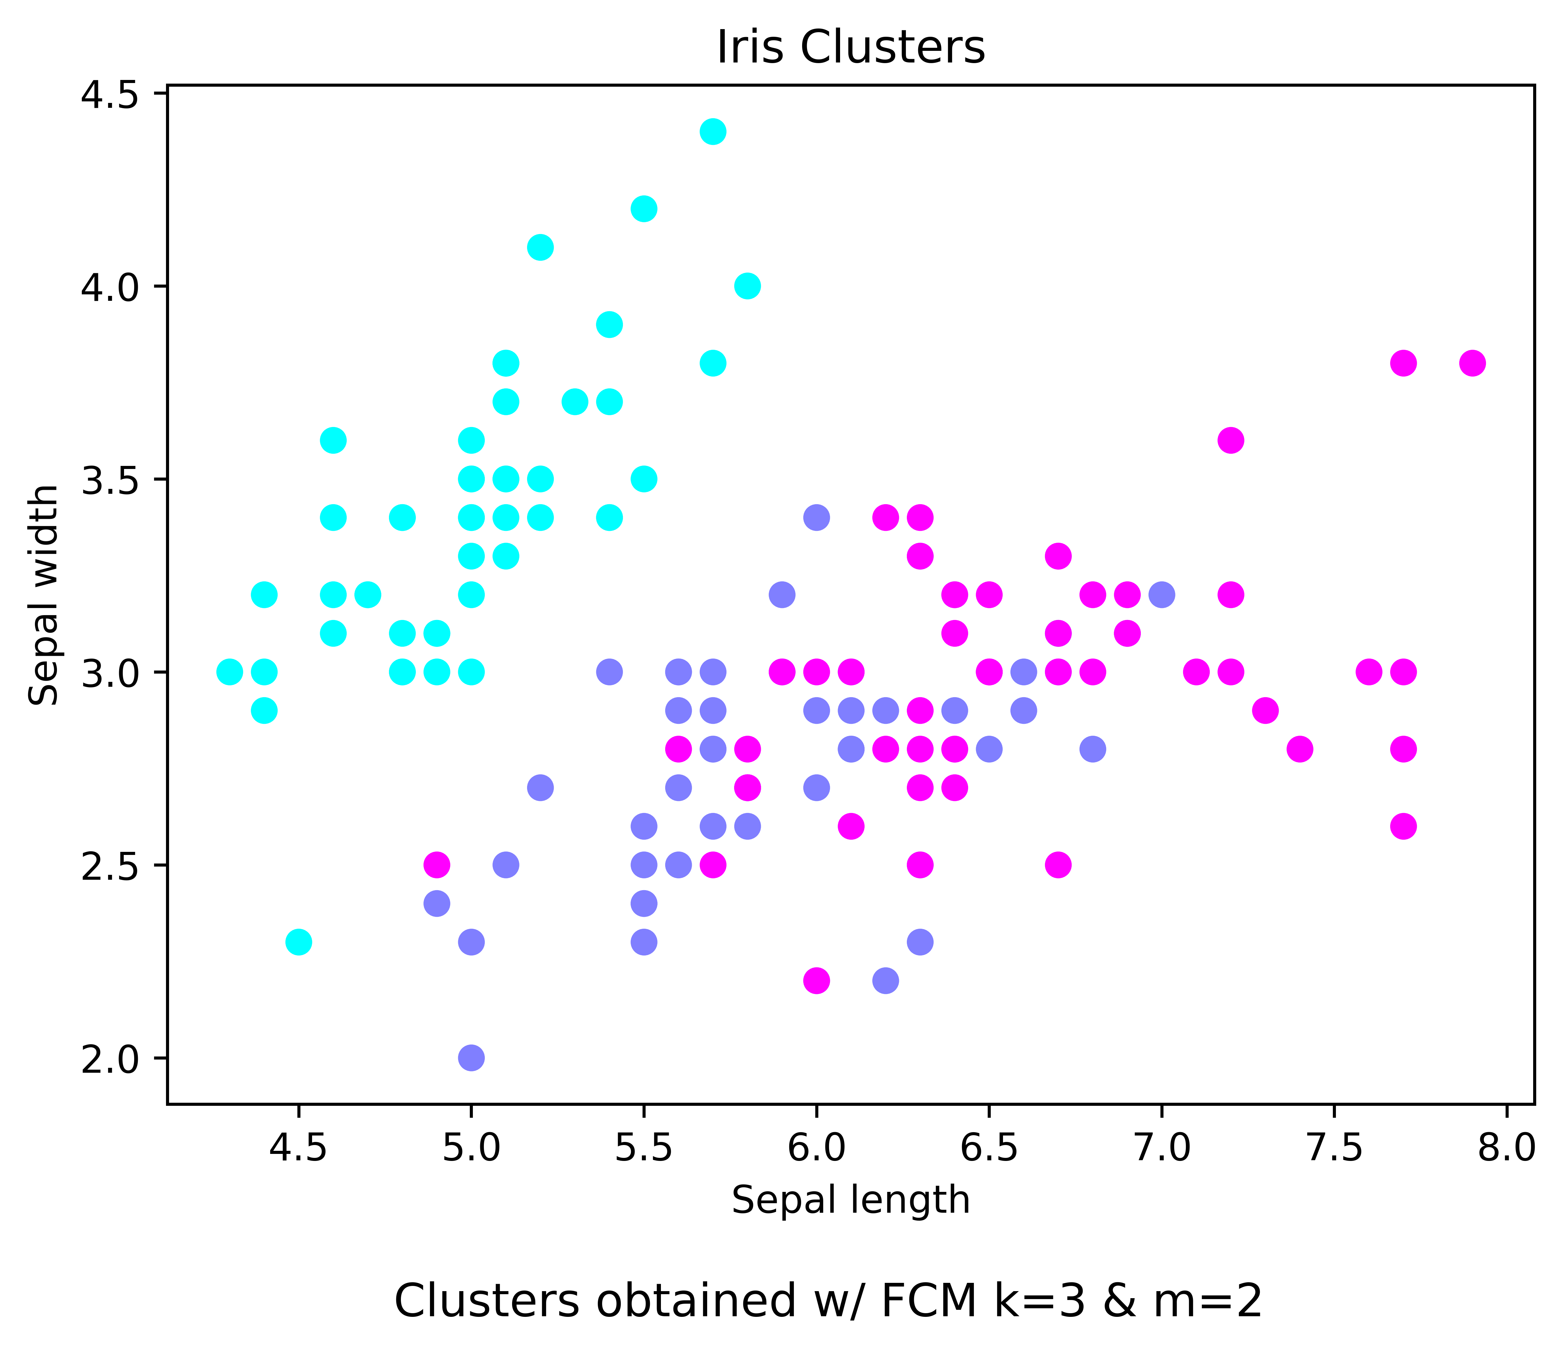
Cluster
Validity measures were showing two (top)
Actual answer is three classes (bottom)
The blue class (bigger cluster) in our initial clustering has subgroups
The validity measures are not always full proof

