Slide 1
Merit in Predicting Bitcoin using Machine learning?
Michael Gallagher – x00121692

Slide 2
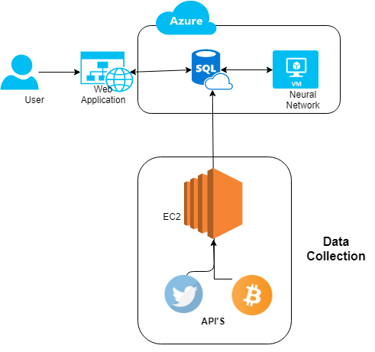
Architecture

Slide 3
Data Collection
Tools used Ec2 instance, Twitter API, CryptoCompare Api, Vader Sentiment Analysis.
Data stored in an Azure Sql Database.
Twitter data used for Calculating Sentiment.
CryptoCompare Api used to bring down Bitcoin information.

Slide 4
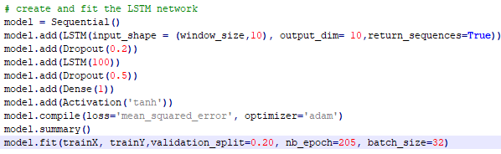
Neural Networks
Data was in the shape as a time series.
Main issue with Time Series is Vanishing Gradient.
Network of choice was a recurrent neural network called a Long Short Term Memory or LSTM solves Vanishing Gradient issue.

Slide 5
Neural Network
I created two main networks.
One with 3 inputs: Closing Price, Sentiment Average, Total Tweets
Another with 10: Closing Price, Opening Price, High & Low price, Bollinger Bands (upper & lower),Bitcoin Transaction amount & price, plus the sentiment average and total tweets.
The data was looked at in a window size of 2 hours(24 values).
And had Two hidden layers plus an output layer.

Slide 6
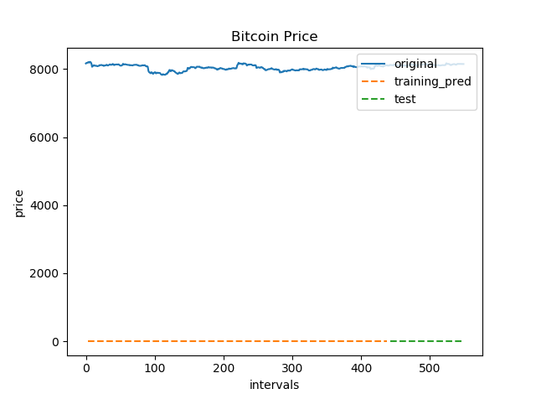
Findings
When using the LSTM Network the data had to be normalized otherwise the LSTM could not predict the data.

Slide 7
Findings
Both networks both lagged behind an issue related when trying to use previous data to predict the future.
The Sentiment only network seemed better at ignoring small jumps in the data and stayed in general seemed to lag a small bit less.
The Larger network was better at predicting the price if there was a spike in the price although is still did not match the bitcoin value.
I noticed a trend with the sentiment that it did seem to correlate with the shifts in price.

Slide 8
Conclusions
Overall I don’t think there is much merit in predicting bitcoin prices with neural networks.
Public opinion and also the fact that the market is unregulated mean it can be very volatile thus meaning it is very hard to get an accurate model that will be able to predict most outcomes.

