Slide 1
A Survey of Web Servers in Trinity College Dublin
Michael Power
04/05/2018

Slide 2


Background & Related Work

Slide 3
Overall Design Of Scans

Slide 4
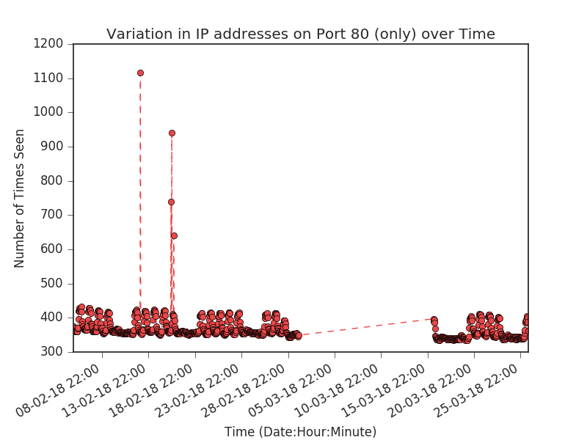
Example Result of ZMap Analysis

Slide 5
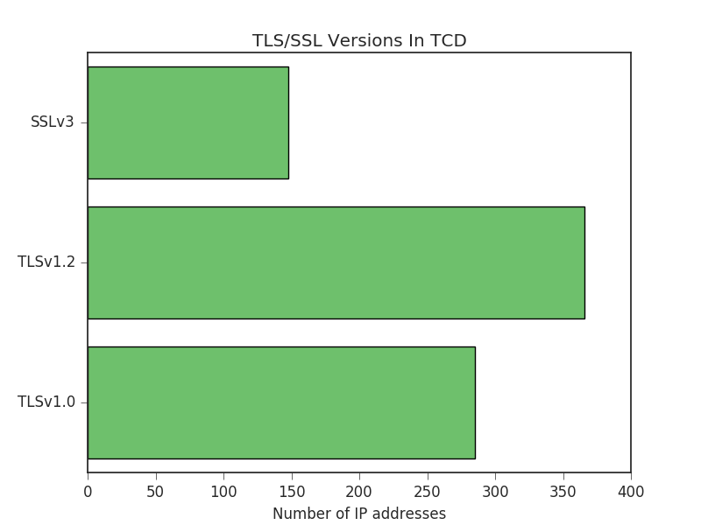
Example Result of ZGrab Analysis

Slide 6
Thank You

