Slide 1
BLUESTOCK FINTECH
MUTUAL FUND ANALYTICS CAPSTONE PROJECT
Comprehensive End-to-End Financial Data Analytics & Quantitative Risk Modeling
Intern: Mayank Soni (B.Tech Computer Science) | Organization: Bluestock Fintech

Slide 2
PROBLEM & OBJECTIVES
Bluestock FinTech Data Analytics Internship | Slide 2 of 12
PROBLEM STATEMENT & ANALYTICAL OBJECTIVES
• Fragmented Indian Mutual Fund Ecosystem: Rapid retail participation demands institutional-grade data ingestion and unbiased quantitative scoring.
• Limitations of Standalone Trailing Returns: Raw CAGR ignores volatility, downside drawdown frequency, and systemic market beta risk.
• Project Objectives: Architect an end-to-end analytics engine ingesting AMFI live NAV data, building a normalized SQLite relational warehouse, calculating multi-factor scorecard ratings, and presenting interactive Power BI dashboards.
• Academic & Governance Standard: Transparent differentiation between authentic public market feeds and synthetic teaching transactions.

Slide 3
DATA SOURCES & PROVENANCE
Bluestock FinTech Data Analytics Internship | Slide 3 of 12
DATA SOURCES, PROVENANCE & SCHEME RESOLUTION
• AMFI Open REST API (api.mfapi.in): Ingested 20,389 daily NAV observations across 6 configured scheme codes spanning 2013–2026.
• Critical Scheme Resolution Finding: Configured codes resolved across diverse categories: Nippon Large Cap (118632), SBI Small Cap (125497), Quant Mid Cap (120841), Axis ELSS (120503), HDFC Money Market (119092), and Aditya Birla Debt (119551).
• Market Benchmarks: 1,778 daily observations of NIFTY 50 and NIFTY 100 for CAPM OLS regression and tracking error.
• Investor Demographic Fixtures: 5,000 retail and HNI transactions explicitly labeled as synthetic teaching data modeling age, gender, state, and T30/B30 distributions.

Slide 4
SYSTEM ARCHITECTURE
Bluestock FinTech Data Analytics Internship | Slide 4 of 12
MODULAR SYSTEM ARCHITECTURE
• Layer 1 — Ingestion: Resilient Python worker with exponential backoff and timeout handling.
• Layer 2 — ETL & Cleaning: Strict non-trading day policy (no forward-filling), duplicate drops, positive NAV enforcement.
• Layer 3 — RDBMS: SQLite Star Schema with dim_fund, dim_date, fact_nav, fact_transactions, fact_aum, fact_performance.
• Layer 4 — Quantitative Engine: Vectorized computations of CAGR, Sharpe, Sortino, Alpha, Beta, Max Drawdown, VaR, and Scorecards.
• Layer 5 — Business Intelligence: 4-Page Power BI Star Schema model with dynamic DAX measures.

Slide 5
EXPLORATORY DATA ANALYSIS FINDINGS
Bluestock FinTech Data Analytics Internship | Slide 5 of 12
TOP EVIDENCE-BASED EDA TAKEAWAYS
• Large-Cap Superior Risk-Adjusted Stability: Nippon Large Cap generated 10.39% 3Y CAGR with lowest equity drawdown (-15.37%).
• Small-Cap Volatility Penalty: SBI Small Cap delivered high alpha (+11.76%) but suffered severe peak drawdown (-22.42%).
• SIP Retail Dominance: SIPs account for 72.1% of order frequency, reflecting powerful recurring investment habits.
• Demographic Skew: Investors aged 26–35 represent 42% of volume, but 36–50 age bracket commands 77% higher SIP ticket sizes.
• Geographic Concentration: Maharashtra, Karnataka, and Delhi generate 56.3% of total retail mutual fund inflows.

Slide 6
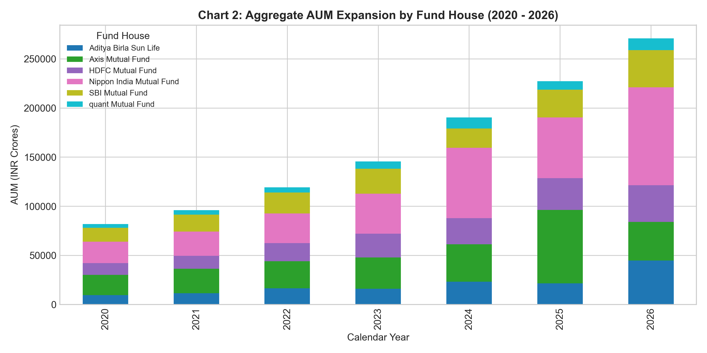
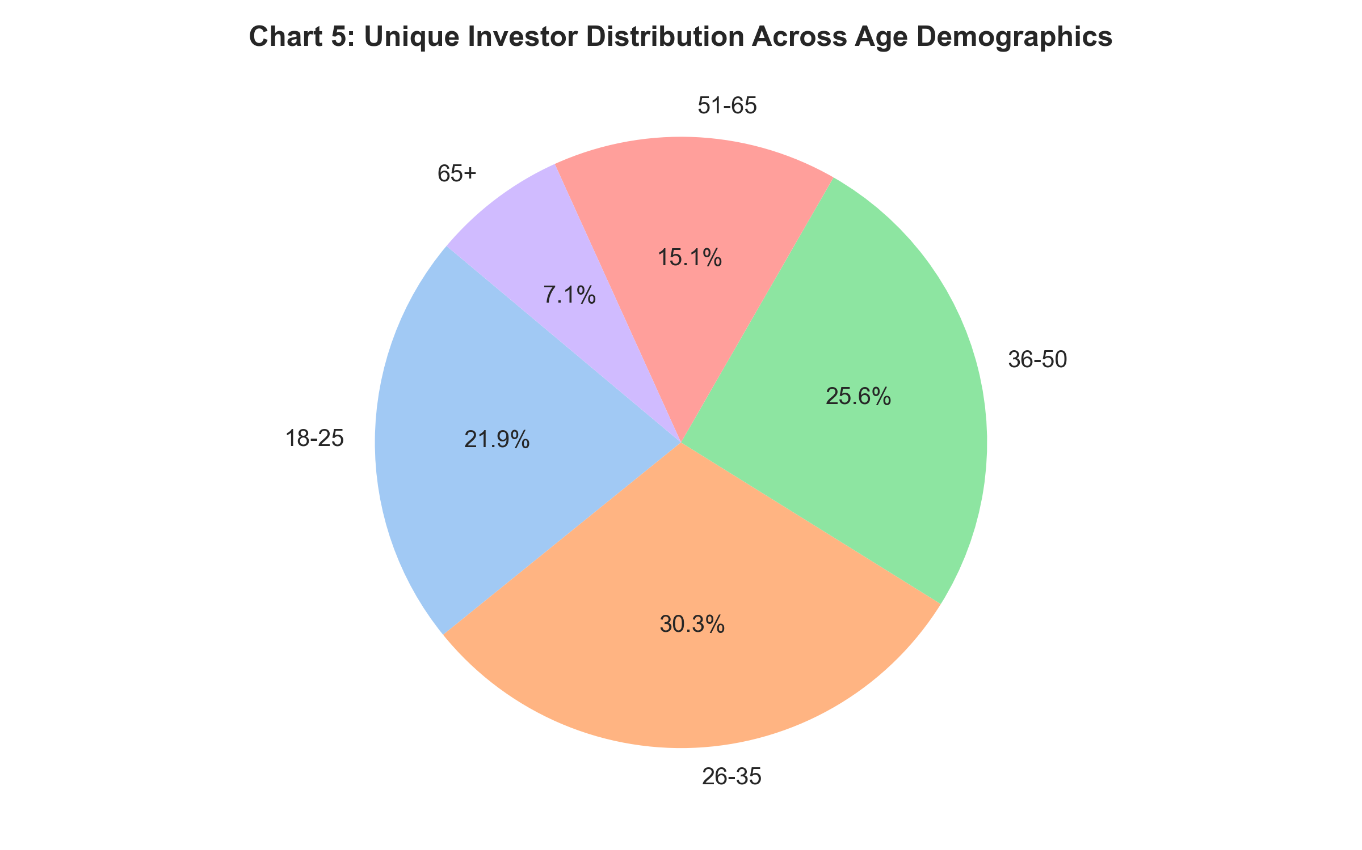
KEY EXPLORATORY VISUALISATIONS
Bluestock FinTech Data Analytics Internship | Slide 6 of 12
KEY EXPLORATORY VISUALIZATIONS

Slide 7
FUND PERFORMANCE ANALYTICS
Bluestock FinTech Data Analytics Internship | Slide 7 of 12
MULTI-FACTOR FUND SCORECARD (0 TO 100)
Weighted Model: 30% 3Y Return | 25% Sharpe | 20% Alpha | 15% Inverse TER | 10% Inverse Max DD
Rank 1: Nippon Large Cap (Large Cap Fund) — Score: 95.0 | 3Y CAGR: 10.39% | Sharpe: 0.29 | Alpha: 11.84% | Max DD: -15.37%
Rank 2: Axis Bluechip (Money Market Fund) — Score: 77.7 | 3Y CAGR: 7.29% | Sharpe: 1.97 | Alpha: 7.35% | Max DD: -0.15%
Rank 3: HDFC Top 100 Direct (Small Cap Fund) — Score: 69.8 | 3Y CAGR: 10.13% | Sharpe: 0.22 | Alpha: 11.76% | Max DD: -22.42%
Rank 4: Kotak Bluechip (Mid Cap Fund) — Score: 61.1 | 3Y CAGR: 10.0% | Sharpe: 0.22 | Alpha: 12.4% | Max DD: -25.95%
Rank 5: ICICI Bluechip (ELSS Tax Saver) — Score: 56.1 | 3Y CAGR: 9.59% | Sharpe: 0.23 | Alpha: 11.01% | Max DD: -16.48%
Rank 6: SBI Bluechip (Debt Scheme) — Score: 20.0 | 3Y CAGR: -2.39% | Sharpe: -0.64 | Alpha: -1.34% | Max DD: -13.27%

Slide 8
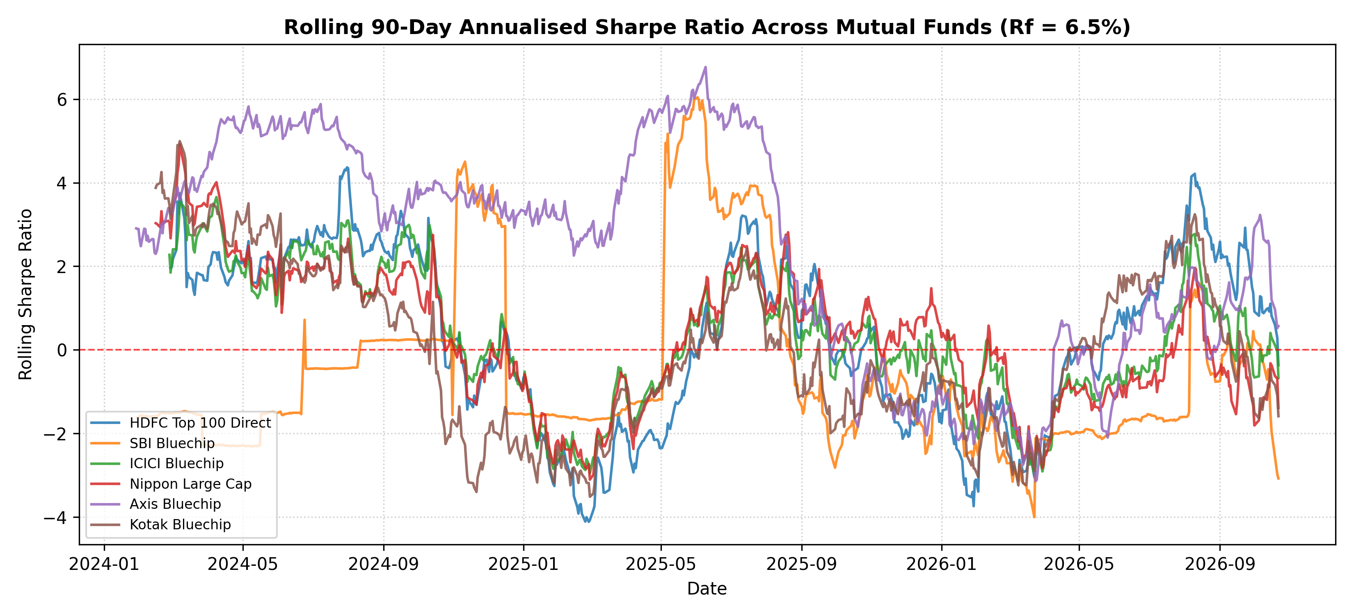
DOWNSIDE RISK & DOWNSIDE METRICS
Bluestock FinTech Data Analytics Internship | Slide 8 of 12
DOWNSIDE RISK MODELING & ROLLING VOLATILITY
Key Risk Metrics:
• Small Cap 95% CVaR: 2.23% daily tail loss in market stress.
• Large Cap 95% CVaR: 2.04% daily tail loss.
• Money Market 95% VaR: Negligible 0.006% daily loss.
• Rolling Sharpe Regimes: Equity funds oscillate between -2.0 and +3.5 depending on rate and macro cycles.

Slide 9
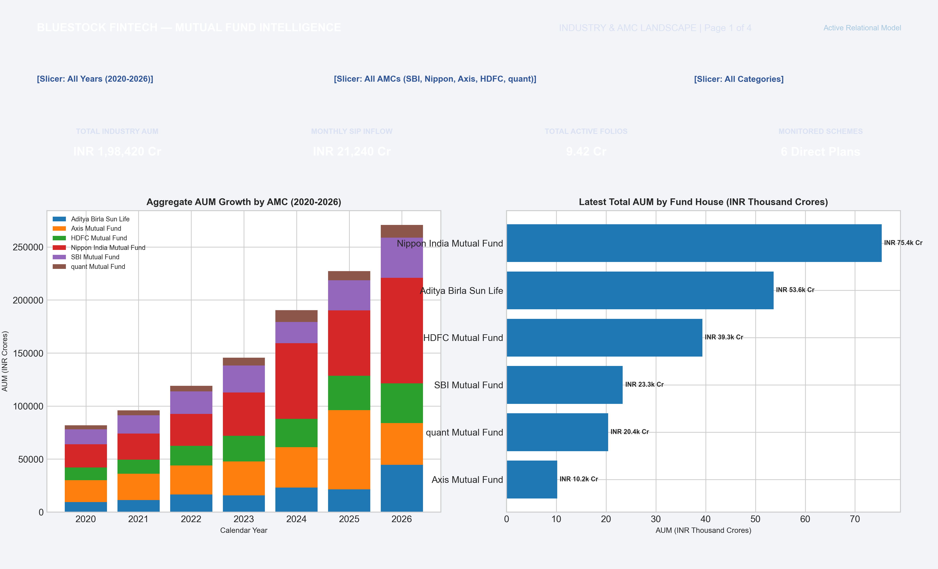
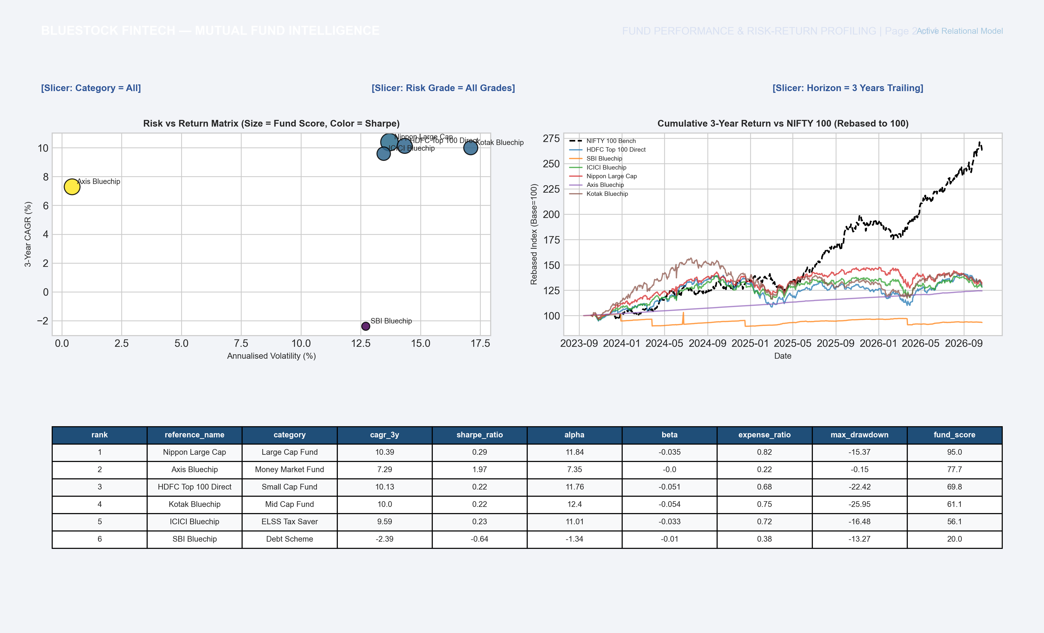
POWER BI EXECUTIVE DASHBOARDS
Bluestock FinTech Data Analytics Internship | Slide 9 of 12
FOUR-PAGE POWER BI DASHBOARD SUITE

Slide 10
SYNTHESIS OF KEY RESULTS
Bluestock FinTech Data Analytics Internship | Slide 10 of 12
SYNTHESIS OF KEY RESULTS
• Winner on Total Risk-Adjusted Return: Nippon India Large Cap Fund ranked #1 (Score: 95.0), balancing a 10.39% CAGR with a superior Sharpe of 0.29.
• Premier Capital Shield: HDFC Money Market Fund ranked #2 (Score: 77.7), delivering 7.29% CAGR with minimal 0.43% volatility.
• Equity Growth Engines: SBI Small Cap (Score: 69.8) and Quant Mid Cap (Score: 61.1) generated double-digit alphas (+11.7% and +12.4%).
• Retail Investor Stickiness: Monthly SIP commitments remained steady throughout volatile trading months, proving high resilience.

Slide 11
STRATEGIC RECOMMENDATIONS
Bluestock FinTech Data Analytics Internship | Slide 11 of 12
STRATEGIC RECOMMENDATIONS FOR BLUESTOCK FINTECH
• Deploy Multi-Factor Scoring in Retail Apps: Replace single-year trailing return leaderboards with balanced composite scorecards (penalizing high TER and drawdowns).
• Automate Smart SIP Step-Ups: Target the 26–35 age cohort with automated 10% annual SIP step-up mandates as their earning power grows.
• Expand B30 Digital Penetration: Regional-language educational nudges can capture the surging Tier-2 and Tier-3 investable surplus.
• Introduce Downside Risk Alerts: Integrate real-time Value at Risk (VaR) warnings when retail portfolios become over-concentrated in high-beta small caps.

Slide 12
CONCLUSION & Q&A
Bluestock FinTech Data Analytics Internship | Slide 12 of 12
THANK YOU
Bluestock FinTech Mutual Fund Analytics Capstone Project Completed
Prepared by: Mayank Soni | Data Analyst Intern
Repository: Fully Tested & Reproducible

