Slide 1
MediLink-DL
A Deep Learning-Guided, Bandwidth-Adaptive, and Secure Framework
for Medical Image Transmission in Rural Telemedicine
Mayank Soni (CS24B1031) · Nandan (CS24B1034) · Sumedha (AD24B1061)
Faculty Advisors
Dr. Kaushiki Roy (DIP) · Dr. Mehbub Alam (CN) · Arnav Ghosh (Optimization)
IIIT Raichur | November 2026

Slide 2
The Problem: 70 Minutes for One X-Ray
“A chest X-ray from a rural PHC in Chhattisgarh weighs 25 MB. The connection runs at 48 kbps. At that rate, the image takes over 70 minutes to reach the specialist radiologist 300 km away. The patient cannot wait.”
📶 Bandwidth Challenge
🖼 Compression Gap
🔒 Security Mandate
2G / EDGE rural connectivity
Typical bandwidth: 48 – 128 kbps
Round-trip latency: > 150 ms
Packet loss: 2 – 10%
Raw 512×512 PNG ≈ 262 KB
DICOM at 25 MB = 70+ min to transmit
One-size-fits-all codecs
Uniform JPEG blurs lung lesions
Background & ROI treated identically
Diagnosis-critical pixels ≈ 15%
of image but need > 90 PSNR
Background can be 25× more compressed
without clinical impact
Untrusted public networks
PHC → hospital over public internet
No VPN, no dedicated line
HIPAA / GDPR mandate:
• Authenticated encryption
• Tamper detection
• Binding to patient identity

Slide 3
Clinical Dataset: 166 Real Chest Radiographs
Dataset Facts
Source: Cohen et al. (2020) COVID-19 CXR
Total radiographs: 166
Unique patients: 110
Views: PA / AP (posteroanterior / anteroposterior)
Resolution: 512×512 grayscale (normalised to [0,1])
Class distribution:
• COVID-19 positive: 83 images
• COVID-19 negative: 83 images
Split strategy: Patient-level (not image-level)
Prevents data leakage from patient anatomy sharing
Patient-Level Split
Split | Patients | Radiographs
Train | 77 | 111
Validation | 16 | 26
Test | 17 | 29
P_train ∩ P_val = ∅, P_train ∩ P_test = ∅
Verified programmatically in test suite
⚠️ Why patient-level splits?
Image-level splitting lets the model memorise patient anatomy across splits, artificially inflating test accuracy. By assigning every radiograph of a patient to exactly one partition, we ensure the model generalises to unseen patients.

Slide 4
MediLink-DL: Five-Stage Cross-Layer Pipeline
Every stage is designed, implemented, tested, and benchmarked end-to-end:
1. Ingestion
2. AI Localization
3. Dual-Stream Compress
4. Encrypt
5. Priority Transport
512×512 grayscale radiograph
DICOM / PNG format validation
Normalise pixel values to [0,1]
Patient metadata extraction
MedicalResNet18 (1-ch conv1)
Differentiable Grad-CAM
Threshold τ=0.35
ROI bounding box extraction
Pointing Game: 93.10%
q_roi = 90 (ROI patch)
q_bg = 25 (background)
28-byte MLDL container
Magic: ‘MLDL’ | ver | H,W | bbox
Output: 26,515 bytes (9.89×)
AES-256-GCM (NIST SP 800-38D)
or Ascon-AEAD128 (SP 800-232)
Fresh 96-bit nonce per packet
AAD: StudyUID ∥ PatientID ∥ Timestamp
Tamper detection: 100%
Min-heap packet scheduler
Priority: Header=30 > ROI=20 > BG=5
T_ROI (Priority) = 0.391 s
T_ROI (FIFO) = 2.430 s
Speedup: 6.21× on GPRS
→
→
→
→

Slide 5
Deep Learning: MedicalResNet18
Architecture Modifications
Why modify ResNet-18?
Chest X-rays are single-channel grayscale — not RGB.
Standard ImageNet conv1 expects 3 channels.
• conv1: 3-channel → 1-channel input
7×7 kernel, stride 2, padding 3
• 4 residual blocks (unchanged)
→ 512×7×7 feature maps at layer4[-1]
• Global Average Pooling
• FC layer → 2 logits
Binary: COVID positive / negative
• Pretrained ImageNet weights
conv1 re-initialised, all other layers fine-tuned
Differentiable Grad-CAM
Standard Grad-CAM (inference only):
Computed after training is complete.
Gradients are detached from the computation graph.
Cannot influence model weights.
Our approach (training time):
torch.autograd.grad(..., create_graph=True)
Second-order gradients flow BACK through the saliency map during training.
“The heatmap actively influences its own training.”
Effect: forces the model to attend to lung parenchyma
and not shortcut on scanner artifacts, diaphragm,
or image borders.

Slide 6
Multi-Task Loss: Kendall & Gal (CVPR 2018) Uncertainty Weighting
Problem: We need the model to simultaneously classify disease AND localise lesions. How do we balance the two loss terms without manual tuning?
L_total = ½·exp(−s₁)·L_cls + ½·exp(−s₂)·L_loc + ½·s₁ + ½·s₂
s₁ = log(σ₁²)
s₂ = log(σ₂²)
L_cls
L_loc
Learnable log-variance for classification task.
Optimised jointly with network weights by AdamW.
Learnable log-variance for localisation task.
Optimised jointly with network weights by AdamW.
Cross-entropy classification loss.
Measures COVID +/− prediction error.
(1−β)·L_align + β·L_dice
Spatial localisation: alignment + contour quality.
🧠 Both s₁ and s₂ are trained by AdamW alongside network weights — the model discovers the right balance automatically. No manual λ tuning required.
L_align: KL divergence between Grad-CAM heatmap and clinical lesion annotation
L_dice: Soft Dice loss on binarised heatmap vs ground-truth mask | β = 0.5 (equal weighting)

Slide 7
Ablation Study: 4 Training Regimes on 29 Test Radiographs (17 Patients)
Regime | Accuracy | F1 Score | ROI Dice | Pointing Game | Energy in ROI
A: Classification-Only | 68.97% | 0.8163 | 0.4764 | 65.52% | 49.21%
B: Combined Loss (Proposed) | 68.97% | 0.8163 | 0.6856 | 93.10% | 80.32%
C: Alignment-Only | 68.97% | 0.8163 | 0.5799 | 96.55% | 82.22%
D: Dice-Only | 75.86% | 0.8511 | 0.7107 | 82.76% | 69.36%
What is Pointing Game?
What is Energy in ROI?
Universal Guarantee
A hit is scored when the highest-activation
pixel of the Grad-CAM heatmap falls inside
the annotated lesion region.
93.10%
Regime B hit rate
Total heatmap activation mass that falls
INSIDE the clinical bounding box vs total.
Measures gradient leakage outside lesion.
80.32%
Regime B energy containment
100% Recall
across ALL 4 regimes
Zero missed COVID cases.
Zero false negatives on viral lesions.
Safety-first: miss-rate = 0

Slide 8
Why We Chose Regime B as the Operational Model
Regime C: Alignment-Only
Regime D: Dice-Only
Regime B: Combined Loss ✔ Selected
Best Pointing Game: 96.55%
Energy in ROI: 82.22%
The gradient PEAK hits the lesion centre,
but the heatmap BLEEDS outside the
clinical bounding box.
Consequence: when cropping the ROI patch
for compression, we over-estimate the
region and include non-diagnostic tissue.
⚠ Peak accuracy ≠ spatial containment
Best Dice: 0.7107
Best Accuracy: 75.86%
Energy in ROI: 69.36%
Good lesion CONTOUR quality, but
attention leaks into surrounding tissue.
Energy in ROI drops to 69.36% — nearly
31% of gradient mass escapes outside
the pathological region.
⚠ Good outline, poor containment
Pointing Game: 93.10%
Energy in ROI: 80.32%
Best COMBINED clinical guarantee.
Gradient is locked inside the
pathological region — not just peaked
at the lesion centre.
Compression ROI bounding box is
tight and diagnostically faithful.
✔ Optimal for telemedicine deployment
100% Recall across ALL regimes — zero false negatives on viral lesions. No COVID case missed.

Slide 9
Dual-Stream ROI-Aware Compression
[Full 512×512 Radiograph | 262,144 raw bytes]
↓
[Grad-CAM Mask τ = 0.35 → ROI bounding box]
↓ ↓
[Background Stream] [ROI Patch Stream]
JPEG quality q = 25 JPEG quality q = 90
~17,000 bytes ~9,000 bytes
(non-diagnostic) (diagnostic lesion)
↓ ↓
└─────────── [28-byte MLDL Binary Container] ───────────┘
Magic:'MLDL' | Version | H, W | q_roi, q_bg | bbox coords | stream lengths
↓
[26,515 bytes transmitted over the wire]
[Compression ratio: 9.89× | Reduction: 89.89%]
9.89×
89.89%
48.31 dB
0.9891
28 bytes
Compression Ratio
Data Reduction
ROI PSNR
ROI SSIM
Container Header

Slide 10
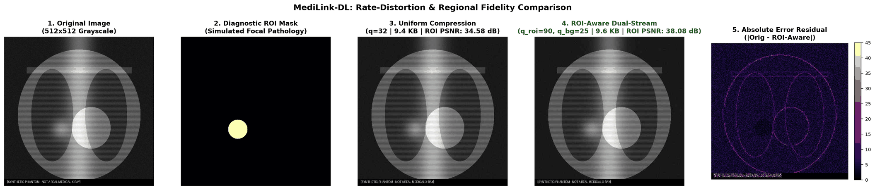
Rate-Matched Comparison: Same Byte Budget, Different Quality
Scheme | Bytes | Reduction | ROI PSNR | ROI SSIM
Dual-Stream (Ours) | 26,515 | 89.89% | 48.31 dB | 0.9891
Rate-Matched Uniform JPEG (q=32) | 26,035 | 90.07% | 38.18 dB | 0.9312
High-Quality Uniform JPEG (q=90) | 98,412 | 62.46% | 48.31 dB | 0.9897
+10.13 dB ROI PSNR gain — at the SAME byte budget
What this means clinically:
10 dB PSNR corresponds to roughly a 3× improvement in pixel fidelity in the diagnostic region. Uniform JPEG at q=32 blurs lung lesions to meet the same byte budget. Our dual-stream preserves them at q=90.
Fair comparison note:
We ran an automated binary search to find q=32 as the uniform JPEG quality that matches our byte budget (26,515 bytes). No cherry-picking.

Slide 11
Authenticated Encryption: Three Ciphers Benchmarked
Cipher | Standard | Encrypt Latency | Throughput | Tamper Detection
AES-256-GCM | NIST SP 800-38D | 2.2 µs | 465 MB/s | 100% (1024-byte chunk)
Ascon-AEAD128 | NIST SP 800-232 | 412 µs | 2.48 MB/s | 100%
MLMC-128 (Research) | Custom / Novel | 7,889 µs | 0.13 MB/s | 100%
💡 Real-World Overhead Context:
On a 64 kbps rural channel, transmitting 1,024 bytes takes ~128 ms. AES-256-GCM encryption of that same payload takes 0.0022 ms. Cryptographic overhead = 0.002% of airtime.
Security is essentially free on the wireless link.
AAD (Additional Authenticated Data) binding:
StudyUID ∥ PatientID ∥ Timestamp ∥ HeaderChecksum
Any bit-flip in the ciphertext OR the routing metadata triggers immediate decryption failure.
AES-256-GCM
Ascon-AEAD128
MLMC-128
NIST-standardised. Hardware AES-NI support on all modern CPUs.
Best choice for cloud gateways and urban relay nodes.
NIST SP 800-232 (2024). Lightweight sponge construction.
Target: IoT / microcontroller gateway nodes.
Novel research cipher. PRESENT S-box + circulant MDS.
Designed for future hardware synthesis evaluation.

Slide 12
Research Lab: MLMC-128 Lightweight Block Cipher
Design
• 128-bit block cipher
• PRESENT S-boxes (4-bit, optimal non-linearity)
• Circulant MDS diffusion layer
PROPOSED-OIN-MDS Matrix:
Hadamard instantiation Had(1, 8, 13, 5)
over GF(2⁴)/(x⁴+x+1)
Key Properties:
• Involutory: M² = I (self-inverse)
No separate inverse circuit needed
• 48 Paar CSE XORs ≈ 96 Gate Equivalents
• Branch number B_nibble = 5 (optimal MDS)
Implementation: Pure Python + GF arithmetic
Formal Verification
SAC Test Result:
49.92% bit-flip avalanche across 4,800 trials
(Theoretical ideal = 50.00% — difference < 0.1%)
4 Impossibility Theorems Proved:
1. No 4×4 Hankel matrix can be simultaneously
MDS and involutory.
2. Symmetric Cauchy matrices collapse under
self-inversion (det ≡ 0 in GF(2^k)).
3. Galois matrix symmetry obstruction:
α = β only trivially (α ∈ {0,1}).
4. Tensor product A⊗B bounded:
B ≤ 4; cannot achieve optimal MDS.

Slide 13
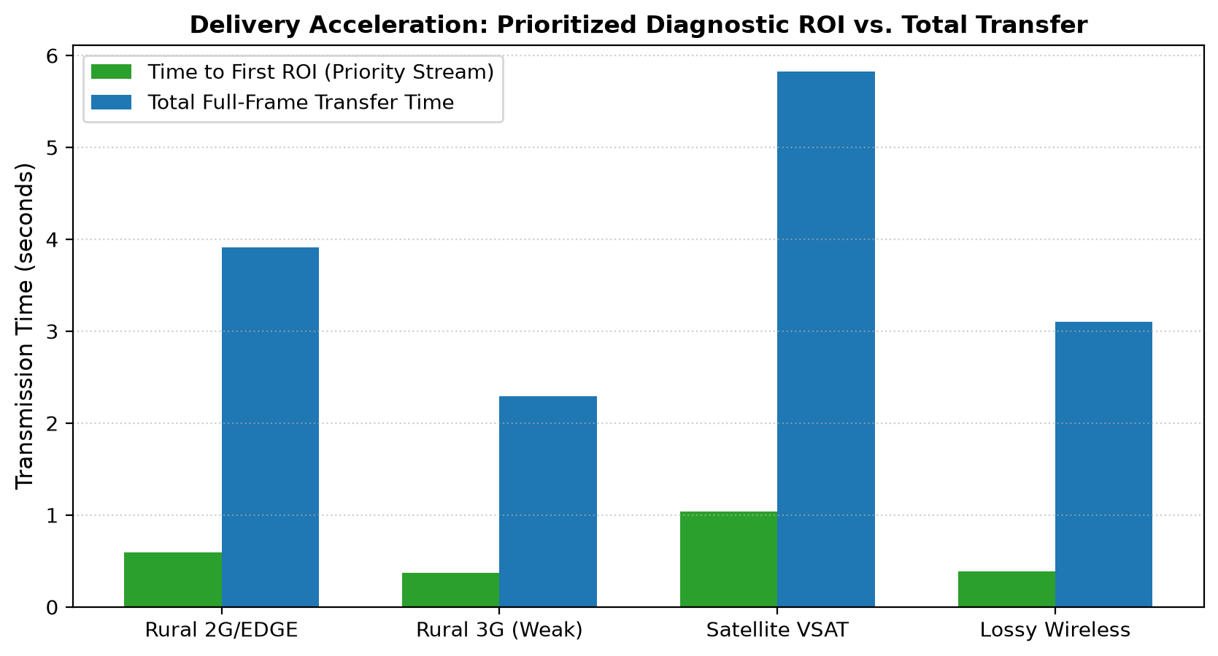
Priority Packet Scheduling: 6.21× Faster Clinical Triage
Channel | Bandwidth / RTT | Priority T_ROI | FIFO T_ROI | Speedup
Rural 2G/EDGE | 48 kbps, 200ms RTT | 0.592 s | 3.592 s | 6.07×
Rural GPRS | 64 kbps, 120ms RTT | 0.391 s | 2.430 s | 6.21×
Weak 3G | 128 kbps, 150ms RTT | 0.372 s | 2.097 s | 5.63×
Satellite VSAT | 256 kbps, 500ms RTT | 1.036 s | 5.299 s | 5.11×
Min-Heap Priority Scheduler:
Header chunk (28 bytes) = Priority 30 ›› ROI chunks = Priority 20 ›› Background chunks = Priority 5
Under FIFO scheduling, the radiologist waits through 65% background pixels before seeing ANY diagnostic data. Priority scheduling flips that — ROI arrives first.

Slide 14
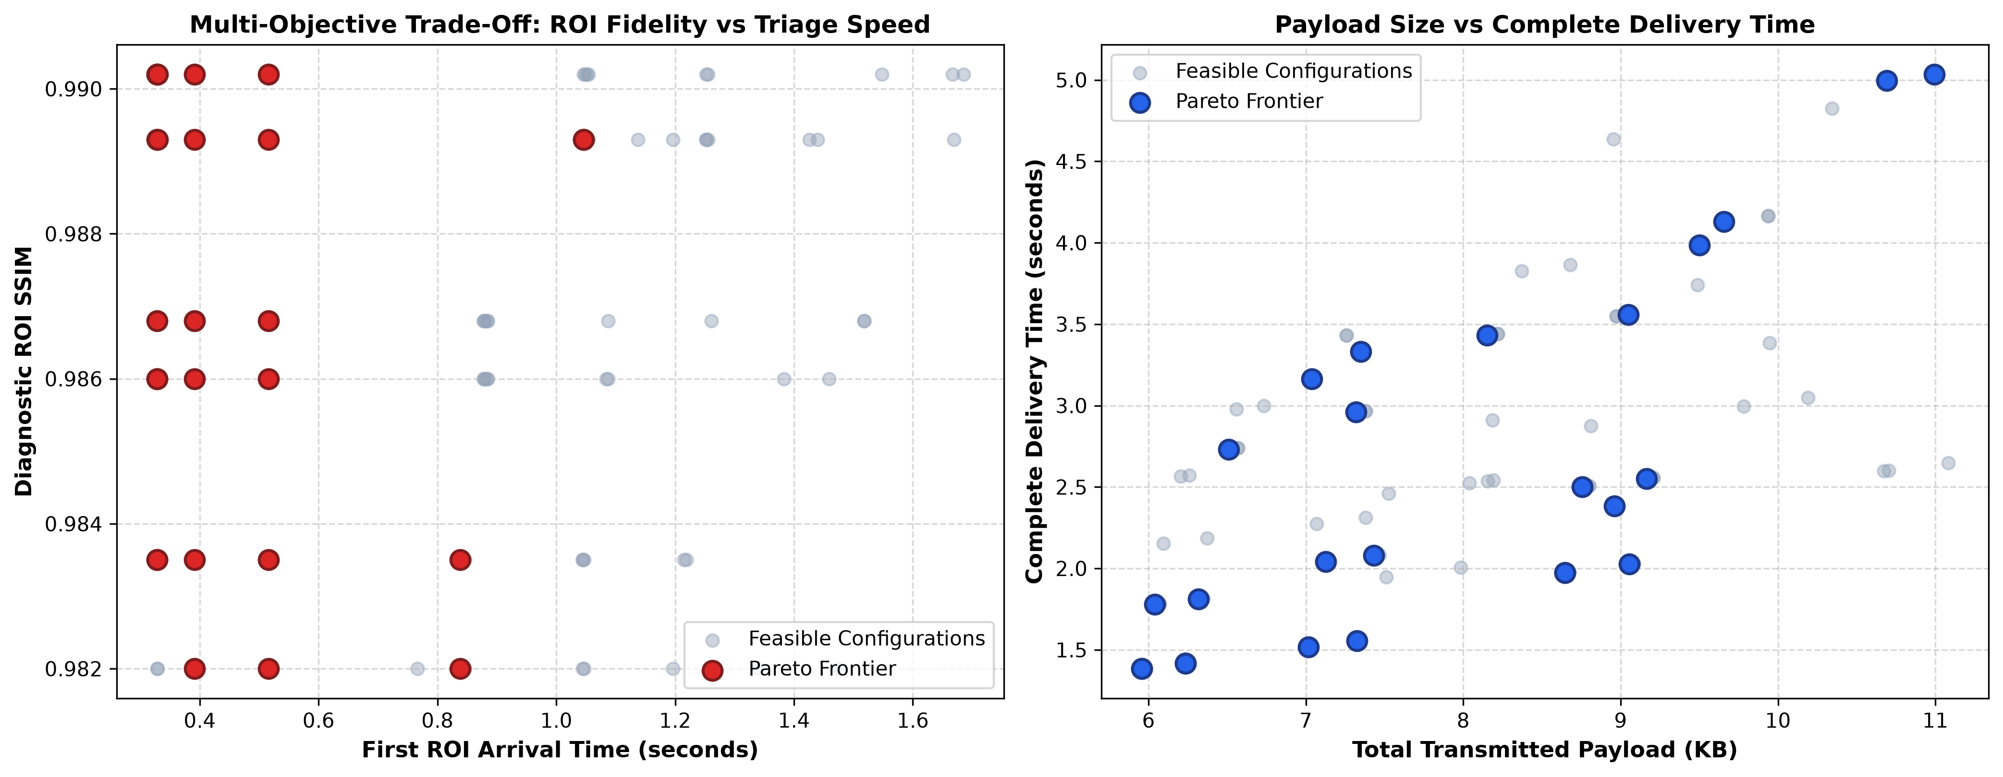
Multi-Objective Pareto Optimization: 108 Configurations
Parameter Search Grid
Compression parameters:
τ (Grad-CAM threshold) ∈ {0.25, 0.35, 0.50}
q_roi (ROI quality) ∈ {85, 90, 95}
q_bg (background quality) ∈ {15, 25, 40}
Security parameters:
Cipher: AES-256-GCM vs Ascon-AEAD128
Transport parameters:
Scheduler: Priority vs FIFO
Bandwidth: 48 / 64 / 128 kbps
Total: 3×3×3×2×2×3 = 108 configurations evaluated end-to-end
Pareto Results
26
non-dominated Pareto configurations
Objectives optimised simultaneously:
↑ Maximise ROI SSIM
↓ Minimise total bytes transmitted
↓ Minimise T_roi (ROI delivery time)
↓ Minimise crypto CPU overhead
🏆 Operational Champion Configuration
Threshold | ROI Quality | BG Quality | Cipher | Transport | Bandwidth
τ = 0.35 | q_roi = 90 | q_bg = 25 | AES-256-GCM | Priority Scheduler | 64 kbps

Slide 15
Summary of Verified Results
93.10%
100%
9.89×
Pointing Game Hit Rate
(Regime B, 29 test radiographs)
Recall: Zero Missed
COVID Cases (all regimes)
Compression Ratio
(89.89% Data Reduction)
+10.13 dB
6.21×
147/147
ROI PSNR Gain over
Rate-Matched Baseline
Faster Clinical Triage
(Priority vs FIFO, GPRS)
Automated Tests
Passing ✔

Slide 16
Live System: MediLink-DL Web Dashboard
https://medilink-dl.onrender.com
1. Live Telemedicine Pipeline
Select any of the 29 test CXR images. Adjust τ (threshold) and compression quality sliders interactively. Watch real PSNR and SSIM update live as you change parameters. See the Grad-CAM heatmap, ROI bounding box, and compressed output side-by-side.
2. Pareto Optimization & Regimes
Interactive Pareto frontier explorer showing all 108 configurations. Click any point to see its full parameter settings and results. Compare all 4 training regimes on the ablation table.
3. NIST SP 800-232 Cryptographic Lab
Live Ascon-AEAD128 encrypt/decrypt with tamper detection. Flip any bit in the ciphertext and watch decryption fail immediately. AAD binding demonstration with StudyUID and PatientID.
4. Research Novelty & Viva Defense
Q&A mode for viva preparation. Covers all system components, design decisions, and experimental results. Panel for exploring the 4 impossibility theorems for MLMC-128.
5. Cryptographic Research Lab
MLMC-128 diffusion matrix explorer. SAC test runner, GF(2^4) arithmetic visualiser, branch number computation, and involutory property verifier.

Slide 17
Honest Assessment: What We Know and What We Don't
⚠ Current Limitations
1. Dataset scale:
166 images is a proof-of-concept.
Regulatory pathway (FDA 510k) requires
20,000+ image clinical validation.
2. No radiologist observer study:
PSNR > 48 dB is mathematically excellent
but unconfirmed by clinical reading.
MRMC ROC study required.
3. Discrete-event simulation:
Network model doesn't capture RF fading,
TCP congestion, or OS scheduler jitter.
4. Key management:
Symmetric keys are in-memory only.
Production needs PKI / HPKE / mTLS.
🚀 Future Work
1. Multi-center DICOM datasets:
NIH ChestX-ray14 (112,120 images)
CheXpert (224,316 images)
Full DICOM pipeline with metadata
2. Volumetric imaging:
3D extension for CT / MRI stacks
Temporal ROI tracking across slices
3. Hardware synthesis:
MLMC-128 RTL on TSMC 28nm standard cells
Gate count and power benchmarking
4. Clinical validation:
Multi-reader MRMC ROC study
Board-certified radiologist panel
Comparison against DICOM WADO-RS

Slide 18
Acknowledgements
Faculty Advisors
We owe particular thanks to Dr. Kaushiki Roy for her guidance through the DIP module — specifically her feedback on partitioned fidelity metrics and why global PSNR doesn’t tell you enough about diagnostic quality.
Dr. Mehbub Alam helped us model the wireless channel realistically and think about priority scheduling at the right abstraction layer — his CN coursework directly shaped the min-heap transport design.
Arnav Ghosh pushed us to formalise the Pareto analysis rather than just picking the best-looking configuration — the 108-configuration grid and non-domination analysis are a direct result of that guidance.
We also thank Cohen et al. for making their COVID-19 chest X-ray dataset open access.
Key References
# | Authors / Standard | Title / Description
[1] | Cohen et al. (2020) | COVID-19 Chest X-ray Dataset. GitHub: ieee8023/covid-chestxray-dataset
[2] | Selvaraju et al. (ICCV 2017) | Grad-CAM: Visual Explanations from Deep Networks via Gradient-based Localization
[3] | Kendall & Gal (CVPR 2018) | Multi-Task Learning Using Uncertainty to Weigh Losses for Scene Geometry and Semantics
[4] | NIST SP 800-38D (2007) | Recommendation for Block Cipher Modes: Galois/Counter Mode (GCM)
[5] | NIST SP 800-232 (2024) | Recommendation for the Ascon Cryptographic Suite (Ascon-AEAD128)
[6] | Wang et al. (IEEE TIP 2004) | Image Quality Assessment: From Error Visibility to Structural Similarity (SSIM)

