Slide 1
Crank Event Schedule
CTC POWERTRAIN

Slide 2
Environment
ECU: mt22p3, cpu mpc5634
RPM: 5000
Tooth Duration: 200us
Reference Event: 3-th, 33-th
Reference Event Average Execution Time: 427us
Channel 4-> crank signal, Channel 2-> event test toggle pin
Software Aim: There is no loss of tooth event.

Slide 3
Software Structure
Process_Crank_Event
{
do{
1, get current irq count and count info.
2, call OS_ToothInt_Hook();
3, check gap, call CRANK_Validate_Synchronization();
4, schedule tooth event
5, temp_count = CRANK_Next_Event_PA_Content;
6, CRANK_Next_Event_PA_Content++;
7, get CRANK_Current_Event_Edge_Content from TPU
} while (CRANK_Current_Event_Edge_Content != temp_count);
8, clear interrupt flag
9, set new interrupt irq count from CRANK_Next_Event_PA_Content
}

Slide 4
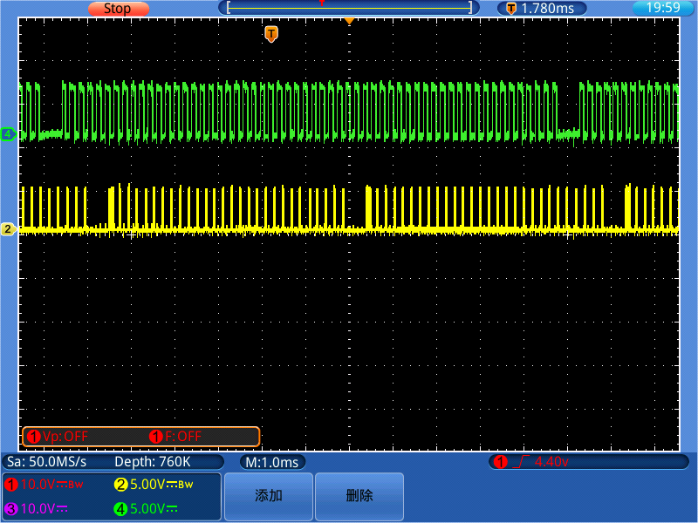
Tooth 4 5 6 or 34 35 36 Event Postpone - Overall

Slide 5
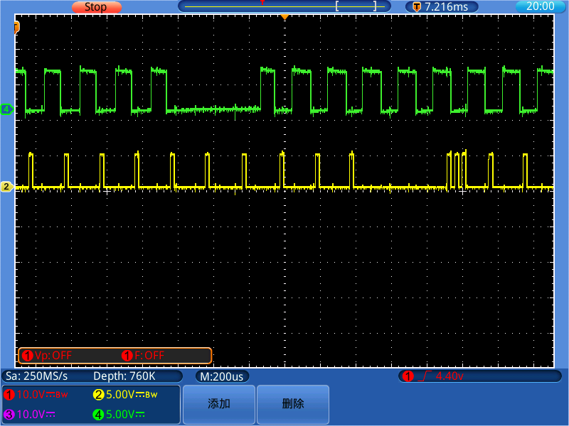
Tooth 4 5 6 or 34 35 36 Event Postpone - Details

