Slide 1
MT22.3 HWIO Fast Synchronization
—CTC POWERTRAIN

Slide 2
Content
Requirement Background
UAES Fast Sync Process
Delphi HWIO Gap Sync Process
Disadvantage of Gap Sync Process
Put forward Fast Sync Resolution
How to Identify the Cylinder B or D
Software Flow Chart
Fast Sync Waveform and Customer Test Result
Optimization of Fast Sync

Slide 3
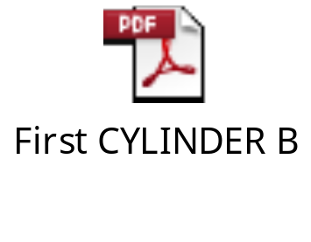
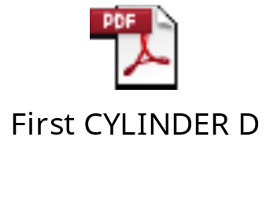
Requirement Background
Customer Requirement
  Chery put forward this fast synchronization requirement, they demand HWIO should identify the cylinder B or cylinder D by taking the advantage of cam edge information.
Acceptance Criteria
  Same as UAES.

Slide 4
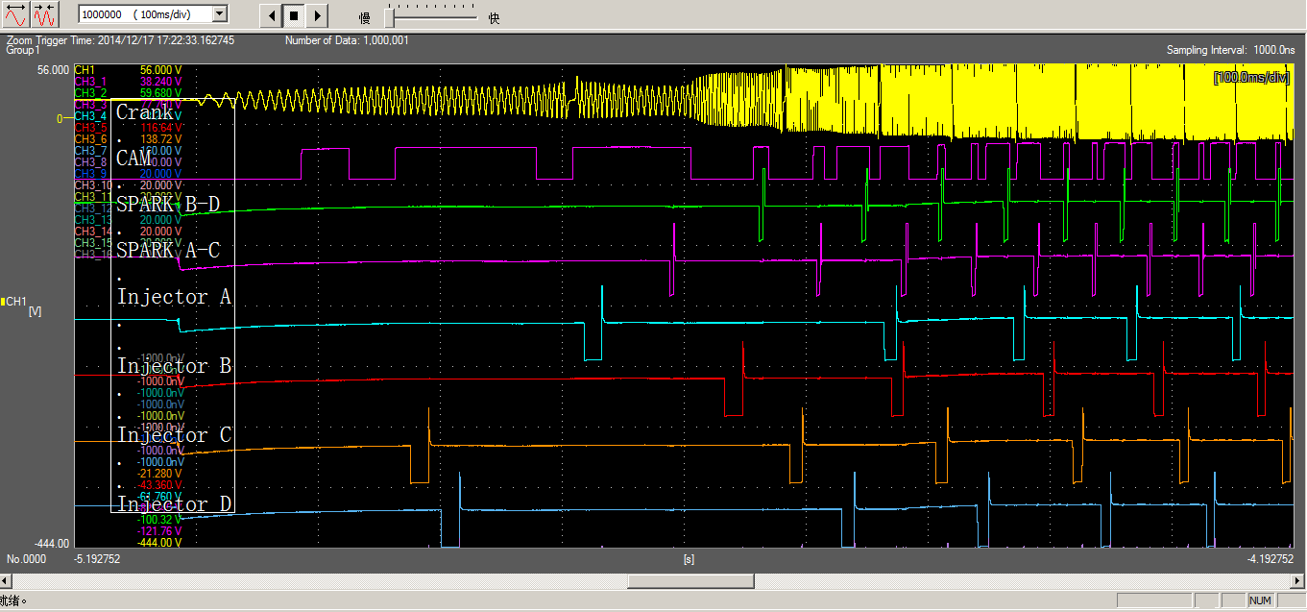
UAES Fast Sync Process, First Cylinder ID B

Slide 5
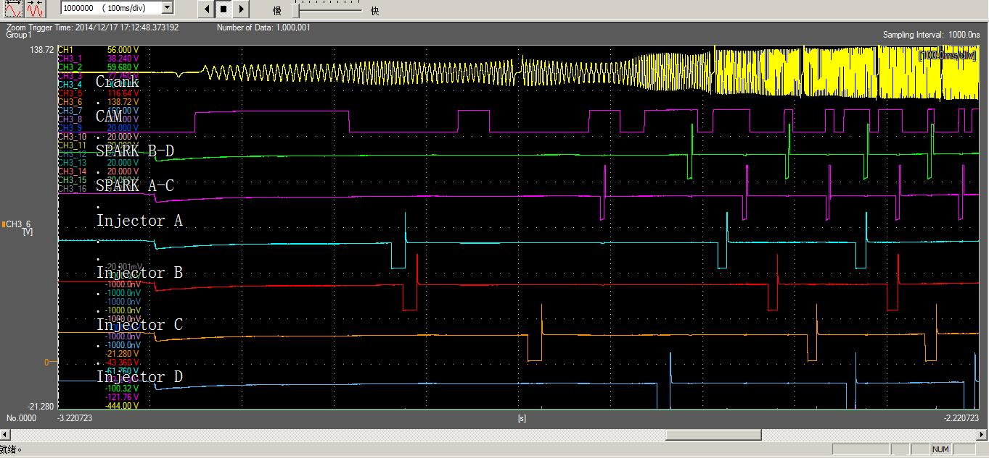
UAES Fast Sync Process, First Cylinder ID D

Slide 6


HWIO Gap Found Process
Check Valid Tooth
  KyHWIO_NumValidPeriodsBeforeSyncStart
Detect Gap Pattern
  Gap Detection Algorithms, “Threshold Method”
Set Crank First Syn and Syn Occurred Flag
  CRANK_Internal_State.U32
Identify Cylinder ID
  CRANK_Cylinder_ID
Set Current Event Tooth
  CRANK_Current_Event_Tooth
Setup Simultaneous Injection
Toggle First Sync Cylinder Sequence Injection

Slide 7
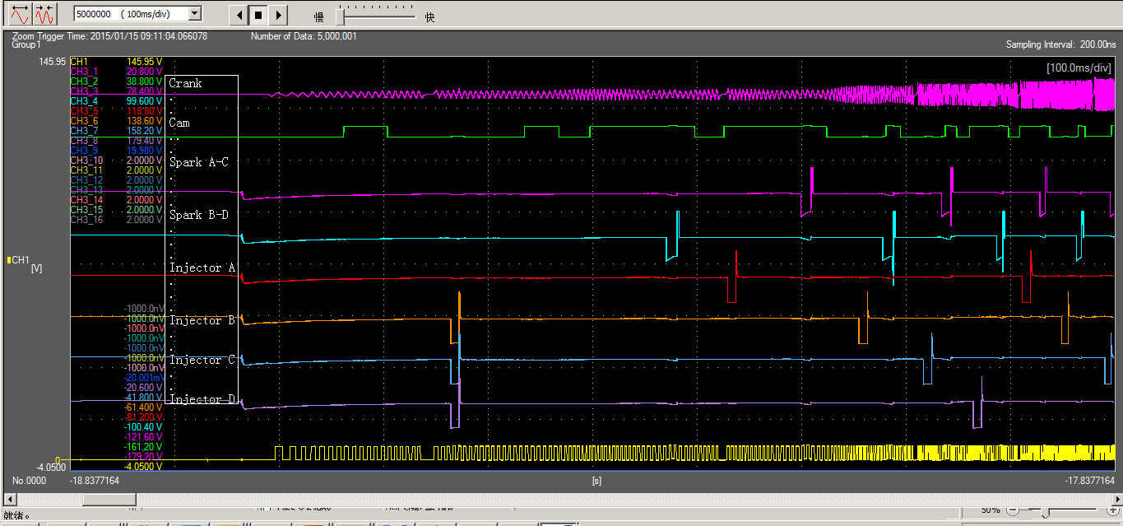
HWIO Normal Sync Process, First Cylinder ID A

Slide 8
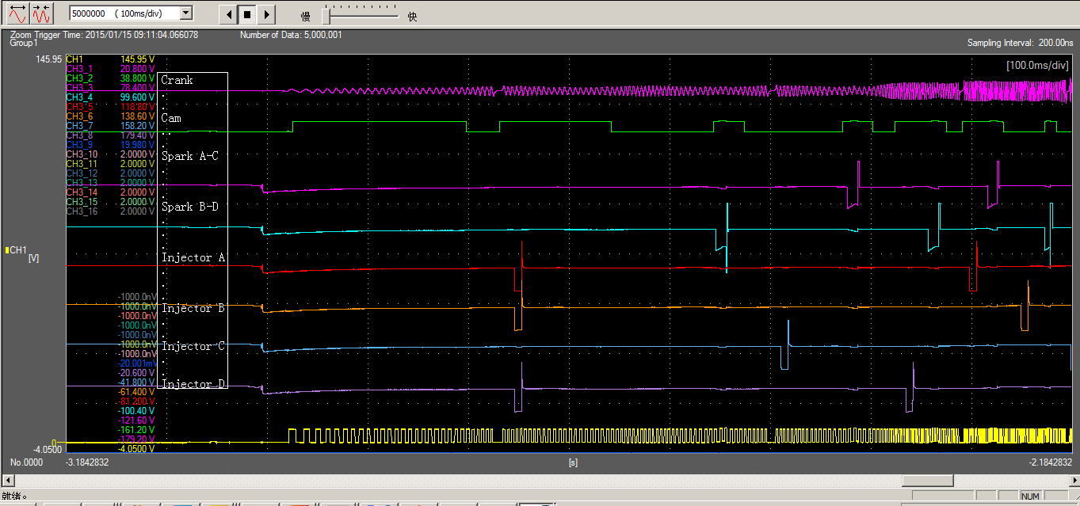
HWIO Normal Sync Process, First Cylinder ID C

Slide 9
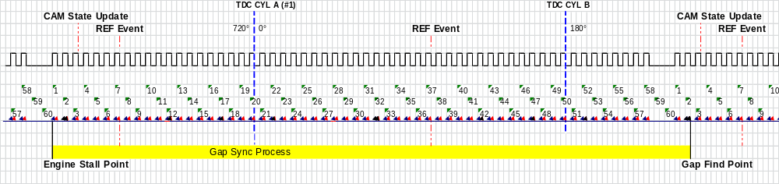
Disadvantage of Gap Sync Process
If the crank sensor stalls far away from the crank gap point, then it will take many teeth time for the 58x gap sync logic to find the gap, and the max teeth value is almost 58!
Long Gap Sync Process Graphic

Slide 10
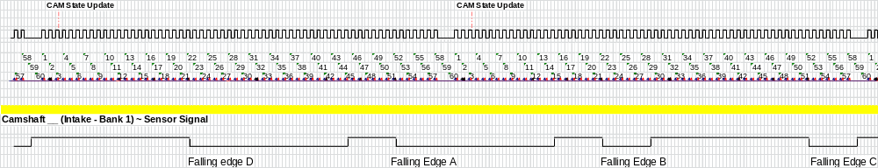
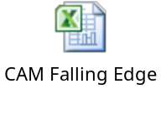
Put forward Fast Sync Resolution
Can whether we Identify the cylinder B or D when the engine stall point is far away from the gap?
  UAES does, so we too!
Crank teeth and Cam teeth mapped relationship

Slide 11
How to Identify the cylinder B or D
How to make use of the cam falling edge to distinguish the cylinder B&D from the cylinder A&C?
Difference between falling edge A and C
  It makes no sense to distinguish edge A from edge C, for if the stall points is nearby the falling edge A or C, it will just quickly go into normal gap sync logic.
Difference between falling edge B and D
  The falling edge B and D are located in same tooth of crank 58x, at about 22. If we count backward about 10 tooth, the cam level is different. So this difference can tell us which the falling edge is, B or D!

Slide 12
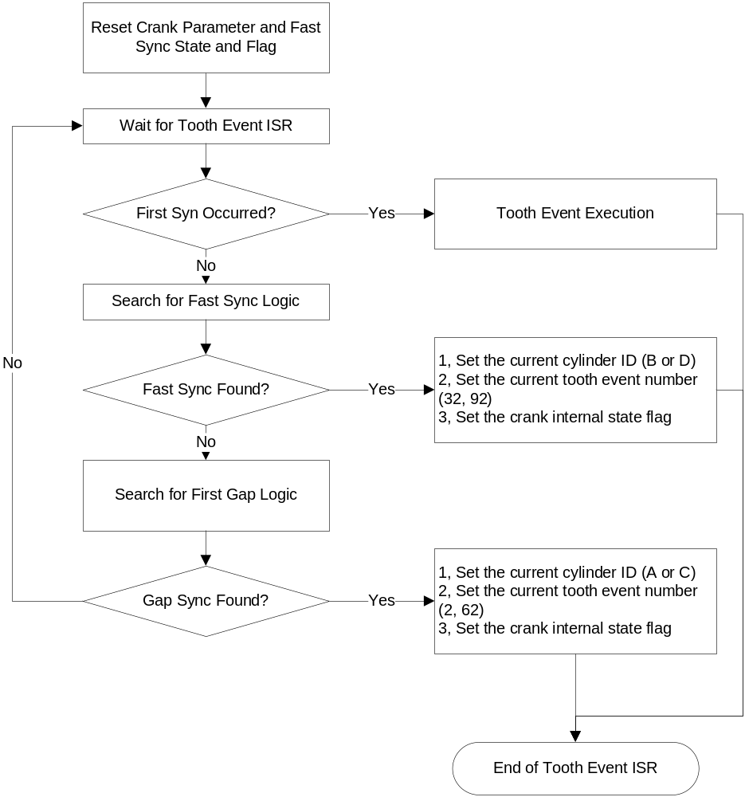
Software Flow Chart – Overall Structure

Slide 13
Fast Sync Data Structure and Variables
Engine State Typedef
  typedef enum {
  FS_INIT_PARAMETER,
  FS_FILTER_VALID_TOOTH,
  FS_WAITING_FOR_FIRST_EDGE,
  FS_CRANK_PULSE_COUNT_INCREASE,
  FS_CRANK_CYLINDER_ID_COMPLETE,
  FS_CRANK_CYLINDER_ID_ERROR
  } CRANK_FS_State_T;
Logic Private Variable
  static CRANK_FS_State_T CRANK_FS_State;
  static uCrank_Count_T CRANK_FS_Pulse_Count;
  static uint8_t CRANK_FS_Last_CAM_Edge_Count;
Calibrations
  KyHWIO_NumValidPeriodsBeforeFastSyncStart
  KyHWIO_NumDeltaToothUsingFastStartUp

Slide 14
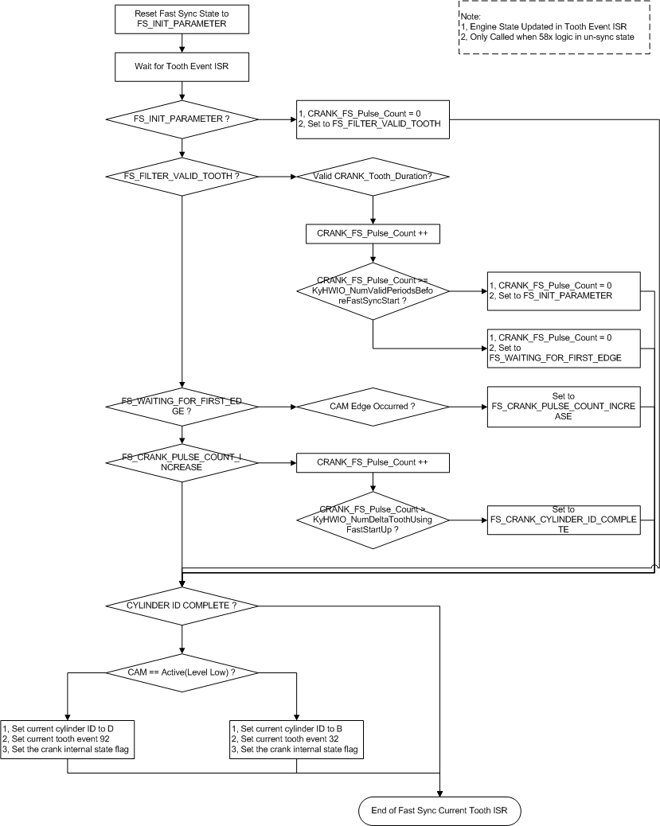
Software Flow Chart – Search Fast Sync

Slide 15


Fast Sync Waveform and Customer Test Result
Fast Sync Waveform
Customer Test Result
  From the customer feedback, the engine crank startup is really improved, the time is averagely shorten to 0.65s from previous 0.75s.
  The worst startup case is obviously removed.

Slide 16
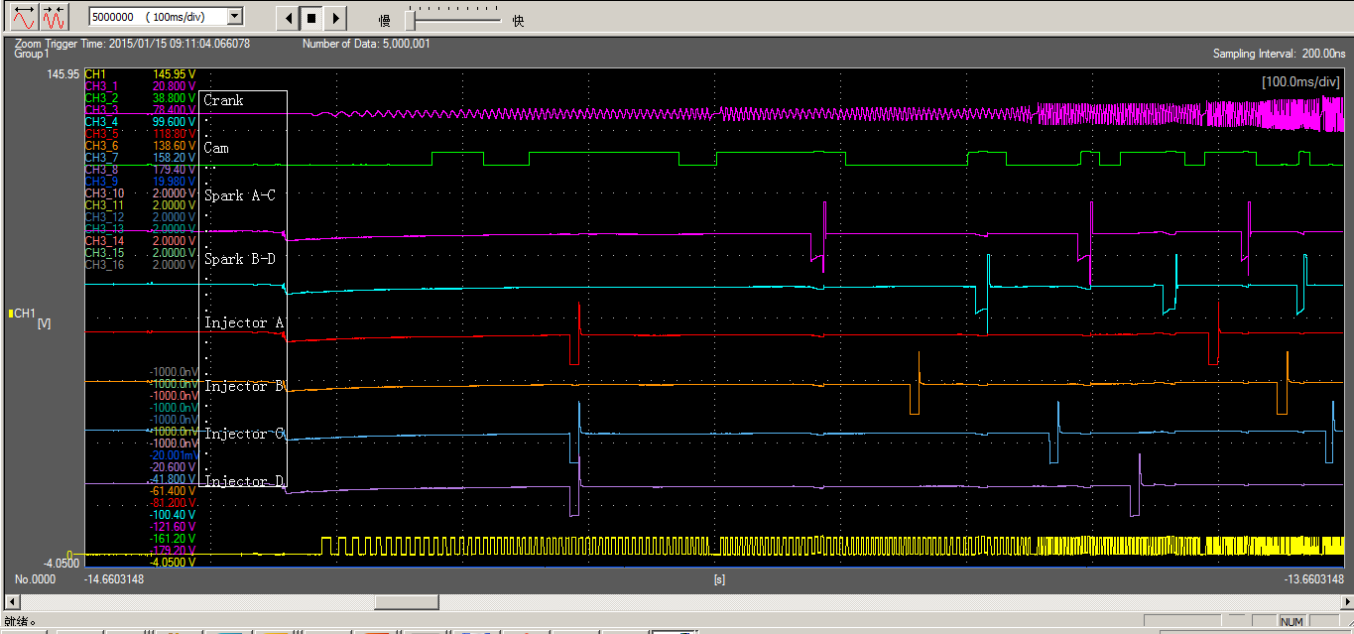
HWIO Fast Sync Process, First Cylinder ID B

Slide 17
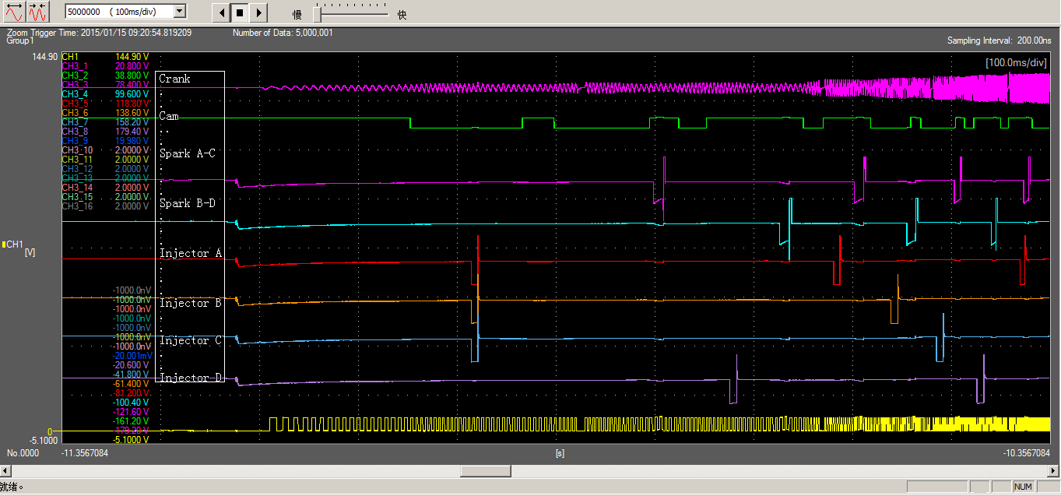
HWIO Fast Sync Process, First Cylinder ID D

Slide 18
Optimization of Fast Sync
Offset Self – Study Logic
  The software can study the four cam falling edges position mapped to crank 58x tooth. By this, we can eliminate the offset deviation between cam and crank installed point.

Slide 19
Thank You
Any Good Suggestion is appreciated?
Any Question?

