Slide 1
Soil response unit estimation - II
7/24/17 – 8/1/17
Scaling & automation of workflow
- Mikey & Hui

Slide 2
QA-QC
Data Acquisition, Cleaning & Filtering
Validation
Exploratory Data Analysis
Comparison of FD Centroids with available shp (@Ross)
Automation & Scaling for the entire U.S.

Slide 3
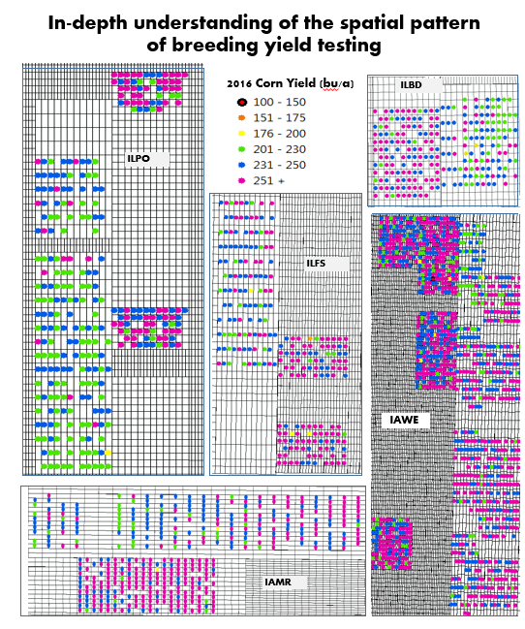
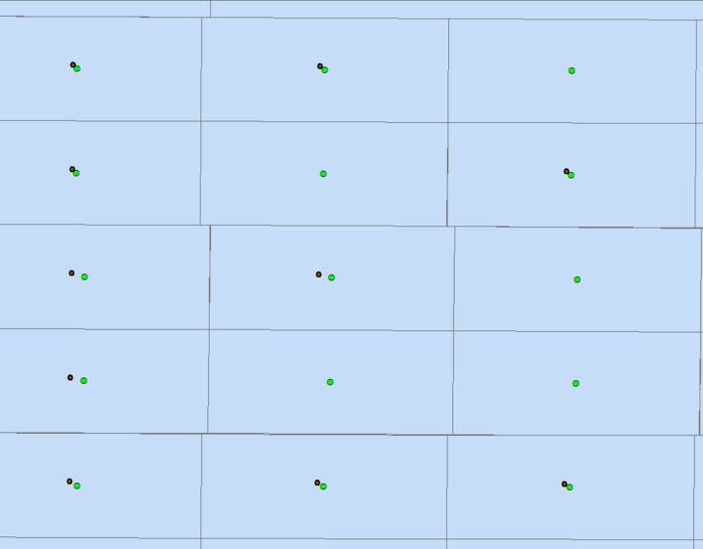
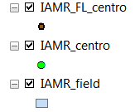
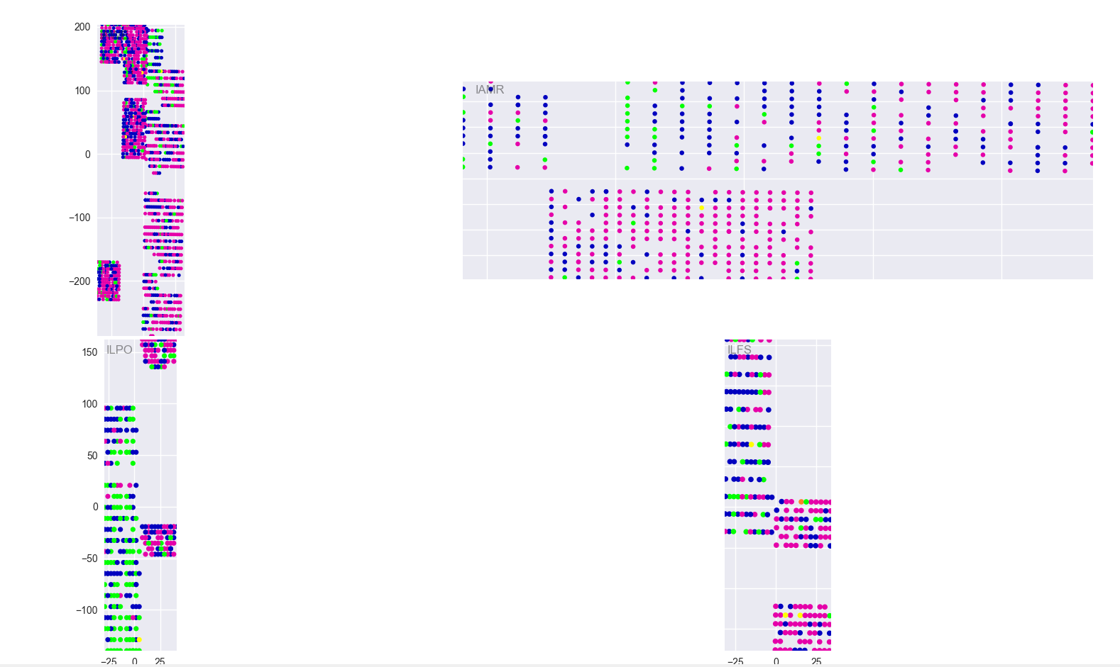
ILPO
Validation

