Slide 1

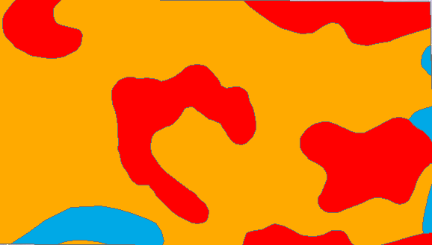





THANK YOU
SOIL RESPONSE UNIT SYSTEM TO IMPROVE BREEDING TRIAL’S ACCURACY AND EFFICIENCY
VARIABLE RATE NUTRIENT APPLICATION FOR OPTIMAL FERTLIZER PRESCRIPTIONS
RESEARCH FINDINGS
SOM, K, S, P, Zn & CEC are spatially correlated
Developed data-driven site-specific Soil Classification Layer and Soil Response Units
SSURGO classified Soil Layer
Newly classified Soil Layer
ISSUES
90 % of field has below optimum S levels
10 % of field has below optimum K levels
Soil Response Units
RECOMMENDATIONS
Additional S and K is required for the field
There is no need to apply additional P or Zn
K variation within-field
S variation within-field

Slide 2
WORKFLOW
If Yes:
Check for Anisotropy: Yes or No (using Variograms)
If Anisotropic:
Perform Anisotropic Kriging
Develop Soil Response Units (Zones)
Compare with SSURGO Layer
Following similar pattern: Yes or No
Take in additional variables
P, K, S, Zn, CEC
Spatially correlated: Yes or No
If Yes: Develop Soil Response Units (Zones)
Following similar pattern as SOM: Yes or No
Summary Table
One-Slide Presentation
Issue/Solution/Conclusion
Recommendation/Workflow
Raw Data: Excel Non-Veris Dataset
Defining/understanding the problem in hand
Develop Questions and Strategy
Selection of Field
MNPX
Exploratory Data Analysis
How much % of data can be used
Summary Statistics
Pick variable
SOM
Spatially Correlated (in terms of values): Yes or No

