Slide 1
WITHIN-FIELD VARIATION OF SOIL NUTRIENTS AND CHEMICAL PROPERTIES
Evaluating & Identifying Trends/Patterns
Field Name: MNPX
Theme: Kriging Maps for 7 variables

Slide 2
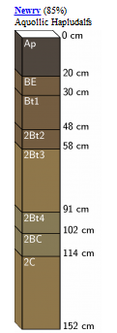
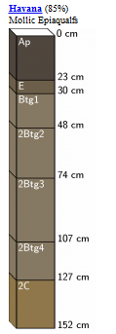
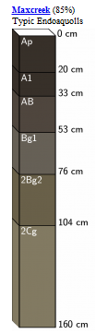
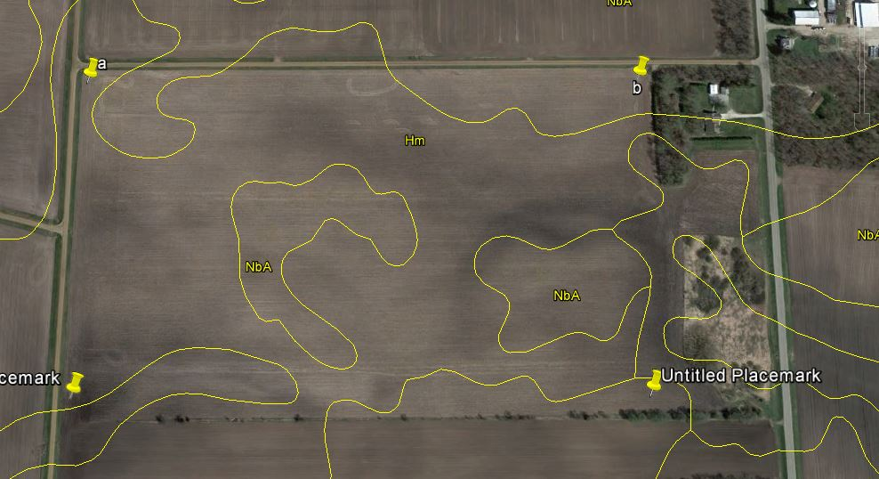
SSURGO LAYER
Newry Silt Loam (Nba)
Havana Silt Loam (Hm)
Maxcreek Silty Clay Loam (south)

Slide 3
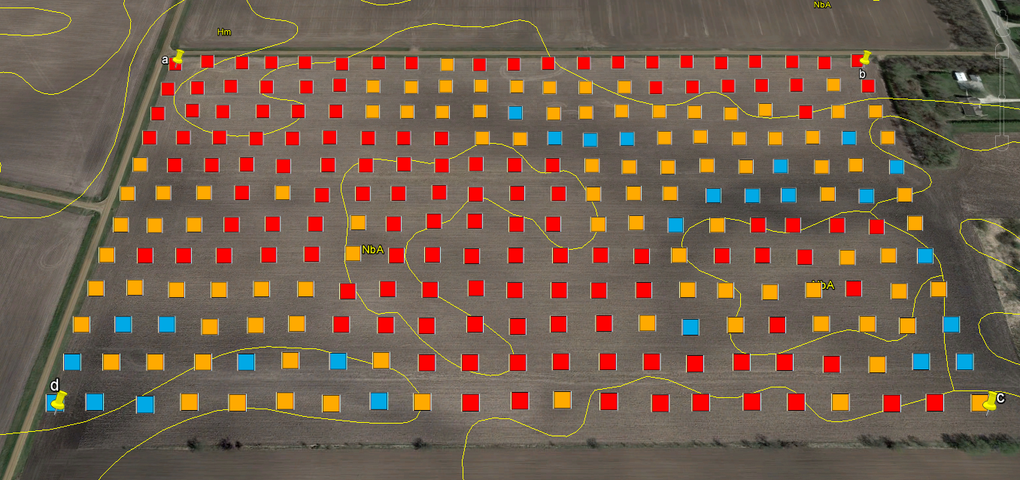
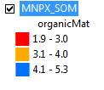
METHODS

Slide 4
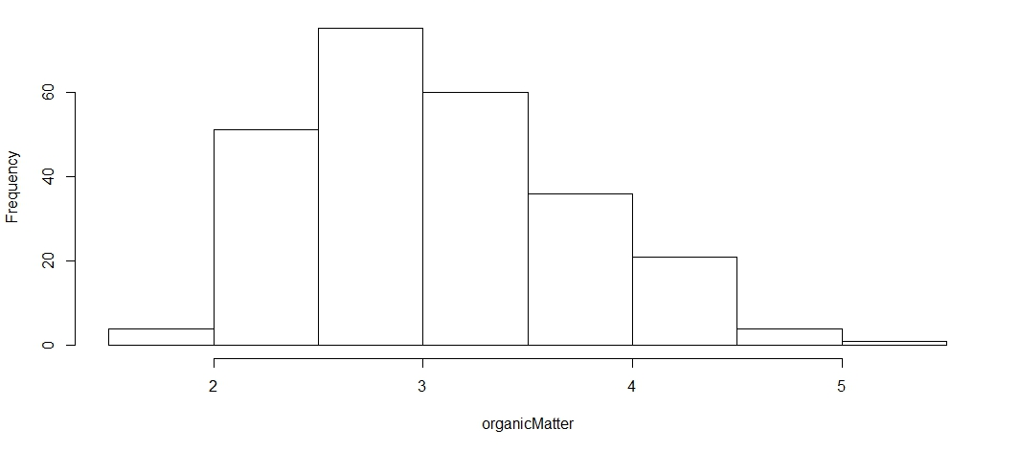
EXPLORATORY DATA ANALYSIS (EDA)
Subsetting Data
Field: MNPX
Variable: SOM
QC Data
% Useful: 100
Summary Statistics

Slide 5
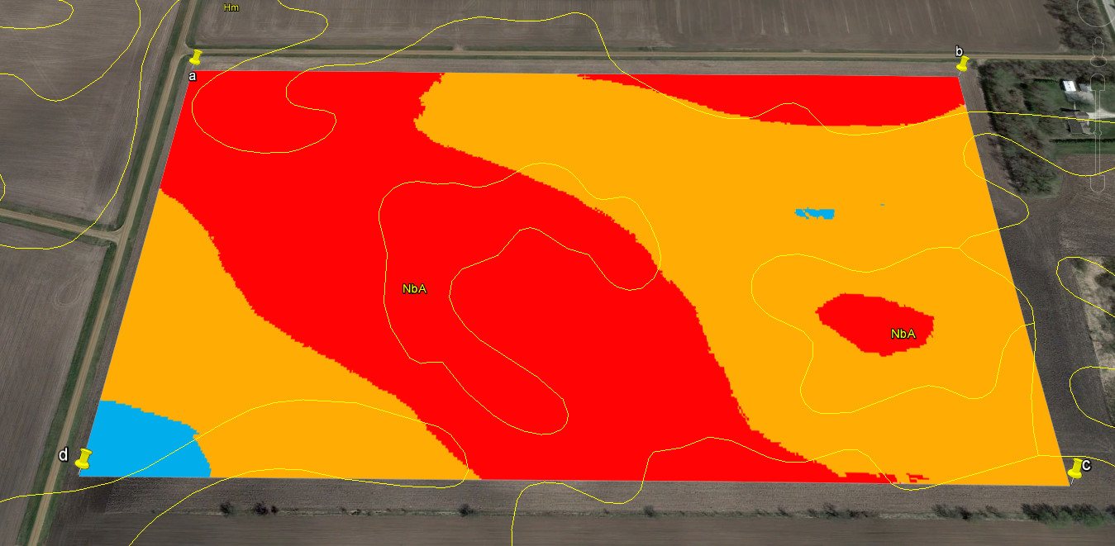

METHODS
Check elevation profile @ Google Earth
Unit: %

Slide 6
TO-DO-LIST-FOR-TODAY
Create Kriging Maps (include Summary Statistics)
N
P
K
S
Zn
CEC
- Check whether the patterns have anything to do with SOM pattern
- Find out areas that are in need of respective nutrients
http://aes.missouri.edu/pfcs/soiltest.pdf

Slide 7
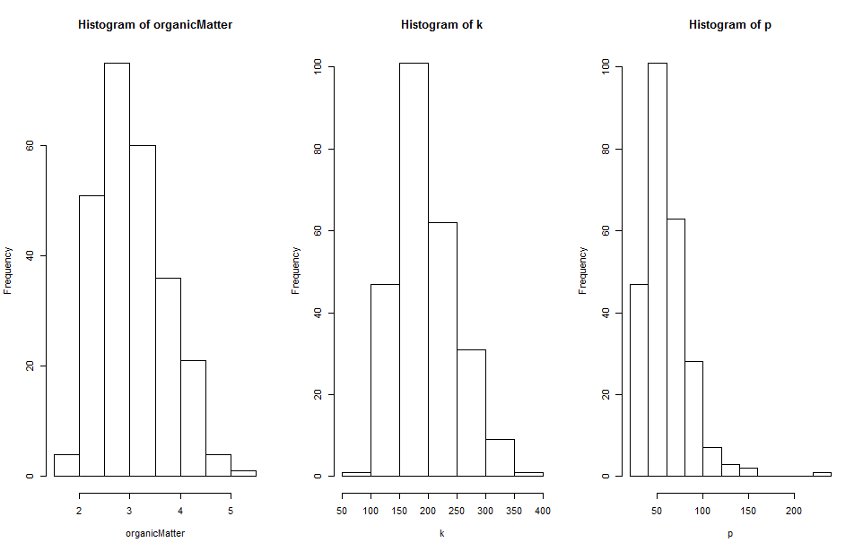
SUMMARY STATISTICS
Organic Matter
Potassium (K)
Phosphorous (P)

Slide 8
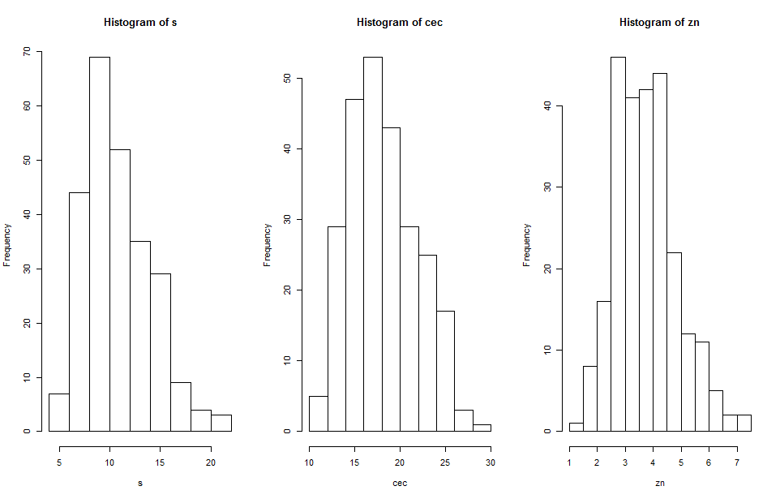
SUMMARY STATISTICS
Sulphur (S)
Cation Exchange Capacity (CEC)
Zinc (Zn)

Slide 9

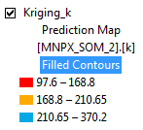

METHODS
Potassium (K)
Unit: ppm

Slide 10

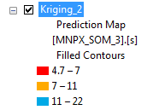
METHODS
http://mvtl.com/_static/web/assets/media/pdf/soil-nutrient.pdf
Sulphur (S)
Unit: ppm

Slide 11
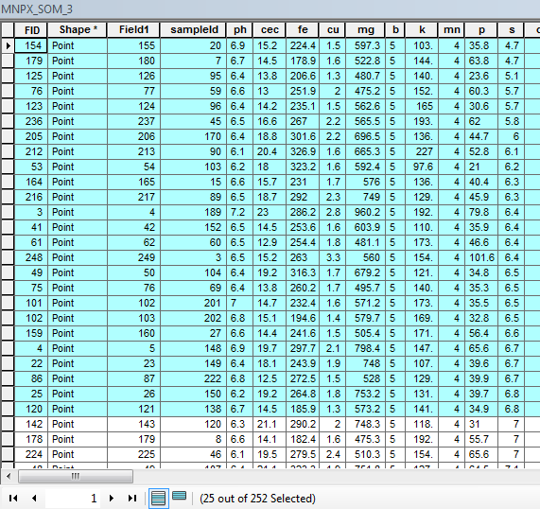

METHODS
Sample plots where s < 7

Slide 12
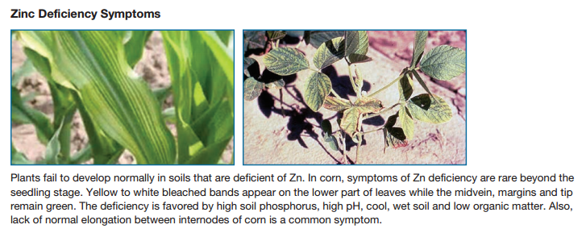

METHODS
http://mvtl.com/_static/web/assets/media/pdf/soil-nutrient.pdf
Zinc (Zn)

Slide 13

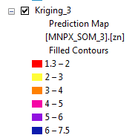
METHODS
Zinc (Zn)
Unit: ppm

Slide 14
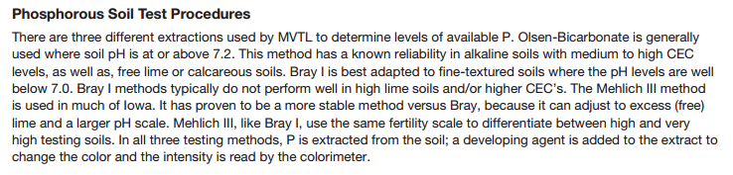
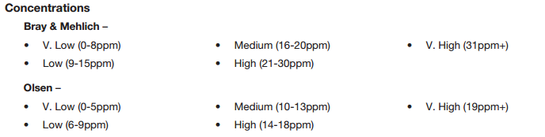
METHODS
http://mvtl.com/_static/web/assets/media/pdf/soil-nutrient.pdf
*Fine textured is more like clayey soil

Slide 15

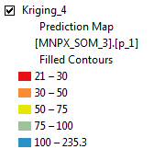
METHODS
Phosphorous (P)
Unit: ppm

Slide 16

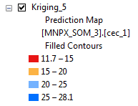
METHODS
Cation Exchange Capacity (CEC)
Unit: mi eq/100g

Slide 17

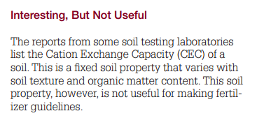
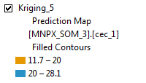
METHODS
Similar to SOM map pattern
Unit: mi eq/100g
https://www.extension.umn.edu/agriculture/nutrient-management/nutrient-lime-guidelines/fertilizer-recommendations-for-agronomic-crops-in-minnesota/docs/BU-6240S-PUB.pdf

Slide 18



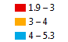
METHODS
CEC
SOM

Slide 19
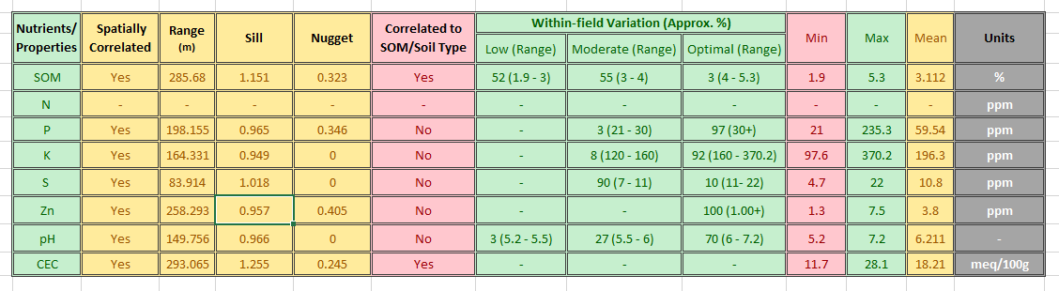
SUMMARY TABLE

Slide 20
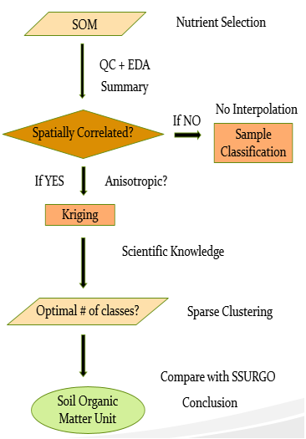
WORKFLOW

Slide 21
THANK YOU

