Slide 1
WITHIN-FIELD VARIATION OF SOIL NUTRIENTS AND CHEMICAL PROPERTIES
Evaluating & Identifying Trends/Patterns
Field Name: MNPX
Theme: Yield-related Analysis

Slide 2
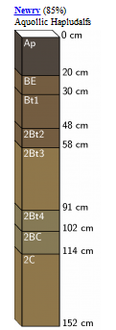
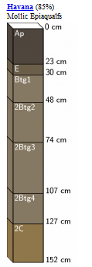
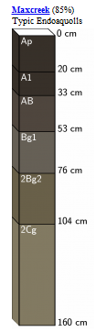
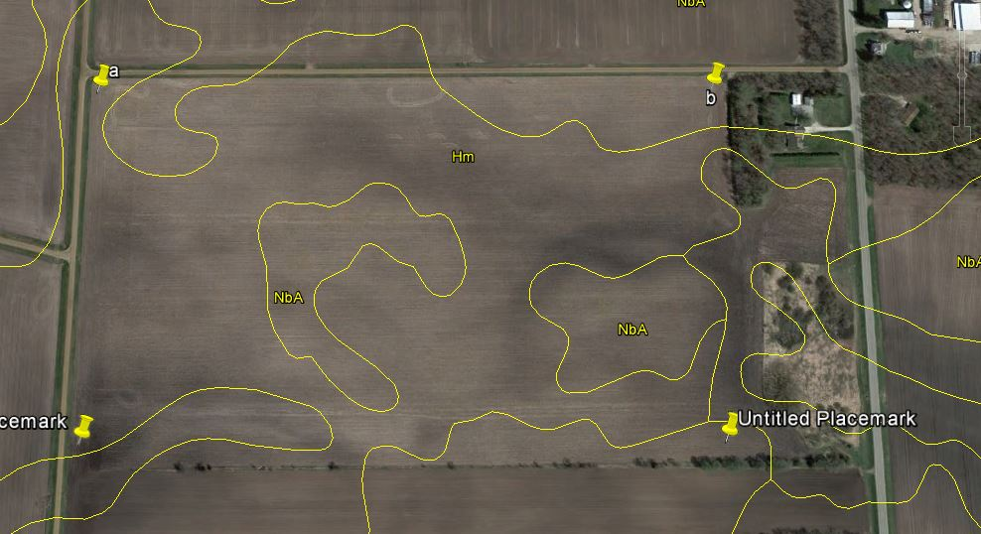
SSURGO LAYER
Newry Silt Loam (Nba)
Havana Silt Loam (Hm)
Maxcreek Silty Clay Loam (south)

Slide 3
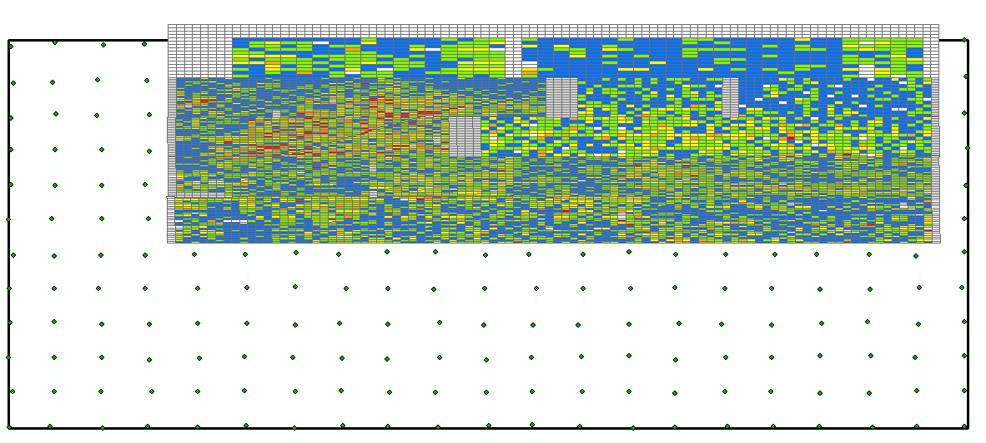
METHODS
MTPX
TPX1
TPX2
TPX3
MNPX
TPX4

Slide 4
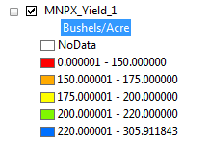
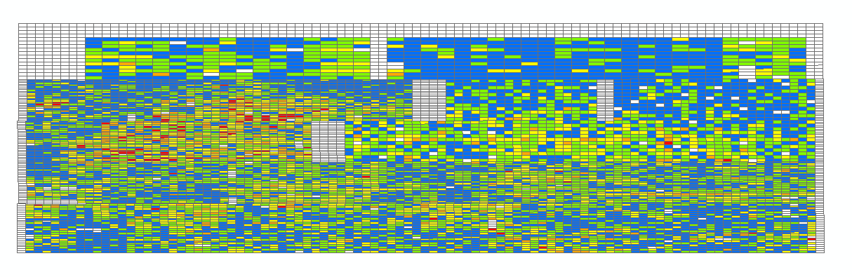
METHODS

Slide 5

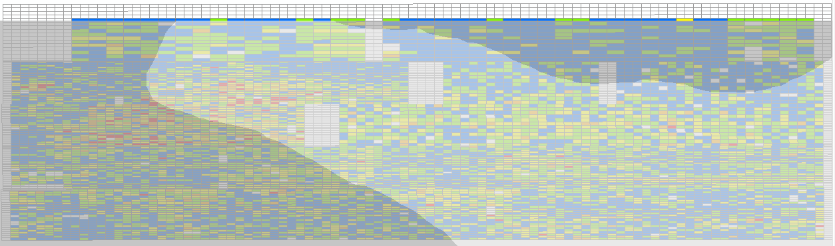
METHODS
*SRUs
Newry
Havana
Newry

Slide 6
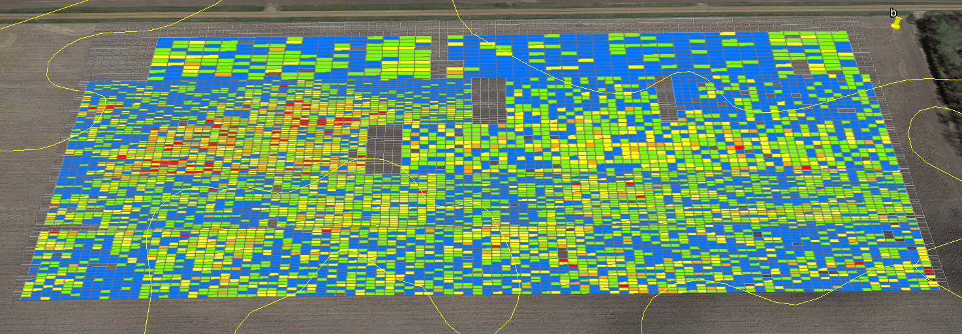
METHODS
*SRUs
Yield vs SSURGO
Newry
Havana
Newry

Slide 7
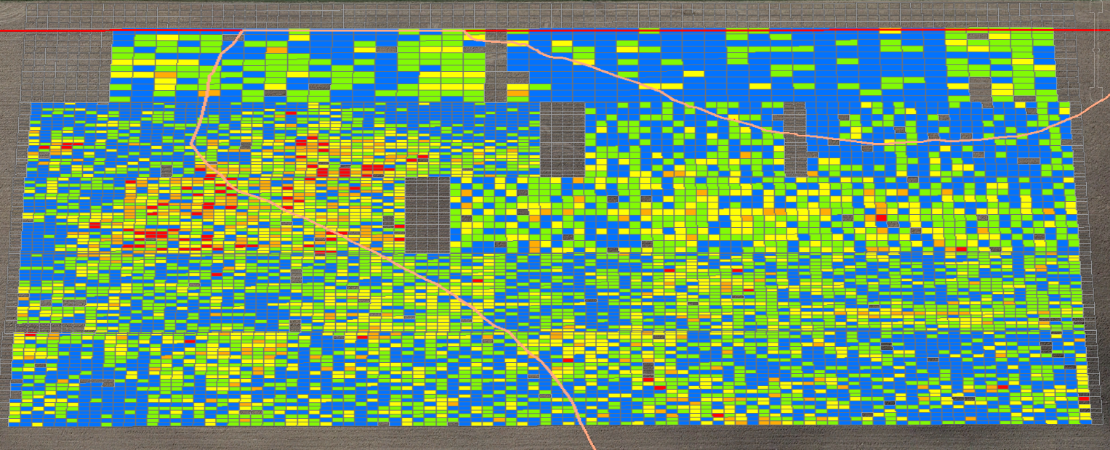
METHODS
Yield vs New SRU
Newry
Newry
Havana

Slide 8
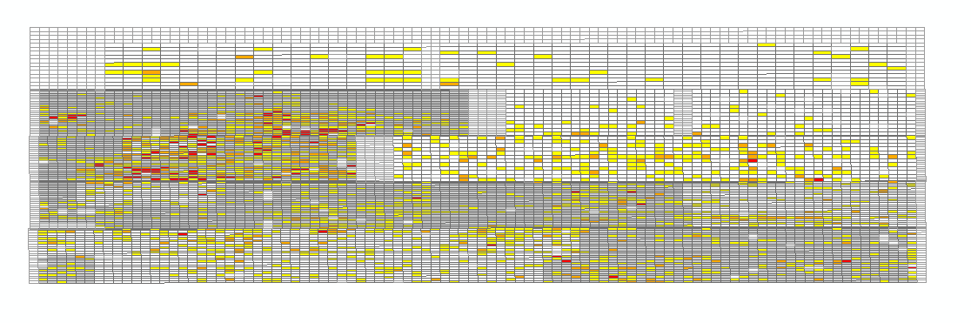
METHODS
Low Yields (<175 Bu/Ac)

Slide 9
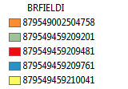
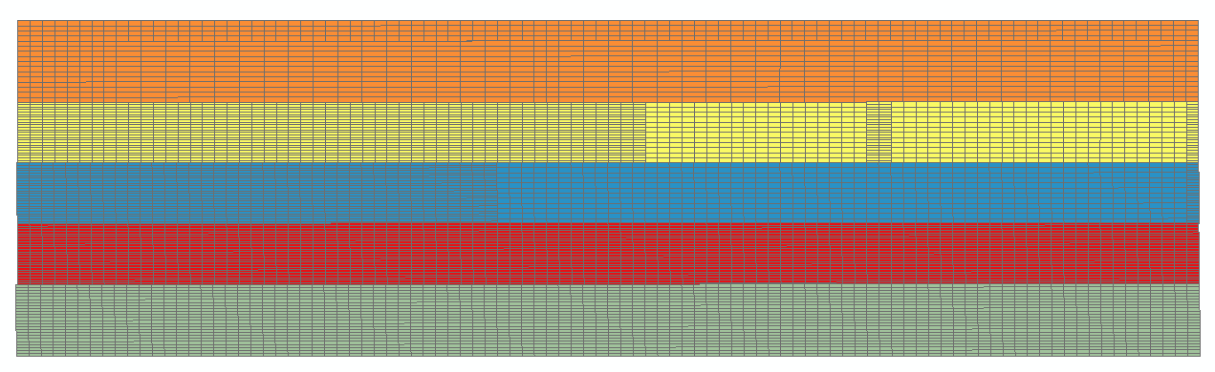
METHODS
Field Names
MTPX
TPX4
TPX3
TPX2
TPX1

Slide 10
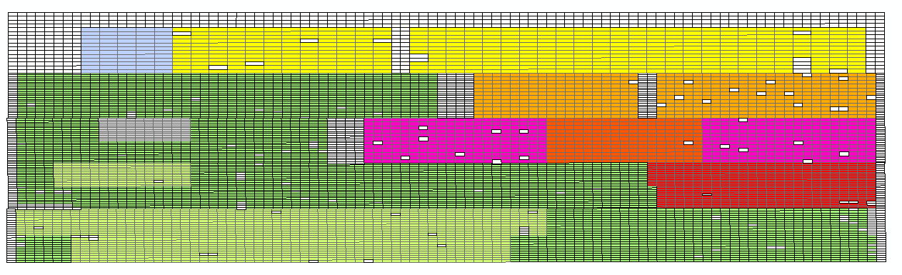
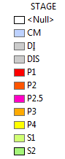
METHODS
CM
P4
P4
P2
P2
DIS
S2
P3
P2.5
P2.5
S1
P1
S1
S2
DI

Slide 11

METHODS
CM
P4
P4
P2
P2
DIS
P3
P2.5
S2
P2.5
S1
P1
S2
DI
S1

Slide 12
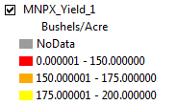
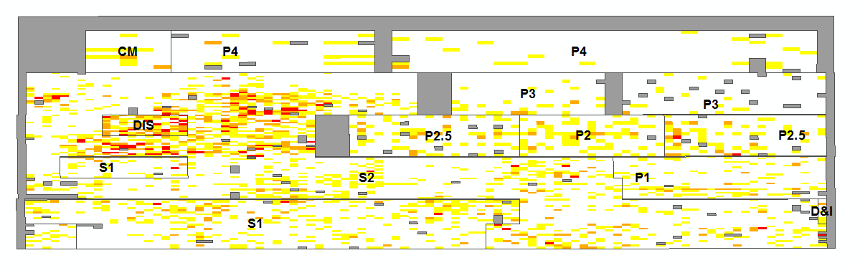
METHODS

Slide 13
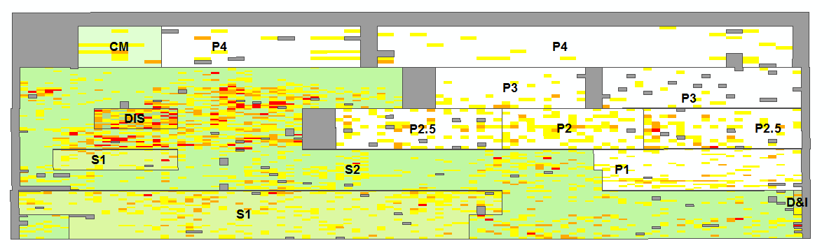
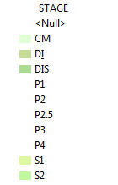
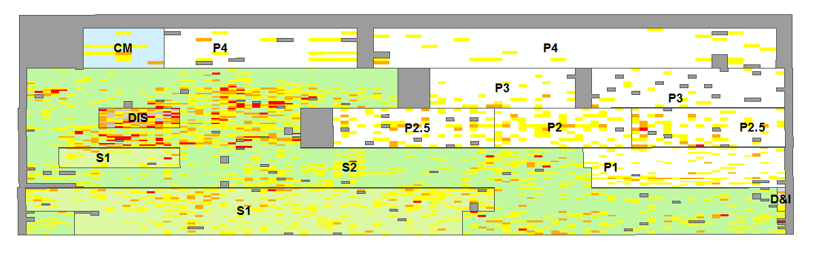

METHODS
Yield for Stages

Slide 14
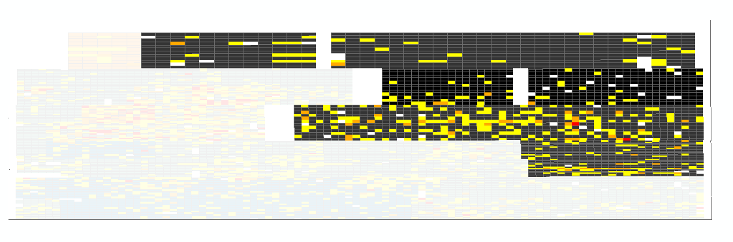
METHODS
Low Yield for SCMs

Slide 15
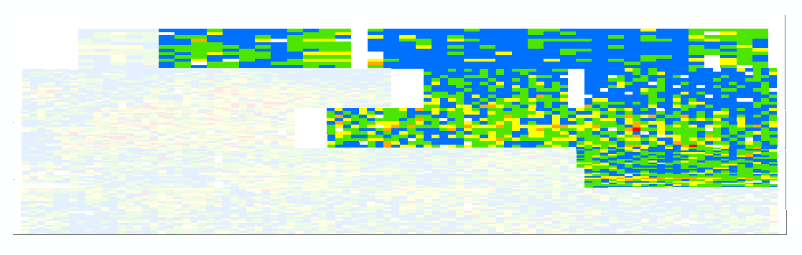
METHODS
Yield for SCMs

Slide 16
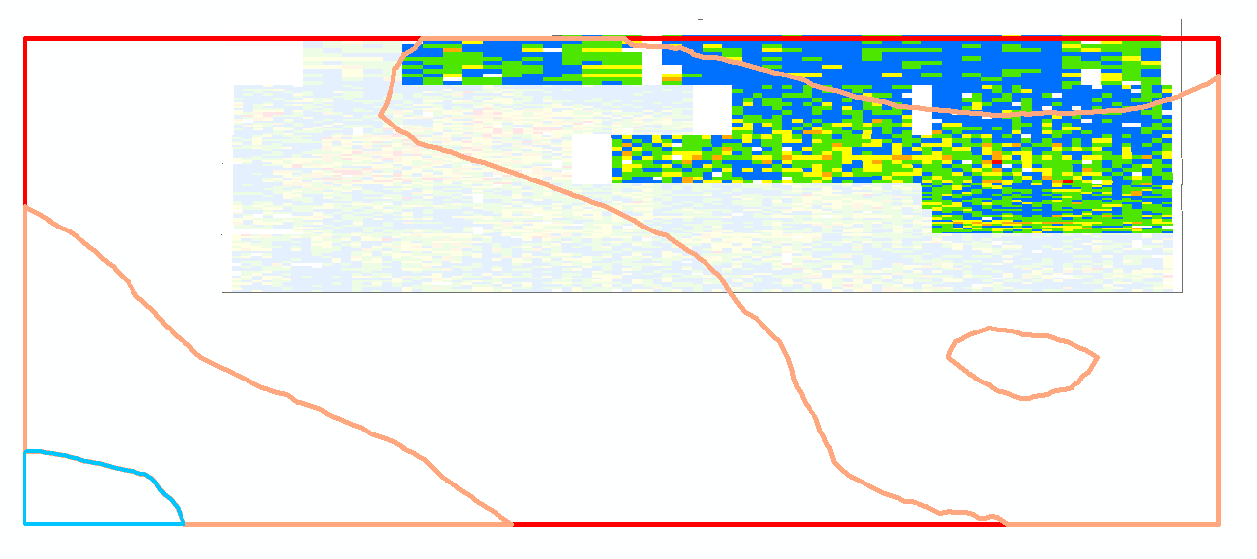
METHODS
*SRUs
Newry
Havana

Slide 17
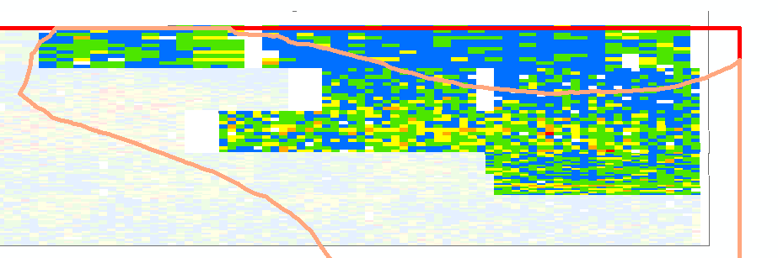
METHODS
Newry
Havana

Slide 18
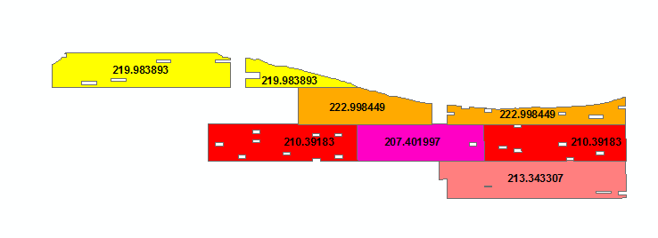
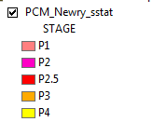
METHODS
*SRUs
Havana

Slide 19
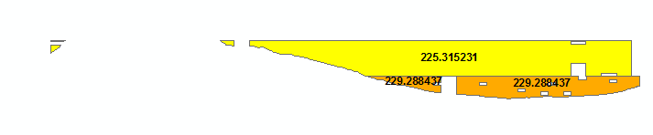

METHODS
*SRUs
Newry

Slide 20
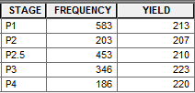
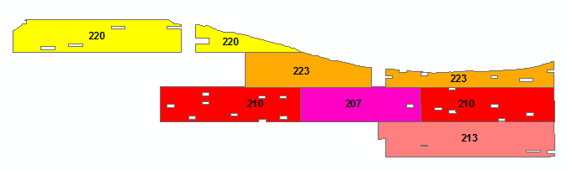


METHODS
*SRUs
Havana
Newry

Slide 21
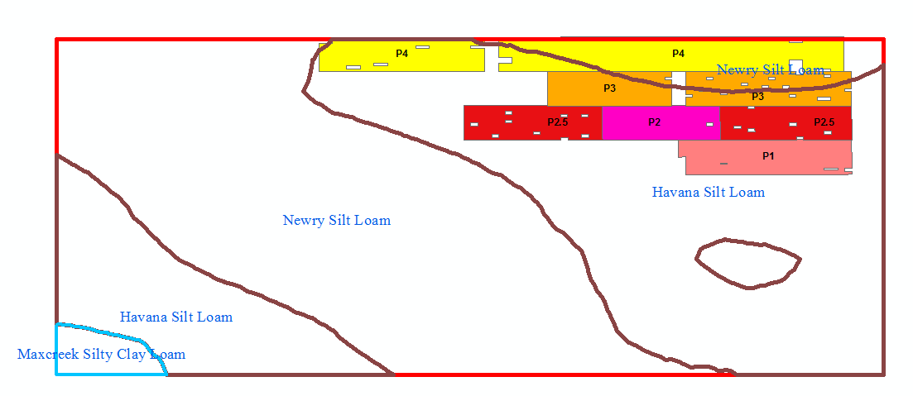
METHODS

Slide 22
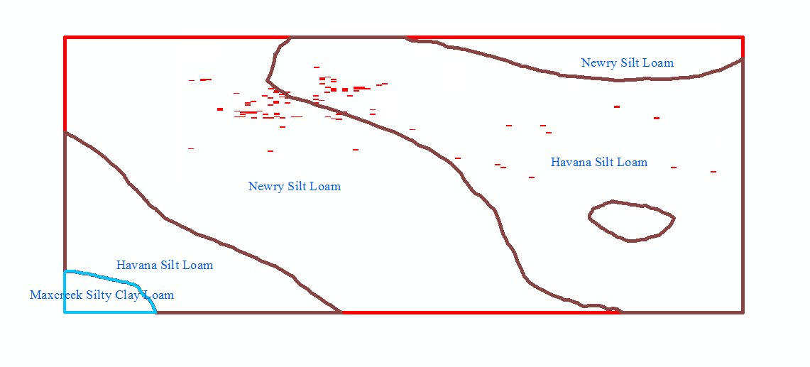
METHODS
Low Yields (<150 Bu/Ac)

Slide 23
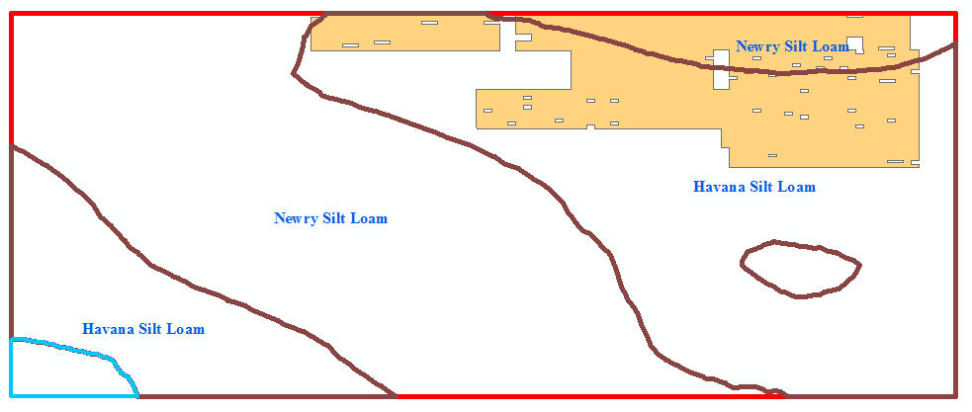
METHODS

Slide 24
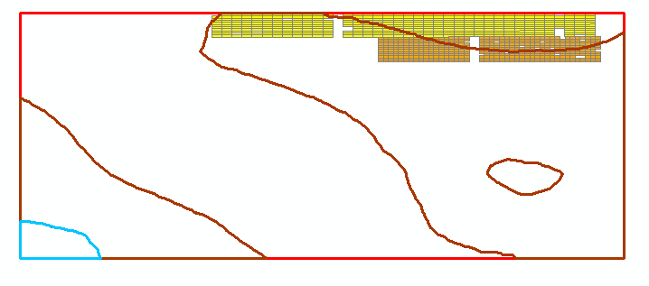

METHODS
Newry
Havana

Slide 25
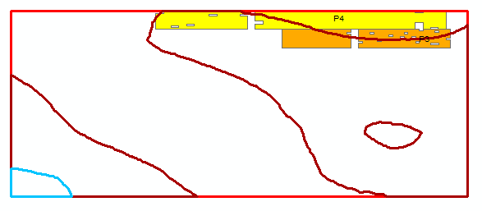
METHODS

Slide 26
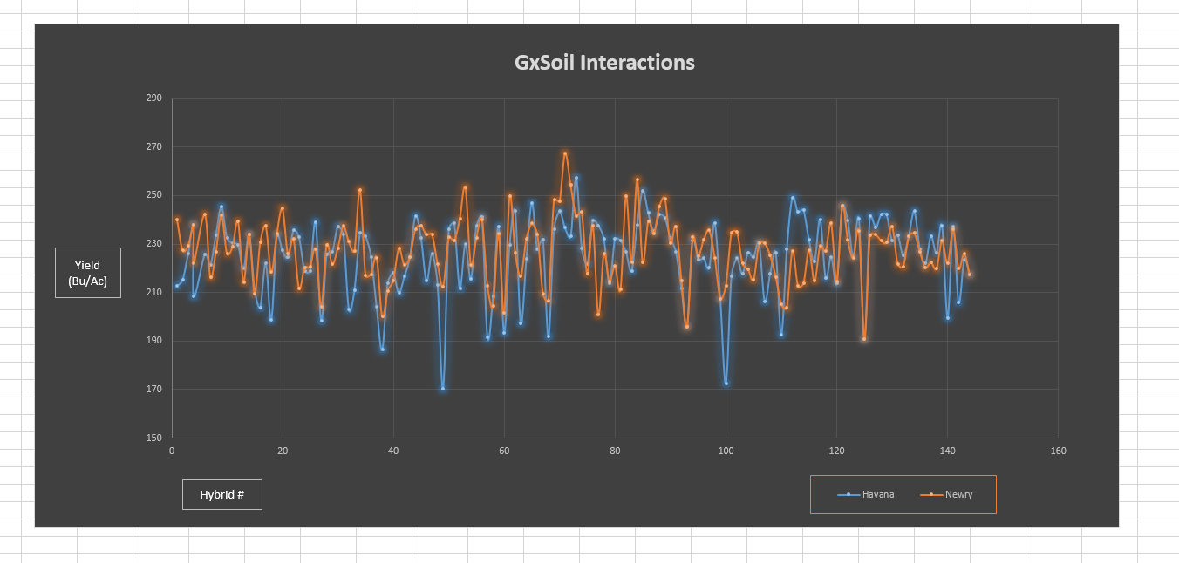
METHODS
Yield vs Soil Type
144 Obs. (unordered)

Slide 27
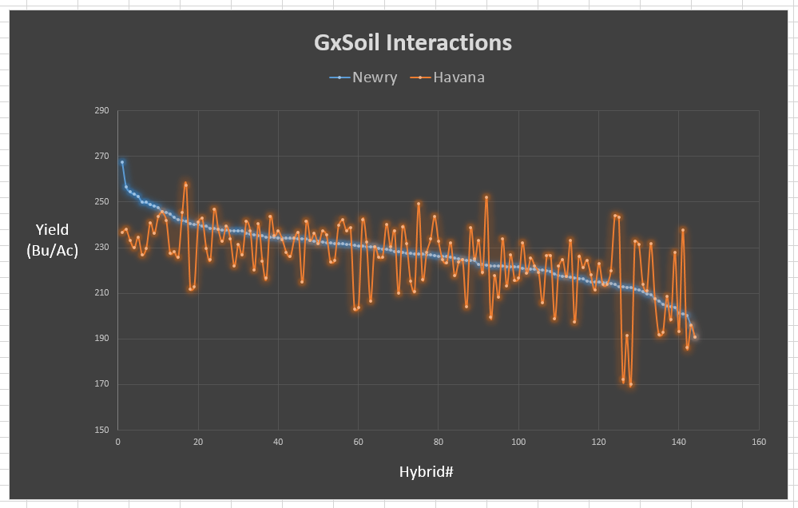
METHODS
Yield vs Soil Type
144 Obs.
(Ordered by Newry)

Slide 28
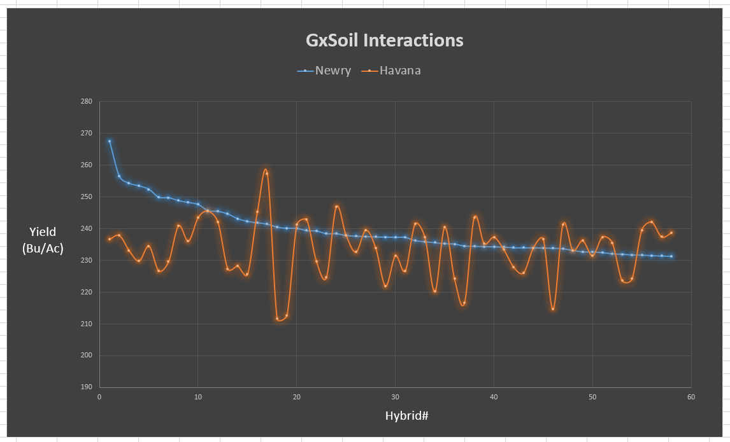
METHODS
Yield vs Soil Type
58 Obs. (Ordered)
Top 40%

Slide 29
THANK YOU

