Slide 1
Sports Card Database
Michael Sanzo

Slide 2
Table of contents
Table of Contents
Executive Summary
E/R Diagram
Create Table Statements
People Table
Team Table
Brand Table
Sports Table
Value Table
Card Set Table
Card Inventory Table
Triggers
Stored Procedures
Views
Reports
Security
Implementation Notes
Known Problems
Future Enhancements

Slide 3
Executive Summary
if you interested in sports, analytics and vast opportunities to make money, then this database is for you!
Investors seek challenging obstacles to make their investment worth while. There are just as many sports cards as there are stars in the sky, an endless amount.
However, with majority of investments, age is a restriction in order to participate in investing. With that said I present to you, the sports card Analytics database where investments are made fun for any age.
With this database users have the chance of tracking an inventory of cards and their values based on 3 different conditions of the card. A Fun, simple, and easy way to track prices and quantities of your sports cards electronically.
transact with friends, watch your account grow, and analyze key players stats in version 2.0, coming out this Spring 2017!
The proposal runs on PostgreSQL 9.6

Slide 4
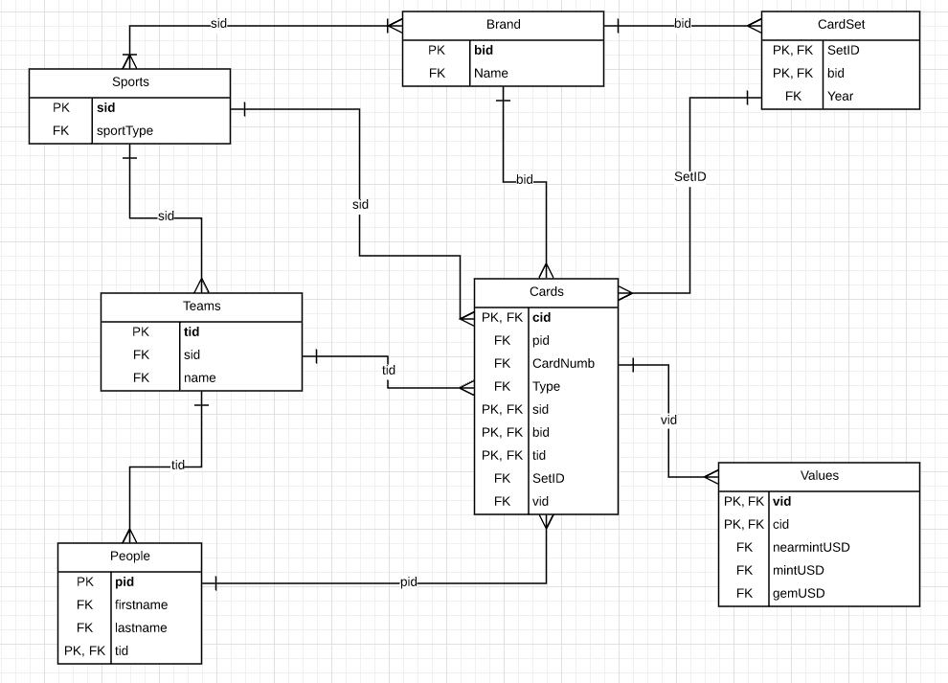
e/r diagram

Slide 5
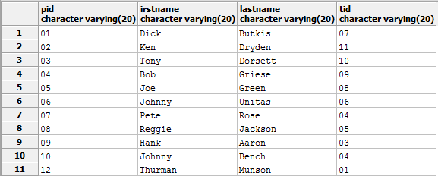
People table
Create Statement
CREATE TABLE People (
pid VARCHAR(20),
irstname VARCHAR(20),
lastname VARCHAR(20),
tid VARCHAR(20),
PRIMARY KEY (pid)
);
Functional Dependencies
Pid---irstname, lastname, tid

Slide 6
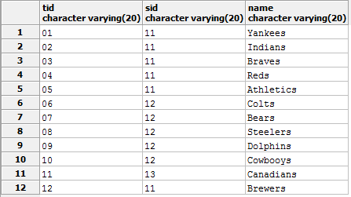
Team table
Create Statement
CREATE TABLE Teams (
tid VARCHAR(20),
sid VARCHAR(20),
name VARCHAR(20),
PRIMARY KEY (tid)
);
Functional Dependencies
Tid –sid, name

Slide 7
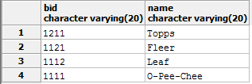
Brand Table
Create Statement
CREATE TABLE Brand (
bid VARCHAR(20),
Name VARCHAR(20),
PRIMARY KEY (bid)
);
Functional Dependencies
Bid--name

Slide 8

Sports table
Create Statement
CREATE TABLE Sports (
sid VARCHAR(20),
sportType VARCHAR (20),
PRIMARY KEY (sid)
);
Functional Dependencies
Sid-- sportType

Slide 9
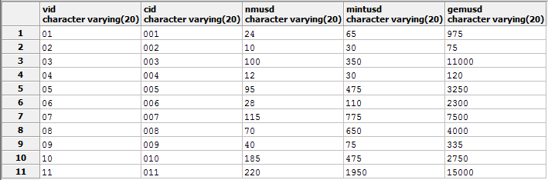
Value table
Create Statement
CREATE TABLE Values (
vid VARCHAR(20),
cid VARCHAR(20),
nmUSD VARCHAR(20),
mintUSD VARCHAR(20),
gemUSD VARCHAR(20),
PRIMARY KEY (vid)
);
Functional Dependencies
Vid—cid, nmUSD, mintUSD, gemUSD

Slide 10
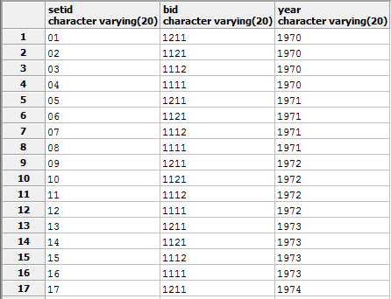
Card set table
Create Statement
CREATE TABLE CardSet (
SetID VARCHAR(20),
bid VARCHAR(20),
Year VARCHAR(20),
PRIMARY KEY (SetID)
);
Functional Dependencies
setID—bid,year

Slide 11
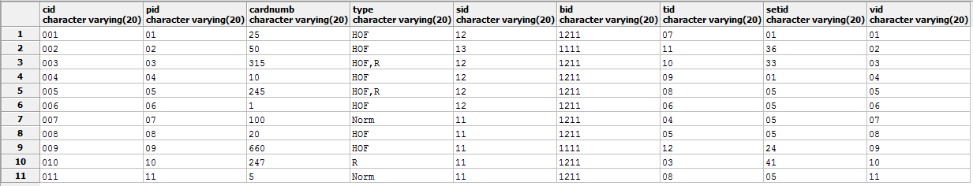
Card table
Create Statement
CREATE TABLE Cards (
cid VARCHAR(20),
pid VARCHAR(20),
CardNumb VARCHAR(20),
Type VARCHAR(20),
sid VARCHAR(20),
bid VARCHAR(20),
tid VARCHAR(20),
SetID VARCHAR(20),
vid VARCHAR(20),
PRIMARY KEY (cid)
);
Function Dependencies
cid—pid, cardnumb, type, sid, bid, tid, setid, vid

Slide 12
trigger
Identify a cardset value if the end user has collected all the cards within a specific set. These sets are worth more than the addition of all cards totaled together but for this database I could not get it to work but it would have worked in that way to give the user a general estimate of the sets worth.
CREATE TRIGGER update_vid
AFTER UPDATE OF vid ON cardset
FOR EACH ROW
EXCECUTE PROCEDURE update_value
Trigger Function:
CREATE FUNCTION update_value()
RETURNS ‘TRIGGER’
AS $BODY$
BEGIN
IF (cardset = ‘UPDATE’) THEN
UPDATE vid SET cardset = vid FOR cid IN cardset
WHERE OLD.vid = NEW.cid;
END IF:
RETURN NULL;
END;
$$ LANGUAGE plpsql;
Notes:
Attempting to run a trigger so that if you get all cards to a set that it will automatically recognize and change price…attempted fail. :/

Slide 13
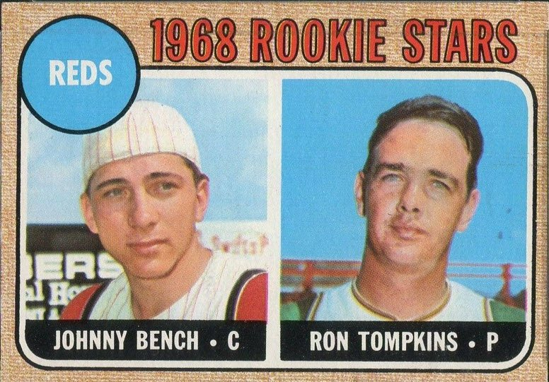
views
Cards over $100
Create view Cardsover100 as
( SELECT cid, nmUSD, mintUSD, gemUSD
FROM value
WHERE nmUSD > 100
);

Slide 14
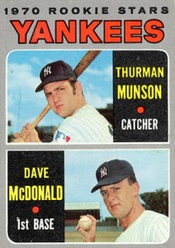
views
Cards over $1000
Create view Cardsover1k as
( SELECT cid, nmUSD, mintUSD, gemUSD
FROM value
WHERE nmUSD > 1000
);

Slide 15
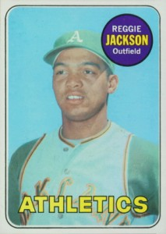
views
Rookie cards
Create VIEW card_type AS
( SELECT type
FROM cards
WHERE type = ‘R’
GROUP BY vid
);

Slide 16
Implementation notes
This database design has been implemented on Postgresql 9.6. The testing of the design has been thorough and will be error free by spring 2017, when version 2.0 will be released. To interface with this database system it is recommended that a web front end be created in order to create the process of adding new information to the database. In addition, by creating a website in future versions to allow a datalink from the website to transform the data into valuable information to benefit the user. in the database it will track the price and transaction history of the card portfolio and levels will be implemented to show profitability in you portfolio and based off reviews.

Slide 17
Known problems
Duplicate data WITHIN TABLES WILL NOT BE IDENTIFIED
Larger unique identifiers
Input cards instead of linked to online data
Put pictures in to identify cards
Version 1 and 2 of cards
Special types of cards as they get newer

Slide 18
Future enhancements
Analytics of player stats
live feeds from users
User login and saved collection/inventory
Transactions between users or in open market
Total valuation with performance tracker (card portfolio)
Leveling up
Pictures of cards to confirm

