Slide 1
GCP IAM Audit Chatbot
Branded End-to-End Solution for Publicis Sapient

Slide 2
Project Goals
• Automate IAM audits across GCP org/folder/project levels
• Detect risky custom roles, unused permissions, and drift
• Integrate CI/CD, GenAI chatbot, and enforce OPA policies
• Deliver insights via Teams with audit logs to GCS/Splunk

Slide 3
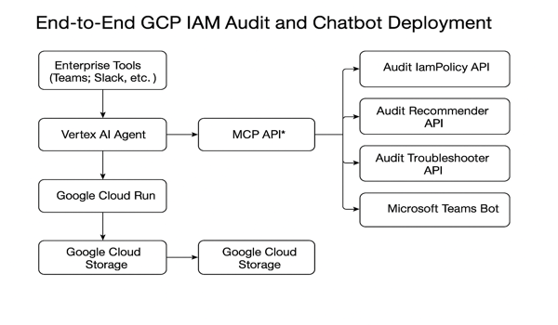
Architecture Overview

Slide 4
Tooling & Integration
• Wiz: Monitors permission drift, risky IAM conditions
• Splunk: Alerts on IAM activity, SA key events
• OPA/Rego: Enforces deny policies, naming, SA key rules
• Confluence: Documents audit decisions & RFI tracking
• GitHub: Source of truth for Terraform IaC & CI/CD reviews

Slide 5
CI/CD & Deployment
• GitHub Actions builds, pushes Docker image
• Terraform provisions Cloud Run, GCS, IAM, Secrets
• OPA checks deny policy compliance before apply
• Jenkins used optionally for approval and rollback

Slide 6
Demo Instructions
1. Trigger audit: `/audit permissions` in Teams bot
2. Review response from Vertex AI chatbot
3. Check GCS logs or Splunk dashboard
4. Inspect GitHub pipeline result (build/tag/deploy)

Slide 7
Q&A
Let’s discuss use cases, integration, and roadmap.

